Slide 1
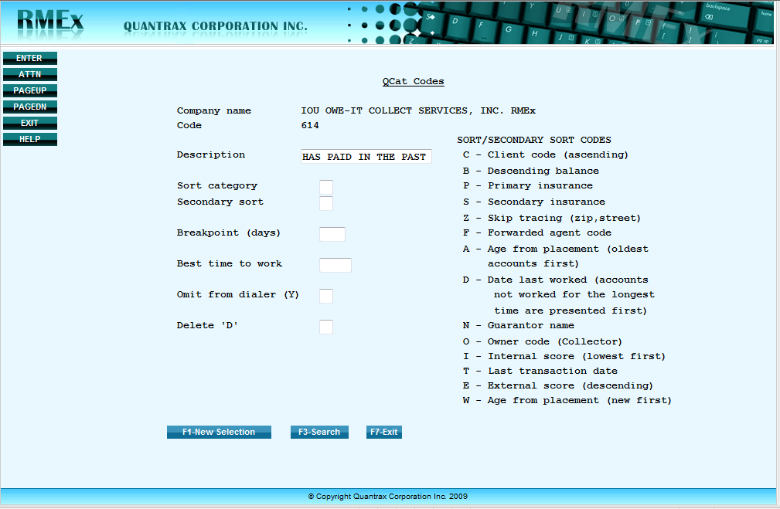
QCat - Make accounts easy for collectors to find
♣ Description will be seen in the collectors WorkMap
♣ You have Primary and Secondary sort capability
♣ Set Breakpoint days
(show these accounts first
if beyond days specified)
♣ Best time to work(Collector will see on their WorkMaps)
♣ Accounts in this QCat can be omitted from going to a dialer
♣ A ‘D” will not deleted the QCat but will deactivate it
© Copyright 2010 – Quantrax Corporation, Inc.

Slide 2
Second Slide
♣ Description will be seen in the collectors WorkMap
♣ You have Primary and Secondary sort capability
♣ Set Breakpoint days
(show these accounts first
if beyond days specified)
♣ Best time to work(Collector will see on their WorkMaps)
♣ Accounts in this QCat can be omitted from going to a dialer
♣ A ‘D” will not deleted the QCat but will deactivate it
© Copyright 2010 – Quantrax Corporation, Inc.

