Slide 1
Enter Title of Presentation Your Name Date
Notes:
(Preparing for RMEx Conversion)

Slide 2
Enter Topic Title here (use for bullet list)
Add text (Arial 20)
Add text
Example of secondary text Add text (Arial 16)
Example of secondary text Add text (Arial 16)
Add text
Add text

Slide 3
Enter Topic Title (use to show relationship)
Phase II
Add Text
Add Text
Add Text
Add Text
Notes:
(Conversion Timeline)
Information to Provide to Quantrax Prior to Installation
The following overview should give you a better understanding regarding these major areas and what is needed for the conversion.
Before starting the installation plan for RMEx, you will need to provide Quantrax with several items of information. This will help us in evaluating your current system set-up and help us understand the level of custom programming needed, before you convert to RMEx. These items relate to areas regarding the conversion of your data, interfaces to other products, e.g. credit reporting or a predictive dialer, custom programming currently in place and the format of your letters. You will need to provide a detailed list with this type of information.
For instance, if you send a letter file to a third party vendor, do you send one daily file or multiple files? In addition, are all your letters submitted to the vendor? Do you have letters you print in-house? We need all the details regarding each item so we can assist you with the set up.
For instance:
• If you are currently automated, you will need to supply record layouts for the information stored on your present system. This will include file descriptions and descriptions of fields within those files. (Field descriptions should be accompanied by starting and ending positions for fields within the file)
• A sample of live data will be required. Approximately 200-400 accounts are needed along with their corresponding notes and payments. Client, collector and statistical information are also required.
IMPORTANT NOTE: We must have approximately 10,000 records for actually running and testing the conversion. We will notify you when we are ready for this file.

Slide 4
Enter Topic Title (use to show parts of an item)
Phase II
Text
Text
Text
Text
Text
Text
Text
Notes:
(Conversion Timeline)
Information to Provide to Quantrax Prior to Installation
The following overview should give you a better understanding regarding these major areas and what is needed for the conversion.
Before starting the installation plan for RMEx, you will need to provide Quantrax with several items of information. This will help us in evaluating your current system set-up and help us understand the level of custom programming needed, before you convert to RMEx. These items relate to areas regarding the conversion of your data, interfaces to other products, e.g. credit reporting or a predictive dialer, custom programming currently in place and the format of your letters. You will need to provide a detailed list with this type of information.
For instance, if you send a letter file to a third party vendor, do you send one daily file or multiple files? In addition, are all your letters submitted to the vendor? Do you have letters you print in-house? We need all the details regarding each item so we can assist you with the set up.
For instance:
• If you are currently automated, you will need to supply record layouts for the information stored on your present system. This will include file descriptions and descriptions of fields within those files. (Field descriptions should be accompanied by starting and ending positions for fields within the file)
• A sample of live data will be required. Approximately 200-400 accounts are needed along with their corresponding notes and payments. Client, collector and statistical information are also required.
IMPORTANT NOTE: We must have approximately 10,000 records for actually running and testing the conversion. We will notify you when we are ready for this file.

Slide 5
Enter Topic Title (use to show a list of info)
Phase II
Add Text
Add Text
Add Text
Add Text
Add Text
Add Text
Notes:
(Conversion Timeline)
Information to Provide to Quantrax Prior to Installation
The following overview should give you a better understanding regarding these major areas and what is needed for the conversion.
Before starting the installation plan for RMEx, you will need to provide Quantrax with several items of information. This will help us in evaluating your current system set-up and help us understand the level of custom programming needed, before you convert to RMEx. These items relate to areas regarding the conversion of your data, interfaces to other products, e.g. credit reporting or a predictive dialer, custom programming currently in place and the format of your letters. You will need to provide a detailed list with this type of information.
For instance, if you send a letter file to a third party vendor, do you send one daily file or multiple files? In addition, are all your letters submitted to the vendor? Do you have letters you print in-house? We need all the details regarding each item so we can assist you with the set up.
For instance:
• If you are currently automated, you will need to supply record layouts for the information stored on your present system. This will include file descriptions and descriptions of fields within those files. (Field descriptions should be accompanied by starting and ending positions for fields within the file)
• A sample of live data will be required. Approximately 200-400 accounts are needed along with their corresponding notes and payments. Client, collector and statistical information are also required.
IMPORTANT NOTE: We must have approximately 10,000 records for actually running and testing the conversion. We will notify you when we are ready for this file.

Slide 6
Enter Topic Title (use this slide for list of info)
Phase II
Add Text
Add Text
Add Text
Add Text
Add Text
Add Text
Add Text
Add Text
Add Text
Notes:
(Conversion Timeline)
Information to Provide to Quantrax Prior to Installation
The following overview should give you a better understanding regarding these major areas and what is needed for the conversion.
Before starting the installation plan for RMEx, you will need to provide Quantrax with several items of information. This will help us in evaluating your current system set-up and help us understand the level of custom programming needed, before you convert to RMEx. These items relate to areas regarding the conversion of your data, interfaces to other products, e.g. credit reporting or a predictive dialer, custom programming currently in place and the format of your letters. You will need to provide a detailed list with this type of information.
For instance, if you send a letter file to a third party vendor, do you send one daily file or multiple files? In addition, are all your letters submitted to the vendor? Do you have letters you print in-house? We need all the details regarding each item so we can assist you with the set up.
For instance:
• If you are currently automated, you will need to supply record layouts for the information stored on your present system. This will include file descriptions and descriptions of fields within those files. (Field descriptions should be accompanied by starting and ending positions for fields within the file)
• A sample of live data will be required. Approximately 200-400 accounts are needed along with their corresponding notes and payments. Client, collector and statistical information are also required.
IMPORTANT NOTE: We must have approximately 10,000 records for actually running and testing the conversion. We will notify you when we are ready for this file.

Slide 7
Enter Topic Title (use this slide to show a cycle)
Add Text
Add Text
Add Text
Add Text
Add Text
Add Text
Add Text
Add Text
Add Text
Add Text
Add Text
Add Text
Add Text
Add Text

Slide 8
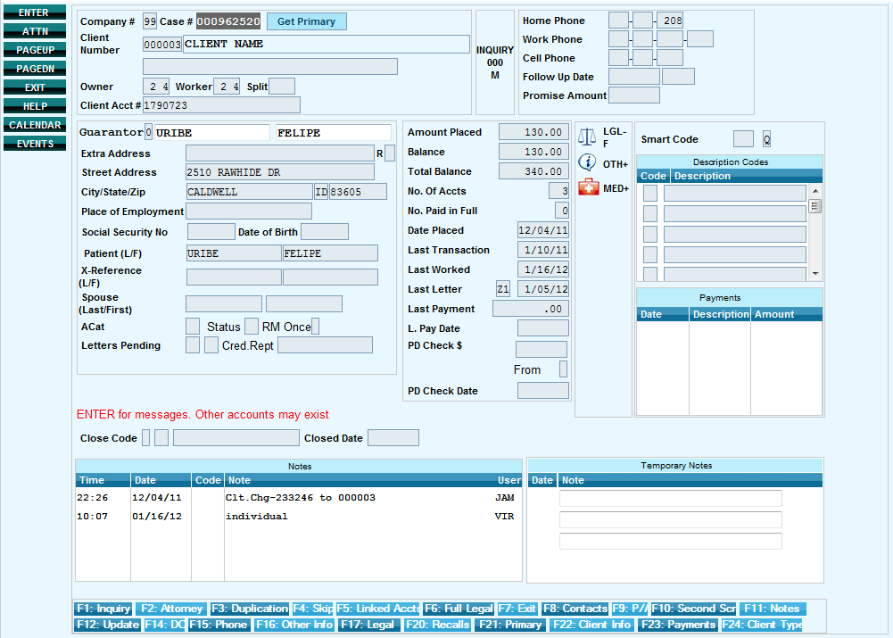
Enter Topic Title (use this slide for screen shots)
Use text box
to label or describe item (use Insert > Shapes for box/line to highlight item

