Slide 1
Time Zone Processing Steve Townend 22 August 2012
Notes:
(Preparing for RMEx Conversion)

Slide 2
Time Zone Processing
Time zone processing ensures that when a call is launched into a particular state or province, it is at an appropriate time relative to the place being called. Every jurisdiction has an allowable calling period. This is typically from 8am to 9pm, local time, but there are significant variations that need to be taken into account.

Slide 3
Pre-Requisites
RMEx 2.2 with latest SCFIX
Valid allowable calling periods (ACP) in the state controls table
A recent version of the Melissa Data time zone file
The settings in the dialer control table
The settings of the Special Control Flags

Slide 4
State Control Table
State Options from System Control Menu 2
Enter ‘No working before HHMM or after HHMM’
Consider a safety margin (end at 2056)
Consider states with multiple time zones such as Florida

Slide 5
The State Controls Table

Slide 6
The Melissa Data File
FONE*Data
Provides RMEx the ability to relate area code and prefix data to location information like city, state, county, and TIME ZONE
http://www.melissadata.com/
1 800 MELISSA
Quarterly updates recommended

Slide 7
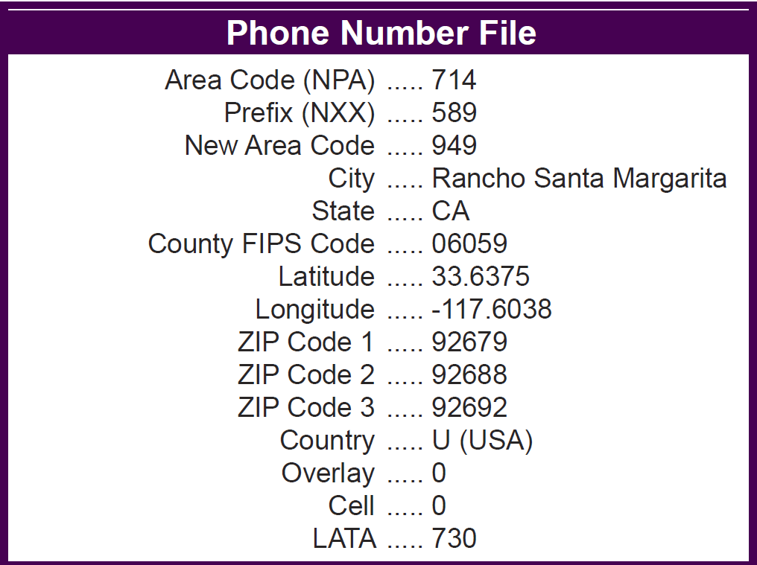
The Melissa Data File

Slide 8
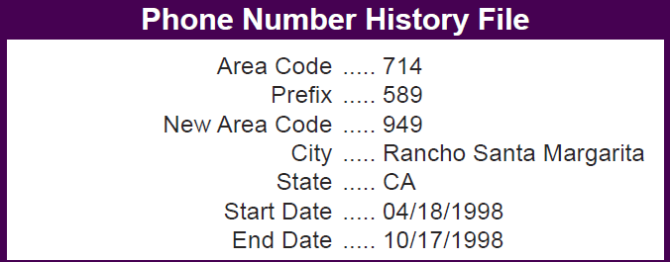
The Melissa Data File

Slide 9
The Melissa Data File

Slide 10
The Melissa Data File SCITLTZ

Slide 11
Loading The Melissa Data File
Information on this in the RMEx Knowledge Base
Download FONE*Data from Melissa Data
Copy PC files to i5, into library FONEDATA
Make sure you copy the data as well as the file structure
Run the RMEx update program from
I-Tel System Control options
Phone number maintenance options
Create area code and time zone files

Slide 12
The Dialer Control Table
In which time zone is the dialer located?
Atlantic Time 4
Eastern Time 5
Central Time 6
Mountain Time 7
Pacific Time 8
Are you observing DST in the location you are calling from?

Slide 13
The Dialer Control Table

Slide 14
Dealing with 800 Numbers
Where is a toll-free number located?
Anywhere in North America
In the same place as other numbers on the account
Options:
‘ ‘ (blank) default to 2pm to 5pm EST
‘N’ ignore toll-fee numbers if there are other numbers on the account
‘A’ always ignore

Slide 15
Special Control Flags
Stored on SCSYSOP2
OPF004 Use State for Preview Dialing
OPF006 Use State in ACP calculation
OPF007 Validate only number being called
OPF008 Validate TAB+ numbers
No Menu option
Updated using DFU
Default Values are ‘safest’

Slide 16
Special Control Flags – OPF004
USE STATE ACP IN PREVIEW
This control flag allows you to use the ACP from the state table in preference to the time zone from the Melissa Data table. This applies only to Preview dialing
The valid values are ‘ ‘ (blank) and ‘Y’.
The default is ‘ ‘ (blank).
Blank The system will calculate the allowable calling period based on the telephone numbers on the account (home, work and cell from the main account screen) and the state in the consumers address. The result will be the most restrictive calling period.
‘Y’ For calls launched in preview (including preview calls from within a predictive campaign), the system will permit the call if the current time is between the ‘earliest time to call’ and the ‘latest time to call’ on the state controls table, for the state in the consumer’s address. There will be no verification on the number being called.
If the return mail flag on the consumer’s account is set to ‘Y’, then the system will calculate the ACP for the number being called, and on no other data.

Slide 17
Special Control Flags – OPF006
INCLUDE STATE IN ACP CHECK
This control flag allows you ignore the ACP on the state controls table.
The valid values for this field are ‘ ‘ (blank) and ‘N’.
The default for this field is ‘ ‘ (blank).
Blank The system will calculate the allowable calling period based on the telephone numbers on the account (home, work and cell from the main account screen) and the state in the consumers address. The result will be the most restrictive calling period.
‘N’ The system will not check the allowable calling times from the state controls table. The allowable calling period will be calculated based only on the phone numbers on the account.

Slide 18
Special Control Flags – OPF007
CHECK DIALED NUMBER ONLY IN PREVIEW
This control flag allows you to calculate the ACP only on the number being dialed. It will bypass the checks on the other numbers on the account and on the ACP in the state controls tables.
The valid values for this field are ‘ ‘ (blank) and ‘Y’.
The default for this field is ‘ ‘ (blank).
This control field affects only preview dialing
Blank The system checks the allowable calling period for all numbers on an account. If the current time falls outside the allowable calling period for any number on the account, or outside the allowable calling period for the state, the call is prohibited.
‘Y’ The system will check the allowable calling period only for the number being dialed: it will not check the allowable calling period for any other numbers on the account, nor will it check the valid calling times for the state in the consumer’s address.

Slide 19
Special Control Flags – OPF008
CALCULATE ACP ON TAB+ NUMBERS
This control flag allows you to calculate the ACP on all numbers on an account, including being dialed. It will bypass the checks on the other numbers on the account and on the ACP in the state controls tables.
The valid values for this field are ‘ ‘ (blank) ‘A’ and ‘D’.
The default for this field is ‘ ‘ (blank).
Blank The system will calculate the allowable calling period based on the telephone numbers on the account (home, work and cell from the main account screen) and the state in the consumers address.
‘A’ The system will calculate the allowable calling period based on the telephone numbers on the account (home, work and cell from the main account screen) and the state in the consumers address AND all numbers on the TAB+ screen that have enabled (the phone code is upper-case).
‘D’ The system will calculate the allowable calling period based on the telephone numbers on the account (home, work and cell from the main account screen) and the state in the consumers address AND all DEBTOR numbers on the TAB+ screen that have enabled (the phone code is upper-case).

Slide 20
The Allowable Calling Period
The Earliest time to call
(normally 8am local time)
The Latest time to call
(normally 9pm local time)
Stored on SCCQUE and TQ files

Slide 21
The Allowable Calling Period
Calculated based on
The area code/exchange records in SCITLTZ
The times in the State Control Table
The values on the Dialer Control Table
The settings of the control flags
The default for US and Canada is 8am to 9pm
The default for elsewhere is 2pm to 5pm

Slide 22
UTC
UTC stands for Universal Time Coordinated.
It is equivalent to GMT (Greenwich Mean Time).
Allowable calling times are stored in UTC format

Slide 23
The Allowable Calling Period
(AST+TZO-DST) / 24
(AET+TZO-DST) / 24

Slide 24
The Allowable Calling Period
(AST+TZO-DST) / 24
AST The allowable start time in local time, in hours. This is the ‘no working before’ time from the state control table. Maryland would be ‘08’
TZO The time zone offset (hours behind UTC or GMT) for the area code/exchange combination being called, from the time zone file. For 301 657 2084, this value would be ‘5’.
DST DST is equal to ‘1’ if the DST flag for the area code/exchange combination is equal to ‘Y’ AND the DST flag on the Dialer Control File on RMEx is equal to ‘Y’. If either flag is blank, then DST is equal to zero.
24 The number of hours in a day

Slide 25
Checking Valid Times

Slide 26
Checking Valid Times

Slide 27
Checking Valid Times (TAB+)

Slide 28
Checking Valid Times (TAB+)

Slide 29
Checking Valid Times (TAB+)

Slide 30
Time Zone Processing
RMEx features a comprehensive set of controls to ensure that your call center can operate in compliance with state and federal regulations.........provided you have:
The latest version of RMEx
An up-to-date time zone table
Set all your controls properly
Trained people in the use of the controls and the system

Slide 31
Time Zone Processing Thank You
Quantrax August 2012

