Slide 1
RMEx 3.0 new Features & Functionality (General Availability scheduled for 9/15/12) August 21, 2012
Notes:
(Preparing for RMEx Conversion)

Slide 2
Debtor Authentication
Designed to reduce the risk of identity theft and fraud of the debtor’s personal information
The collector must enter the correct debtor information before they are presented with the account details
Uses up to seven options to validate the debtor’s identity Authentication options are setup on the client level
The Authentication options are as follows:
Full SSN
Last 4 digits of the SSN
Full DOB
Month and Date of the DOB
Address
Client account number
Last 4 digits of the Client account number
Type Y (Need to authenticate) or S (Single option to authenticate)

Slide 3
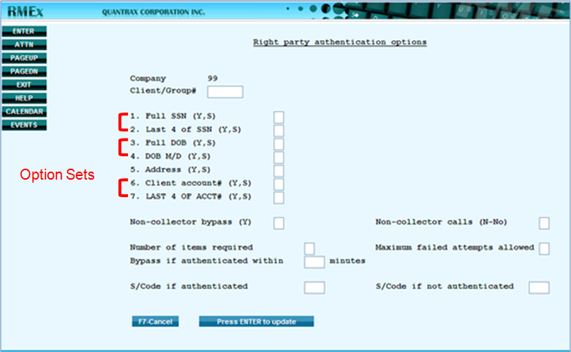
Debtor Authentication (Setup)

Slide 4
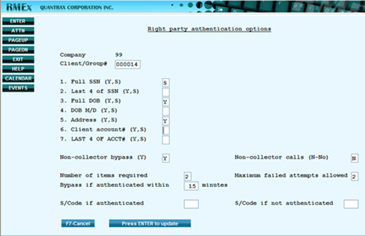
Debtor Authentication (Setup)

Slide 5
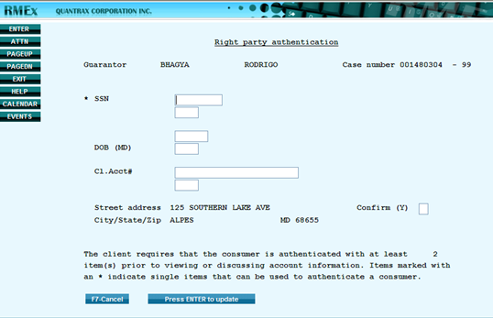
Debtor Authentication (Collector screen)

Slide 6
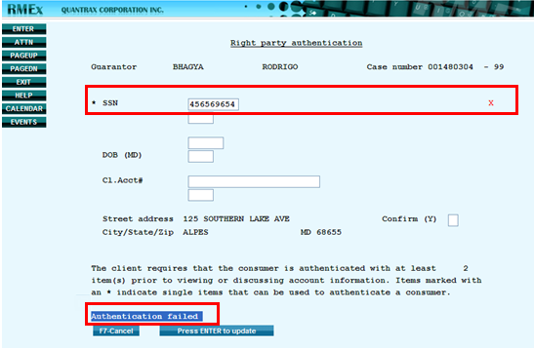
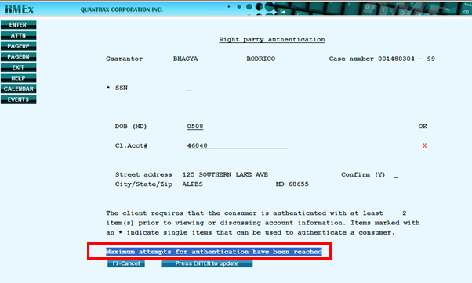
Debtor Authentication (Failed Authentication)

Slide 7
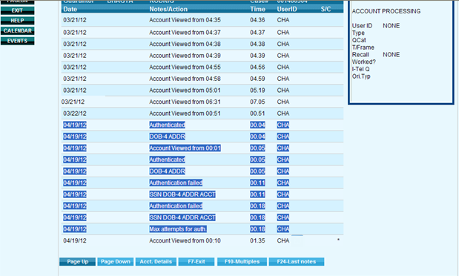
Debtor Authentication (Audit Notes)

Slide 8
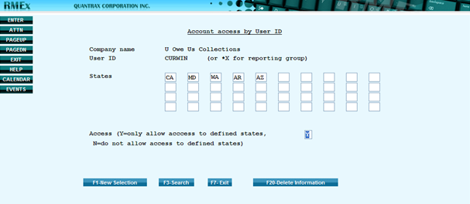
Collector License by State
Permits users (Collectors) to work debtor accounts by the state
Each state has different rules, depending on state rules
Agency may need to have a license and some states may require the collector to be licensed for that particular state
The license can be a collector license or a common state license

Slide 9
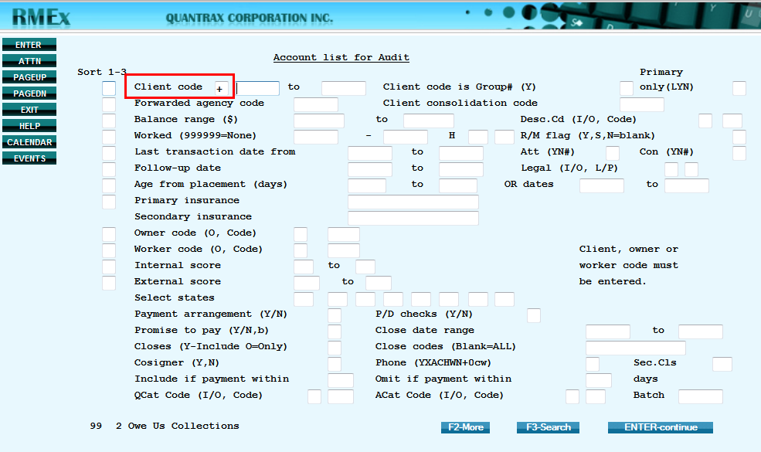
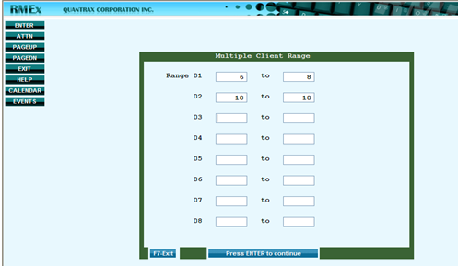
Account List For Audit - Enhancements
Adding Multiple Client Range(s)
Saving A SubList

Slide 10
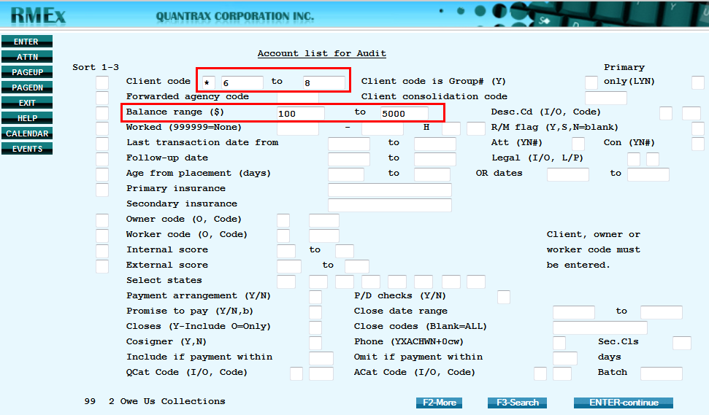
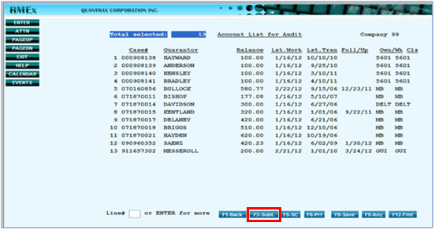
Account List For Audit – Enhancements (continued)

Slide 11
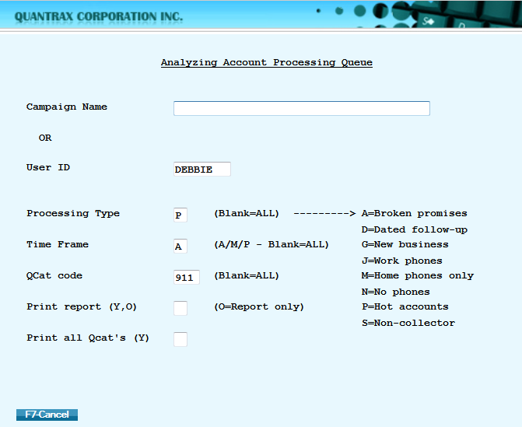
Analyzing Account Processing Queue
Permits users (Collectors) to work debtor accounts by the state
Agency may need to have a license and some states may require the collector to be licensed for that particular state
The license can be a collector license or a common state license

Slide 12
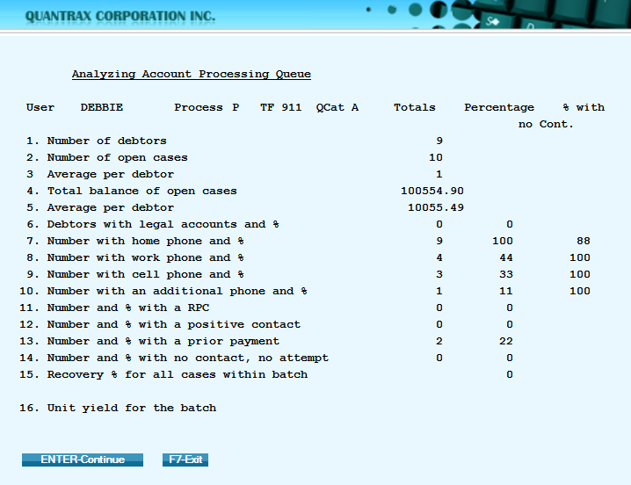
Analyzing Account Processing Queue
Average per debtor = Total Payments divided by Total Balance of Open Cases
Unit Yield = Commission divided by Number of Accounts
Recovery % = Total Placements divided by Total Payments. Percentages will be rounded either up or down EXAMPLE: 1.1% will be displayed as 1% and 7.7% will be displayed as 8%

Slide 13
Analyzing Account Processing Queue
Average per debtor = Total Payments divided by Total Balance of Open Cases
Unit Yield = Commission divided by Number of Accounts
Recovery % = Total Placements divided by Total Payments. Percentages will be rounded either up or down EXAMPLE: 1.1% will be displayed as 1% and 7.7% will be displayed as 8%

Slide 14
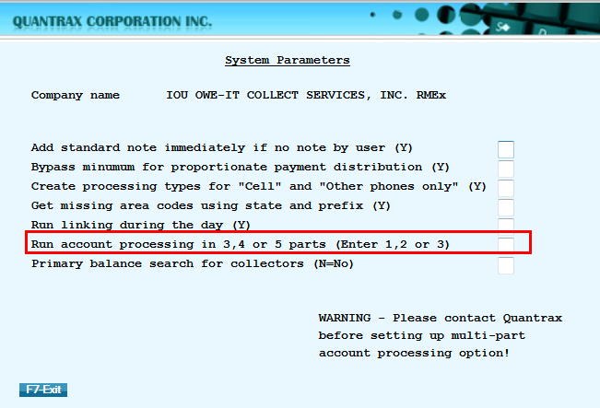
Account Linking Through Postings
Ability to link accounts when posting accounts into the system
Allowing part of the linking process to run during day, enables the Nightly Process run faster by reducing the time taken for account linking

Slide 15
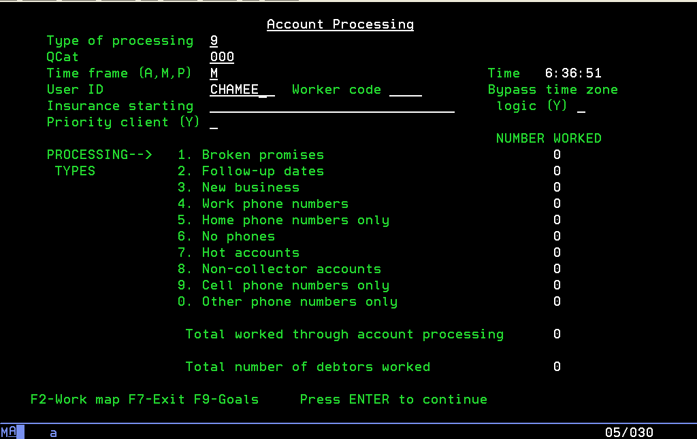
Additional Account Processing Types

Slide 16
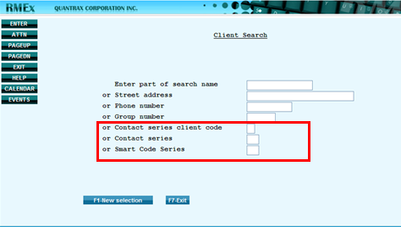
Search for Clients - Enhancements
By Contact Series
By Contact Series by Client
By Smart Code Series

Slide 17
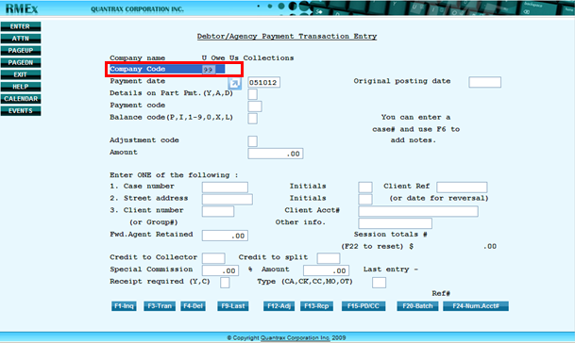
Change Company in Payment Entry Screen

Slide 18
Multi-Part Account Processing During the Nightly
Speeds up the Nightly Process by allowing Account Processing to run effectively in multiple simultaneous jobs (this minimizes the time spent on completing the Nightly process)
Allows this process to run conveniently in 3, 4 or 5 parts according to your needs
WARNING: It is advised to contact Quantrax before setting up the Multi-part Account Processing option

Slide 19
Account Inquiry Search - Enhancements
Phone Number
Email Address
Social Security Number of patient, spouse, Co-signer or multiple co-signers
Court Case Numbers
View Balance for Linked Accounts with Different Court Case Numbers (F6 – Full Legal)

Slide 20
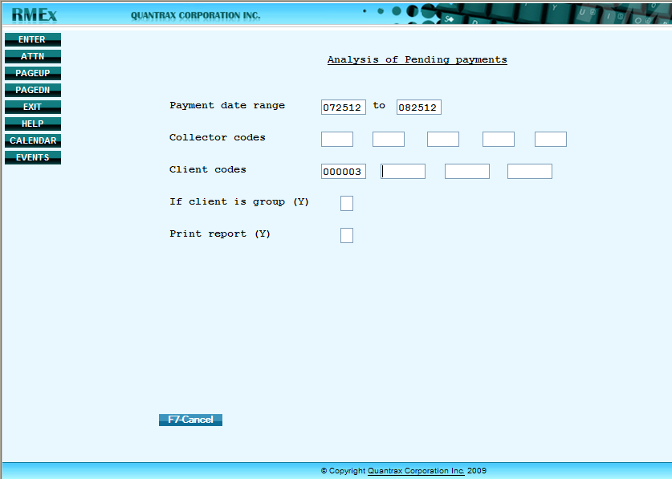
Analysis of Pending Payments
View a summary of the total number of accounts, the total payments due and potential commission due for a particular date range
Ability to select the data by Client codes and if client is a group

Slide 21
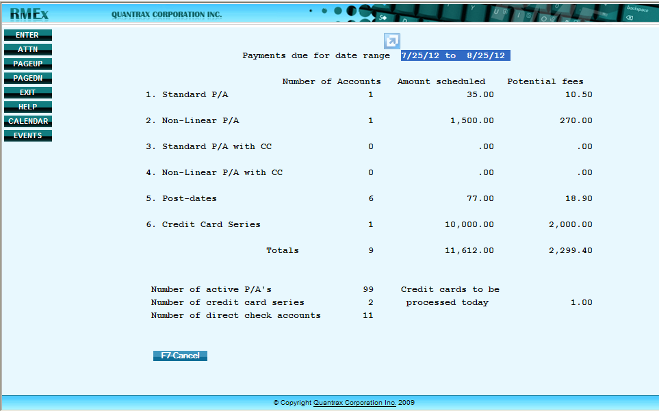
Analysis of Pending Payments
Amount scheduled = total amount due from each payment type/method
Potential fees = the possible commission that can be obtained from the total due amount

Slide 22
Prevent Fishing in Account Inquiry Screen
Prevent “fishing” has been added for the Account Inquiry > Primary balance
It stops collectors from using this Primary balance option to fish" for high balance accounts
To control which users are allowed to use Account Inquiry > Primary balance:
The user must be set up as a collector
The user cannot have a Y in the close accounts field
NOTE: If the user does not have access to use the option, they will be presented with the message: SC-9017 This option has been disabled for you

Slide 23
Legal Screen Enhancements
Additional fields in Defendant Attorney Codes
Additional fields in Court Codes
Additional fields in County Codes
New options on Legal Master Files Menu
Judge Codes
Covering Attorney Codes
Additional screens in Full Legal Screen
New Caption screen
New Suit Detail screen
New Garnishment screen

Slide 24
Compliance & I-Tel Changes
These items will be covered in another session – date to be announced
State Compliance changes
Campaign Merging Options
Controlling Maximum Calls

Slide 25
RMEx 3.0 new Features & Functionality (General Availability scheduled for 9/15/12) Thank you!

