Slide 1
ITel Services Webinar August 1, 2012
Notes:
(Preparing for RMEx Conversion)

Slide 2
Overview
Services show on the dialer server
Different services based on which version you are on and which features you have installed
Services not in use are disabled
Split services based on if you have multiple servers

Slide 3
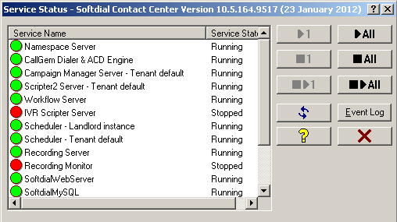
Dialer Services

Slide 4
Namespace Server
Must be running at all times
Responsible for inbound routes and queues, sound resources configuration, dialing outcome, etc.
Can not be recycled by the one service, must recycle all
Agents must be off when recycling

Slide 5
CallGem Dialer and ACD Engine
Must be running at all times
Responsible for predictive dialing engine and inbound call distribution
Can not be recycled by the one service, must recycle all
Agents must be off when recycling

Slide 6
Campaign Manager Server
Must be running at all times
Responsible for campaign manager settings and functions
Can not be recycled by the one service, must recycle all
Agents must be off when recycling

Slide 7
Scripter2 Server
Responsible for scripter services
IVR (inbound and outbound)
Dialer Console
Can be recycled while live agents are signed in
Will only affect virtual agents and if you are signed into dialer console

Slide 8
IVR Scripter Server
Old IVR services
Replaced by Scripter 2 server service
Should appear as disable unless you do not have Scripter 2 service running and enabled

Slide 9
Scheduler
Responsible for automated tasks
Signing in IVR agents into campaigns
Can be recycled while agents are signed in

Slide 10
Workflow Server
Responsible for
Starting the campaign Administrator
Used for the Dialer Console
Can be recycled while agents are signed in

Slide 11
Recording Server
Used to index recordings for new recording monitor
Not responsible for recording the call
Can be recycled while agents are signed in

Slide 12
Recording Monitor Server
Responsible for recording monitor feature
Adds recordings to recording monitor database
Archive recordings based on age of recording
Can be recycled while agents are signed in

Slide 13
Softdial Web Server
Used for web interface
Access to new recording monitor feature
Can be recycled while agents are signed in

Slide 14
HTTP SDMP Bridge Server
Responsible for user ID authentication
Primary used for dialer console and web interface ID authentication
Can be recycled while agents are signed in

Slide 15
Tenant Provision Server
Must be running at all times
Responsible for tenant default (used through system)
Can not be recycled by the one service, must recycle all
Agents must be off when recycling.

Slide 16
Softdial Telephony Gateway Server
Must be running at all times
Responsible for all telephony related matters and sounds files/recordings
Can not be recycled by the one service, must recycle all
Agents must be off when recycling

Slide 17
Independent Services
Services that can be recycled while agents are on
Scripter 2 server
Workflow server
Scheduler
Recording server
Recording monitor server
Softdial web server
HTTP SDMP bridge server

Slide 18
ITel Services Webinar Thank you!

