Slide 1
Recording all your Calls using I-Tel May Tang & Steve Townend August 29th, 2012
Notes:
(Preparing for RMEx Conversion)

Slide 2
Benefits
Allows for PBX (non-dialer) calls to be recorded
Central location of all recordings
Easy to find recordings regardless of if they were made on the dialer or through PBX
No need to purchase additional software or hardware to record PBX calls

Slide 3
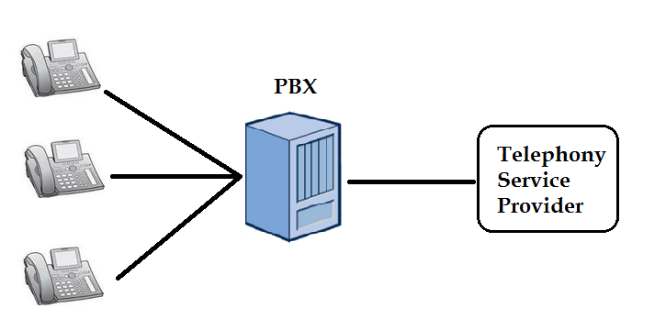
Current PBX Setup

Slide 4
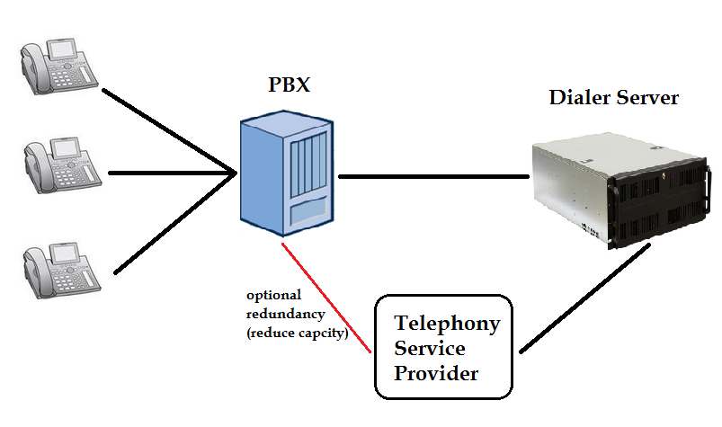
PBX Recorded Setup

Slide 5
Setup
Change PBX to direct traffic from phones to connections on the dialer, instead of to the PSTN
Dialer will reroute calls externally (through PSTN) based on CLI
Setup CLI for recording and/or external dial
Note: Can also setup particular CLI to not record

Slide 6
Possible Capacity Expansion
Increase PBXs connections on dialer (or move connection from telephony provider)
Increase PSTNs on Dialer (or move from PBX)
Increase recording storage space
Increase recording licenses

Slide 7
Other Benefits
All telephony resources are shared, providing greater efficiency
Agents cannot bypass the recording system by manually dialing
All calls are recorded separately, eliminating the ‘one call per session’ problem

Slide 8
Sample Costs
Call Center with 30 agents and 10 other staff
All agents have a dialer license and a call recording license
Add two call recording licenses - $600
Implement and configure system - $2,000
Total cost - $2,600

Slide 9
Sample Costs
Call Center with 20 Agents and 5 other staff
All agents have a dialer license
Add 21 call recording licenses - $6,300
Implement and configure system - $2,000
Total cost - $8,300

Slide 10
Next Steps
Contact Quantrax
Dialer configuration details
PBX configuration details
Quantrax will provide a quote
Implementation in about a week

Slide 11
Thank you!
Recording all your Calls using I-Tel May Tang & Steve Townend August 29th, 2012
Notes:
(Preparing for RMEx Conversion)

