Slide 1
RMEx: Handling Error Messages for Job Logs and Nightlys August 16, 2012
Notes:
(Preparing for RMEx Conversion)

Slide 2
Basics…..
You should have a technical person in the office who is familiar with the AS400
Basic AS400 commands (from command line):
• PWRDWNSYS Power off the system
• WRKMSG Work with messages
• WRKACTJOB Work with active jobs
• WRKSBMJOB Work with submitted jobs
• WRKOUTQ Work with output queues
• CPYFRMTAP Copy from Tape
• CPYTOTAP Copy to Tape
• CRTPF Create a physical file
• DLTF Delete a physical file
• CLRPFM Clear a physical file
• SAVOBJ Save objects in iSeries format
• RSTOBJ Restore objects saved in iSeries format
• DSPJOBLOG Display job log
• WRKDEVD Work with device descriptions
• CHGUSRPRF Change user profile
• WRKOBJLCK Work with object lock
• DSPSYSSTS Display system status

Slide 3
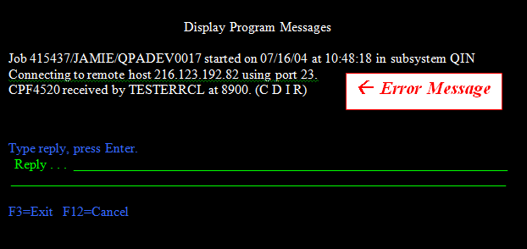
What To Do When You Get Error
Send an email to support@quantrax.com with the following information (or when calling have this information in front of you)
Print screen of the initial message
Print screen of the job log
To get to the job log, place the cursor directly over the white letters of the error message and press the HELP key
Depending on what software you are using will determine what your HELP key is (Alt + F1 is default in client access)
NOTE: Refer to your software documentation for more information on key mapping
List of details took prior to getting the error message

Slide 4
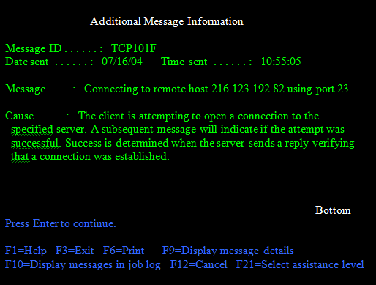
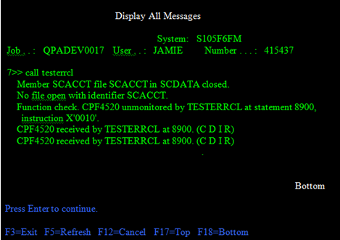
What To Do When You Get Error
Another message Information screen
Press F10 to display messages in job log, then press F18 to move Bottom
Print this screen for support

Slide 5
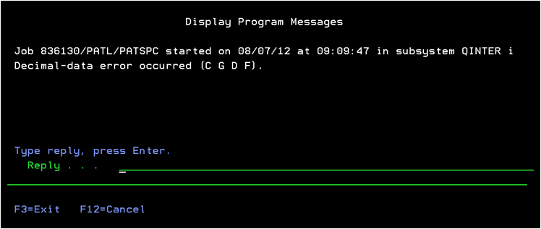
Answering an Error Message
Answering a message C, D, S, F all do the same thing – they STOP the program
The difference is the information that we are given to help solve the problem:
C is reasonable
D is the best
Example: If a Data decimal error a D is really the only way to help us solve, we will probably recreated a data decimal so we can take a D
I can be OK, but it is situation by situation.
S and F: Unless talking to IBM should probably not be used
G to a message is never a good idea

Slide 6
Data Decimal Error
Cause: When a field has been designed to store numeric data and an alpha character is in this field
Example: A character got into a phone number at the time of loading an account electronically
Solution:
If urgent:
Display the Job Log
Have the Job Log ready to answer support’s questions and call Quantrax
If not urgent:
Display the Job Log
Go to the bottom of the Job Log – Print the last page and email to support
Respond to the messages with a D

Slide 7
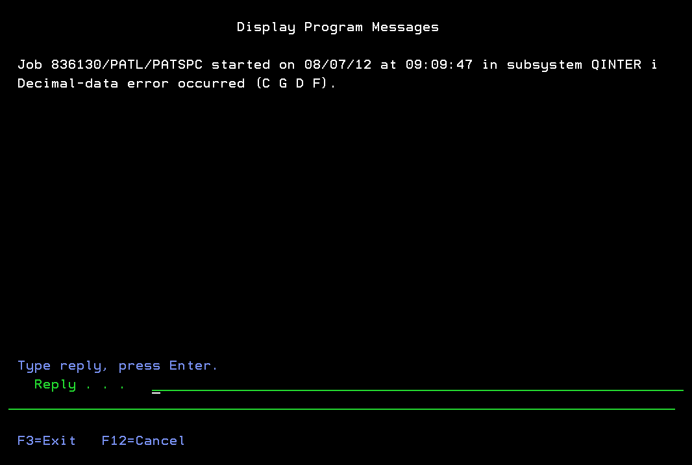
Data Decimal Error
Place your cursor on the message and press the Help key

Slide 8
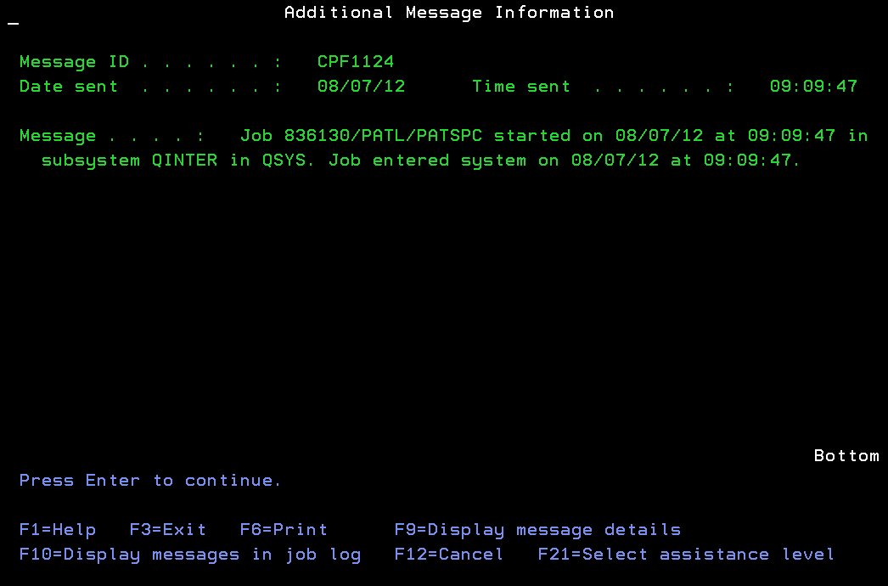
Data Decimal Error
Press F10 to display messages in Job Log

Slide 9
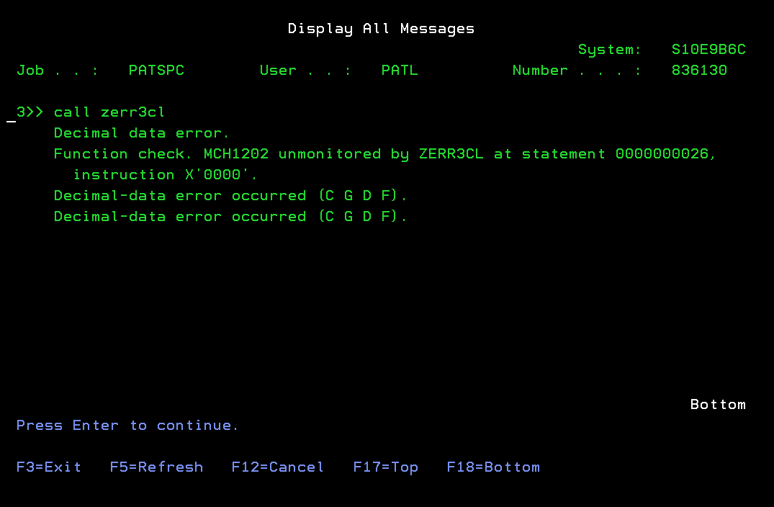
Data Decimal Error
Place your cursor on the line that says Data Decimal Error and press the Help key

Slide 10
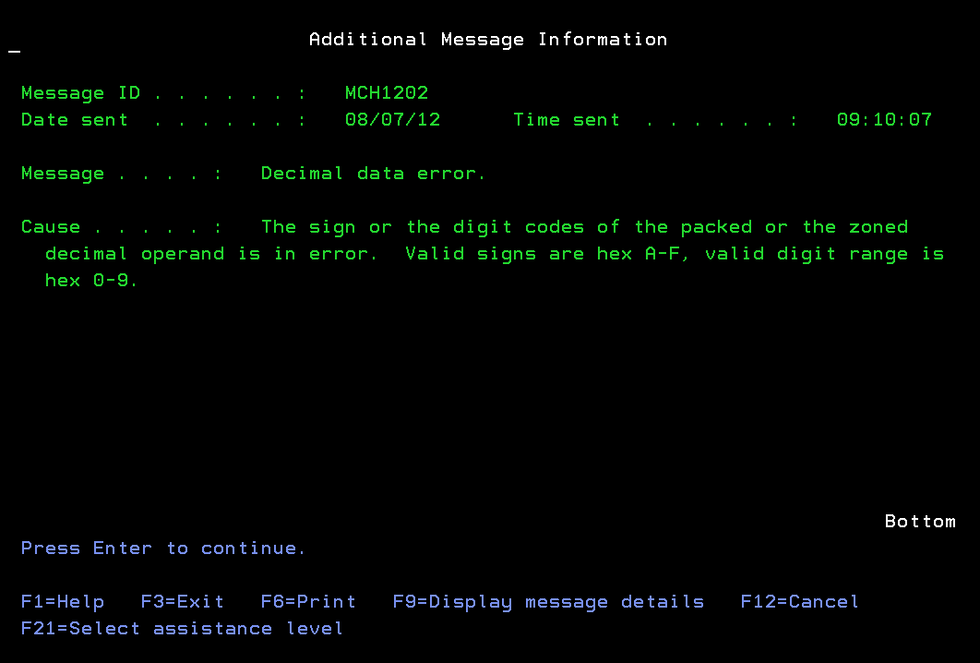
Data Decimal Error
Press F9 to display message details

Slide 11
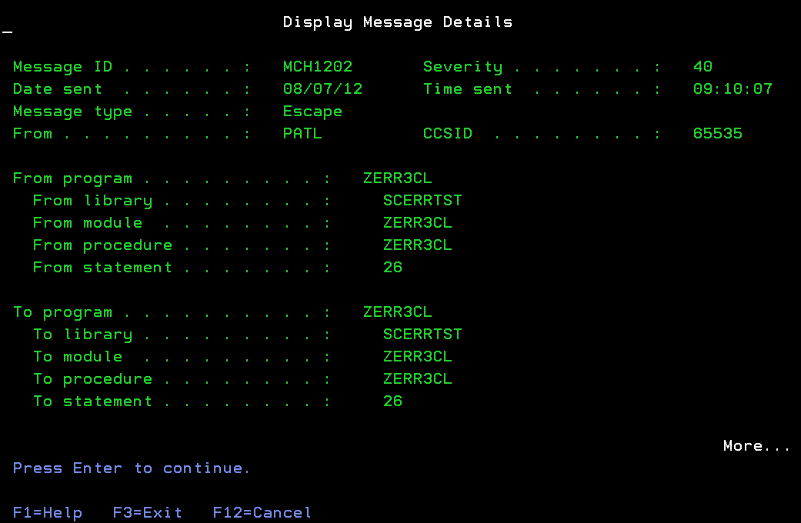
Data Decimal Error
If urgent, call support and tell them you got a Data Decimal Error in program ZERR3CL in Library SCERRTST and from Statement 26

Slide 12
Function Check
Cause: Generic message that can be caused my various things; a program is trying to do something and is stopped
Examples:
File issue
Program not found
Code is missing
Record lock
Solution: Put your cursor on the message and press Help
If urgent:
Contact support and tell them that you got a Function Check and read them the line above the function check message Example: I got a function check in program ZERR1CL – File ZERR1FM not found in *LIBL or inline data missing
If not urgent:
Email support the last page of the job log

Slide 13
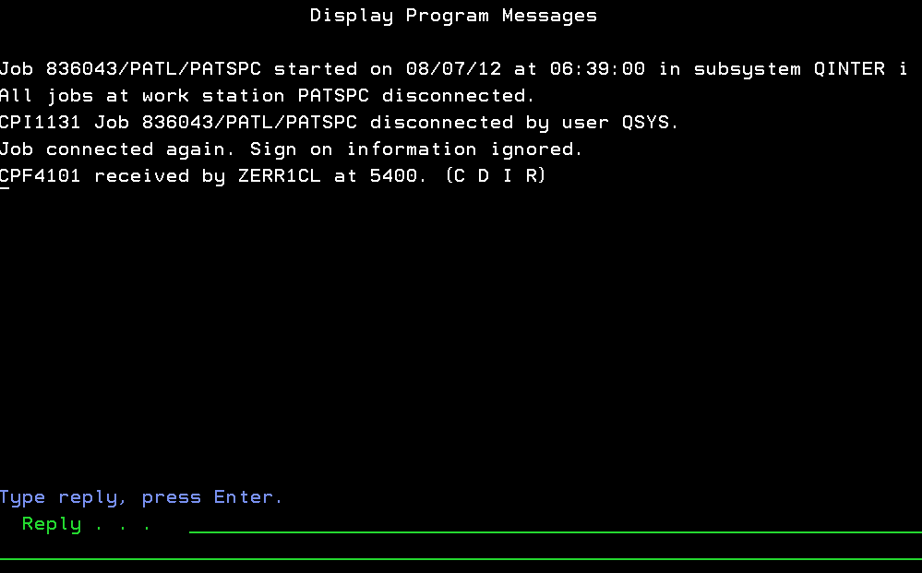
Function Check
Put your cursor on the message and press the Help key

Slide 14
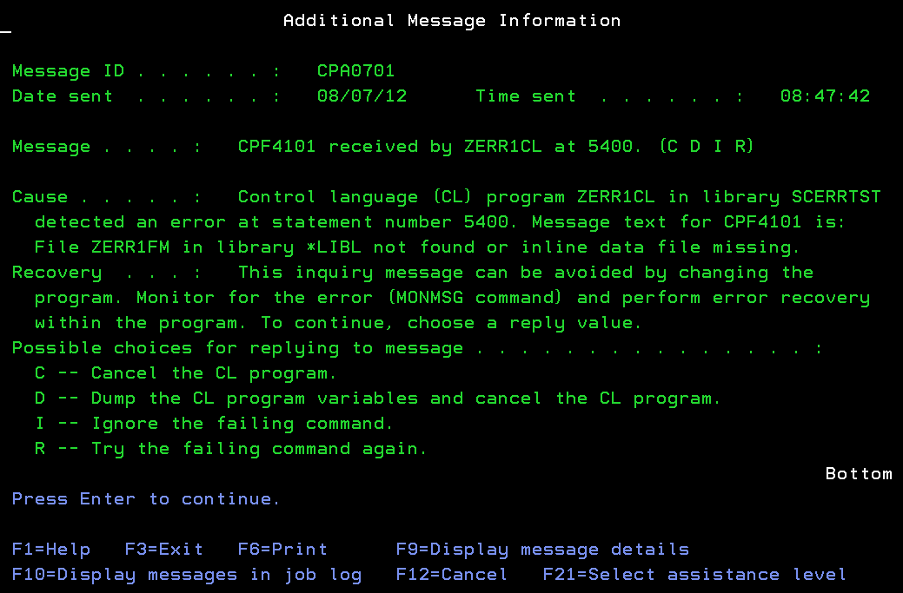
Function Check
Hit F10 to Display Messages in Job Log

Slide 15
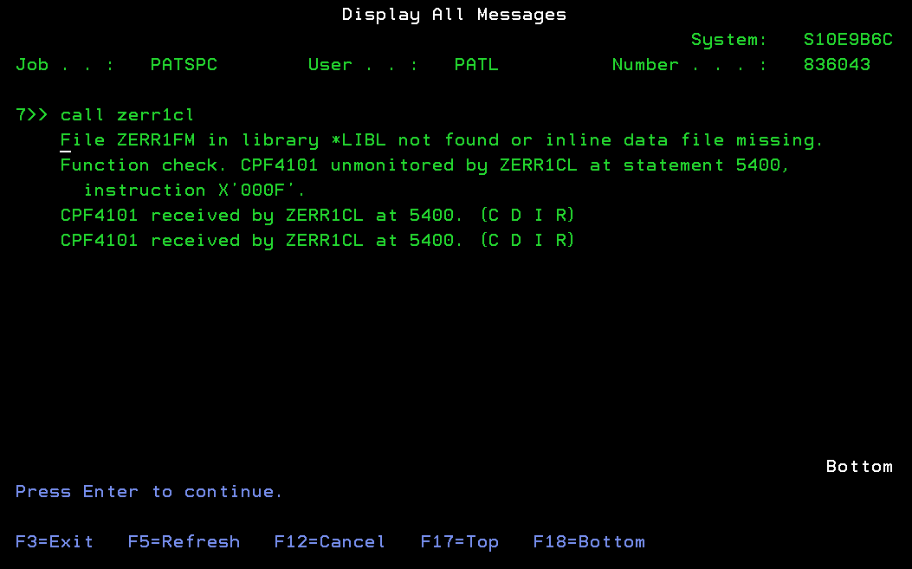
Function Check
Press F18 to go to the bottom and you will see that there was a Function Check

Slide 16
Level Check
Cause: A Physical File was changed to an existing program and the program was not recompiled
Example A: Changes were made to the Account Master File and the Inquiry program was not re-compiled. This could happen to a modification as well as a new program.
Example B: The file layout for one of your New Business Loads changes and we do not recompile the program
Solution:
Contact support
Send print screen of the Job and send us the program name and Level Check in what file (screen)
Quantrax will need to compile here and resend code – important to send program and file information

Slide 17
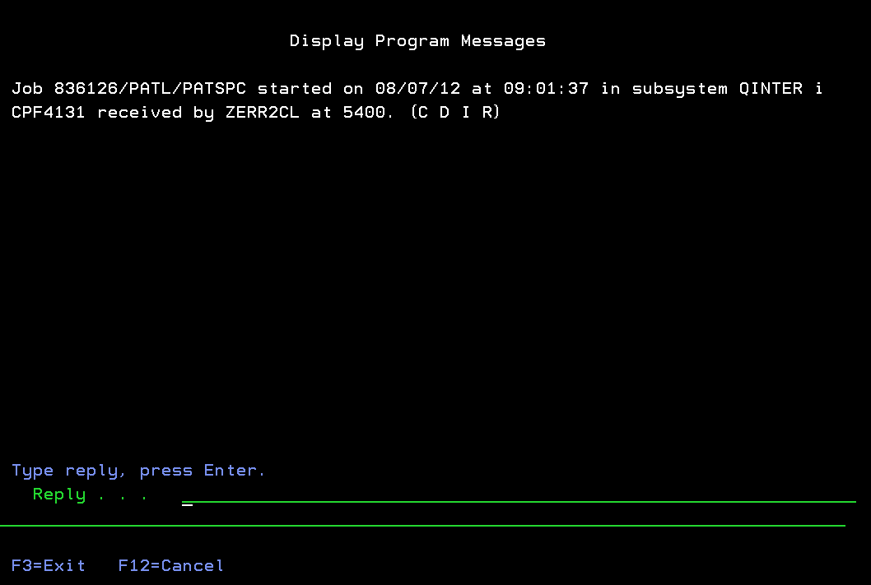
Level Check
Put your cursor on the message and press the Help key

Slide 18
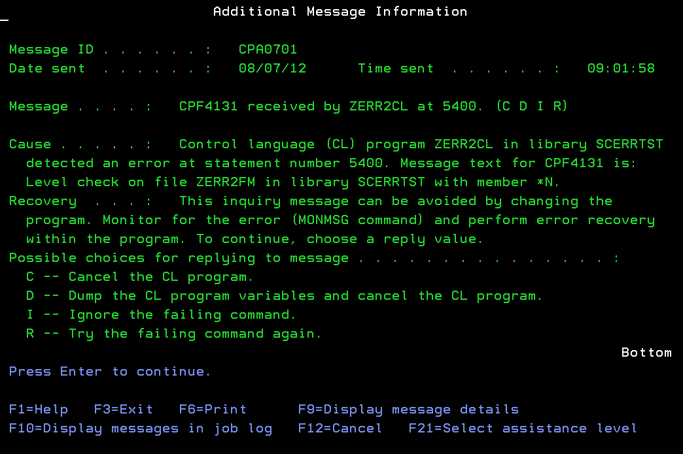
Level Check
Press F10 to display the Job Log, then press F18 on the next screen to go to the bottom

Slide 19
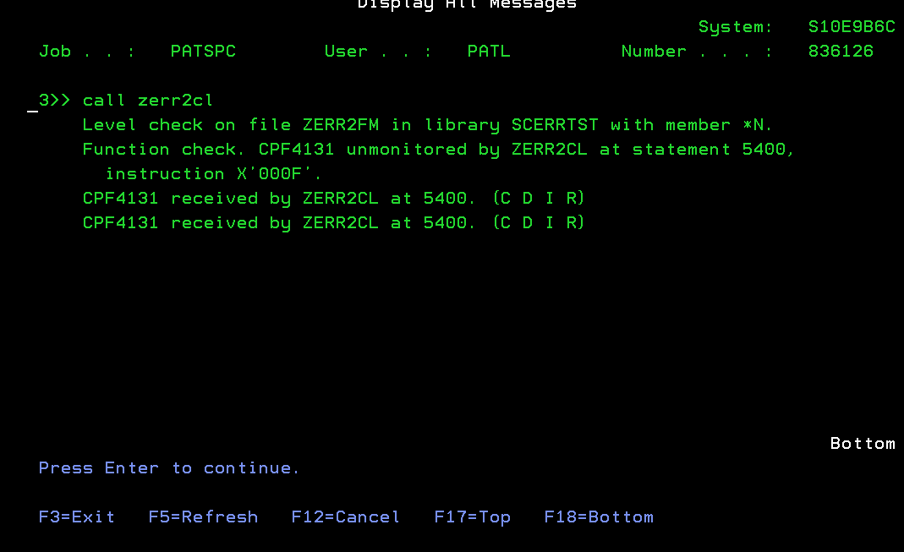
Level Check
Tell support that you got a Level Check on ZERR2FM in library SCERRTST in program ZERR2CL at Statement 5400

Slide 20
I/O Errors
Cause: Many different reasons:
A file is not there
Lock on a record – catch immediately to stop the job / could be multiple jobs by same user, need to detect which one causing the problem
Solution:
If urgent:
Display the Job Log
From command line type: WRKUSRJOB username *active - this gives you job that has the problem (where username is person experiencing issue)
NOTE: If you have a dialer you should not be locked in multiple times

Slide 21
RMEx: Handling Error Messages for Job Logs and Nightlys Thank you!

