Slide 1
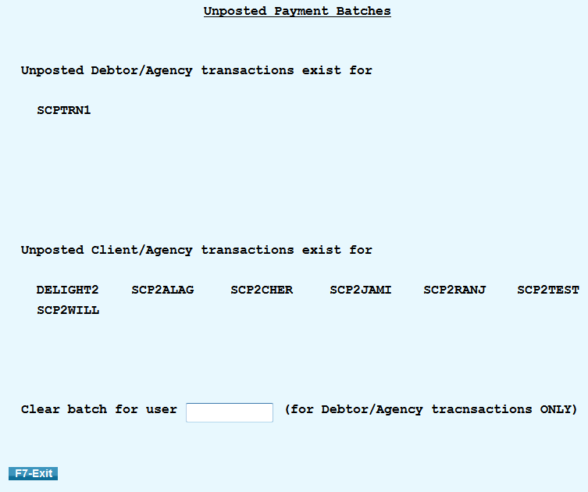
Unposted Payment Batch Inquiry – Displays a list of users who have entered payment transactions that have not been posted.
Located off the Payment Transaction Menu
Shows payment batches for Debtor/Agency transactions and Client/Agency transactions.
This options should be checked regularly before processing clients statements.
Gives you the option to clear a Debtor/Agency payment batch for other users.

