Slide 1
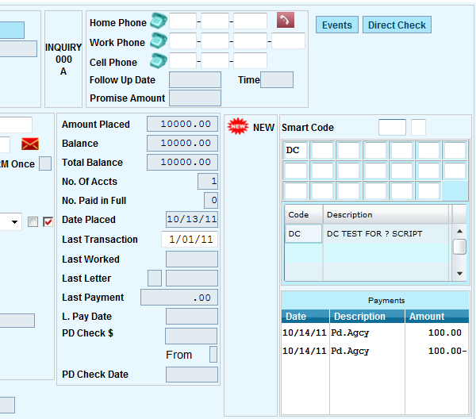
Omitting Transactions From a Clients Remittance Statement.
If there’s a payment posted, and then reversed within the same statement period, it’s possible to omit both that positive and negative payment from the clients statements.

Slide 2
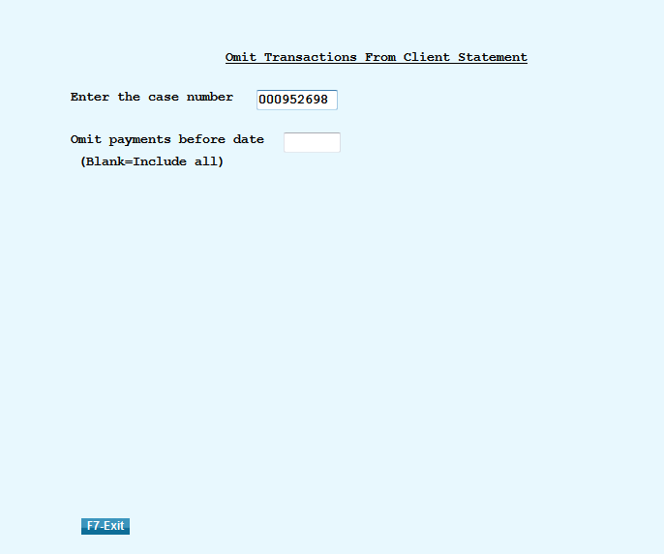
Omitting Transactions From a Clients Remittance Statement.
Found off the Payment Transaction Menu
Omit payments before date: If there are hundreds of transactions on this account you can enter a date into the Omit Payments before Date option to cut down on the number of transactions that appear on the screen.

Slide 3
Omitting Transactions From a Clients Remittance Statement.
put an “N” in both the negative and positive transactions and hit Enter.
Note: If the transactions are not an exact match, (but positive and negative). They cannot be omitted

Slide 4
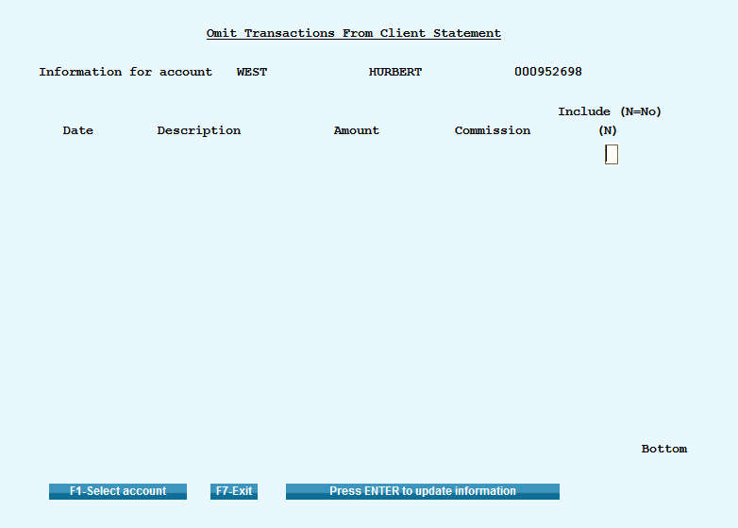
Omitting Transactions From a Clients Remittance Statement.
After you hit Enter, those payments, if you go back in those transactions will no longer be listed.

