Slide 1
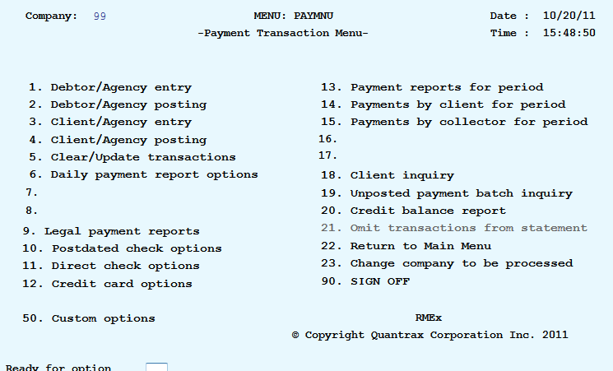
Client/Agency Transaction Entry– This refers to transactions between the client and the agency, and is not applied to a specific account, but to a specific client number
When you process client statements RMEx produces an invoice number. This information is maintained in the client receivables module. When you send this statement to your client showing the amount that the client owes your agency, the client in turn sends you a check. The below process explains how those checks are applied to the client’s receivables.
Found off the Payment Transaction Menu

Slide 2
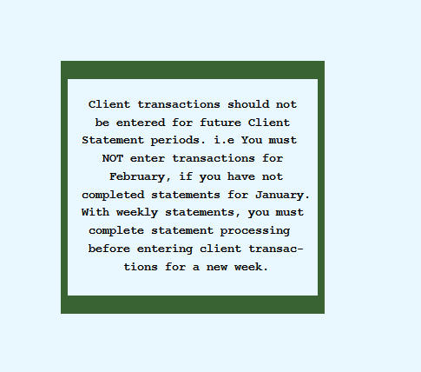
Client/Agency Transaction Entry– This refers to transactions between the client and the agency, and is not applied to a specific account, but to a specific client number
Hit Enter to get past the warning reminding you that client transactions should NOT be enter for future client statement periods.
Notes:
When you hit enter

Slide 3
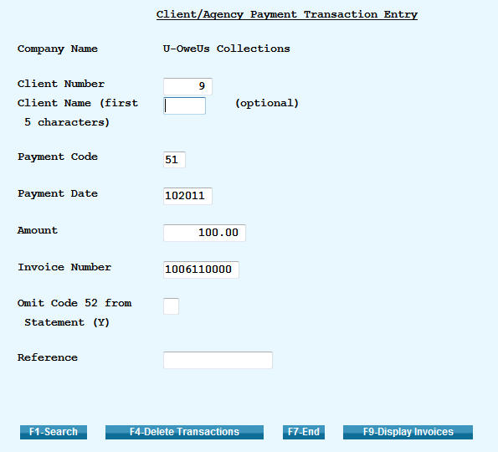
Client/Agency Transaction Entry– This refers to transactions between the client and the agency, and is not applied to a specific account, but to a specific client number
This is where you will enter you client payment
As with debtor/agency transactions, you should use a positive amount to reduce a client's balance (e.g. a client payment) and a negative amount to increase a client's balance. (e.g. to bill a client)
If you want to omit payment transaction code 52 from the statement enter a “Y”
The reference field is user defined
Notes:
When you hit enter

Slide 4
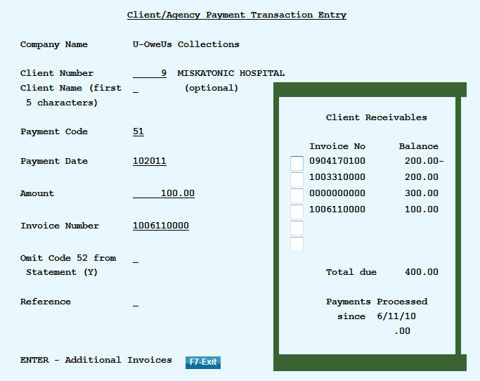
Client/Agency Transaction Entry– This refers to transactions between the client and the agency, and is not applied to a specific account, but to a specific client number
This is where you will enter you client payment
As with debtor/agency transactions, you should use a positive amount to reduce a client's balance (e.g. a client payment) and a negative amount to increase a client's balance. (e.g. to bill a client)
If you want to omit payment transaction code 52 from the statement enter a “Y”
The reference field is user defined
The invoice number – To display a list of invoices for this client use the F9-Display Invoices key. You will be able to select an invoice and this field will be populated
If the you have a payment that needs to be applied but you do not have an invoice number. Populate the Invoice Number field with all nines ”9999999999”
Notes:
When you hit enter

Slide 5
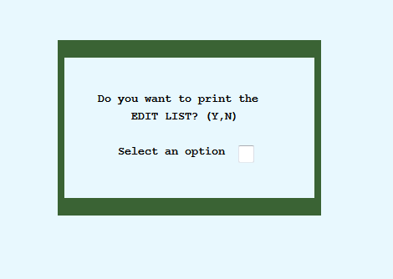
Client/Agency Transaction Entry– This refers to transactions between the client and the agency, and is not applied to a specific account, but to a specific client number
After transactions have been entered you need to request the Edit Report to check for any payment entry errors and to balance your payment batch.
The Payment Transaction Edit report is requested when exiting (F7 function key) the Client/Agency entry option on Payment Transaction Menu after entering a batch of payment transactions. When exiting the option the system prompts you to print the edit report.
Notes:
When you hit enter

Slide 6
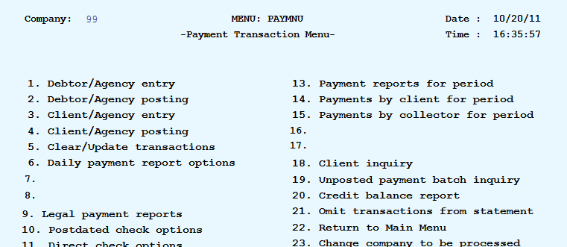
Client/Agency Transaction Entry– This refers to transactions between the client and the agency, and is not applied to a specific account, but to a specific client number
After reviewing your edits the Client/Agency posting option can be found off the Payment Transaction Menu
After posting a report will print will the information pertaining to the payments just entered.
Notes:
When you hit enter

