Slide 1
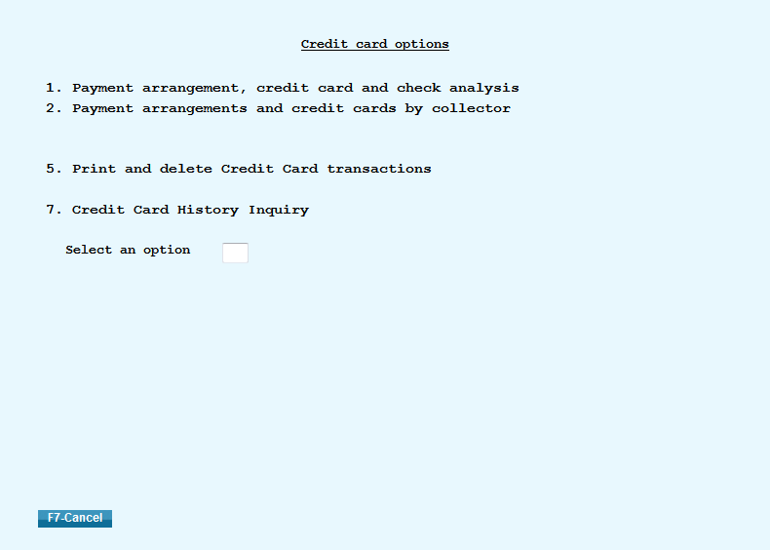
Applying and Posting Credit Card Transactions
Located off the Payment Transaction Menu
Shows payment batches for Debtor/Agency transactions and Client/Agency transactions.
This options should be checked regularly before processing clients statements.
Gives you the option to clear a Debtor/Agency payment batch for other users.

Slide 2
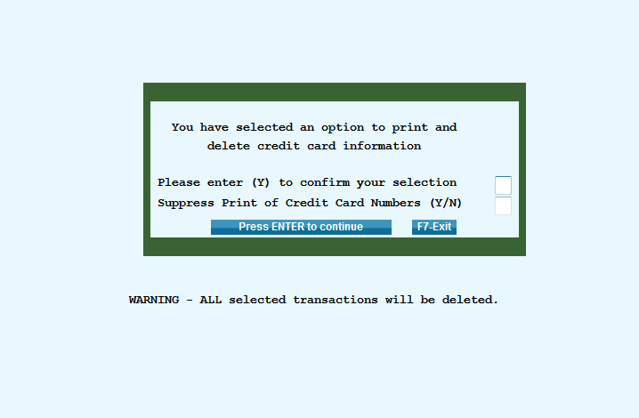
Applying and Posting Credit Card Transactions
Located off the Payment Transaction Menu
Shows payment batches for Debtor/Agency transactions and Client/Agency transactions.
This options should be checked regularly before processing clients statements.
Gives you the option to clear a Debtor/Agency payment batch for other users.

Slide 3
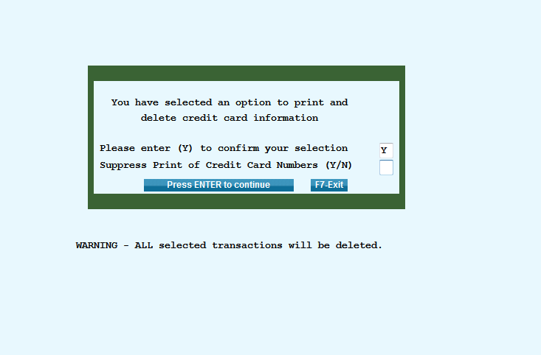
Applying and Posting Credit Card Transactions
Located off the Payment Transaction Menu
Shows payment batches for Debtor/Agency transactions and Client/Agency transactions.
This options should be checked regularly before processing clients statements.
Gives you the option to clear a Debtor/Agency payment batch for other users.

Slide 4
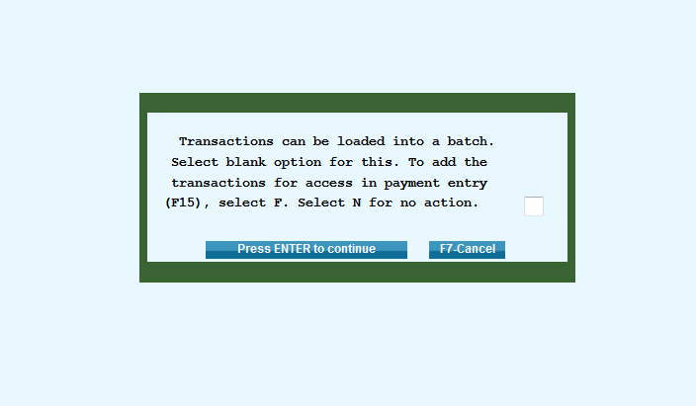
Applying and Posting Credit Card Transactions
Located off the Payment Transaction Menu
Shows payment batches for Debtor/Agency transactions and Client/Agency transactions.
This options should be checked regularly before processing clients statements.
Gives you the option to clear a Debtor/Agency payment batch for other users.

Slide 5
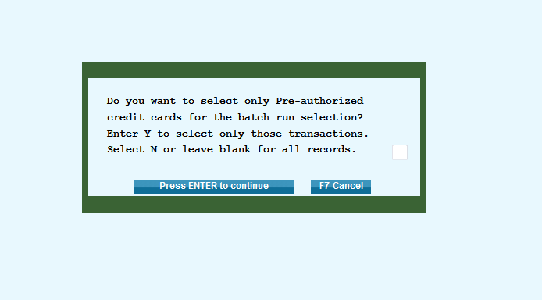
Applying and Posting Credit Card Transactions
Located off the Payment Transaction Menu
Shows payment batches for Debtor/Agency transactions and Client/Agency transactions.
This options should be checked regularly before processing clients statements.
Gives you the option to clear a Debtor/Agency payment batch for other users.

Slide 6
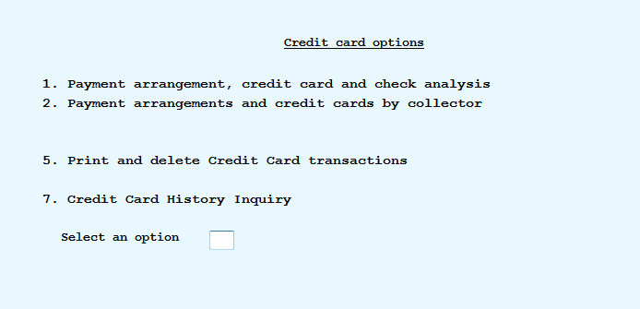
Applying and Posting Credit Card Transactions
Located off the Payment Transaction Menu
Shows payment batches for Debtor/Agency transactions and Client/Agency transactions.
This options should be checked regularly before processing clients statements.
Gives you the option to clear a Debtor/Agency payment batch for other users.

