Slide 1
I-Tel Training Valid Extensions
© Copyright 2013 – Quantrax Corporation, Inc
Notes:
(Preparing for RMEx Conversion)

Slide 2
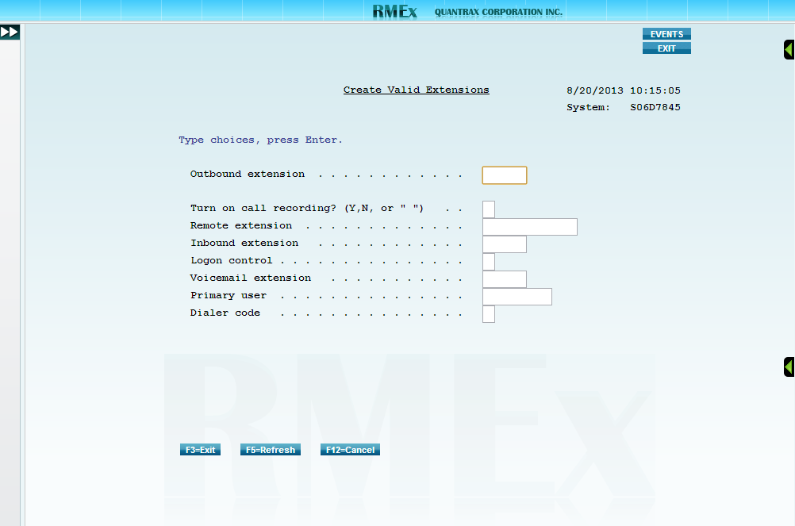
Valid Extensions
(Option 2- Management menu, Option 15 – I-Tel options menu, Option 16 – I-Tel System Control options, Option 1 – Valid extensions)
Press F6 to create a new extension.
Outbound extension
Enter the extension already set up in the company PBX.
Call recording (Y,N,b)
Enter a Y here to turn on call recording for the extension.
Enter a N here to turn off call recording for the extension.
Leave this field blank to allow call recording control at the System Control level.
Remote extension
This option allows a user to use the dialer while working remotely by calling the phone number specified in this field rather than the outbound extension.
Enter anything unique in the Outbound extension field.
Enter the remote telephone number for the user in the Remote extension field.

Slide 3
Valid Extensions
(Option 2- Management menu, Option 15 – I-Tel options menu, Option 16 – I-Tel System Control options, Option 1 – Valid extensions)
Inbound extension
Enter the PBX extension for the inbound.
Dialer code
Should be an A when only 1 dialer is installed.

