Slide 1
I-Tel Need to Know System Setup
© Copyright 2013 – Quantrax Corporation, Inc
Notes:
(Preparing for RMEx Conversion)

Slide 2
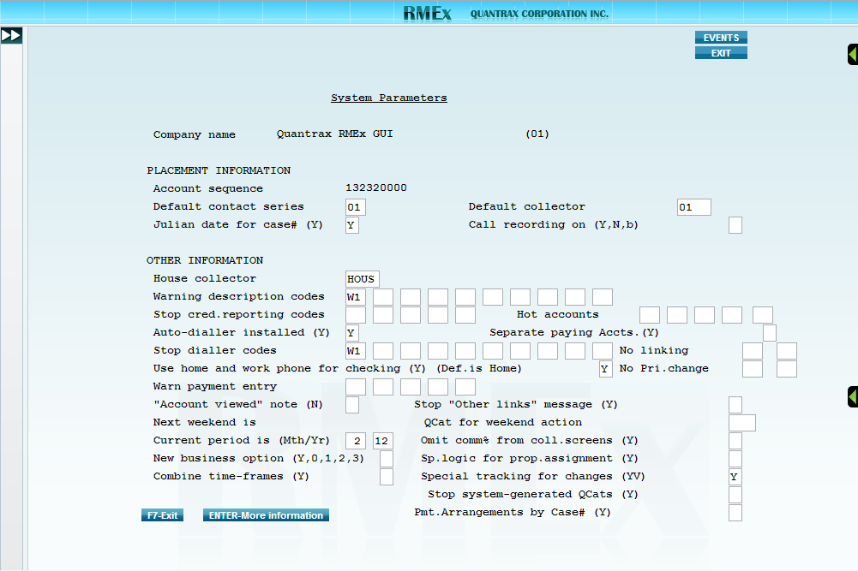
System Parameters
(Option 1 - System Control Menu, Option 3 – System Parameters)
Call recording on (Y,N,b)
Enter a Y here to turn on call recording for the entire company.
Enter a N here to turn off call recording for the entire company.
Leave this field blank to allow call recording control at the dialer, campaign, or user ID level(s).
Auto-dialler installed (Y)
Enter Y here when a dialer is installed.
Stop dialler codes
Use these 10 fields to enter description codes that will prevent an account from being eligible for dialing via the dialer.

Slide 3
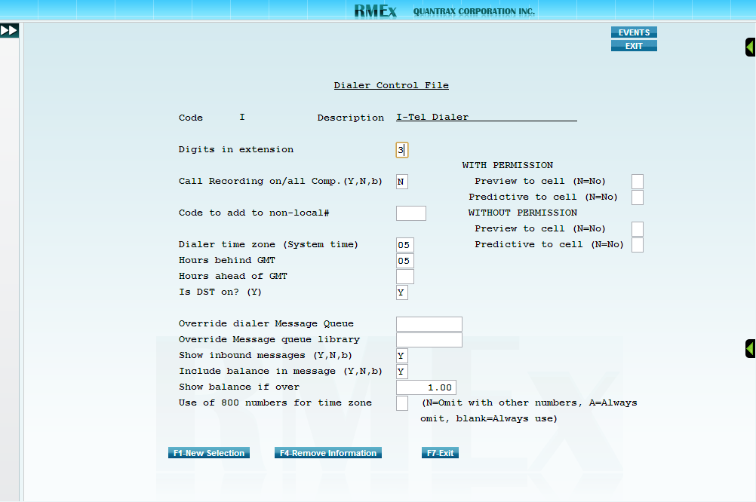
Dialer Control File
(Option 2- Management menu, Option 15 – I-Tel options menu, Option 16 – I-Tel System Control options, Option 10 – System controls)
Digits in extension
Enter the number of digits in your company’s extension (typically 3-5).
Dialer time zone (System time)
Enter the number of hours ahead or behind GMT the dialer is.
Is DST on? (Y)
Enter a Y in this field when Daylight Savings Time is in effect.
Override dialer Message Queue
Enter the name of the Message Queue that you would like dialer messages sent to. Default Message Queue is ITELMSGQ.
Override Message queue library
Enter the name of the Message Queue Library that you would like dialer messages sent to. Default Message Queue Library is SCLIB.

Slide 4
Dialer Control File
(Option 2- Management menu, Option 15 – I-Tel options menu, Option 16 – I-Tel System Control options, Option 10 – System controls)
With permission
Preview to cell (N-No)
Enter a N in this field to prevent preview calls to a cell phone even when permission has been granted by the cell phone owner.
Leave this field blank to allow preview calls to a cell phone number when permission has been granted by the cell phone owner.
Predictive to cell (N-No)
Enter a N in this field to prevent predictive calls to a cell phone even when permission has been granted by the cell phone owner.
Leave this field blank to allow predictive calls to a cell phone number when permission has been granted by the cell phone owner.

Slide 5
Dialer Control File
(Option 2- Management menu, Option 15 – I-Tel options menu, Option 16 – I-Tel System Control options, Option 10 – System controls)
Without permission
Preview to cell (N-No)
Enter a N in this field to prevent preview calls to a cell phone when permission has not been granted by the cell phone owner.
Leave this field blank to allow preview calls to a cell phone number when permission has not been granted by the cell phone owner.
Predictive to cell (N-No)
Enter a N in this field to prevent predictive calls to a cell phone when permission has not been granted by the cell phone owner.
Leave this field blank to allow predictive calls to a cell phone number when permission has not been granted by the cell phone owner.

Slide 6
Dialer Control File
(Option 2- Management menu, Option 15 – I-Tel options menu, Option 16 – I-Tel System Control options, Option 10 – System controls)
Use of 800 numbers for time zone
This field determines whether the dialer will include toll-free numbers in campaigns.
Toll-free numbers have a dialing eligibility window of 2 PM to 8 PM to prevent accidental calling outside of time restrictions
Enter a N here to ONLY omit toll-free numbers from time zone calculations.
Enter an A here to ALWAYS omit toll-free numbers from time zone calculations.
Leave this field blank to allow toll-free numbers to be included in the time zone calculations.

Slide 7
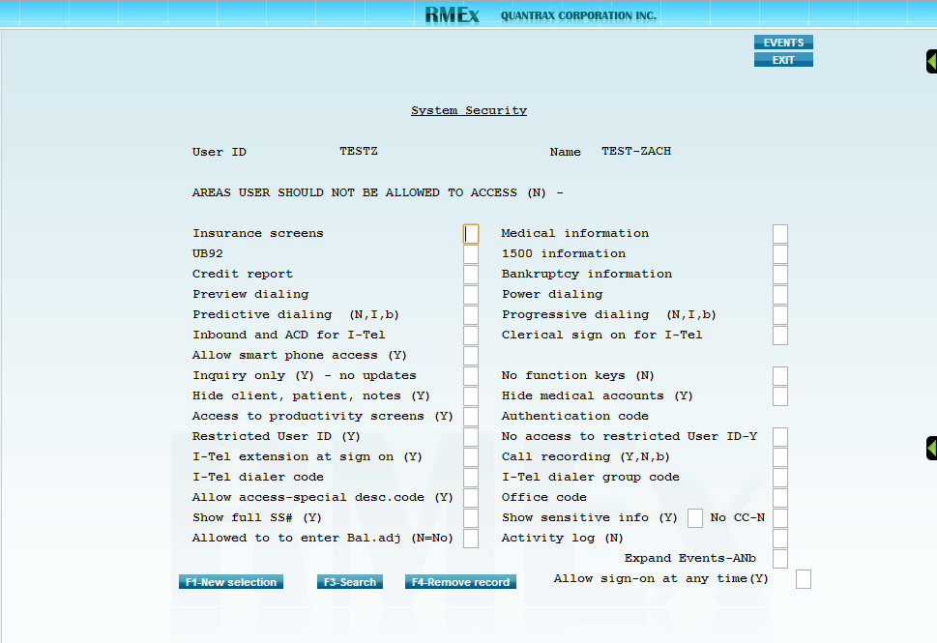
System Security
(Option 1 – System Control Menu, Option 1 – System security, Option 1 – System security) then enter the User ID being set up to use the dialer
Front page has no I-Tel or dialer related fields
Back page has I-Tel and dialer related fields
Preview dialing
Leave this field blank to allow the User ID to use this dialing type
Enter a N here to disallow access to this dialing type
Power dialing
Leave this field blank to allow the User ID to use this dialing type.
Enter a N here to disallow access to this dialing type.

Slide 8
System Security
(Option 1 – System Control Menu, Option 1 – System security, Option 1 – System security) then enter the User ID being set up to use the dialer
Predictive dialing
Leave this field blank to allow the User ID to use this dialing type.
Enter a N here to disallow access to this dialing type.
Enter an I in this field to allow outbound calls via this dialing type while preventing inbound calls from being received.
Progressive dialing
Leave this field blank to allow the User ID to use this dialing type.
Enter a N here to disallow access to this dialing type.
Enter an I in this field to allow outbound calls via this dialing type while preventing inbound calls from being received.

Slide 9
System Security
(Option 1 – System Control Menu, Option 1 – System security, Option 1 – System security) then enter the User ID being set up to use the dialer
Call recording (Y,N,b)
Enter a Y here to turn on call recording for the User ID.
Enter a N here to turn off call recording for the User ID.
Leave this field blank to allow call recording control at the dialer or campaign levels.
I-Tel dialer code
Should be “A” by default when only a single dialer is installed.
I-Tel dialer group code
This option allows you to assign the User ID to a specific dialer group. A dialer group allows you to group agents together based on the criteria of your choosing (pre-collect, for example).

Slide 10
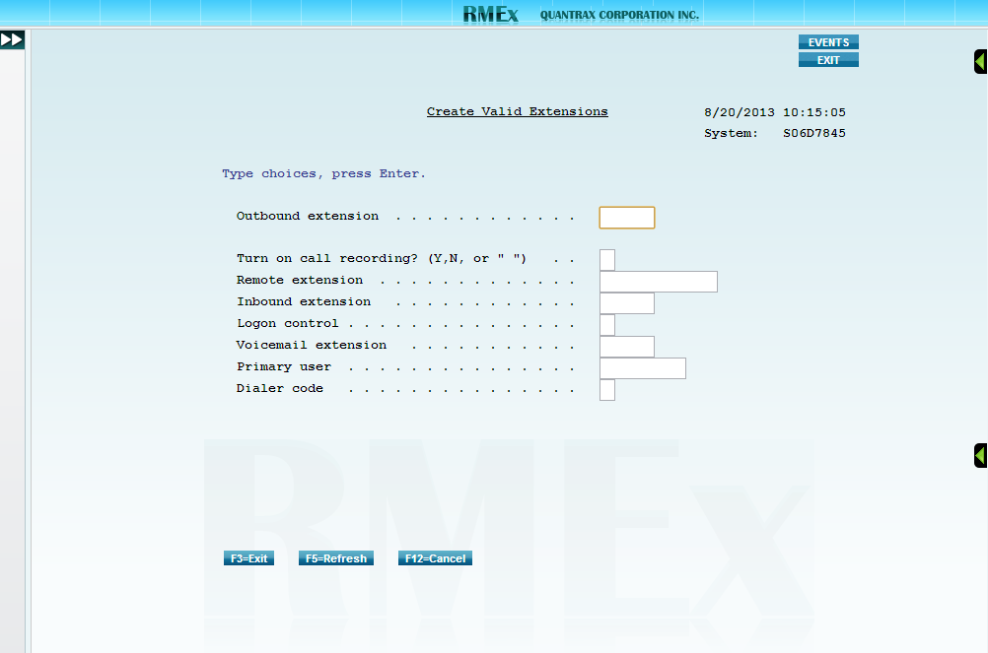
Valid Extensions
(Option 2- Management menu, Option 15 – I-Tel options menu, Option 16 – I-Tel System Control options, Option 1 – Valid extensions)
Press F6 to create a new extension.
Outbound extension
Enter the extension already set up in the company PBX.
Call recording (Y,N,b)
Enter a Y here to turn on call recording for the extension.
Enter a N here to turn off call recording for the extension.
Leave this field blank to allow call recording control at the System Control level.
Remote extension
This option allows a user to use the dialer while working remotely by calling the phone number specified in this field rather than the outbound extension.
Enter anything unique in the Outbound extension field.
Enter the remote telephone number for the user in the Remote extension field.

Slide 11
Valid Extensions
(Option 2- Management menu, Option 15 – I-Tel options menu, Option 16 – I-Tel System Control options, Option 1 – Valid extensions)
Inbound extension
Enter the PBX extension for the inbound.
Dialer code
Should be an A when only 1 dialer is installed.

