Slide 1
I-Tel Training System Security
© Copyright 2013 – Quantrax Corporation, Inc
Notes:
(Preparing for RMEx Conversion)

Slide 2
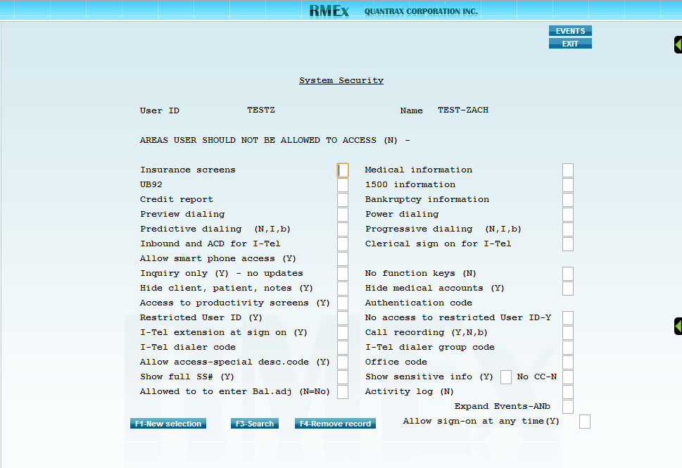
System Security
(Option 1 – System Control Menu, Option 1 – System security, Option 1 – System security) then enter the User ID being set up to use the dialer
Front page has no I-Tel or dialer related fields
Back page has I-Tel and dialer related fields
Preview dialing
Leave this field blank to allow the User ID to use this dialing type
Enter a N here to disallow access to this dialing type
Power dialing
Leave this field blank to allow the User ID to use this dialing type.
Enter a N here to disallow access to this dialing type.

Slide 3
System Security
(Option 1 – System Control Menu, Option 1 – System security, Option 1 – System security) then enter the User ID being set up to use the dialer
Predictive dialing
Leave this field blank to allow the User ID to use this dialing type.
Enter a N here to disallow access to this dialing type.
Enter an I in this field to allow outbound calls via this dialing type while preventing inbound calls from being received.
Progressive dialing
Leave this field blank to allow the User ID to use this dialing type.
Enter a N here to disallow access to this dialing type.
Enter an I in this field to allow outbound calls via this dialing type while preventing inbound calls from being received.

Slide 4
System Security
(Option 1 – System Control Menu, Option 1 – System security, Option 1 – System security) then enter the User ID being set up to use the dialer
Call recording (Y,N,b)
Enter a Y here to turn on call recording for the User ID.
Enter a N here to turn off call recording for the User ID.
Leave this field blank to allow call recording control at the dialer or campaign levels.
I-Tel dialer code
Should be “A” by default when only a single dialer is installed.
I-Tel dialer group code
This option allows you to assign the User ID to a specific dialer group. A dialer group allows you to group agents together based on the criteria of your choosing (pre-collect, for example).

