Slide 1
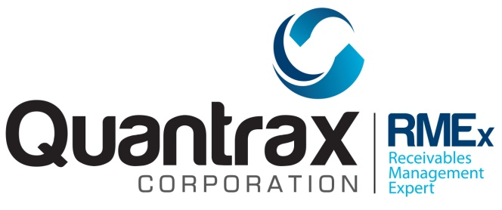
I-Tel Licenses

Slide 2
The Different Types of License
Predictive
Preview
IVR Outbound
IVR Inbound
Call Recording

Slide 3
Predictive License
Can be used for any type of dialing and call
Can be used by a live or a virtual agent

Slide 4
Preview License
Can be used only for preview dialing and inbound calls routed to an agent
Can be used only by a live agent

Slide 5
Outbound IVR License
Can be used for any type of dialing (outbound or inbound)
Can be used only by a virtual agent

Slide 6
Inbound IVR License
Can be used only for inbound calls
Can be used only by a virtual agent
Assigned only when a call is in progress

Slide 7
Call Recording License
Used only when a call is actually connected
Calls transferred to PBX are still connected and still use a license
Can be used for inbound or outbound calls, with live or virtual agents

Slide 8
The License Monitor
Started from the Windows start menu
Normally started automatically
Displays current license usage
Historical information available by scrolling down

Slide 9
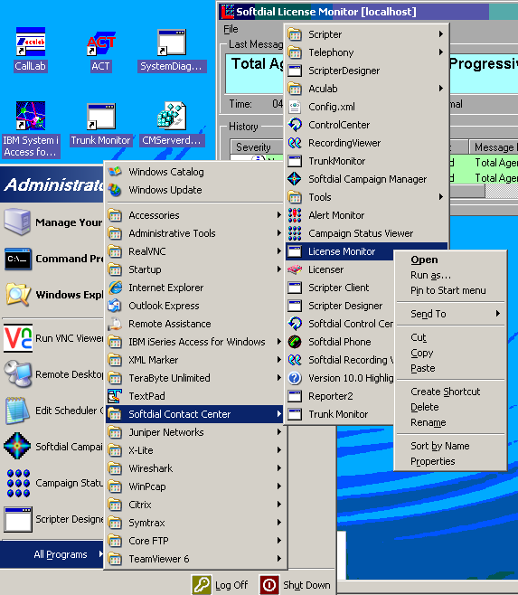
The License Monitor

Slide 10
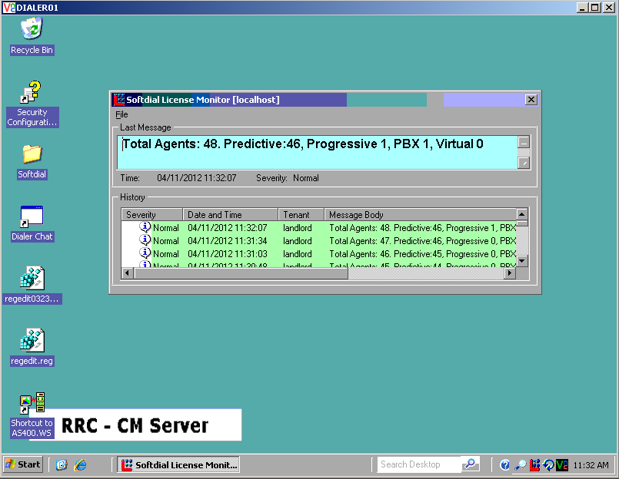

Slide 11
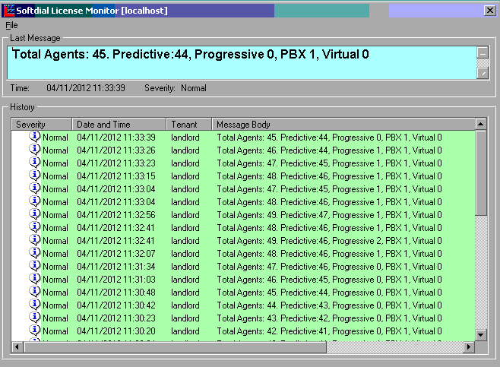

Slide 12
License Key
Can be either hardware or software
Software licenses are temporary
Hardware (dongle) licenses are transferable

Slide 13
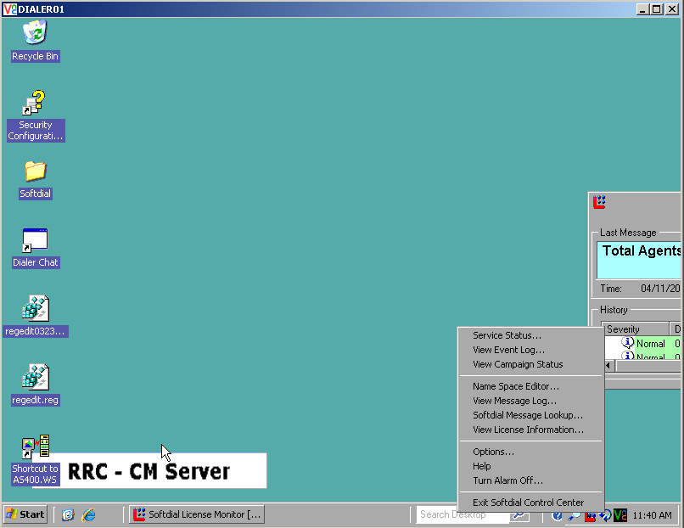

Slide 14
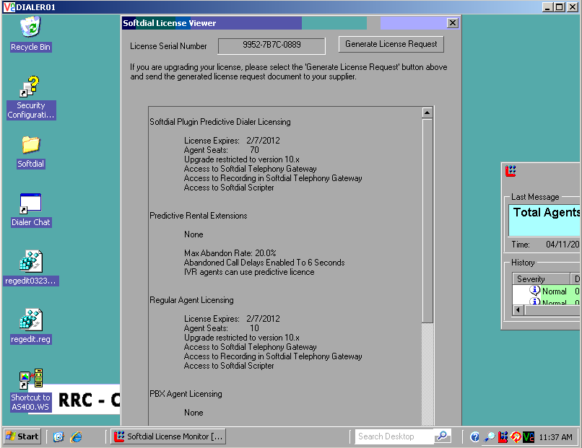

Slide 15
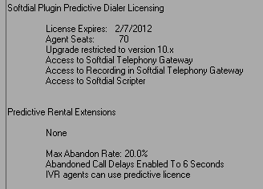

Slide 16
License Usage
The system determines the function being performed and assigns the lowest applicable license
IVR (scripter) or live
Predictive or preview

Slide 17
License Shortages
If license has EXPIRED, a warning message will be issued first thing in the morning to all agents
If license usage exceeds the limit, the warning message will be issued only to the excess agents
Stop IVRs!
Buy licenses!

Slide 18
Considerations
Cost vs flexibility
Predictive vs preview
Inbound IVR vs Outbound IVR
Dedicated inbound virtual agents
Call recording for PBX launched calls

Slide 19
License Costs
Predictive $1,900
Preview $1,200
IVR Outbound $1,500
IVR Inbound $1,200
Call Recording $300

Slide 20
I-Tel Licenses
Thank you
Quantrax April 2015

