Slide 1
I-Tel
Playing Messages

Slide 2
Message Features
Generic Messages
Customised Messages
Attended Playback
Unattended Playback
Available in all dialing modes

Slide 3
Message Options
Can be a generic or customized message
Over 1000 messages available
Messages are pre-recorded
The message can play the mini-miranda, advise that the call is being recorded, or provide any additional information

Slide 4
Script Options
The agent can transfer the consumer to a script by transferring the consumer to a hunt group
The script can play the mini-miranda, advise that the call is being recorded, or provide any additional information
The script can be the IVR payment portal!

Slide 5
Message Set-Up Tasks
Record a message…..
’This is Quantrax. Please call us at 301 657 2084’
Place the message on the STG server
Assign a ‘symbolic name’
Assign a message code on RMEx
Train the agents

Slide 6
Sample Messages
‘This call is being recorded for quality assurance purposes’
‘This call is from a debt collection agency’
‘This is John Doe. I’m calling from Quantrax about your account with your local hospital. Please call me at 301 657 2084’

Slide 7
Sample Scripts
Standard generic script
Outbound TTS script
Payment Portal script

Slide 8
Setting up the Message

Slide 9
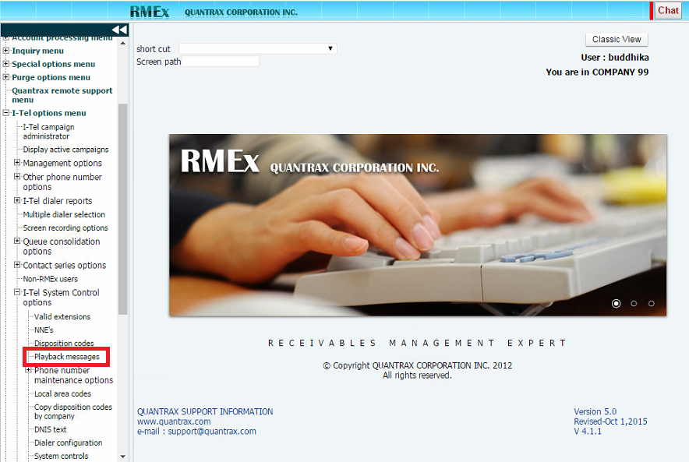

Slide 12
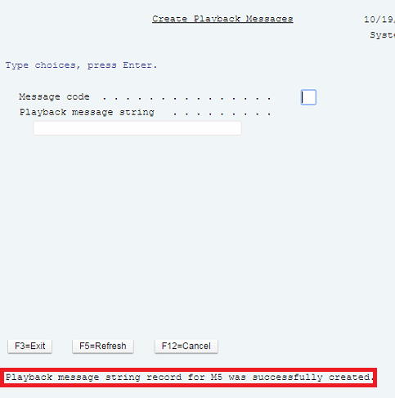

Slide 14
Playing the Message

Slide 15
Agent Options
Play the message
Plays the message while the agent is still on the call
Agent has the option to stop the message or terminate the call
Transfer to the message
Agent moves on to the next account
The dialer plays the message to the consumer and then terminates the call

Slide 22
Transferring to a Script

Slide 23
Agent Options
Transfer to a script
Agent must know the hunt group for the relevant script
800001 – Standard generic outbound
800006 – Standard TTS outbound
800066 – Payment Portal
Agent moves on to the next account
The dialer plays the message to the consumer and then terminates the call

Slide 24
The Benefits – Immediate
8.00% Increase in accounts worked
11.21% Increase in RPCs
7.83% Increase in attempts

Slide 25
The Benefits - Sustained
20.99% Increase in accounts worked
9.49% Increase in RPCs
23.77% Increase in attempts

Slide 26
I-Tel Message Transfer
Allows uniformity in communicating with consumers
Allows agents to play messages instead of talking directly to the consumer
Allows agents to move on to the next account while the dialer is leaving a message

Slide 27
I-Tel Script Transfer
Allows uniformity in communicating with consumers
Allows agents to delegate standard tasks to virtual agents, such as taking payments!
Allows agents to move on to the next account while the dialer is dealing with a consumer
Virtual agents will free up time for live agents, allowing them to focus on generating revenue

Slide 28
I-Tel
Message Transfer
Quantrax November 2016

