Slide 1
Setting Up a Campaign on the Dialer Server
Notes:
(Preparing for RMEx Conversion)

Slide 2
Introduction
Once you have created a campaign on RMEx, you need to set up and configure the same campaign in ‘Campaign Manager’ on the dialer server. The campaign name on the dialer server MUST be the same as the name on RMEx, and the TQ file created by RMEx must be refenced in the campaign you set up on the dialer server. The campaign configuration on the dialer CM server contains all the information needed to successfully run the campaign, including the file containing the records to be dialed, how long the phone should ring, whether the call should be recorded, what CLID should be displayed, and many other details.

Slide 3
Getting Started
There are two ways to create a campaign on the dialer server:
Windows client software. This application is available on the dialer CM server and can be downloaded to user PCs.
Web client software. This application is available as a web service and can be run on any PC with access to the dialer CM server.

Slide 4
Two Interfaces
The interfaces are slightly different but the functionality is identical and the screens contain the same parameters. Note that the Campaign Manager service must be running on the dialer CM server for the tenant for whom you are creating or changing a campaign.

Slide 5
Campaign Manager Service must be Running

Slide 6
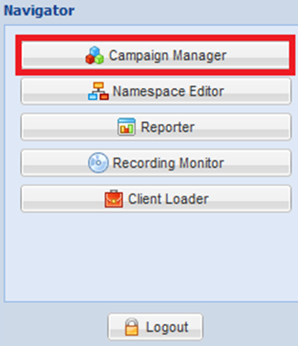
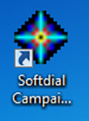
Starting Campaign Manager

Slide 7
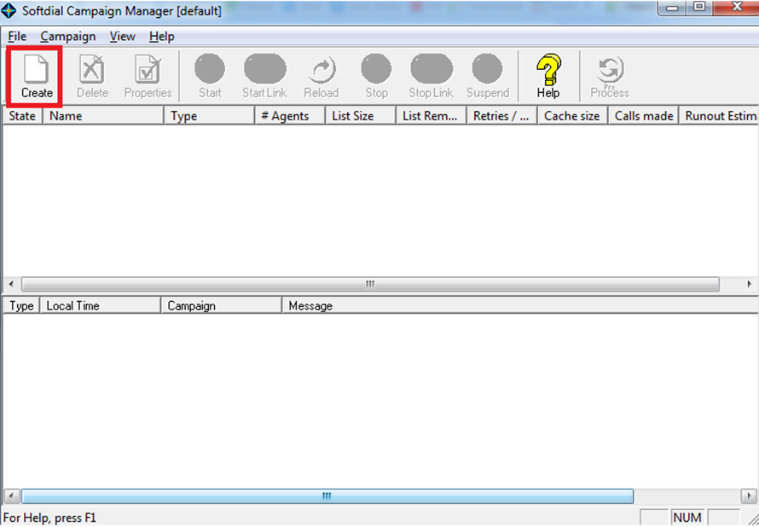
The Initial Screen

Slide 8
The Initial Screen

Slide 9
Default Campaigns
Normally, Quantrax will set up two default campaigns: one for a predictive campaign with live agents and one for an IVR campaign with virtual agents. You can use these campaigns as templates for creating additional campaigns and this will save time in the future. The default campaigns contain the values recommended by Quantrax for the type of campaign you are running. Note that if you change these values, you may get undesirable results.

Slide 10
Default Campaigns
In the examples below, we are creating the default campaign. Note that a default campaign MUST begin with an underscore. If you are creating a different campaign that you want to have the same values as a default campaign, then you must place the name of the default campaign, preceded by the underscore, in the ‘Campaign template’ field below:

Slide 11
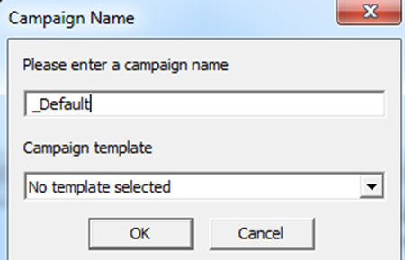
Entering a Campaign Name

Slide 12
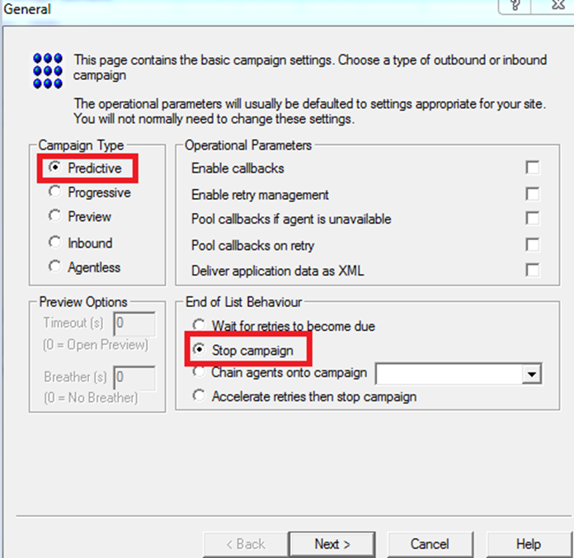
The General Tab

Slide 13
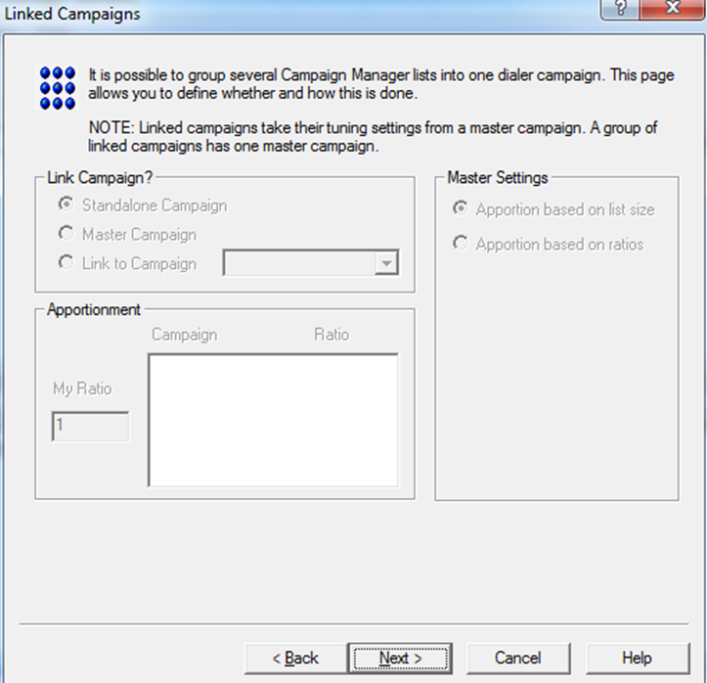
The Linked Campaigns Tab

Slide 14
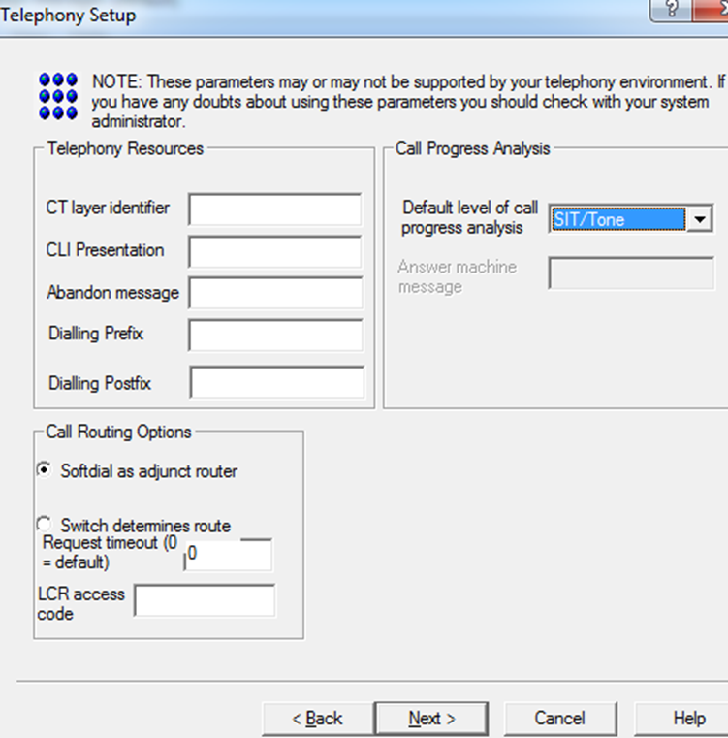
The Telephony Setup Tab

Slide 15
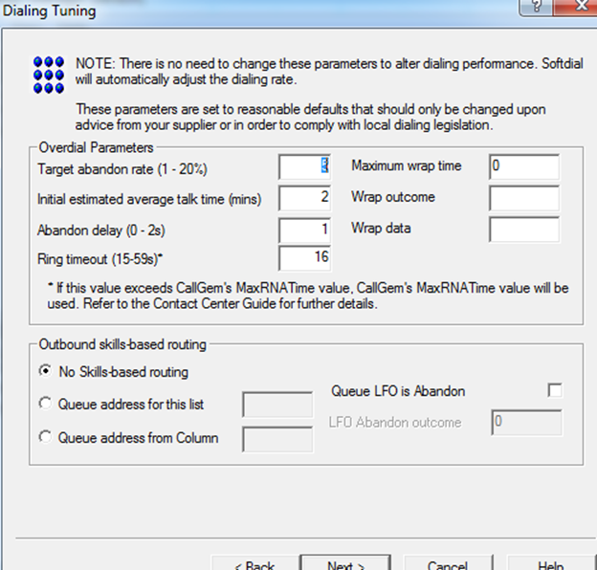
The Dialer Tuning Tab

Slide 16
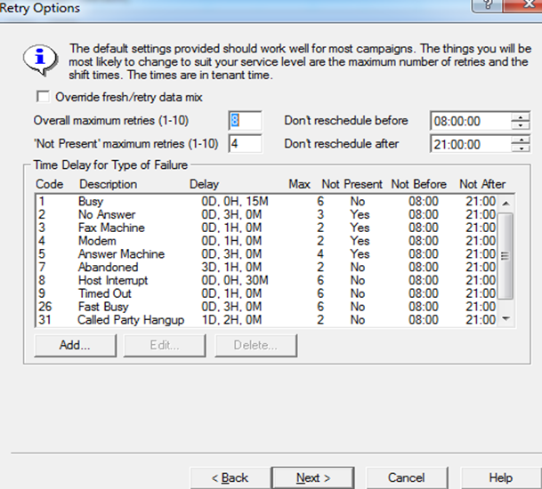
The Retry Options Tab

Slide 17
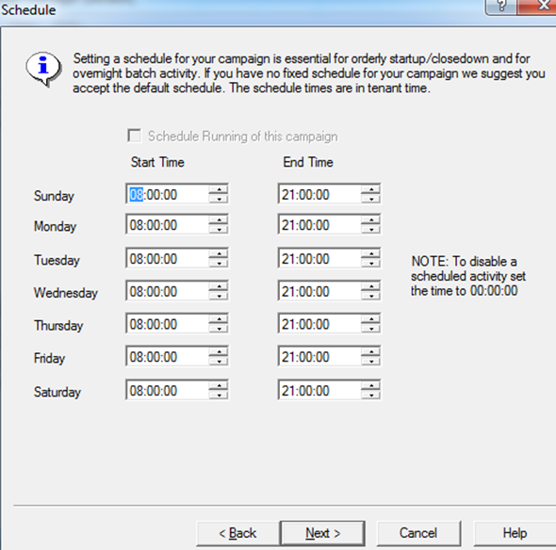
The Schedule Tab

Slide 18
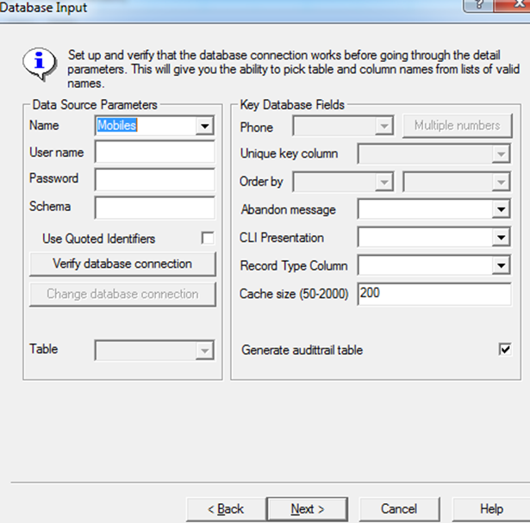
The Database Input Tab

Slide 19
The Database Input Tab
Data Source Parameters
Name: itel
User Name: ITELODBC Password: ITELODBC

Slide 20
The Database Input Tab
Verify Database Connection: Click on this link to verify that you are authorized to retrieve records from the database.
You must verify the database connection in order to proceed.

Slide 21
The Database Input Tab
Table: Click on the Down Arrow and select the TQ file from which you want to call records. You can find the TQ file name by looking at the campaign in Campaign Administrator in I-Tel (the first step in creating a campaign).
It will generally be formatted like this: TQAxxxxxIT.

Slide 22
The Database Input Tab
Telephone number column: QIPHN
Unique Key Column: QUNIKY
Order by: ascending and QSEKEY
Cache Size (50-2000): 50
Generate Audit Table: MUST be blank

Slide 23
The Database Input Tab
Multiple Numbers
Do not use!

Slide 24
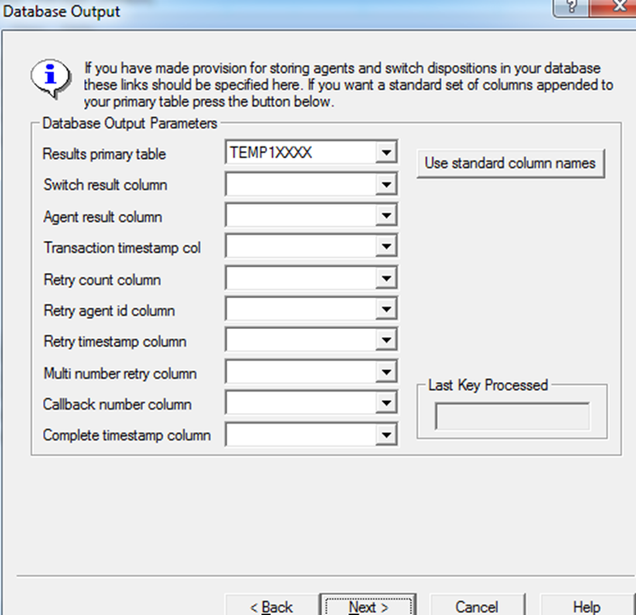
The Database Output Tab

Slide 25
The Database Output Tab
Results primary table: This MUST be same mini-queue file as specified on the Database Input tab. Failure to ensure that these two values are the same is a common cause of dialer ‘problems’ and database corruption.

Slide 26
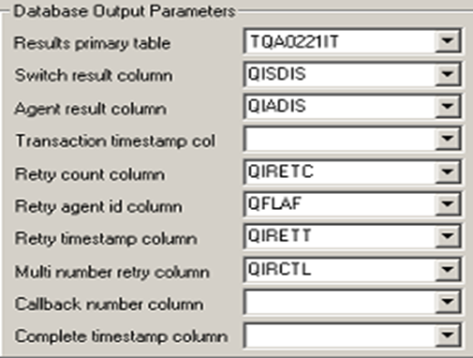
The Database Output Tab

Slide 27
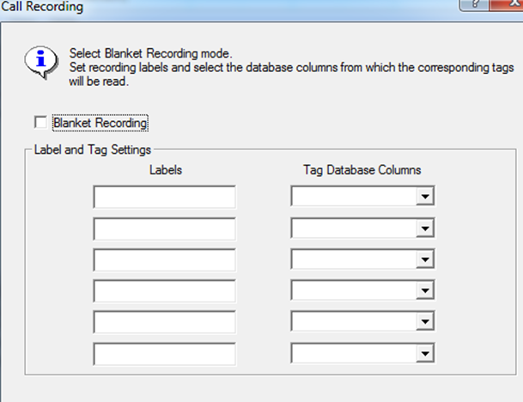
The Call Recording Tab

Slide 28
The Call Recording Tab
Check the field “Blanket Recording” if you want to record calls for this campaign.

Slide 29
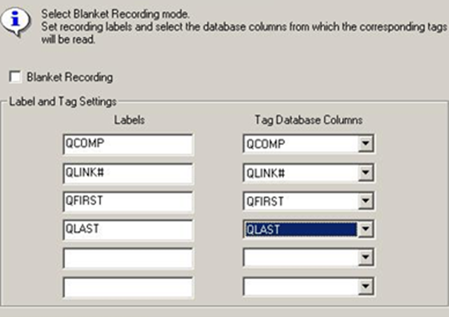
The Call Recording Tab
Set up the Labels and Tag Database Columns as displayed

Slide 30
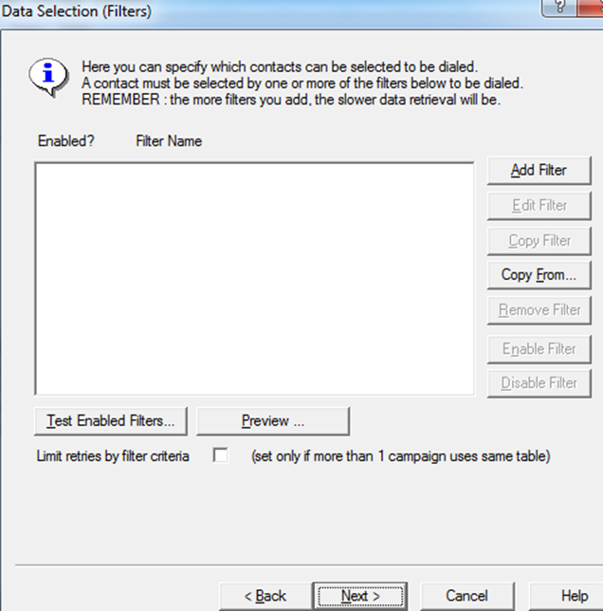
The Filters Tab

Slide 31
The Filters Tab
Filters are no longer required

Slide 32
Setting Up a Campaign on the Dialer Server The End
Notes:
(Preparing for RMEx Conversion)

