Slide 1
Itel Inbounds

Slide 2
Benefits
Allow calls to be routed to the relevant agents
Allows for inbound calls to be recorded
Provides screen pop for known phone numbers
Notation on files of inbound details
More effective methods for inbound call distribution

Slide 3
Blended Inbounds
Allows for inbound calls to be received on the same line as outbound calls
Available only while agents are in predictive
Gives agents inbounds calls while in wait mode for outbound calls
Inbounds answered very quickly
Inbound calls are directed to “INBOUND” campaign

Slide 4
Second Ext. Inbounds
Inbound calls that are directed to an agents second extension
Two lines are required with a different extension number for each line
Ideal for when agents are in preview
Agent puts outbound line on hold while on inbound call
Screen pop accessible through Inbound List (agents required to press ESC)
Inbound calls are directed to “system” campaign

Slide 5
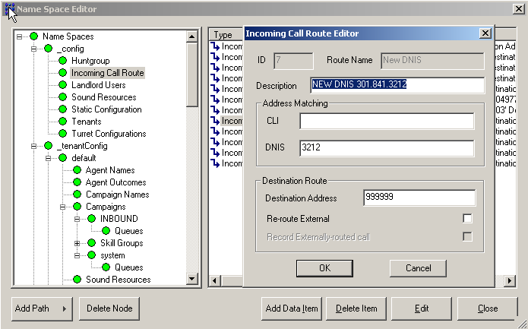
Namespace

Slide 6
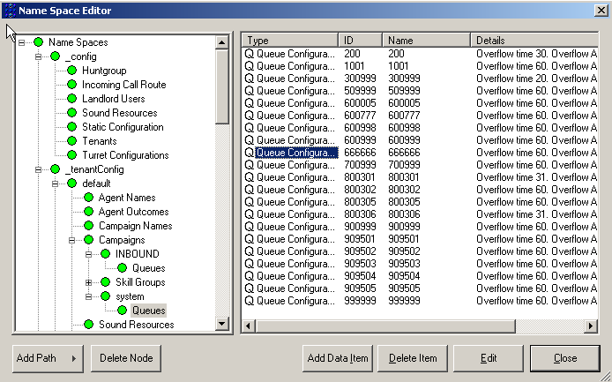
Hunt Groups

Slide 7
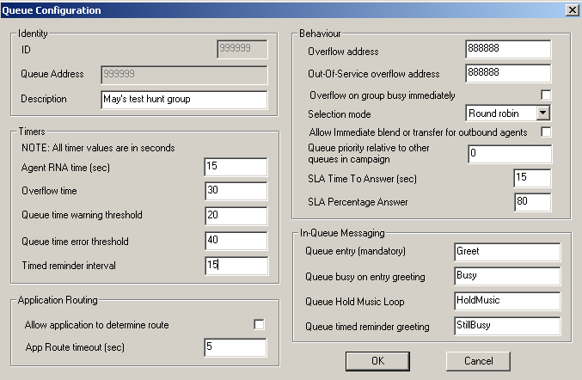
Queue Configuration

Slide 8
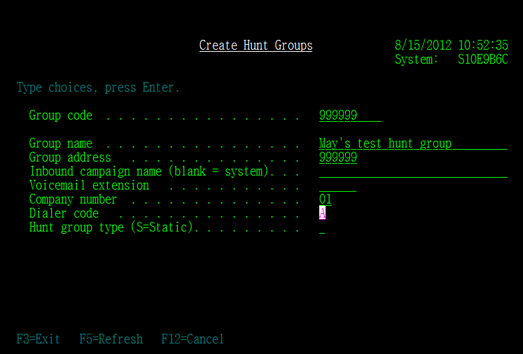
RMEX Hunt Group

Slide 9
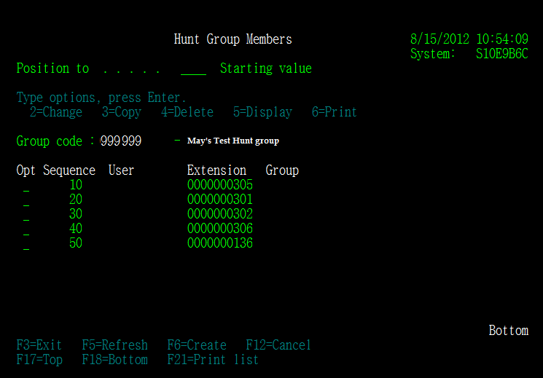
Hunt Group Members

Slide 10
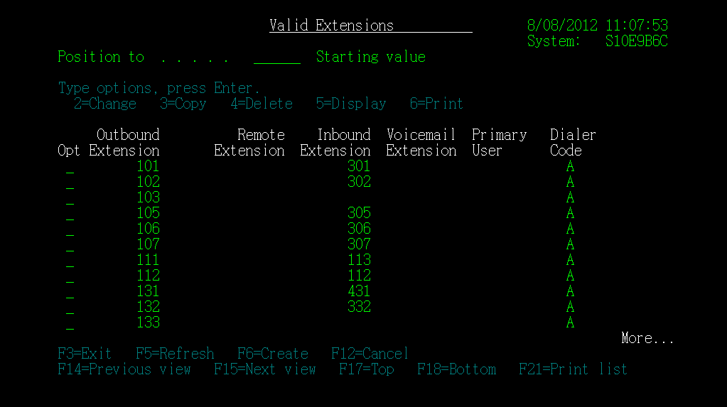
Creating Valid Extensions

Slide 11
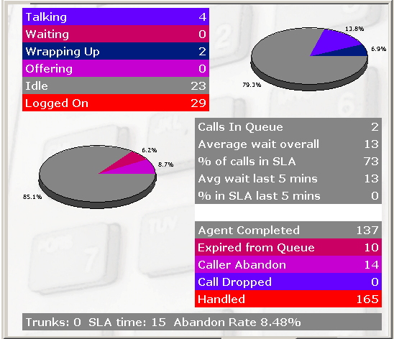
Monitor Inbounds (blended)

Slide 12
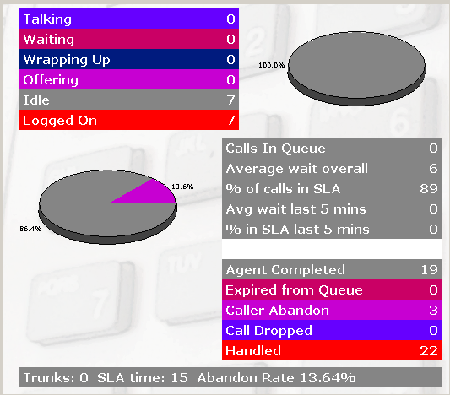
Monitor Inbounds (system)

Slide 13
Inbound Calls to IVR
Quantrax has two standard inbound scripts
Receptionist Script
Payment Portal Script
IVR runs all day even when agents are gone

Slide 14
Itel Inbounds Thank You
Quantrax 2016

