Slide 1
The Dialer Console
A new way to manage virtual agents

Slide 2
Dialer Console Functions
Starts, stops and kills campaigns
Displays basic campaign information
Kills agents
Changes an agent’s campaign
Changes the script assigned to a campaign
Changes the number of virtual agents assigned to a campaign
Notes:
2

Slide 3
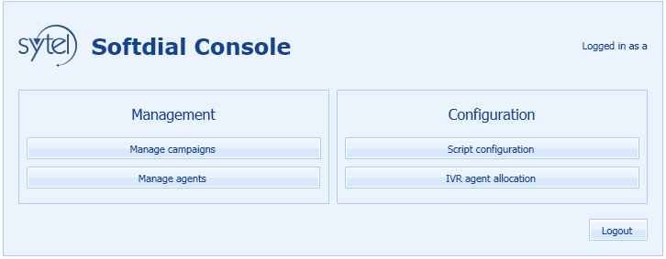
Dialer Console
http://<server address>:81/scripter/default/BrowserApp.xbap
Notes:
3

Slide 4
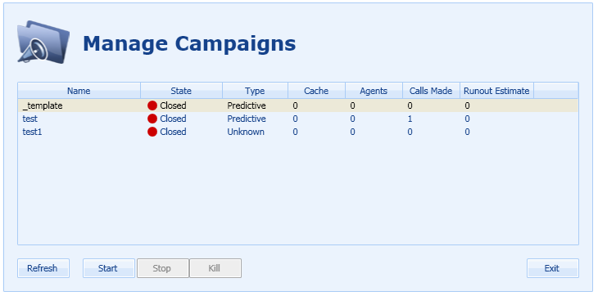
Managing Campaigns
Notes:
4

Slide 5
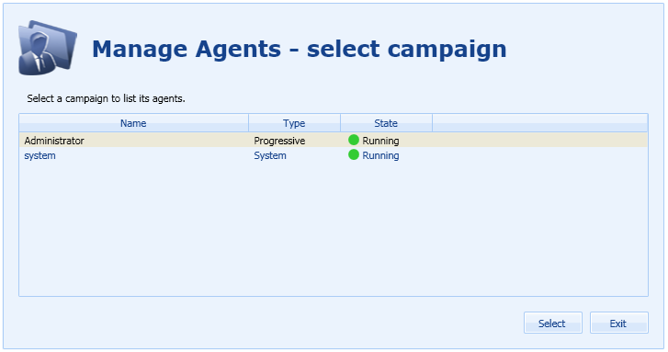
Managing Agents
Notes:
5

Slide 6
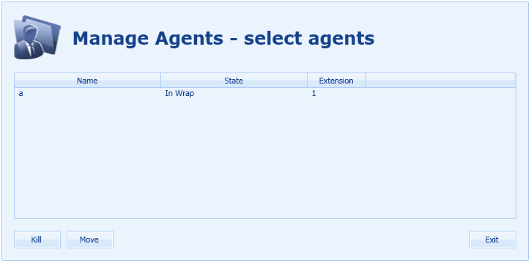
Managing Agents
Notes:
6

Slide 7
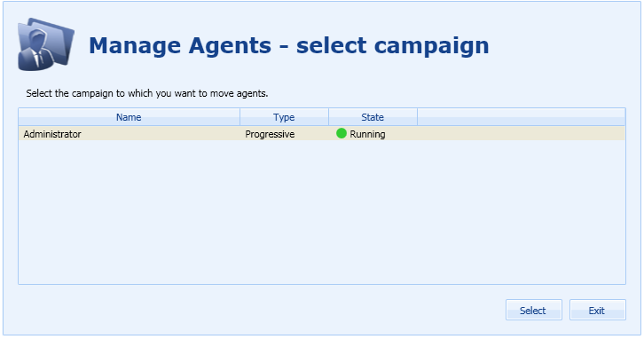
Moving Agents
Notes:
7

Slide 8
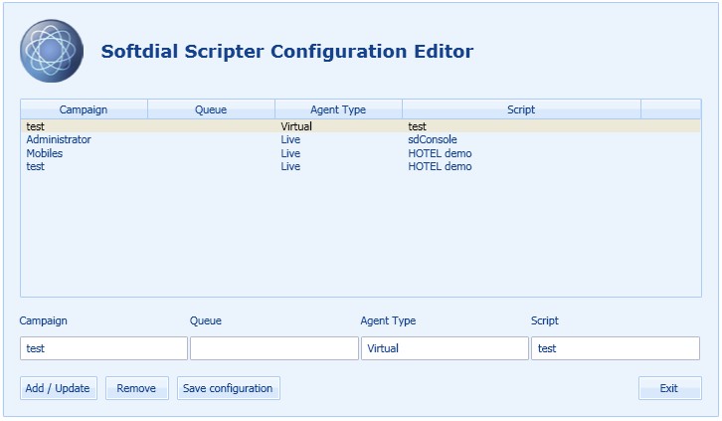
Changing Scripts
Notes:
8

Slide 9
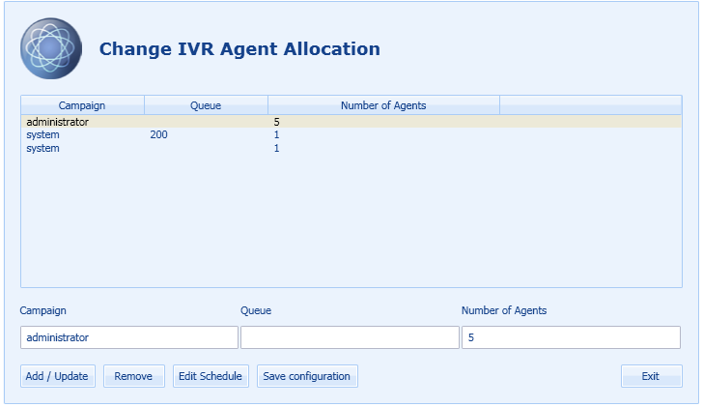
Changing the Number of Agents
Notes:
9

Slide 10
Dialer Console
Uses the existing scheduler configuration file BUT does not display information from that file UNLESS Dialer Console was used to add that information!
Notes:
10

Slide 11
Dialer Console
Allows dynamic changes to scripts and agents.
A great new way to manage your virtual agents…………but be careful!
Notes:
11

