Slide 1
Graphical User Interface (GUI) & Collector Desktop Q & A
© Copyright 2012 – Quantrax Corporation, Inc
Notes:
(Preparing for RMEx Conversion)

Slide 2
RMEx Graphical User Interface (GUI)
Modernization
PC in place of dumb terminal
Additional fields on each screen
Better navigation, one click away from data, dashboards, graphs
Reports on smart phones and tablets
Letters sent directly from your software
Software install not required on end user PCs, runs directly from Internet Explorer
Foundation for future upgrades and functionality
Benefits
Increases productivity
Lowers training costs
Facilitates compliance
Extends life of your software

Slide 3
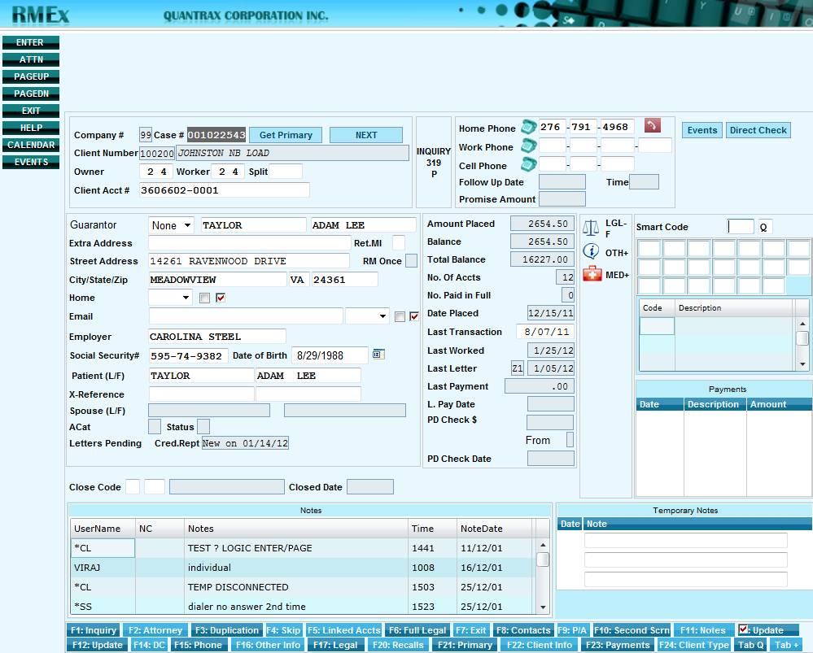
GUI Account Details Screen

Slide 4
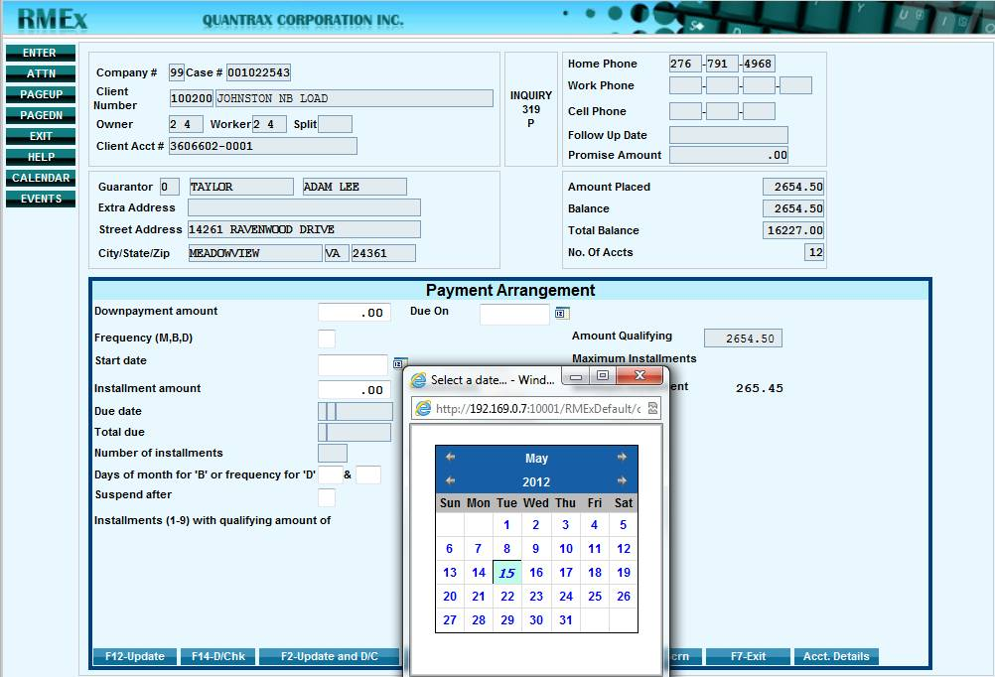
GUI Payment Arrangement Screen

Slide 5
GUI Dashboard

Slide 6
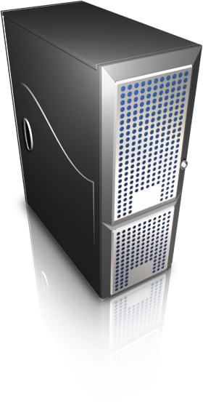
*RMEx GUI System Configuration
QServer (Windows Server) needed for GUI functionality. Purchase from Velocite contact: Eric Schroeder
 iSeries AS400, verify you have correct configuration for GUI:
“engine” for GUI functionality
Internet Information Services (IIS)
System iAccess (formerly Client Access)
.Net 3.5
ASP.NET
*WebSphere Application Server (WAS)
IBM Operating System
Current PTF’s
WebSphere Application Server (WAS)
JAVA
HTTP Server
RMEx GUI
*WebSphere Application Server (WAS) on QServer is only needed for clients with over 50 user **System requirements and other details can be found in the email sent to you on 5/14

Slide 7
Pricing
Graphical User Interface
License | Cost
Up to 10 Users | $2,000
Up to 25 Users | $3,000
Up to 50 Users | $5,000
Up to 75 Users | $6,000
Up to 100 Users | $7,500
Over 100 Users (per user) | $80
Enterprise License | $50,000
QServer (Windows Server) – from Velocite
Have Quantrax build the Server, costs = $1,500
Load applications after delivery will incur a fee of $500 per application
Purchase the server from Velocite, the cost for this server is $2,790.00
Order the server from Velocite, even if you would like to install the products
NOTE: For clients who have 50 users or less, a single Windows server will be able to run all of the
applications listed

Slide 8
2012 RMEx GUI Timeline
May 15th – 31st Purchase QServer & GUI 2.0
June 1st GUI purchase price increase
June – July * Schedule and install GUI 2.0
Late October User Conference in St. Louis!
January - April successful client GUI installs
Late June release of GUI 3.0
* The implementation will take approximately 2 – 3 weeks from the time you order your QServer

Slide 9
Summary
Purchase QServer
Verify required components on AS400
Schedule install of RMEx GUI (done by Quantrax Team)
Questions & Answers

