Slide 1
Transforming Automation Into Profits Jamie Horrell Day 3

Slide 2
Day 3 - Agenda
Module 9: Automating The Collection Process for Efficiency and Consistency

Slide 3
Module 9: Automating The Collection Process for Efficiency and Consistency
What processes can I automate?
How can I avoid human error?
How to insure the correct actions happen at the correct time?
How can I maintain standards and consistency?
How to I enforce compliance?
How do I work accounts intelligently?
How do I keep from over OR under-working accounts?
Solution in RMEx
System Control > Smart codes (or SM in Ready for option)

Slide 4
What Is A Smart Code?
It is an Action! It is the collector telling the system what just occurred
They allow the agents to make the same decision that the manager or owner would make if THEY were working the account
They will help you in stopping the overworking and under working of accounts
They are user defined
They can behave differently based on clients, collectors, ACats (type of accounts), whether they are in a Contact Series or not
They can make decisions today based on what you may find in the future

Slide 5
How Can You Apply A Smart Code?
Can be applied to an account manually by a user
Can be applied by the system behind the scenes
A Smart code can apply a smart code

Slide 6
Examples : “Basic” Smart Codes
Call Residence Phone – No Answer
If a call (attempt) was made to the home number and there is no answer then automatically notate the and move to the next account
Debtor Dispute
If the balance is >100 then send to a manager

Slide 7
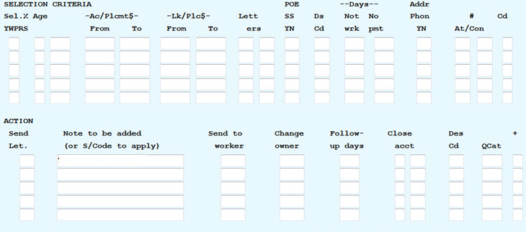
Write it / Say it in “Plain” English!
SELECTION CRITERIA = If an account meets certain conditions then . . .
AND
OR
OR
ACTION = THEN send a letter, note the account, send to a worker , change owner, follow up days, close account, adds description, or several other actions

Slide 8
RMEx Translation : “Basic” Smart Codes
Call Residence Phone – No Answer
Selection Criteria = If a call (attempt) was made to the home number AND there is no answer
Action = THEN automatically notate the and move to the next account
Debtor Dispute
Selection Criteria = If the balance is >100
Action = THEN send to a manager
Let’s create Smart Codes!

Slide 9
Module 9: Interactive Exercise
Let’s create the following Smart Codes together:
Typical Smart Code for Collectors
If the balance is <10 then close the account with a close code E
If the balance is 10 to 25 and there has been one attempt, close with E
If the balance is 25 – 100 and there has been 6 attempts, close with E
Do we want the collector to be able to send a letter?
Duplicate this smart code for linked accounts
Do we want to advance this account immediately OR have the ability to apply another smart code
Debtor Dispute Smart Code
If the balance is <100 put a debtor dispute description code on account then close it
If the balance is >100 send to a manager to review
Force the collector to add a note
Do we want to allow them to put in a follow-up date?
Do we want to advance this account immediately OR have the ability to apply another smart code

Slide 10
Smart Codes (Automation → Profit) . . . .
How does this make you profitable?
Your new rookie collector can work like an experienced collector
Accounts will not be overworked and under worked
Accounts are being worked by the right person at the right time
Due Diligence! (meet your client’s needs)
Prevent Compliance Issues
Accelerates “working accounts”

Slide 11
Day 3: Homework
Use Company 99 on your system
Configure the system with the following:
Create a Smart code the collectors will use:
When they call a debtors residence and there is no answer
Checks if the debtor has more than one account, that you notate all accounts
Prevents collector to enter any notes, send any letters and cannot to date the account
Once the collector has entered the Smart Code, it takes them to the next account
Give the collector the ability to enter an additional Smart Code before being presented with their next account
Create a Smart Code that a user can that will send a Final Demand Letter to the debtor
For this letter to be sent, the debtor must have a good address and has never received a Final Demand in the past

Slide 12
Day 3: Homework (continued)
Use Company 99 on your system
If a Final Demand is sent, you want to notate the account and date it for 14 days
The collector cannot send the letter manually
The collector cannot notate the account manually
The collector cannot date the account manually
The collector has the ability to enter an additional Smart Code before being presented with their next account

