Slide 1
RMEx Management Training: Loading New Business

Slide 2
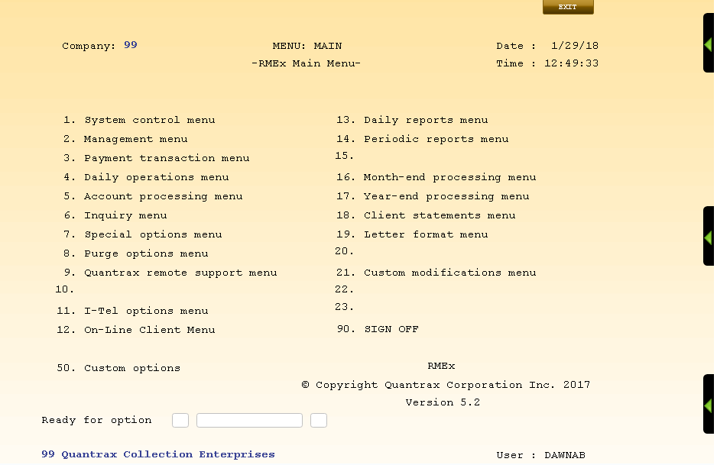
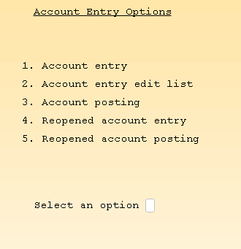
Entering Accounts Manually - Options For Smaller Companies
Daily operations menu > Account entry options
Enter, edit and post accounts
Allow clients to enter accounts directly into the system

Slide 3
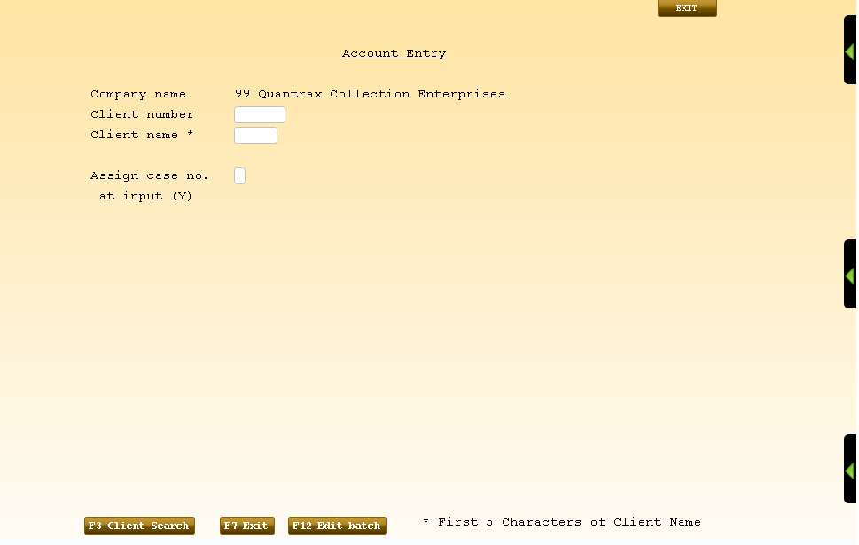
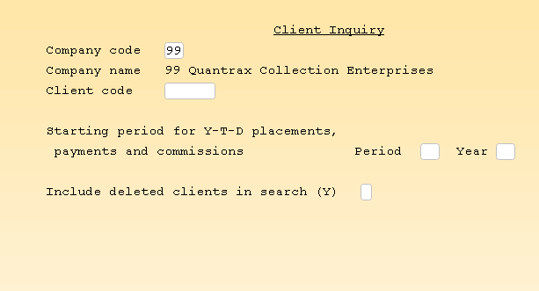
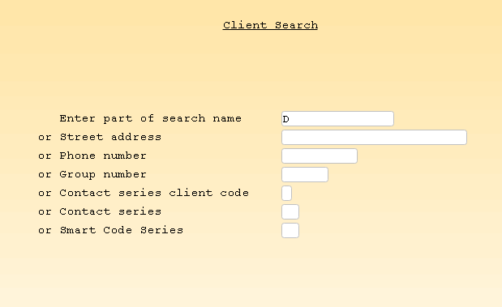
Entering Accounts Manually – Search For Client No.
Daily operations menu > Account entry options > F3 – Client Search
Type in client number and name or Search for it

Slide 4
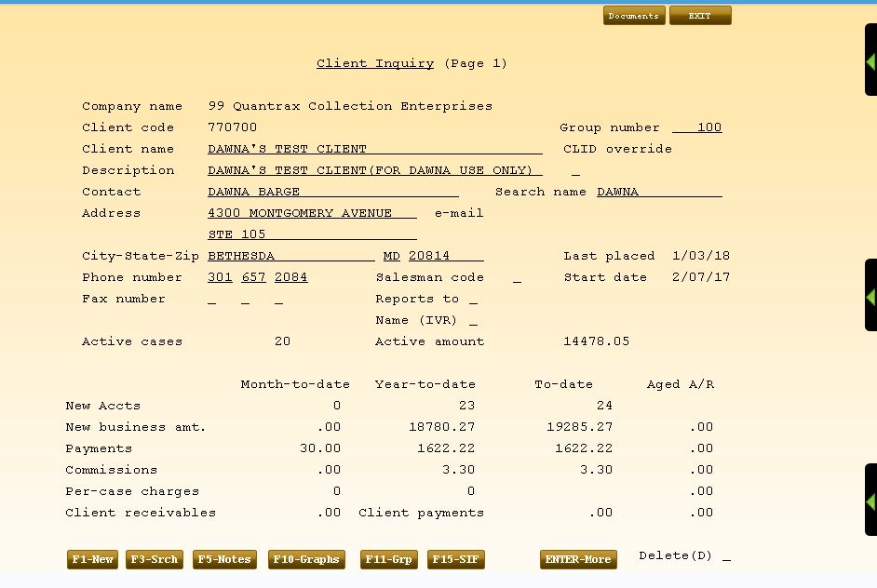
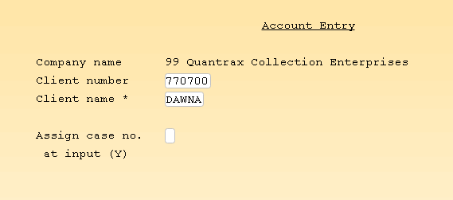
Enter New Account Information
At Client Inquiry Screen Press F7- Exit and press ENTER to display Account Entry screen

Slide 5
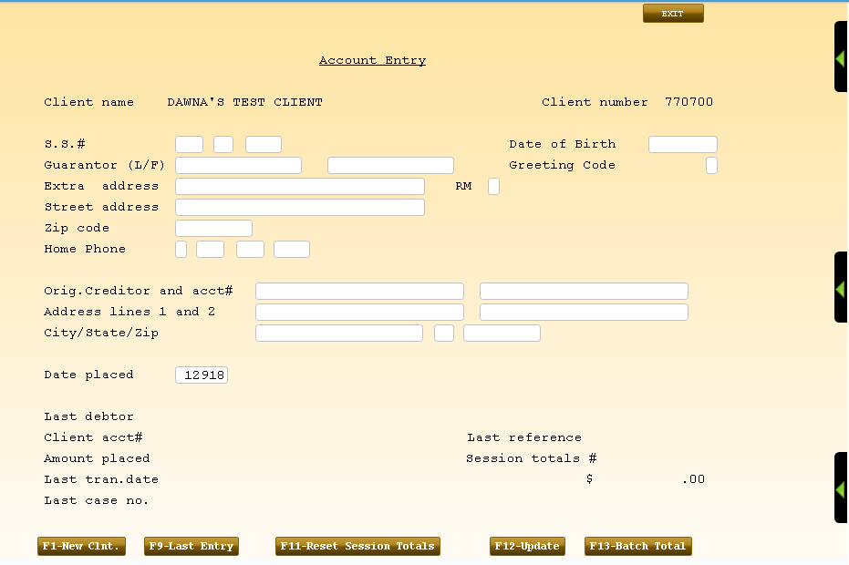
Account Entry Screen

Slide 6
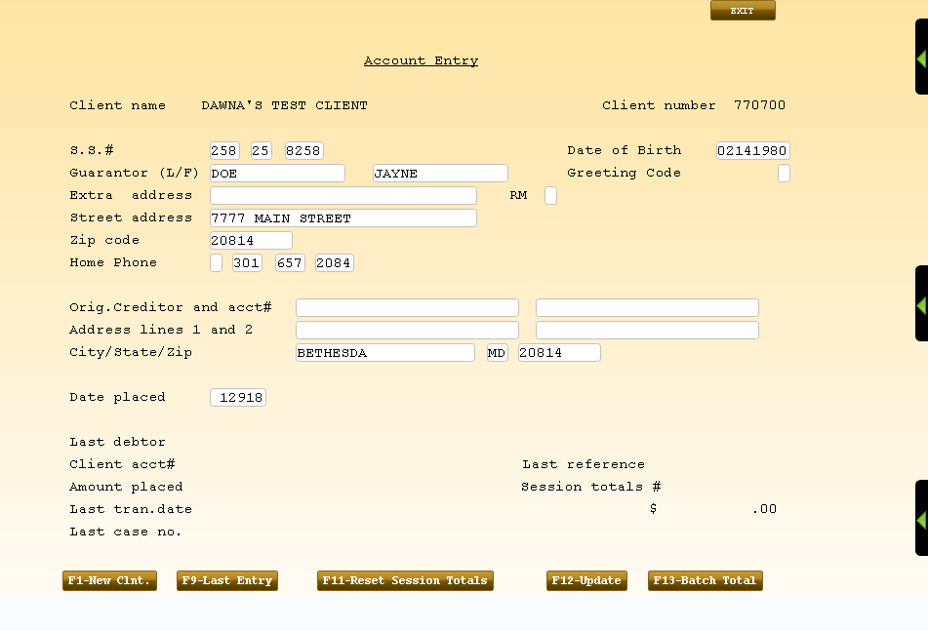
Account Entry Screen
Enter information and press Enter to move to next screen

Slide 7
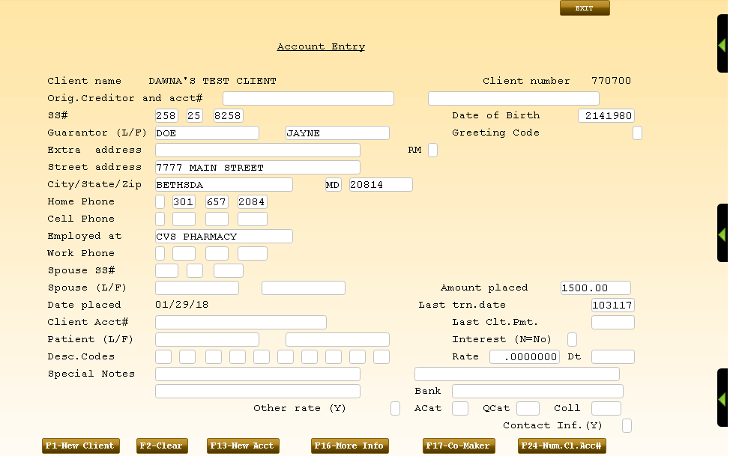
Account Entry Screen
Add more information
Press ENTER to move to next screen

Slide 8
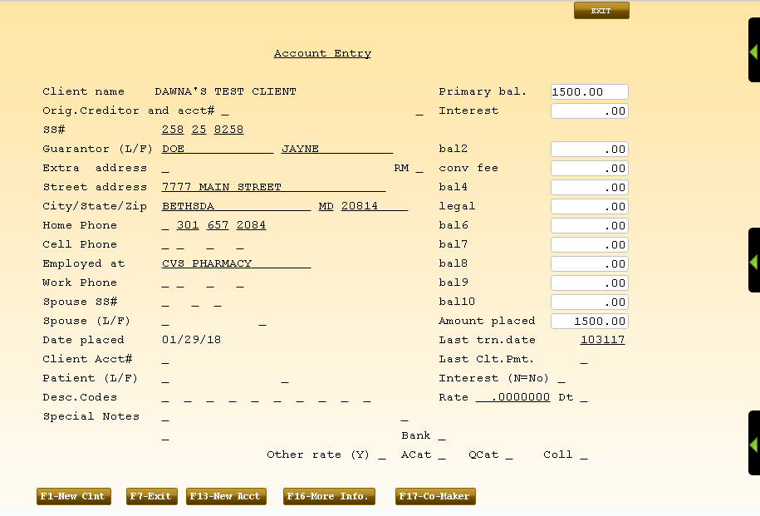
Account Entry Screen
Add primary balance and press ENTER to save

Slide 9
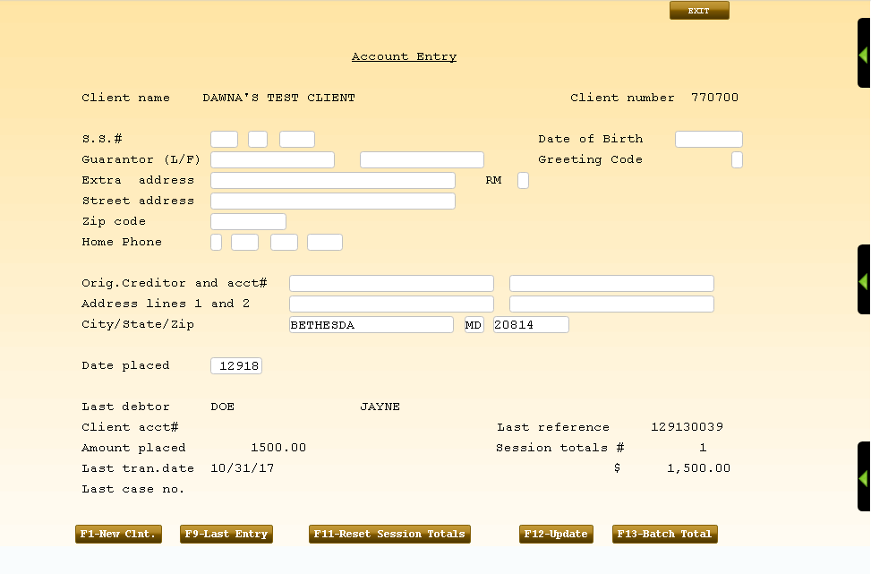
Account Entry Screen
Press F12 – Update

Slide 10
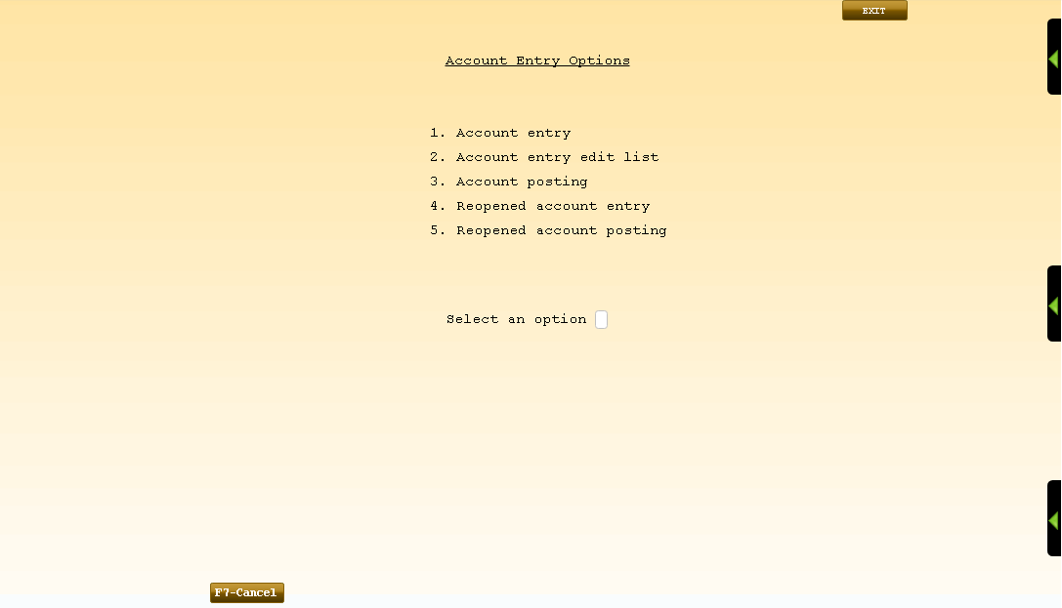
Next Steps
Account entry edit list
Account posting

Slide 11
RMEx Management Training: Loading New Business
Thank you!

