Slide 1
RMEx Management Training: Credit Reporting

Slide 2
Agenda
Credit Reporting in RMEx
Setting Up Credit Reporting on Your System
Setting Up Your Clients for Credit Reporting
Stopping Credit Reporting by State When Account is Placed
Establishing When To Start Credit Reporting New Accounts
Creating A Test or Live File To Send To Credit Bureau
Viewing Credit Reporting History
Credit Reporting An Account That Was Flagged to not be reported to the Credit Bureaus
Credit Reporting An Account That Was Stopped in Metro2 Controls or if Account Was Withdrawn
Notes:
Credit Reporting in RMEx
What Credit Bureaus can you report to with RMEx?
What is the Metro2 Report?
Understanding Credit Reporting Types
Exception Reporting
Balance Reporting
Setting Up Credit Reporting on your system
Setting Up the Credit Agency Identifier and your company’s ID Number (System Control 2 > Credit Reporting > New Credit Reporting (New Metro2 unpacked Standard format> pg. 1)
Selecting Types of Reporting
Credit Reporting for Bankruptcies and Disputes
Credit Reporting for Accounts Withdrawn by your Client (System Control 2 > Credit Reporting > New Credit Reporting> pg. 2)
Specifying Accounts To be Included or Omitted from Credit Reporting
Stopping Accounts From Being Reported in the Future
Identifying Balance Types to Be Included
Handling Credit Reporting for Accounts Settled in Full
Working with Credit Bureaus Skip Locator for Consumers
Reporting Fraud
Minors
Setting Up Your Clients for Credit Reporting (Management Menu > Client Update > pg. 4/pg. 7)
Stopping Credit Reporting by State When Account is Placed (System Control 2 > State Options)
Establishing When To Start Credit Reporting New Accounts (System Control 1> Contact Series Definition)
Creating A Test or Live File To Send To Credit Bureau (Periodic Reports Menu > Credit Reporting File
Creation > Metro2 TEST file creation)
(Periodic Reports Menu > Credit Reporting File Creation for Metro2 format)
Viewing Credit Reporting History (Periodic Reports Menu > Credit Reporting for (New Metro2) History Run)
Credit Reporting An Account That Was Flagged to not be reported to the Credit Bureaus (Account Details – Remove Description Code)
Credit Reporting An Account That Was Stopped in Metro2 Controls or if Account Was Withdrawn (System Control 1 > Smartcodes – pg. 7) (Account Details > Apply the Smartcode)

Slide 3
Credit Reporting in RMEx
Credit Bureaus
Equifax
Trans Union
Experian
Innovis
Notes:
The process by which credit reporting agencies/credit bureaus are used to inform banks and other business about a consumers payments and spending habits via their credit report in u.s.. Top 3 (Experian, Equifax, Trans Union)
If a debtor is delinquent on payment and client allows credit reporting
RMEX allows you to report various accounts via Metro 2 credit report

Slide 4
The Metro2 File
The Consumer Data Industry Association (CDIA) standardized format for credit reporting
Includes wide range of credit history information while complying with federal laws and regulations in credit reporting (such as accommodating consumer disputes and disputed status of information)
Notes:
Metro 2 is a data specification created by the Consumer Data Industry Association for credit reporting data furnishers (who are members of the credit bureau with a data furnishing service agreement) to report consumers' credit history information to major credit bureaus electronically and in a standardized format. It is implemented in credit reporting software packages. The specification is extensive and is designed to standardize a wide range of credit history information while complying with federal laws and regulations in credit reporting (such as accommodating consumer disputes and disputed status of information).

Slide 5
Exception Reporting vs. Balance Reporting
Exception reporting – New, PIF or withdrawn by the client
Balance reporting – New, PIF withdrawn by client or balance has changed
All Account reporting – once reported, reported with every file run until PIF or withdrawn by client
NOTE: Most credit want All Account reporting (as of 9/2016)
Notes:
All reporting –
These terms refers to two different ways of credit reporting accounts once they have initially been reported:
NOTE: Most credit bureaus prefer the Balance reporting option. It ensures the Credit Bureau has the most current updates for the accounts without causing redundant account processing.

Slide 6
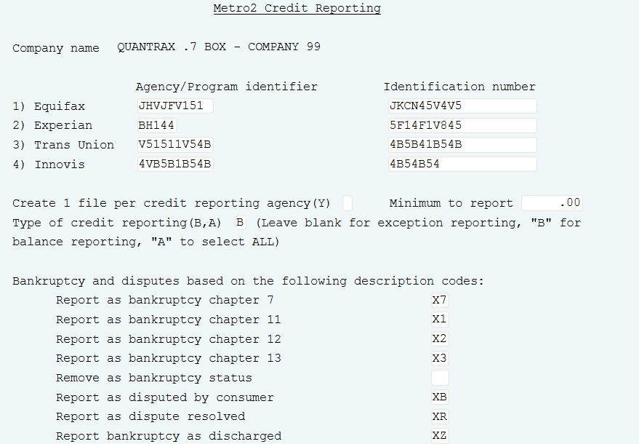
Setting Up Credit Reporting On Your System
System Control 2 > Credit Reporting > New Credit Reporting (New Metro2 unpacked Standard format> pg. 1
Notes:
-Setting Up the Credit Agency Identifier and your company’s ID Number
-Selecting Types of Reporting
-Credit Reporting for Bankruptcies and Disputes
The METRO2 feature allows you to control:
•Which Credit Bureau to report to
•How many files to create
•Which accounts to be reported
•What the minimum balance to report is
•Designate the status of reported accounts
if you are using the "balance reporting" type.

Slide 7
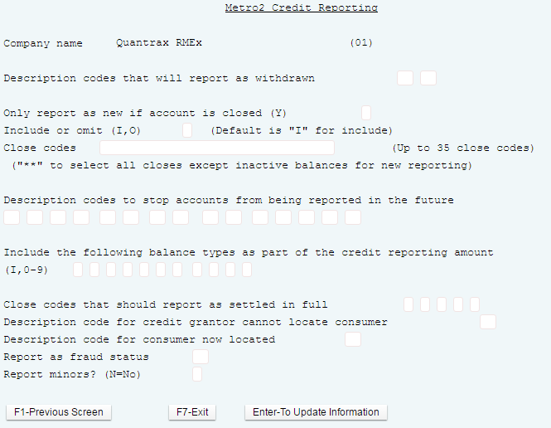
Credit Reporting for Accounts Withdrawn By Your Client
System Control 2 > Credit Reporting > New Credit Reporting (New Metro2 unpacked Standard format> pg. 2
Notes:
Specifying Accounts To be Included or Omitted from Credit Reporting
Stopping Accounts From Being Reported in the Future
Identifying Balance Types to Be Included (primary or principal balance, court cost , attorney fee, etc.)
Handling Credit Reporting for Accounts Settled in Full
Working with Credit Bureaus Skip Locator for Consumers
Reporting Fraud
Minors
•What balance types are included in the reported balance
•Stopping accounts that have never been reported from reporting in the future
This option is used to withdraw or remove an account from the credit bureau if it has AREADY been credit reported. Credit reporting flag changes to withdrawn.
Only report as closed and 2 after – talk to Quantrax Support – do not use these your self
Stop accounts from being reported – this option is used to stop an account that has never been credit reported, from being selected for the credit reporting file, enter up to 15 description codes; only applies to account that have NEVER been reported, credit reporting flag changes to “do not report”. The “do not report” flag will NOT update unit the account's eligibility date has been and the credit reporting process has been run.
To report these accounts description must be removed and credit reporting flag must be rewest via a smartcode suing the filed “credit report as new account”
Include balance type as part of cred rpt amount: By default only the Primary Balance is reported , to include additional balances enter I for interest (0-9) to also be reported
Enter close code that must exist on the account in order for the account to be reported to credit bureau with acct status code of 13=paid

Slide 8
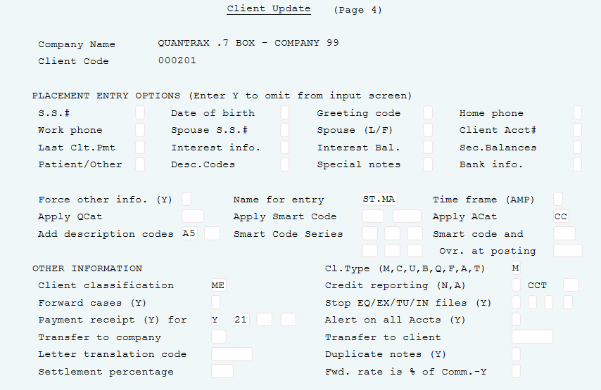
Setting Up Your Clients for Credit Reporting
Management Menu > Client Update > pg. 4
Notes:
Credit Reporting N/A
A = Report to Credit Bureau but ignore the minimum placement amount setup on the credit Reporting System Controls
NOTE: The field is defaulted to an "N" as a security measure when setting up a new client requires special user authority to change it.
(copying to create a new client code will adopt the same setting)
We have added a field to the Client Update to store the Creditor Classification Type (CCT). When the Metro2 file is created, we will select the value from this field for the file. If the field is “blank” or has an “invalid” code we will use the original programming for the Client Type field.
Note: We recommend you update these fields for all clients as the bureaus are beginning to reject accounts that are not “typed” properly.

Slide 9
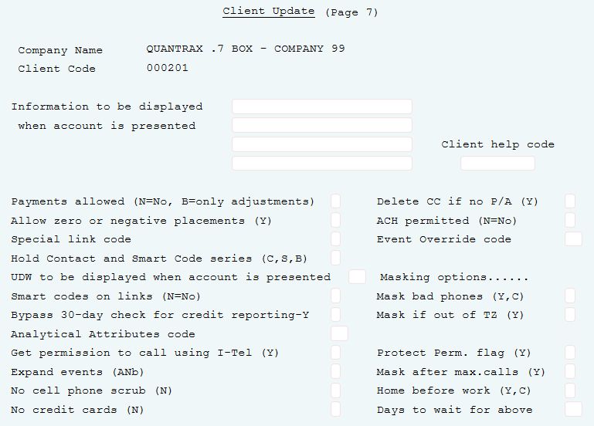
Setting Up Your Clients for Credit Reporting
Management Menu > Client Update > pg. 7
Notes:
"Y" = Bypass the system 30 day credit reporting rule.
By default, if the placement date (date opened) and last transaction date (date of 1st delinquency) is not 30 days apart, the system will omit the account from the Credit Reporting files.

Slide 10
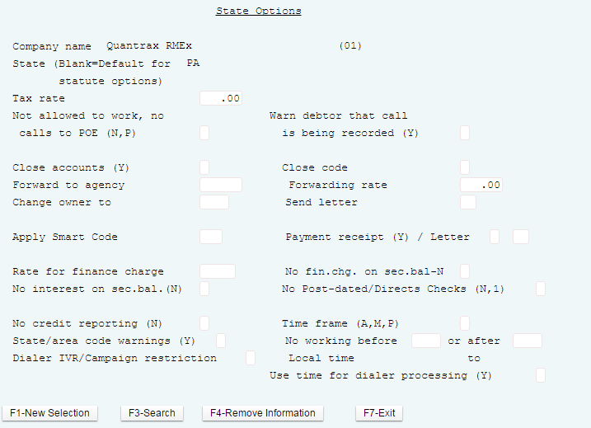
Stopping Credit Reporting by State When Account is Placed
System Control 2 > State Options
Notes:
Place an "N" in this field to stop debts from this state being credit reported

Slide 11
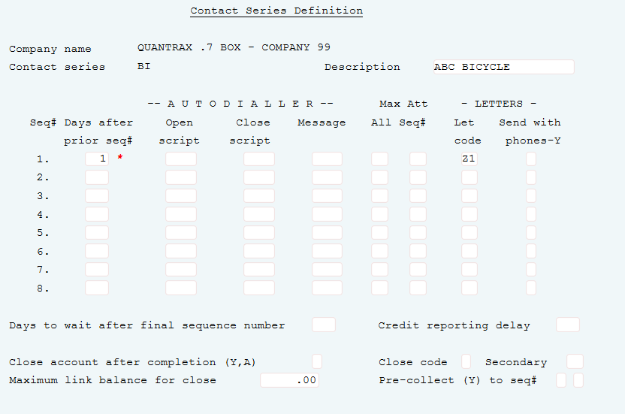
Establishing When To Start Credit Reporting New Accounts
System Control 1> Contact Series Definition
Notes:
Enter the number of days after the placement date that the account is to be eligible for credit reporting. If a number of days is not specified, the placement date will be used. Note: METRO 2 credit reporting does not report an account if the Last Transaction Date is less then 30 days from the Placement Date. This is not applicable for Bad Check clients (B or Q Client types).

Slide 12
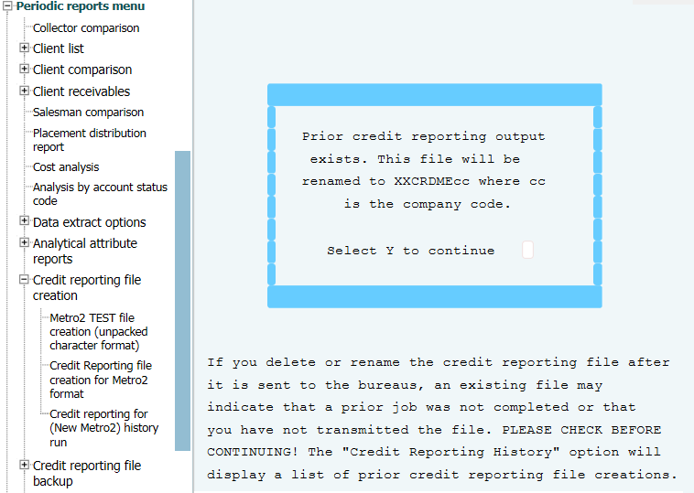
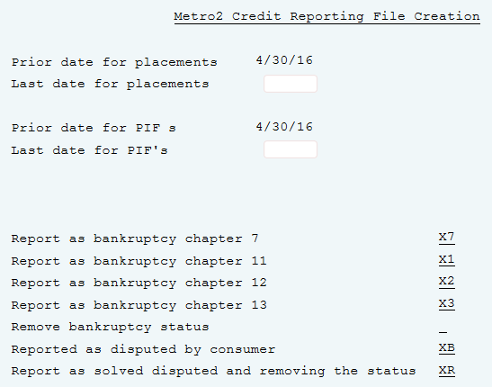
Creating A Test or Live File To Send To Credit Bureau
Periodic Reports Menu > Credit Reporting File Creation > Metro2 TEST file creation

Slide 13
Process-Test/Run/View Credit Reporting
Periodic reports menu > Credit reporting file creation > Credit Reporting for (Metro2) history run
Run Test (Optional – after first time doing credit reporting) Periodic Reports Menu > Credit Reporting File Creation > Metro2 TEST file creation
View History:
Periodic reports menu > Credit reporting file creation > Credit Reporting for (Metro2) history run
Run File:
Periodic Reports Menu > Credit Reporting File Creation > Metro2 file creation

Slide 14
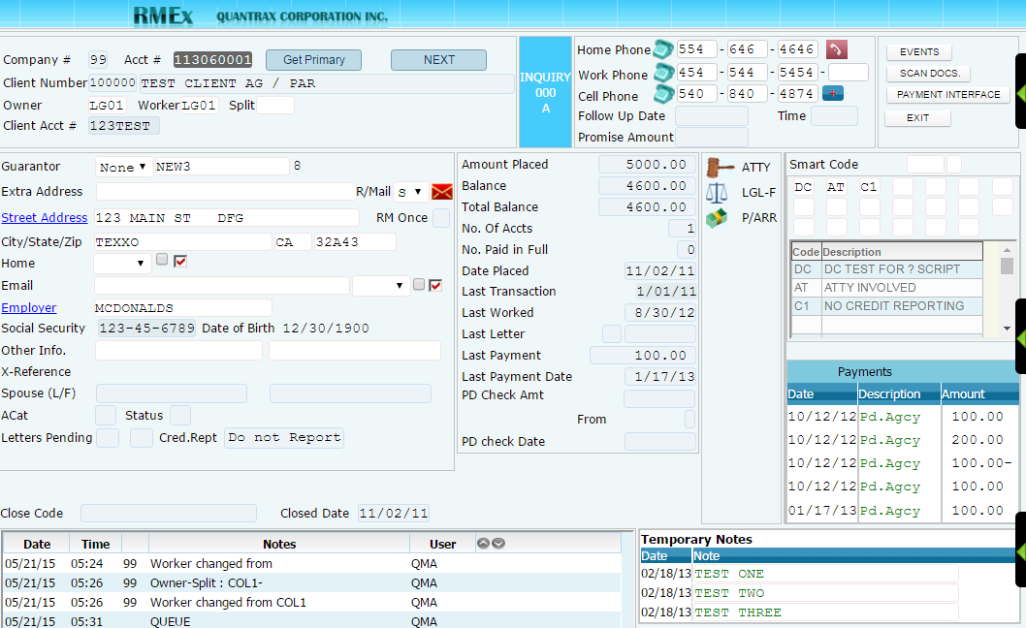
Credit Reporting An Account That Was Flagged To Not Be Reported to The Credit Bureaus
Account Details – Remove Description Code
(For the Description Code setup in System Parameters for Credit Reporting)
Notes:
Enter Description Code then press F12

Slide 15
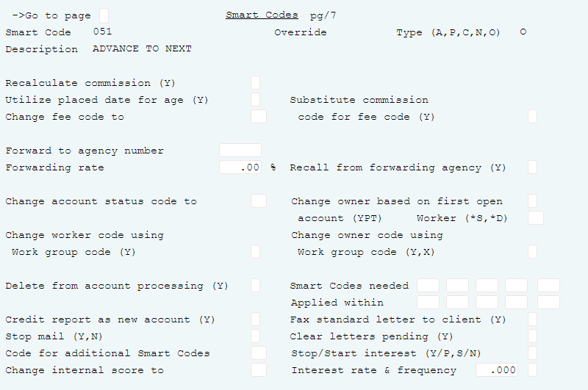
Credit Reporting An Account That Was Stopped in Metro2 Controls or if Account Was Withdrawn
System Control 1 > Smart codes – pg. 7
Notes:
By placing a "Y" in this field the current credit reporting status, such as "do not credit report", will be changed to "new-pending". This will also make the account eligible to be credit reported the next time credit reporting is run provided the "credit passed (see NOTE below).
Possible Use: Originally, a client stated that they did not want you to credit report their accounts. Now they want you to report the accounts. By applying a Smart Code with a "Y" in this field, the account will be eligible to credit report as "new" the next time credit reporting is run provided the account is not stopped from reporting for any other reasons. Eg: Do not report description code exists, is in a do not report state, the client is set-up to not report or because the account has a balance under the minimum balance to report.

Slide 16
Exercises – Credit Reporting
In your system, use COMPANY 98
Print and review the following reports:
Setup your Company for Credit Reporting for Equifax, Experian and Trans Union using the following test information:
Credit report only for accounts that are New, Paid In-Full (PIF), Withdrawn by the client or when the account balance is changed.
Setup your company to credit report for:
a. Accounts that have filed for bankruptcy Chapter 11 – 13.
b. Accounts that have a bankruptcy that was discharged.
c. Accounts when their dispute or objection is resolved.
Credit Bureau | Agency/Program Identifier | Identification Number
Equifax | JHVJFV151 | JKCN45V4V5
Experian | BH144 | 5F14F1V845
Trans Union | V51511V54B | 4B5B41B54B

Slide 17
Exercises – Credit Reporting (continued)
Setup your company to not do credit reporting if:
a. Accounts have a disputes or objections by a consumer.
Accounts that were withdrawn from the client.
Setup credit reporting to remove an account from the credit bureau if it has already been reported.
Stop accounts from being reported in the future.
Make sure that the credit reports include interest.
Credit report then close the account if it has settled in full (SIF).
Credit report then close the account if it has paid in full (PIF).
Alert the credit bureau know if you do not know the location of the consumer.
Alert the credit bureau know when there has been a fraud.

Slide 18
RMEx Management Training: Credit Reporting
Thank you!

