Slide 1
RMEx Management Training: Dealing With Compliance

Slide 2
Agenda
RMEx Compliance Features related to Security
Encryption and masking of key information
Ability to add a note on the account when there is no “access footprint” left on the account
Consumer authentication and permission options
RMEx Compliance Features related to I – Tel
Time zone compliance
Masking phone numbers
Cell phone scrubbing
Call controls by client and state (or setting a default at the state level)

Slide 3
Restrictions On Accessing Different Areas
Restrictions On Accessing Different Areas
User Id
Accounts
Option (menus)
Licensing and rules

Slide 4
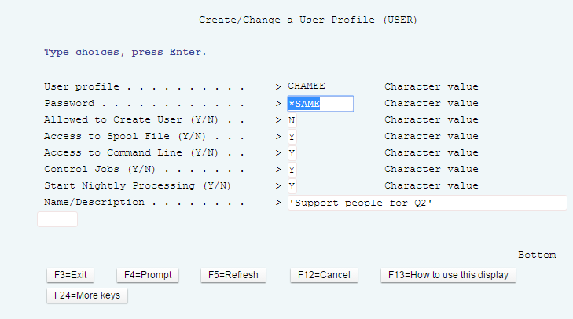
User ID – System Security
RMEx Main Menu > System control menu > System security > System security > (Type the particular User ID)
Accounts – Legal accounts, Balance (based on role and responsibilities)
Options – Management options, System control options

Slide 5
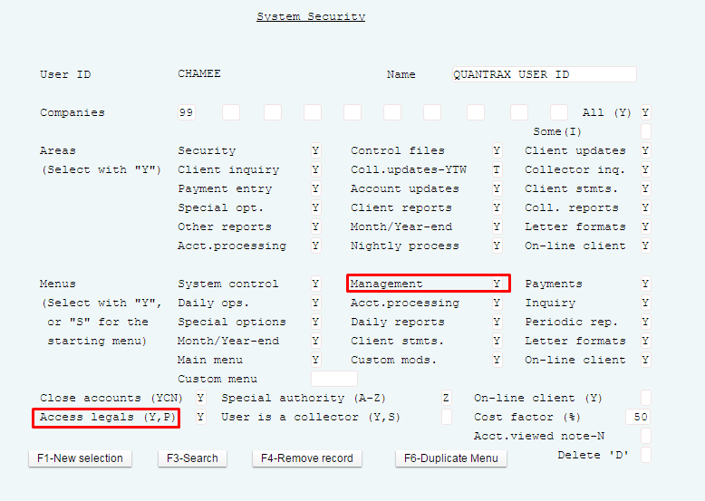
Accounts and Options (menus)
RMEx Main Menu > System control menu > System security > System security > (Type the User ID) > Press ENTER

Slide 6
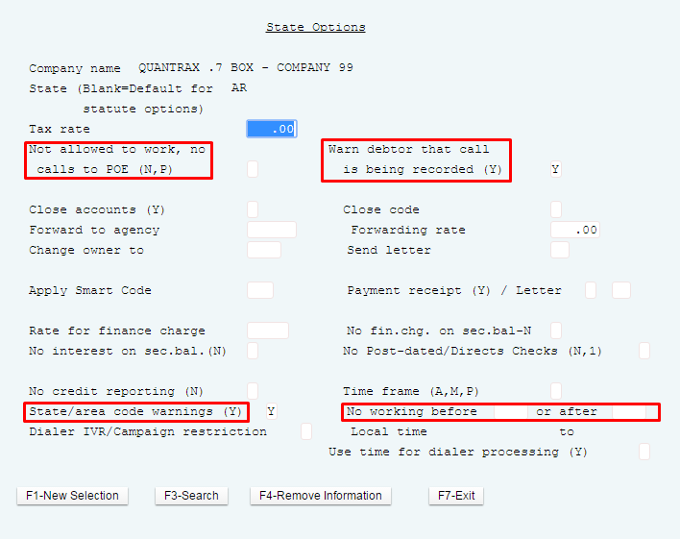
State Rules
System Control Menu 2 > State options
No calls to POE
No calls to cells based on state

Slide 7
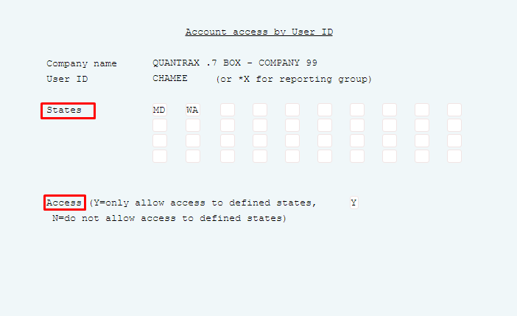
Collector Licensing
RMEx Main Menu > System control menu > System security > Account access for states by User ID (or reporting group code)
Collector licensing for states
No license to work in a state

Slide 8
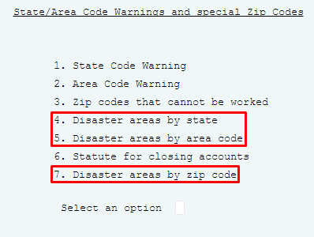
Disaster Areas
System control menu 2 > State options (select state) > F7

Slide 9
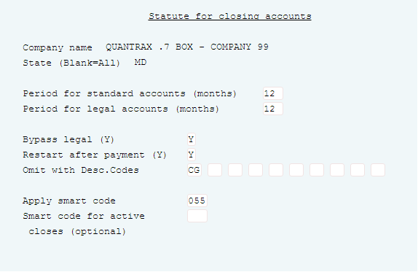
Statute Of Limitations
System Control Menu 2 > State options > F7

Slide 10
Encryption And Masking Of Key Information
Mask By User
Social Security Numbers
Credit Card Numbers
Bank Account Numbers
Mask By Client Level
Bad Phones
Out Of Time Zone
After Maximum Amount Of Calls
Home Before Work
Your RMEx solution. . . . .

Slide 11
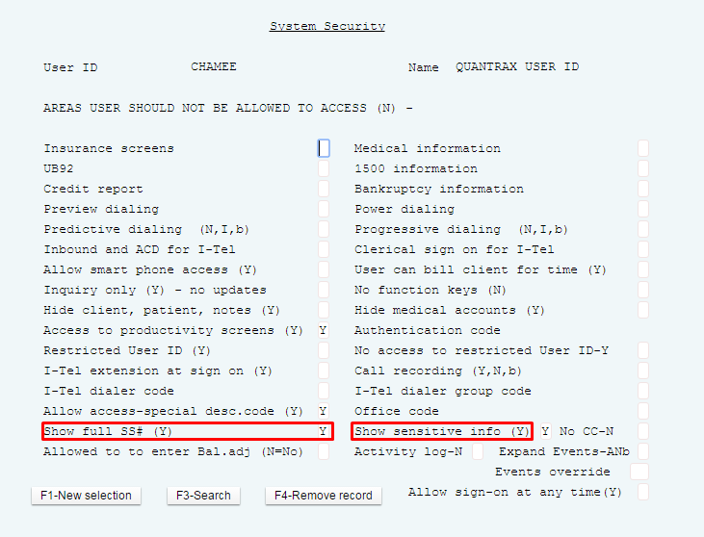
Masking By User
RMEx Main Menu > System control menu > System security > System security > Type User ID > System Security – Page 2

Slide 12
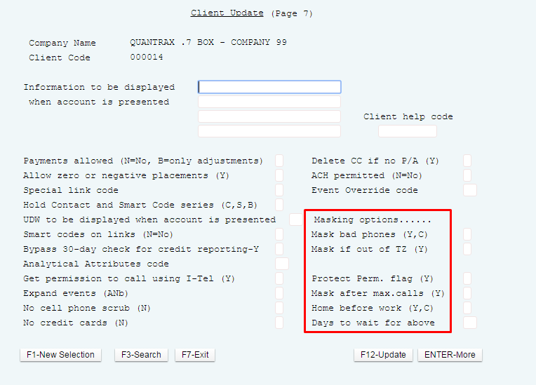
Masking By Client
Management menu > Client update > Type Client code > Client Update – Page 7

Slide 13
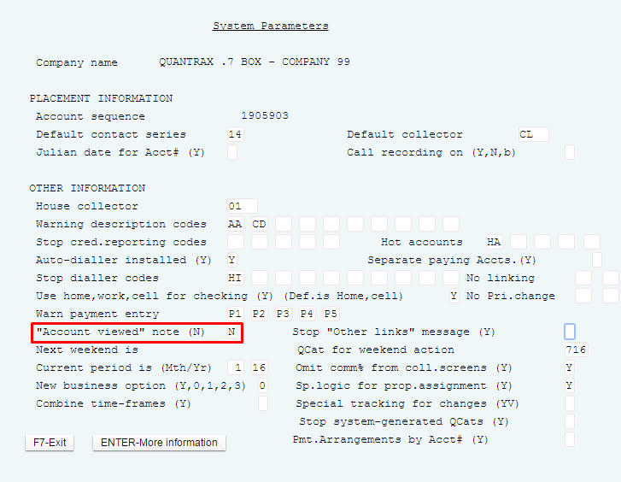
Add A Note On The Account (No “Access Footprint” Left On The Account)
System control menu > System Parameters
Stop a note from being entered on the account each time the account is viewed
Ability to control this feature at the USERID level (System security)

Slide 14
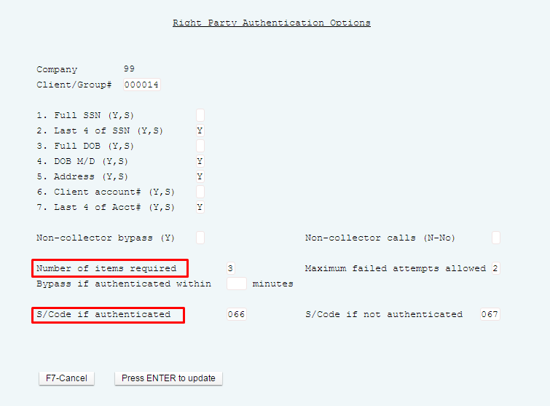
Consumer Authentication And Permission Options
System control menu > System security > Right party authentication options

Slide 15
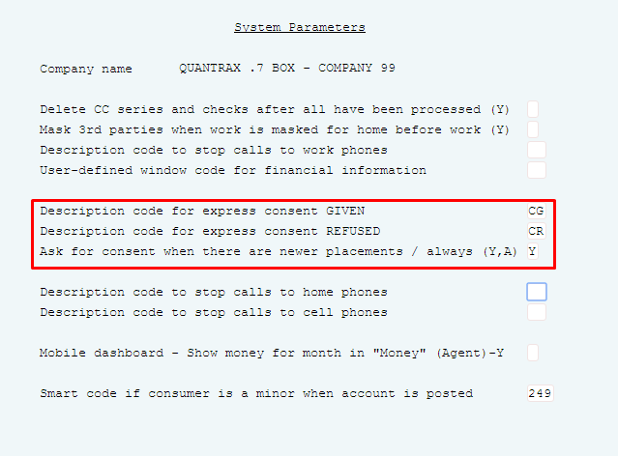
Express Consent – Set Up
System control menu > System parameters - Page 3
Obtain and revoke permission to call phone number
Achieve this by applying a smart code that is an RPC

Slide 16
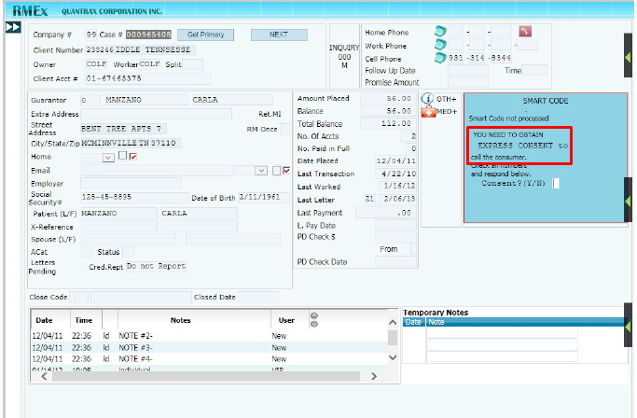
Express Consent – View From Account Detail

Slide 17
Time Zone Compliance - Overview
Subscription to Melissa Data phone number database is required
Area code and exchange are located within a time zone, state and county
All phone numbers and state can be factored into calculation
Option available for Other Phones (TAB+ numbers)
Special rules for toll-free numbers
Calls can be launched from anywhere to anywhere using UTC time formats

Slide 18
Time Zone Compliance - Overview
Time zone processing
Ensures that calls launched to specific state or province are launched at allowable times
Pre-Requisites
RMEx 2.2 or above
Every jurisdiction has an allowable calling period
Valid allowable calling periods (ACP) in state controls table
A recent version of the Melissa Data time zone file
The settings in the dialer control table
The settings of the Special Control Flags
Notes:
Time zone processing ensures that when a call is launched into a particular state or province, it is at an appropriate time relative to the place being called. Every jurisdiction has an allowable calling period. This is typically from 8am to 9pm, local time, but there are significant variations that need to be taken into account.

Slide 19
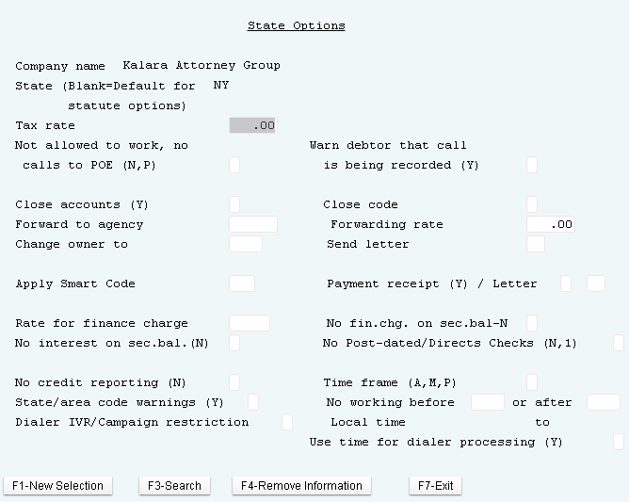
State Control Table
System Control 2 > State Options
Enter ‘No working before HHMM or after HHMM’
Consider a safety margin (end at 2056)
Consider states with multiple time zones such as Florida

Slide 20
Subscription To Melissa Data Phone Number Database Is Required
FONE*Data
Provides RMEx the ability to relate area code and prefix data to location information like city, state, county, and TIME ZONE
http://www.melissadata.com/
1 800 MELISSA
Quarterly updates recommended

Slide 21
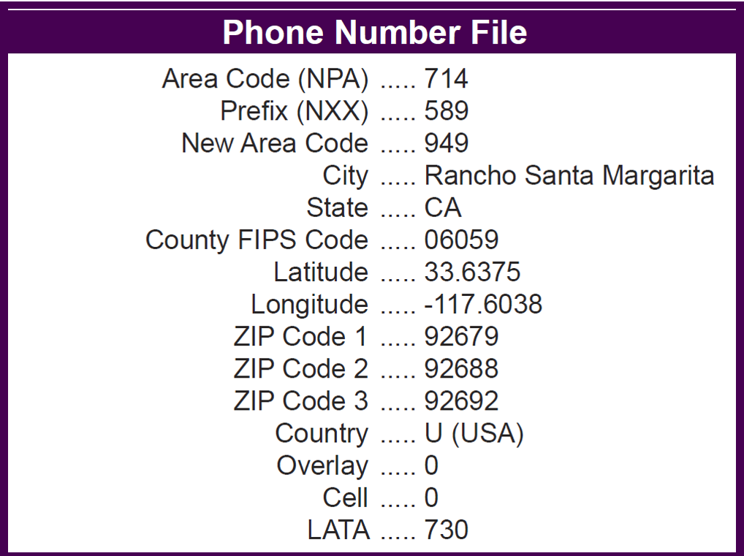
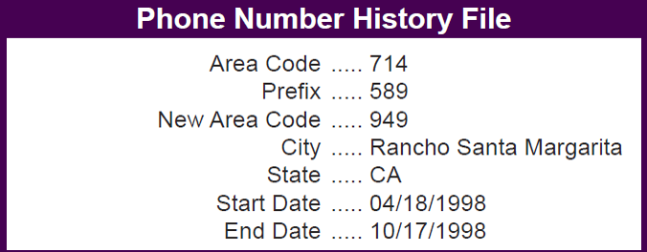
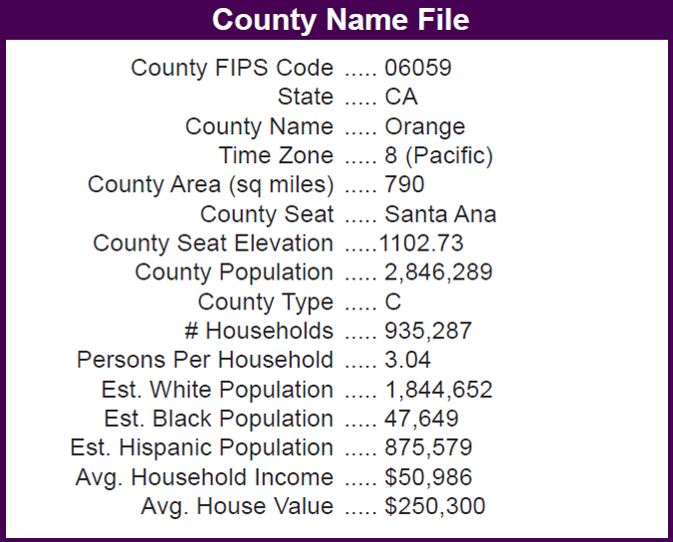
Area Code And Exchange Are Located Within A Time Zone, State And County

Slide 22
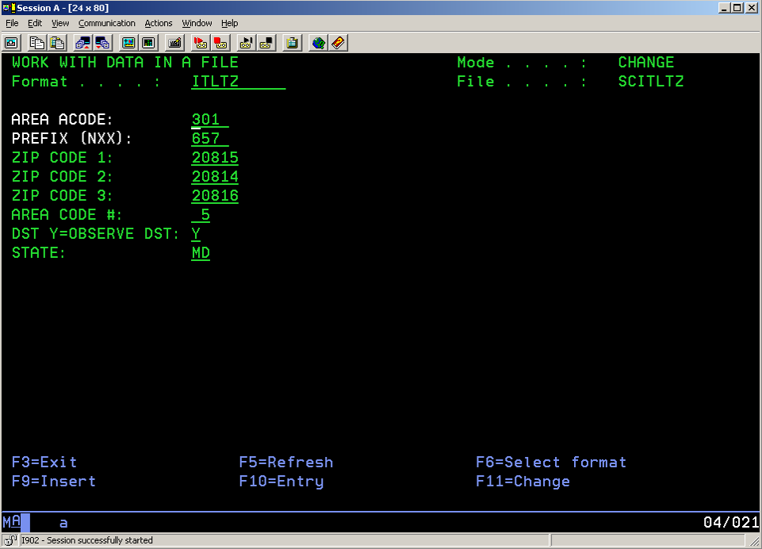
The Melissa Data File SCITLTZ

Slide 23
Loading The Melissa Data File
Information on this in the RMEx Knowledge Base
Download FONE*Data from Melissa Data
Copy PC files to i5, into library FONEDATA
Make sure you copy the data as well as the file structure
Run the RMEx update program from
I-Tel System Control options
Phone number maintenance options
Create area code and time zone files

Slide 24
The Allowable Calling Period (ACP)
ACP is calculated based on
The area code/exchange records in SCITLTZ
The times in the State Control Table
The values on the Dialer Control Table
The settings of the control flags
The default for US and Canada is 8am to 9pm
The default for elsewhere is 2pm to 5pm
The Earliest time to call - normally 8am local time
The Latest time to call - normally 9pm local time
Stored on SCCQUE and TQ files

Slide 25
All Phone Numbers And State Can Be Factored Into Calculation
The Allowable Calling Period =
(AST+TZO-DST) / 24
(AET+TZO-DST) / 24
AST - The allowable start time in local time, in hours. This is the ‘no working before’ time from the state control table. Maryland would be ‘08’
TZO - The time zone offset (hours behind UTC or GMT) for the area code/exchange combination being called, from the time zone file. For 301 657 2084, this value would be ‘5’
DST - DST is equal to ‘1’ if the DST flag for the area code/exchange combination is equal to ‘Y’ AND the DST flag on the Dialer Control File on RMEx is equal to ‘Y’. If either flag is blank, then DST is equal to zero.
24 - The number of hours in a day

Slide 26
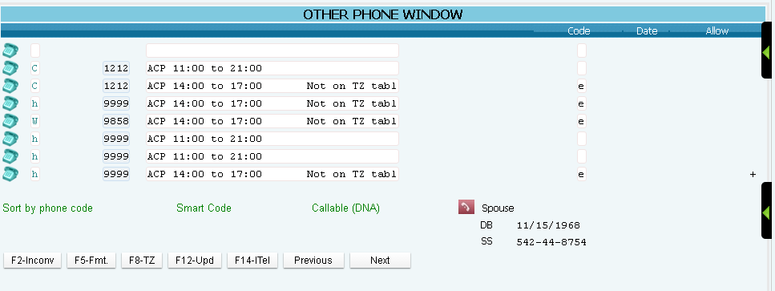
Option Available For Other Phone Window- Time Zone
Account Details Screen > Tab-+ > F8-TZ

Slide 27
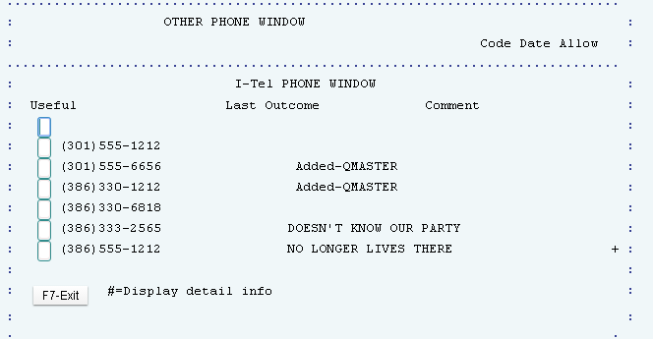
Option Available For Other Phone Window Numbers
Account Details Screen > Tab-+ > F14 - ITel

Slide 28
Special Rules For Toll-free Numbers
Dialer Setup Menus
Where is a toll-free number located?
Anywhere in North America
In the same place as other numbers on the account
Options:
‘ ‘ (blank) default to 2pm to 5pm EST
‘N’ ignore toll-fee numbers if there are other numbers on the account
‘A’ always ignore

Slide 29
Calls Can Be Launched From Anywhere To Anywhere Using UTC Time Formats
UTC stands for Universal Time Coordinated.
It is equivalent to GMT (Greenwich Mean Time).
Allowable calling times are stored in UTC format

Slide 30
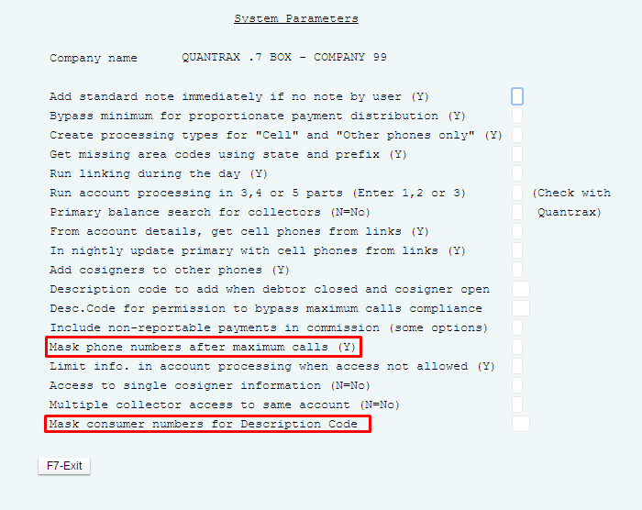
Masking Phone Numbers
System control menu > System parameters - Page 2
Controlled by description code
All consumer numbers on an account are masked, so agent cannot dial manually
No Calls message displayed to agent

Slide 31
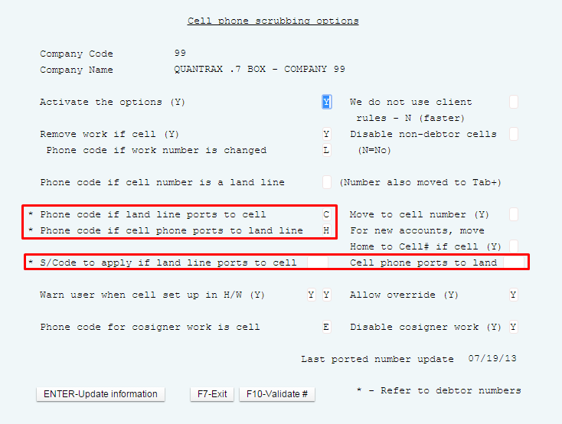
Cell Phone Scrubbing
System control menu 3> Cell phone scrubbing options

Slide 32
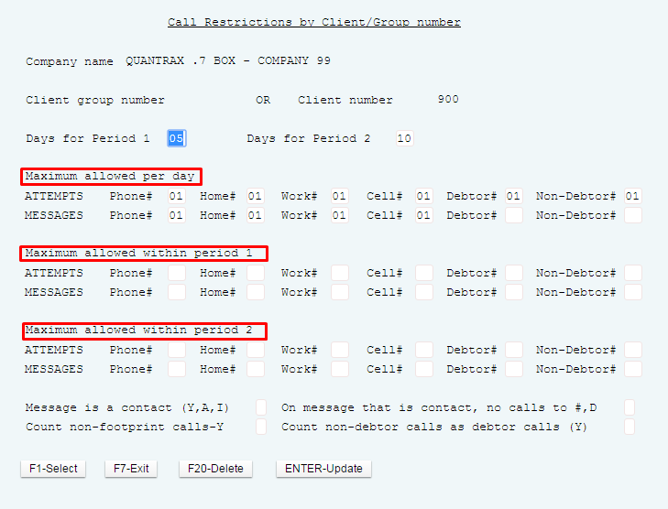
Call Controls By Client And State (Or Setting A Default At The State Level)
Maximum calls for a day or a period
Maximum messages
Methods of counting and tracking manual calls when cell phones should not be called using a dialer
Demand letter can be considered ‘contacts’
The “home before work” rule

Slide 33
Call Controls By Client And State (Or Setting A Default At The State Level)
RMEx Main Menu >I-Tel options menu > Other phone number options > Phone number restrictions by client

Slide 34
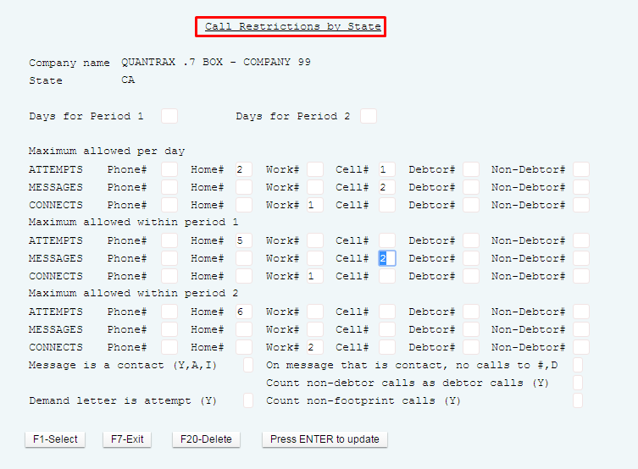
Call Controls By State (Or Setting A Default At The State Level)
RMEx Main Menu >I-Tel options menu > Other phone number options > Phone number restrictions by state > Phone number restrictions by state (2nd file)

Slide 35
Exercises – Dealing With Compliance
In your system, use COMPANY 98
Print and review the following reports:
Setup a default collector user id, in system security.
This user id can update account demographics but cannot close accounts.
The special authority level for this user should be B and should not have access to bankruptcy screens.
Login to the system, with the user id from above and try to access the bankruptcy information on any account.
What happens?
Apply a smart code with an authority level higher than B.
Manually close the account.
Add a description code to an account that only a user with special authority will be able to access.
Attempt to access with account through account inquiry, with the default collector login.
What happens?

Slide 36
Exercises – Dealing With Compliance (continued)
In your system, use COMPANY 98
Print and review the following reports:
Setup the state options for FL to warn consumer call is being recorded and work phone numbers are not allowed to be called.
Change the state on a test account to FL.
Access account through account inquiry, what happens?
Do you see a message?
Setup home before work rules on the state control options for MA.
Change the state on a test account to MA, make sure you have both a home and work phone number on the account.
Pull the account up, what phone numbers do you see?

Slide 37
RMEx Management Training: Dealing With Compliance
Thank you!

