Slide 1
RMEx Management Training: Remittance Statements/Client Receivables

Slide 2
Agenda
Identifying The Areas Associated With Remittance Statements And Receivables
Working With Client Options That Affect The Remittance Statements
Understanding Remittance Statements
Understanding Client Receivables
Updating Client Receivables

Slide 3
Identifying The Areas Associated With Remittance Statements And Receivables
Remittance Statements
What accounts paid?
Where the payment was made?
How much of the payment is owed to the client and the agency?
What prior balance(s) is owed to the agency (check amount included and current amount due to agency)?
Notes:
A statement allows us to provide information to our client showing what accounts paid, where the payment was made, and how much of the payment is owed to the client and the agency. We can also indicate what prior balance(s) is owed to the agency, check amount included and current amount due to agency.
If you are an agency, remittance processing is arguably the most important reporting you ever do. Millions of dollars are reconciled and remitted to your clients. If money is owed to you, you need to keep track of it and make sure it is collected.
Amount collected must be periodically remitted to the client. Fees must be retained or billed for the transactions as well as amounts paid to the client.

Slide 4
Identifying The Areas Associated With Remittance Statements And Receivables
Remittance Statements
Payment codes
Balance types
Remitting codes and remit types (e.g. Gross and net)
Reportable balances vs. non-reportable balances
Notes:
A statement allows us to provide information to our client showing what accounts paid, where the payment was made, and how much of the payment is owed to the client and the agency. We can also indicate what prior balance(s) is owed to the agency, check amount included and current amount due to agency.
If you are an agency, remittance processing is arguably the most important reporting you ever do. Millions of dollars are reconciled and remitted to your clients. If money is owed to you, you need to keep track of it and make sure it is collected.
Amount collected must be periodically remitted to the client. Fees must be retained or billed for the transactions as well as amounts paid to the client.

Slide 5
Working With Client Options That Affect The Remittance Statements – Client Master Level
Client Options
Remitting codes
Net and Gross clients
Commission rates
Separate statements by type of payment transaction

Slide 6
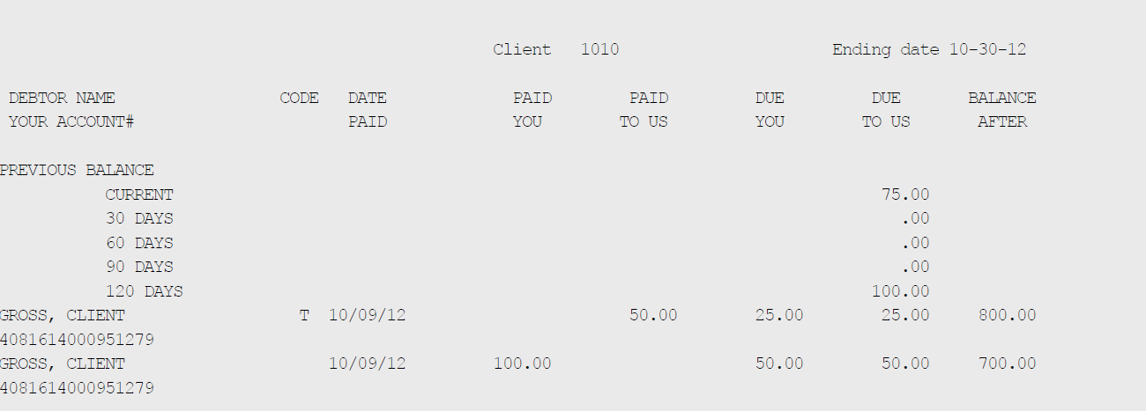
Working With Client Options That Affect The Remittance Statements – Client Master Level
RMEx “Plain Paper” Statement

Slide 7
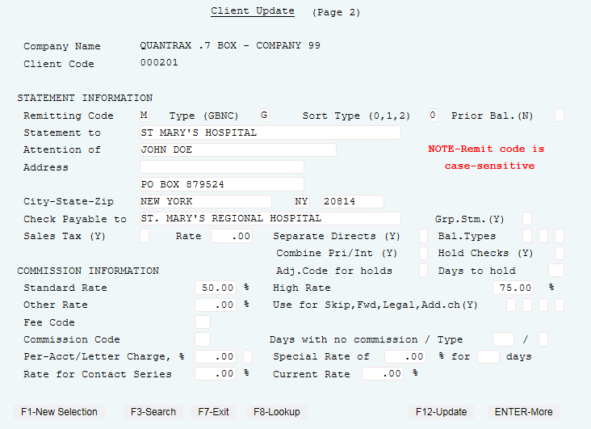
Working With Client Options That Affect The Remittance Statements - Client Master Level
Management Menu > Client update

Slide 8
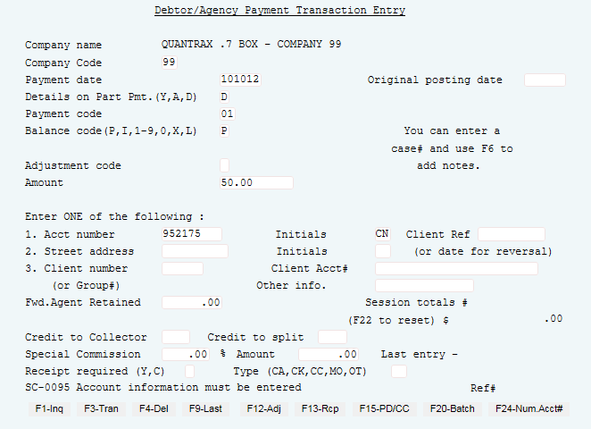
Working With Client Options That Affect The Remittance Statements – Payment Posting
Payment transaction menu > Debtor/Agency entry

Slide 9
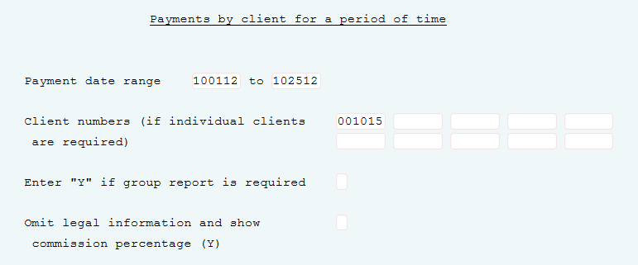
Identifying The Areas Associated With Remittance Statements And Receivables – Payment Report
Payment transaction menu > Payment reports for Period > Payments by client for period

Slide 10
Identifying The Areas Associated With Remittance Statements And Receivables – Payment Report
Payment transaction menu > Payment reports for Period > Payments by client for period

Slide 11
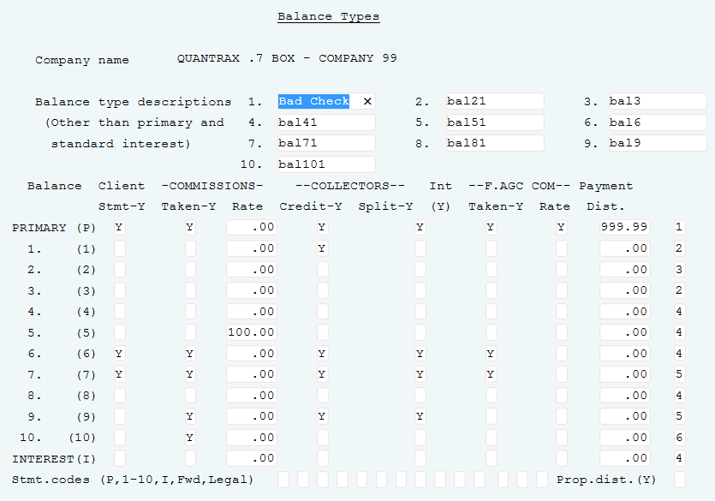
Understanding Remittance Statements – Balance Types
System Control menu 1 > Balance Types > Options for the company

Slide 12
Understanding Remittance Statements – Balance Types
Payment Codes
APPEAR on Statements | DO NOT APPEAR on Statements
01 paid agency 02 forwarding agency payment 11 direct payment to client 52 AR adjustment (optional) 21 Agency NSF 31 Client NSF 59 Bill client and increase debtor balance 71 Overpayment refund client | Adjustments (payment codes 40-49) Balance types can keep transactions from appearing Payment code 52 may or may not Payment Code 72 Refund to debtor Payment Code 73 Overpayment adjustment Payment Code 90 collector commission adjustment

Slide 13
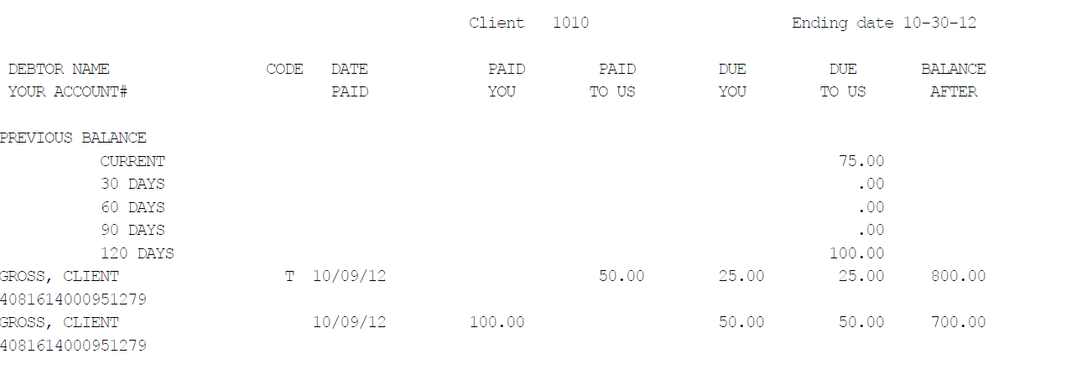
Understanding Remittance Statements
The statement below is for a remit type of G = gross client statement
This is where you will send 100% of the money the agency collects to your client and bill them for your fees on payments made to the agency and the payments made to the client

Slide 14
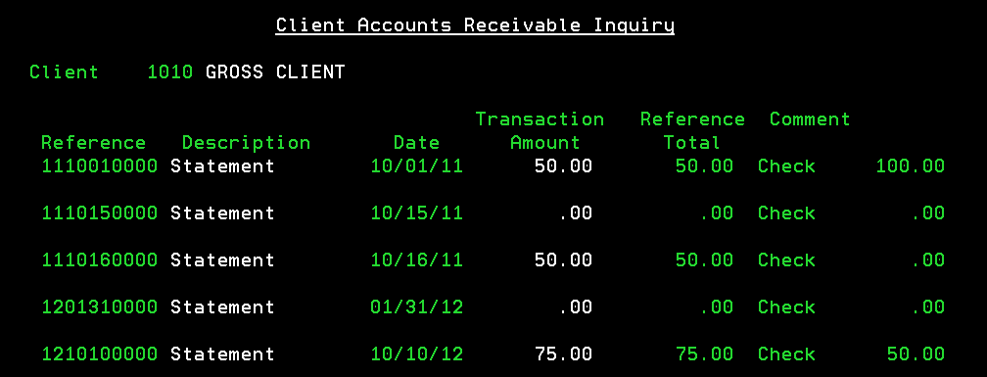
Understanding Client Receivables
Client statements menu > Client receivables entry

Slide 15
Understanding Client Receivables
Client statements menu > Client receivables entry
Reference # - this number is printed on each statement and the first 6 digits indicate the year, month, and day the statement was run
Description – indicates type of AR transaction
Statement – indicate a statement was created
Statement Credit – indicates a statement created was applied to the AR
Statement Credits are typically seen with Net statements and will be applied when the client has a prior balance. When the statement is processed, it will look at outstanding AR and if you are sending a check to the client and the client owes you money, we will reduce the amount sent to the client by the amount owed, if the amount collected is enough to pay off prior balance.
Payment – indicates a payment was made
Adjustment – indicates an adjustment was made to the AR
Date – indicate the date the transaction occurred
Transaction Amount – shows amount of transaction. For statements it indicate how much is owed to the agency.

Slide 16
Understanding Client Receivables
Client statements menu > Client receivables entry
Reference Total – indicate the balance due for the transaction amount. So, if you post a $50.00 payment to line 1 of this AR the Transaction Amount will show $50.00 and the Reference Total will show $0.00.
Comment – this field will show the following:
Check and amount – when a statement is run. If you are billing client or the in the case of a Net remit, you may see “Check 0.00” since there is no money owed to the agency.
Payment – if the transaction indicates a payment was applied.
Adjustment – if the transaction indicates an Adjustment was made the AR.
STM.DATE mmddyy – this indicates a statement credit was applied to the statement date indicated on the comment line.
Check No – indicates a statement credit. This type of statement credit needs to be looked at closely and could be an incorrect statement credit for various posting reasons. This can occur when payments applied to AR are NOT applied to the correct Reference #, thus creating a credit balance on the client AR.

Slide 17
Types of Statements
Gross client statement
Gross client statement with separate statement for returned check
Gross statement with separate statement for direct payments (payment code 11)
Main statement
Direct statement
Balance statement
Net client statement
Net clients statement with separate statement for returned checks
NOTE: If the client wants both a direct and balance type statement, when a direct payment is made to balance type 3, that payment will show up on the direct statement NOT the balance type statement. Only payment type 01 will show on the balance type statement, when is set up for separate direct statements, as shown below. List different types of statements

Slide 18
Understanding Client Receivables - FAQs
When running statements: RULE- Don’t post any client payments until you have completed your weekly statements RULE: Don’t post any debtor payments until all client payments have been applied RULE: Group Statements – all clients must have the same ‘Group Code” RULE: Per case reports MUST be run prior to statements.

Slide 19
Any Way To Run A Client AR Report ………..

Slide 20
Understanding Client Receivables – Top Questions
I wonder ……….
1. Can a payment transaction appear on statement more than once?
No, once it has appeared it will not appear on another statement.
2. Can I rerun a statement for one client?
Yes, create unique remitting code, run a test statement, and put remit code back to original.
3. If the balance type 5 was posted as transaction type 11, but the client statement option is not checked. Does the system still put this on the statement anyway at 100% commission? If it does show up on the statement, wouldn’t it also show on the A/R?
Yes, even if a balance is non-reportable it will appear on the statement if the transaction was posted as paid to client. Double check the ones that appeared on the statement to make sure they are charging the client 100%, especially since they are set up for no commission, you want to make sure you get the money back from the client.

Slide 21
Understanding Client Receivables – Top Questions
I wonder ……….
4. What can I do with overpayments?
Refund to the debtor using a payment code 72, refund to the client using payment code 71 or adjust the balance to zero using payment code 73.
5. Why would per case/ per letter charges not appear on a client statement?
You have specified that the client is per case but you did not specify an amount. Because you ran the statements prior to running the per case report. The report must always be run prior to the statements being processed.
6. What happens if I transfer an account from one client to another?
The transactions posted prior to the transfer will appear on the old client statement and all futures will be applied to the new client.
7. Why do Per Case charges not appear on “Statement Report”?
Per Case charge appear on an “Invoice Report”

Slide 22
Understanding Client Receivables – Top Questions
I wonder ……….
8. Why does my statement say “Statement Credit”?
• If you do run client statements a week later after running month-end, DO NOT post client payments to the receivables during this period. This will cause client receivable issues and statement issues regarding balances. • If the client is a Net client and they owe you a prior balance. • If you have a gross client with separate balance type statement and an NSF was posted to the separate balance type will create a statement credit for the amount of the NSF amount due to the agency .
9. What happens if a client is set up for separate directs and separate balance types. Where will that transaction appear?
If a transaction qualifies for a client direct statement and a balance type statement, it will always appear on the client direct statement.

Slide 23
Understanding Client Receivables – Top Questions
I wonder ……….
10. What happens if you run statements twice?
Receivables will be aged – If not include prior balance, will generate a statement saying owes nothing. If include prior balance it will not show. Another AR item will be created.

Slide 24
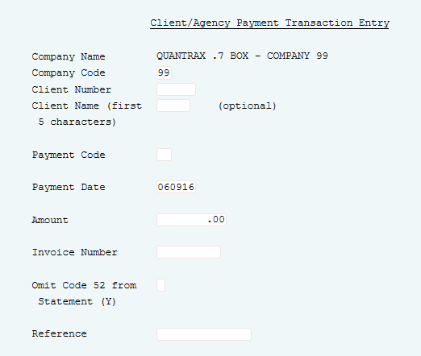
Updating Client Receivables – Client Agency Payments
Payment transaction menu > Client/Agency Entry

Slide 25
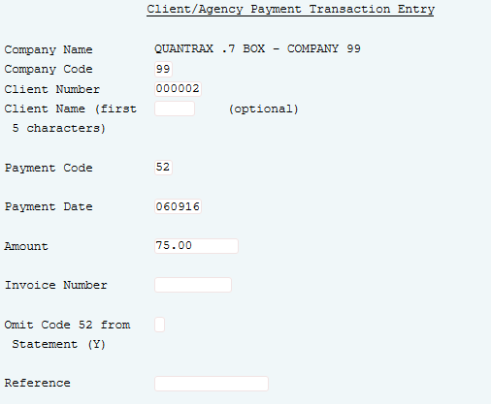
Updating Client Receivables – Accounts Receivable Adjustments
Payment transaction menu > Client/Agency Entry

Slide 26
Exercises – Remittance Statements/Client Receivables
In your system, use COMPANY 98
Print and review the following reports:
Enter and post the following payment transactions on accounts for a NET client. Make sure the accounts have a commission rate.
Paid Agency $25.00
Paid Client $30.00
Return check Agency $25.00
Paid Agency $500.00
Run the payment summary to check your numbers.
Run a test statement.
Are you billing the client?
Is there check for the client?
Change the client to a gross remit. Run the test statement again. Can you explain the results?

Slide 27
Exercises – Remittance Statements/Client Receivables (continued)
Enter a balance adjustment on one of the accounts on the statement.
Enter it with a date that falls within the statement date range.
How do you expect the statements to change? Run a test if you are not sure.
You discover that the commission on one payment is wrong. How would you correct this?
For the above, you would reverse the payment with the wrong commission (you could use today’s date for the reversal), change the commission rate on the account, and re-enter the payment. Try that.
Run a test statement. Does the statement reflect the changes correctly?
What if you did not want the positive and negatives to show on the statement?
Run the live statement.
Check the client receivables inquiry.
Are you seeing the new receivable?
If you sent a check to the client, is that amount showing?
What is the significance of the “Invoice number”?

Slide 28
Exercises – Remittance Statements/Client Receivables (continued)
In your system, use COMPANY 98
Look at client inquiry. Does the receivable show on the first screen?
Run the Client receivables reports. There are different reports. Some relate to the A/R open items, while others refer to the receivables and their aging. What are the differences?
Enter and post a partial payment against the receivable. Review the information on the client receivables inquiry. Look at other areas that show receivables. Do you understand what happened?
The client disputed the balance and you want to adjust the balance on that invoice to zero. How would you do that? Enter an A/R adjustment to handle this.
Run the inquiry and receivables reports and compare them with the previous reports
Try to run the live statements for the same period. How does the system warn you, so you do not run statements for a period that has already been processed?
You forget if you have run the statements for a given period. How can you check?

Slide 29
RMEx Management Training: Remittance Statements/Client Receivables
Thank you!

