Slide 1
RMEx Management Training: Internal Reports To Manage Your Productivity

Slide 2
Agenda
Determining The Information Needed To Manage Your Internal Operations And Results
Viewing Reports Based On Data From:
Agents
Reports To View Agent Productivity
Collections
Understanding Account Processing – A Quick Overview
Reports To View Collections
Clients
Reports To View Activity by Client
Using Comparison Reports

Slide 3
Determining The Information Needed To Manage Your Internal Operations And Results - Agents
What did agents accomplish for your company?
What are individual agents doing?
Can an agent be followed while they work? (listen to them /display the account they were working)
Can agent goals be set, and can agents see where they are against their goals?
In a pooled environment, what was their individual productivity?
What did they agents generate in terms of promises and “money”

Slide 4
Reports To View Agent Productivity
Details Of Work Done By A Collector (Smart code analysis)
Time Management Reports
Audit Accounts Being Worked (while agents are working)
Your RMEx solution. . . . .

Slide 5
Agent Reports: Collector Reports: Details Of Work Done By A Collector
RMEx Main Menu > Management Menu > Account processing review > User productivity - Smart code analysis
Prints a list of Smart codes applied by the user,
Omits duplicates of the same Smart code applied to the same account
Includes different Smart codes applied to the same account (since the report is an analysis of all the smart codes used)
Counts the same debtor more than once if different smart codes were applied to the same account

Slide 6
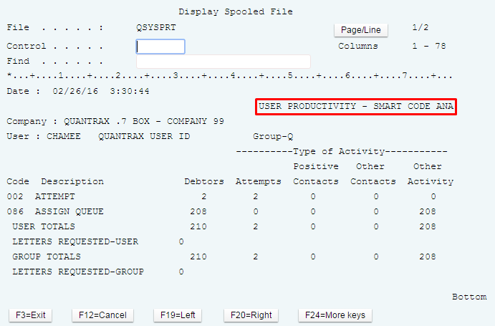
Agent Reports: Details Of Work Done By A Collector (continued)
RMEx Main Menu > Management Menu > Account processing review > User productivity - Smart code analysis
Based on the type of smart codes applied (attempts, positive contacts, etc.)

Slide 7
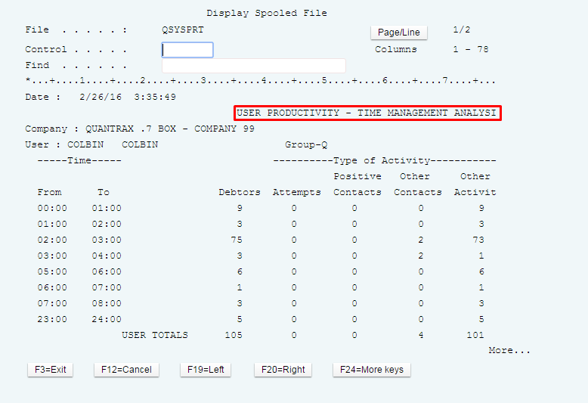
Agent Reports: Time Management Reports
RMEx Main Menu > Management Menu > Account processing review > User productivity – Time Management Reports
Based on the type of smart codes applied (attempts, positive contacts, etc.)

Slide 8
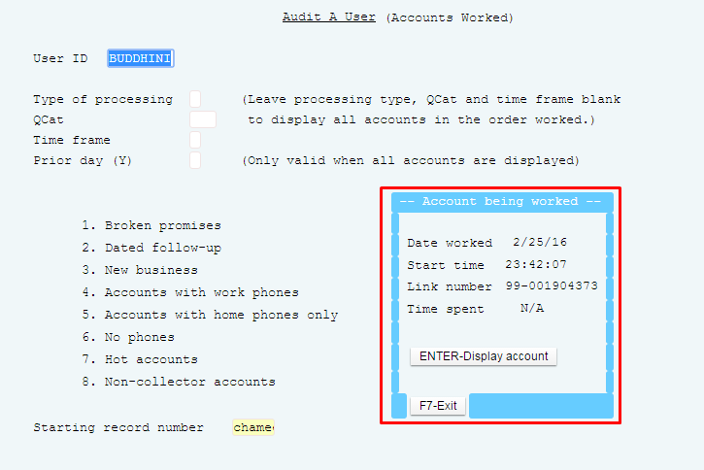
Agent Reports: Audit Accounts Being Worked
Management Menu > Smart Code/User Audit Options > Audit a user (worked)
Audits an agent while they work
Allows you to listen to agents and display the account they are working on
Enter User ID, then press F10-Most recent account

Slide 9
Determining The Information Needed To Manage Your Internal Operations And Results - Collections
What have you collected this month and how does that compare with the same month, last year?
What is due from checks and credit cards for the rest of the month?
Where is money being applied (e.g. principal, interest)?
How much of court costs have you put up and billed the consumer?
What about a summary of payments for the month?
How are you doing as far as recovery percentages for your company?

Slide 10
Reports To View Collections
Reports
Daily Payment Report Options
Payments By Collector For Period
Daily Collector Activity Summary
Audit Accounts Worked
Daily And Month-to-date Payment Report
Activity History By Company
Your RMEx solution. . . . .

Slide 11
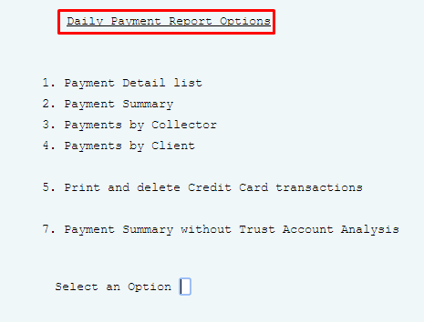
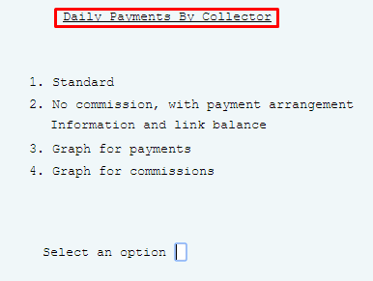
Collection Reports: Daily Payment Report Options
RMEx Main Menu > Payment transaction menu > Daily payment report options

Slide 12
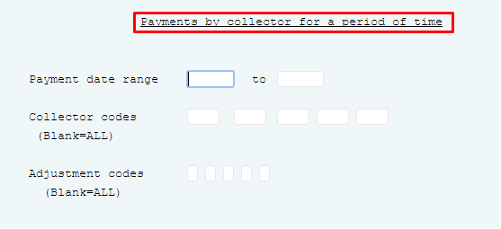
Collection Reports: Payments By Collector For Period
RMEx Main Menu > Payment transaction menu > Payments by collector for period

Slide 13
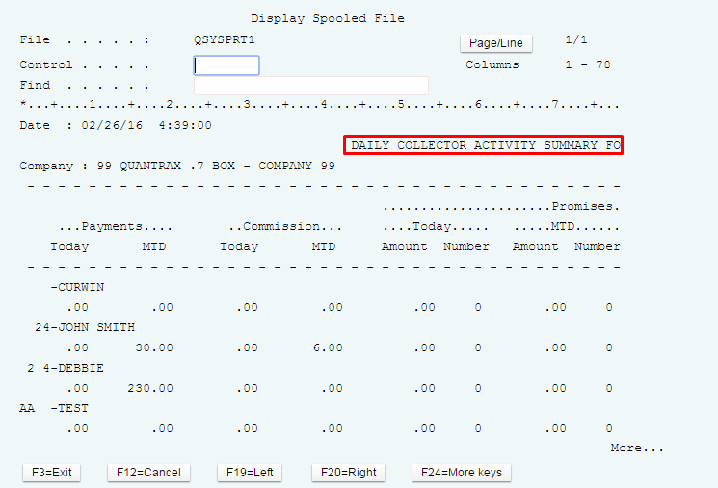
Collection Reports: Daily Collector Activity Summary
Management Menu > Collector set up/Analysis > Daily collector activity summary
Shows new business, efforts and results in one report

Slide 14
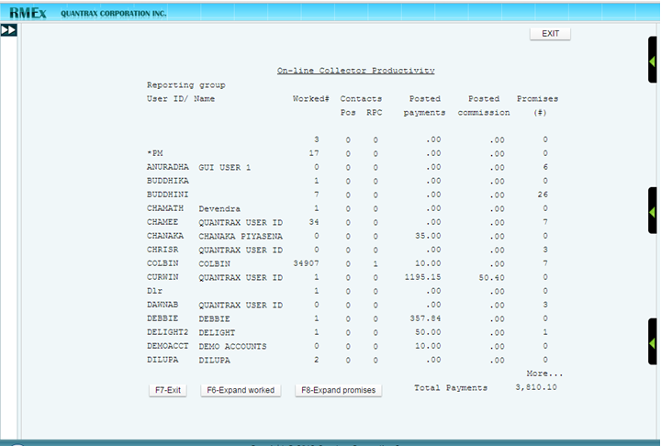
Collection Reports: Audit Accounts Worked
Management Menu > Smart Code/User Audit Options > Activity dashboard
Displays the # of accounts worked, contacts etc.

Slide 15
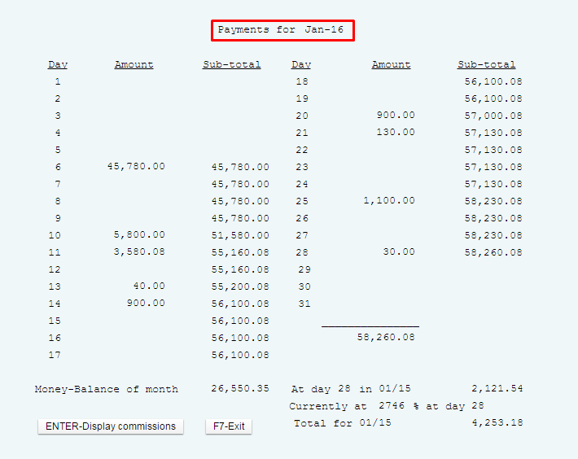
Collection Reports: Daily And Month-to-date Payment Report
Payment Transaction Menu > Payment reports for period > Daily Payment totals for a period (Inquiry)
Know exactly where you are each day of the month

Slide 16
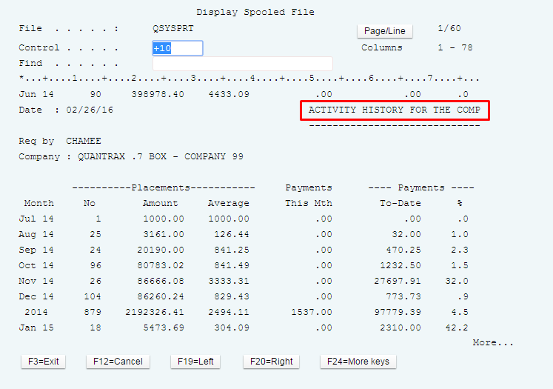
Collection Reports: Activity History By Company
Management Menu > Company statistics options > Activity history by Company

Slide 17
Determining The Information Needed To Manage Your Internal Operations And Results - Clients
Do you have the ability to look at some of your key clients and monitor them frequently?
Who are my most profitable clients? What about a summary of payments for the month?
Am I spending a lot on some clients, but not justifying the expense?
Where are your future payments coming from (e.g. checks, credit cards)
How quickly are you recovering money for your clients?

Slide 18
Reports To View Activity by Client
Analysis Of Payments Pending
Company Statistics
Placement History By Company
Executive Dashboard Options
Account List For Audit
Payments By Client For Period
Client Comparison Reports
Your RMEx solution. . . . .

Slide 19
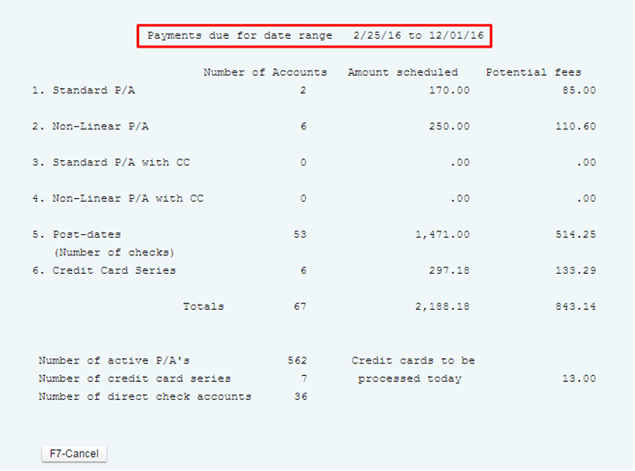
Internal Client Reports: What IS Expected For The Rest Of The Month - Analysis Of Payments Pending
Payment Transaction Menu > Payment reports for period > Analysis of pending payments
Shows where your future payments are coming from (checks, credit cards, etc.)

Slide 20
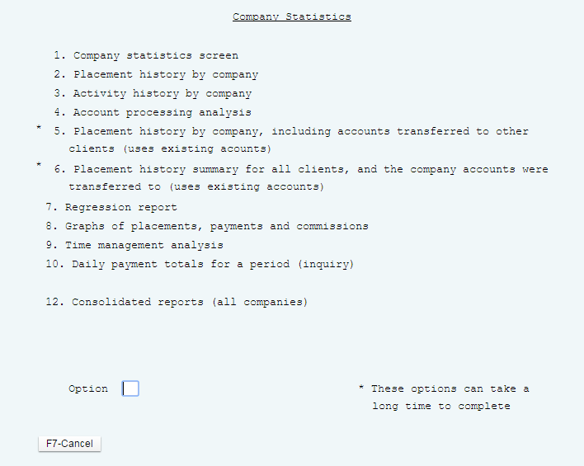
Internal Client Reports: Company Statistics
Management Menu > Company statistics options
Displays company information, placement history, activity history, daily payment totals

Slide 21
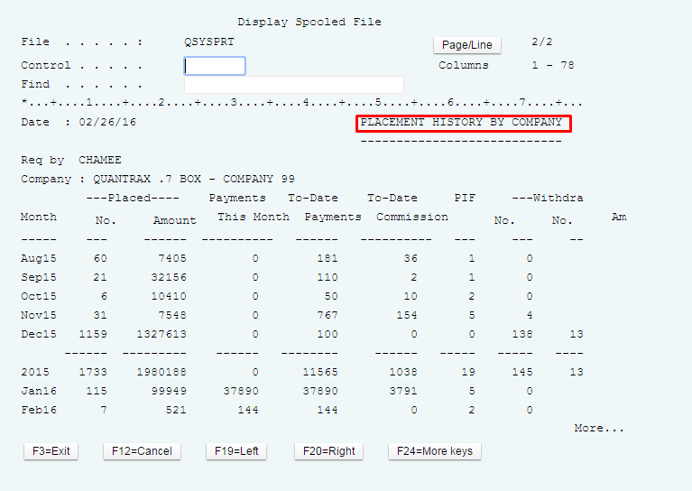
Internal Client Reports: Placement History By Company
Management Menu > Company statistics options >Placement history by Company

Slide 22
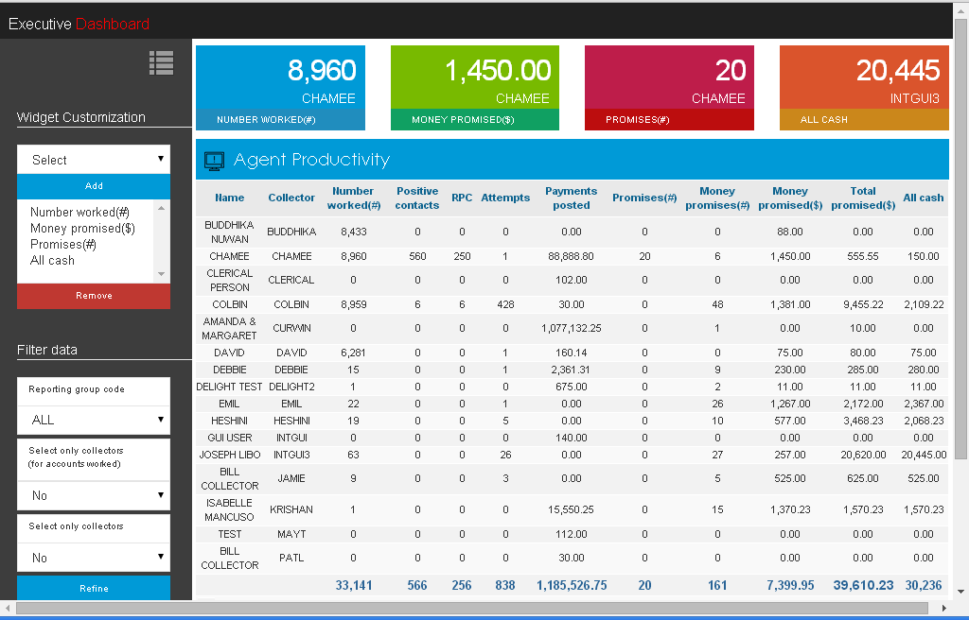
Internal Client Reports: Executive Dashboard Options
RMEx Main menu > (right- bottom) >Executive Dashboard
Displays what individual agents are doing
Shows what was generated in terms of promises and “money” (checks and credit cards)
Shows what is happening now with effort, money promised on the phone and payments posted, etc.

Slide 23
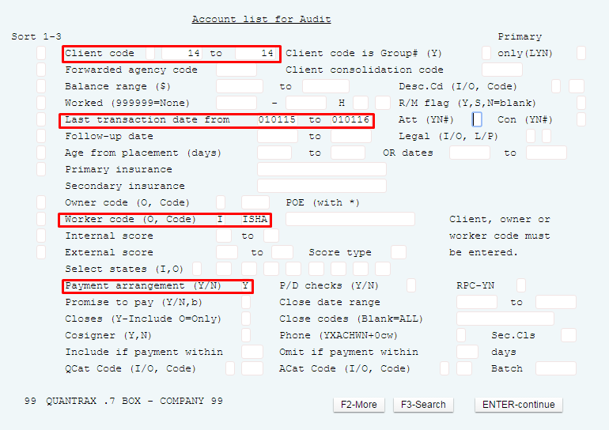
Internal Client Reports: Analyzing A Collector's Inventory - Account List For Audit
Management Menu > Smart Code/User audit options > Display accounts for audit
Use to analyze your accounts and to target groups of accounts

Slide 24
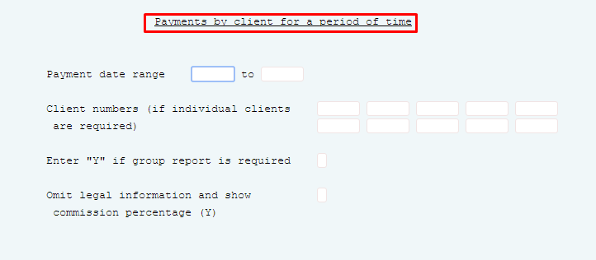
Internal Client Reports: Payments By Client For Period
RMEx Main Menu > Payment transaction menu > Payments by client for period

Slide 25
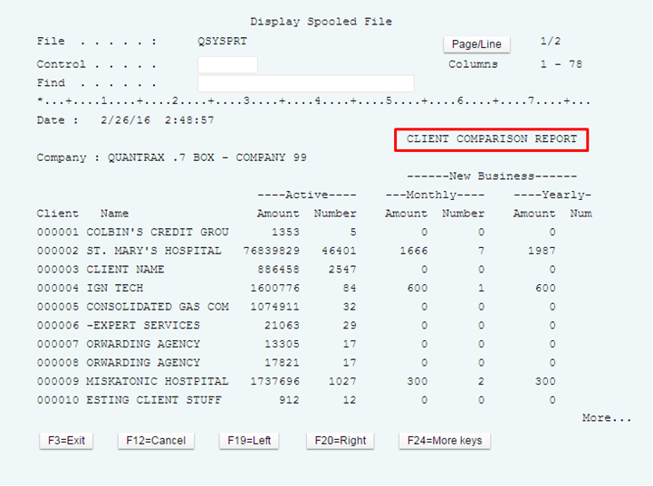
Internal Client Reports: Client Comparison Reports
RMEx Main Menu > Periodic reports menu > Client comparison OR
RMEx Main Menu > Month-end processing menu > Month-end reports > Client comparison report

Slide 26
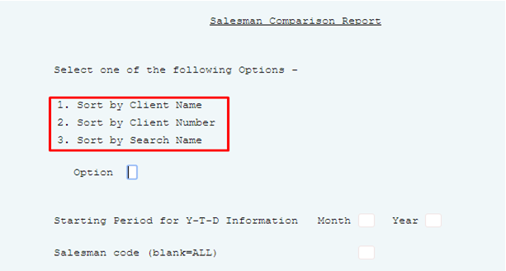
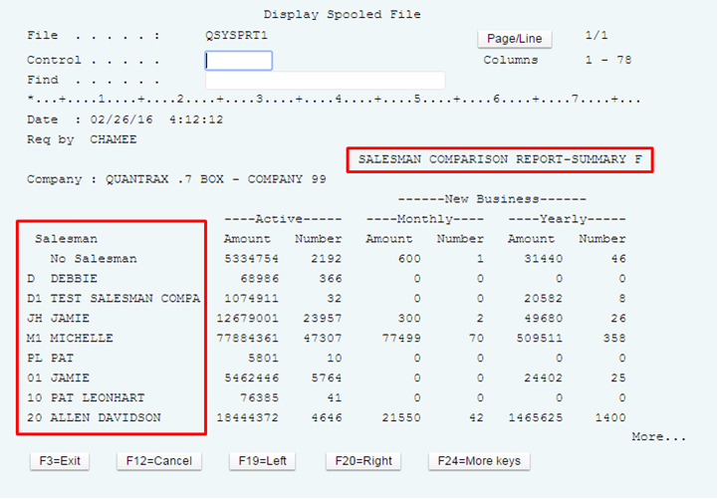
Internal Client Reports: Salesman Comparison Report
RMEx Main Menu > Month-end processing menu > Month-end reports > Salesman comparison report
Ability to sort by various options

Slide 27
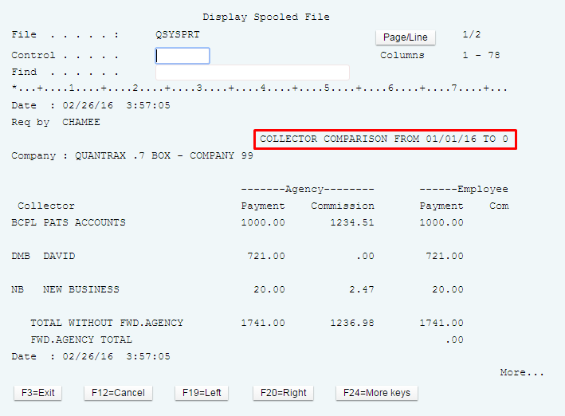
Internal Client Reports: Collector Comparison Report
RMEx Main Menu > Periodic reports menu > Collector comparison
OR
RMEx Main Menu > Month-end processing menu > Month-end reports > Collector comparison report

Slide 28
Exercises – Internal Reports To Manage Your Productivity
In your system, use COMPANY 98
Print and review the following reports:
Daily Collector Activity report – What information does this report provide?
Smart code analysis – how can this report be useful?
Time management analysis – what can you learn from this report?
Collector Comparison – What information does this report provide and how is this useful?

Slide 29
RMEx Management Training: Internal Reports To Manage Your Productivity
Thank you!

