Slide 1
RMEx Management Training: Generating Reports For Your Clients

Slide 2
Agenda
Review the different types of reports to give your clients a perspective of your accounts and overall performance
Generate and send reports automatically to your clients
Deliver reports to clients via printing or email

Slide 3
RMEx Client Reports
Client reports can be used to analyze and report on new placements, account statuses, closed accounts, and recovery analysis based on placement periods
RMEx Client Reports
New Accounts
Closed Accounts
Active Accounts
Placement & Activity History
Recoveries
Recovery Rate
Your RMEx solution. . . . .
Notes:
1. New accounts – Acknowledgements can be printed or e-mailed
2. Closed accounts can be reported with user-defined descriptions
3. Active accounts can be listed on a status report
4. Placement histories and activity history reports analyze recoveries by period of placement
Recoveries can be analyzed by other interesting options (zip code, amount placed, service dates)
How quickly are you recovering for a client? (Recovery rates)

Slide 4
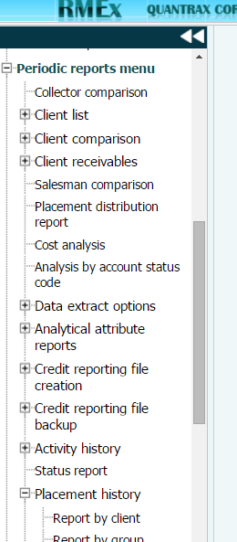
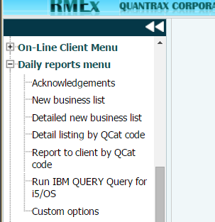
RMEx Client Reports
Reports are found in their logical locations and can be run manually
Reports like acknowledgements can be created automatically
Notes:
1. New accounts – Acknowledgements can be printed or e-mailed
2. Closed accounts can be reported with user-defined descriptions
3. Active accounts can be listed on a status report
4. Placement histories and activity history reports analyze recoveries by period of placement
Recoveries can be analyzed by other interesting options (zip code, amount placed, service dates)
How quickly are you recovering for a client? (Recovery rates)

Slide 5
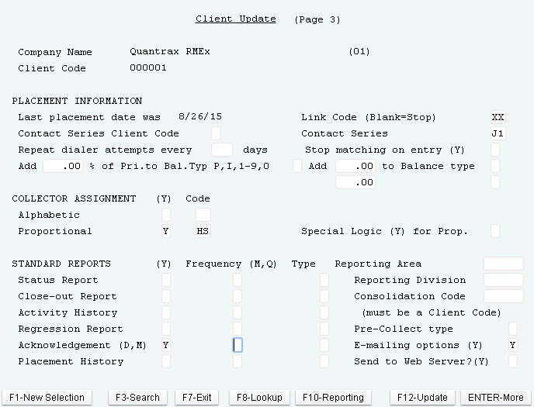
New Accounts: Acknowledgements
Management menu > Client Update > Page 3 - STANDARD REPORTS -Acknowledgements
Management > Client update > Page 3 - E-mailing options

Slide 6
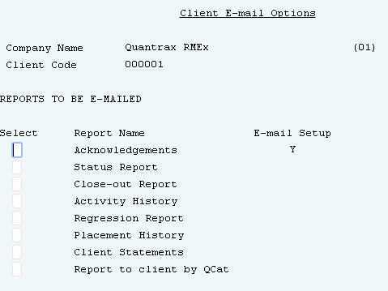
Client Reports – Add/Edit Email Options
Management > Client update > Page 3 - E-mailing options > Press Enter

Slide 7
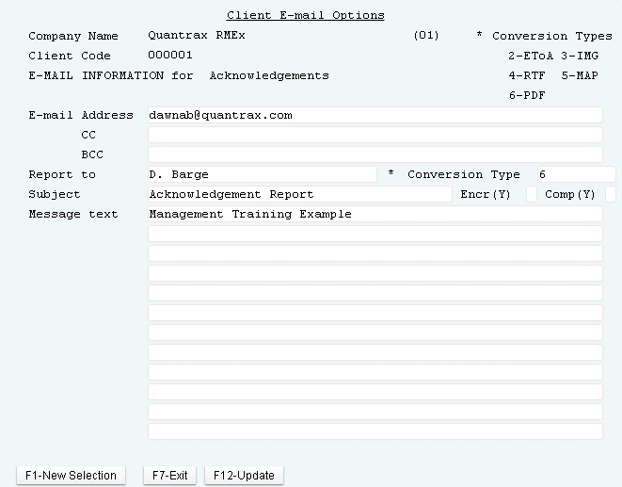
Client Reports– Setup Email Options

Slide 8
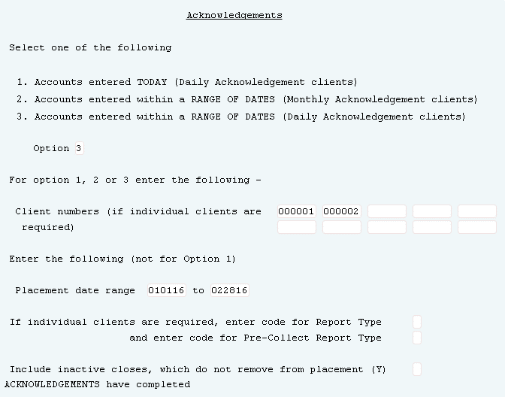
Client Reports – Print Manually Using Acknowledgements
Daily reports menu > Acknowledgements

Slide 9
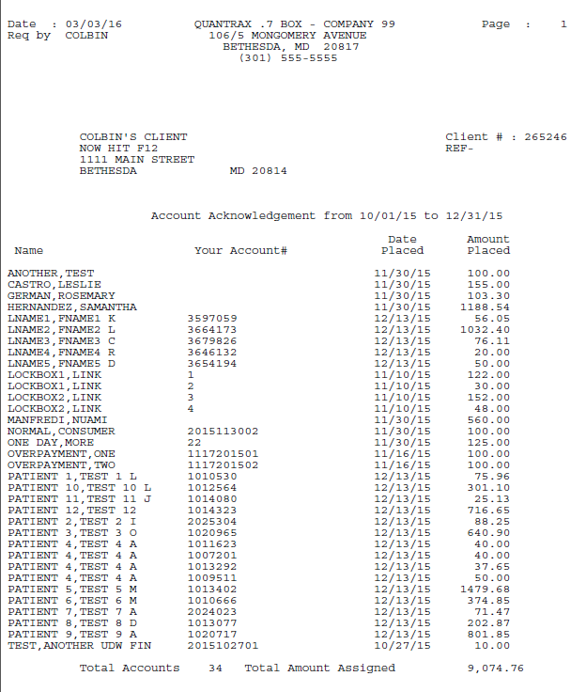
Printing Manually: Example of Acknowledgement
Daily reports menu > Acknowledgements

Slide 10
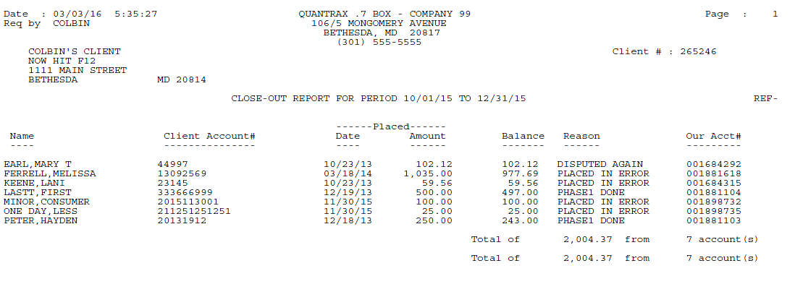
Example of Close-Out Report
Periodic Reports >Close-out report
The field Reason is user- defined by Close code or Description code

Slide 11
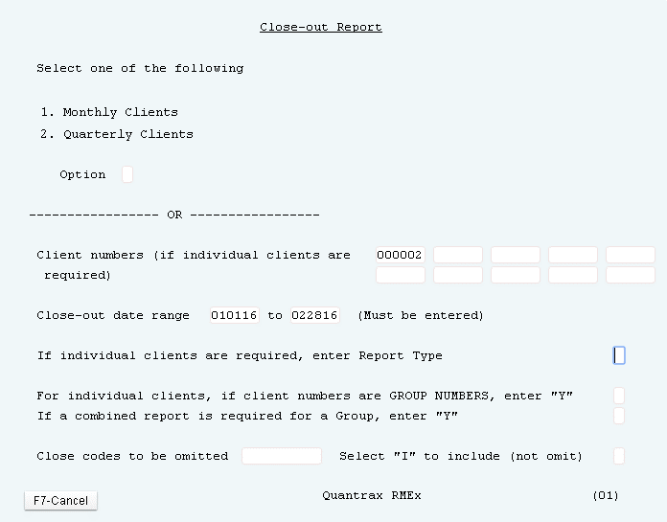
Closed Accounts - Close-Out Report
Periodic Reports >Close-out report

Slide 12
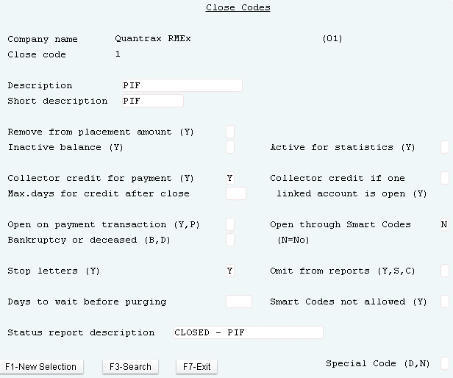
Closed Codes- Close-Out Report
System Control 1 >Close Codes
Closed accounts can be reported with user-defined description
Close codes can be omitted from the Close out report

Slide 13
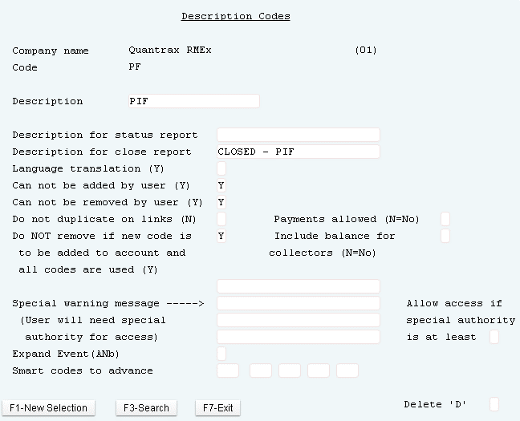
Description Codes - Close-Out Report
System Control 1 > Description codes
Description codes can provide a user-defined description

Slide 14
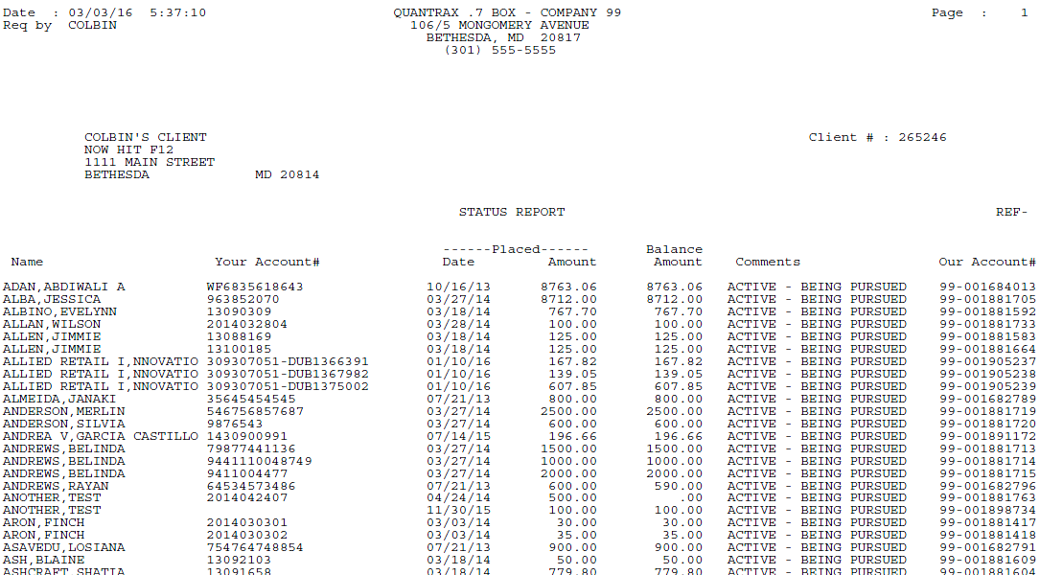
Example of Status Report
Periodic Reports > Status report
Status reports are designed to inform the client the status of their account

Slide 15
Status Report Descriptions
Periodic Reports > Status report
The status report description can be obtained by one of the following ways:
If the account is closed, the comment is obtained from the Secondary Close code if applicable; if not then the Close code is used
If the account has an Account Status code where the description for status report field was added by a Smart code
If it was entered in the Description code
If the account is in legal (not pre-legal)
If the address is bad and there are no phone numbers, the account is shown as a Skip
Collector (owner) code, where you want to let the client know the account is being handled by a special unit
An example of the use of this may be a skip tracing unit
If no description is found from the above, the account is described as active and being worked

Slide 16
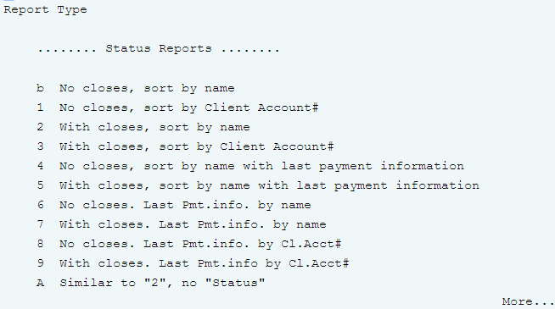
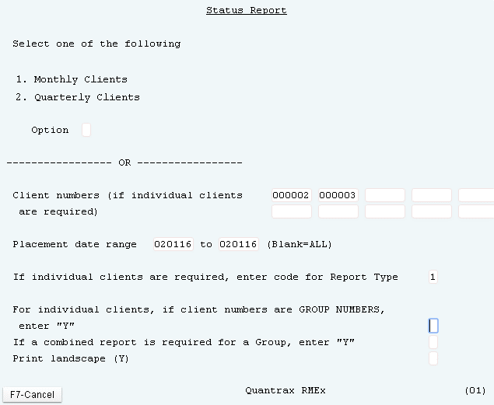
Active Accounts – Status Report
Periodic Reports > Status report
Status reports are designed to inform the client the status of their accounts

Slide 17
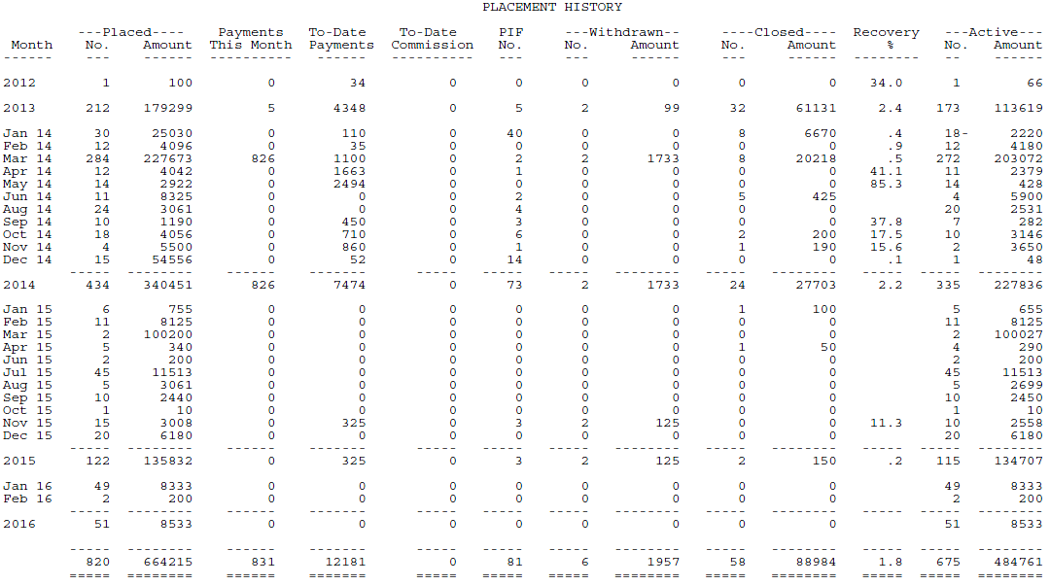
Example of Placement History
Periodic Reports >Placement history > Report by client
A statistical report that analyzes batches of placements
Notes:
Recovery % is based on the payments and dollar amount of accounts placed during the specified time period LESS inactive closes

Slide 18
Example of Placement History
Periodic Reports >Placement history > Report by client
Close Code affects the Placement History
Notes:
Recovery % is based on the payments and dollar amount of accounts placed during the specified time period LESS inactive closes
Remove from placement amount Y and Inactive balance Y as if the account was never there
Remove from placement amount Blank and Inactive balance Y Moves to withdrawn
Review Active for Statistics

Slide 19
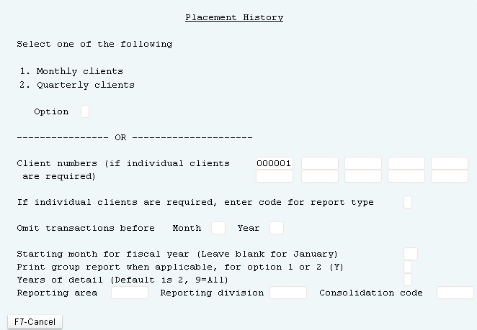
Placement History Report
Periodic Reports >Placement history > Report by client
Analyze recoveries by period of placement

Slide 20
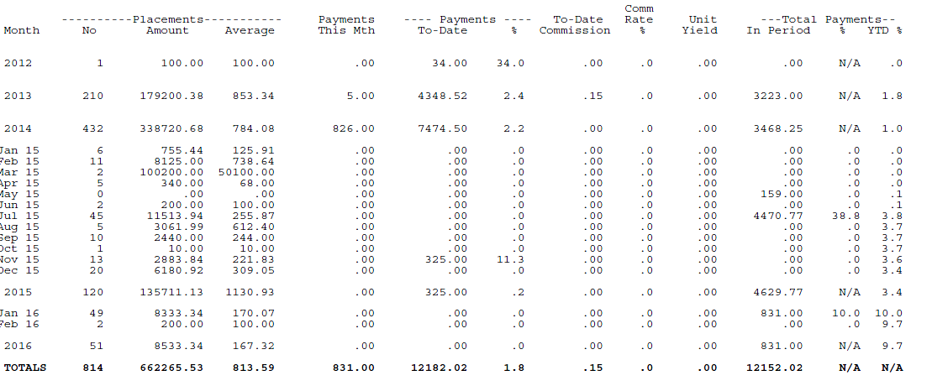
Activity History Report
Periodic Reports > Activity history > Report by client
Analyzes placements and payments by placement period and month of activity
Notes:
Payments this month, are just that – The payments received for the month against placements for that month
Payments to date are the total dollar amount collected to date against the placed amount for the time period.
Unit Yield is the Per account return. (To date commission divided by the number of placements)
Total Payments In Period are the total dollar amount collected for the client during the specified period regardless of placements
% the percent is the percent of payments generated from the placed amounts.
YTD % is the total year to date payments received against all accounts for this client.

Slide 21
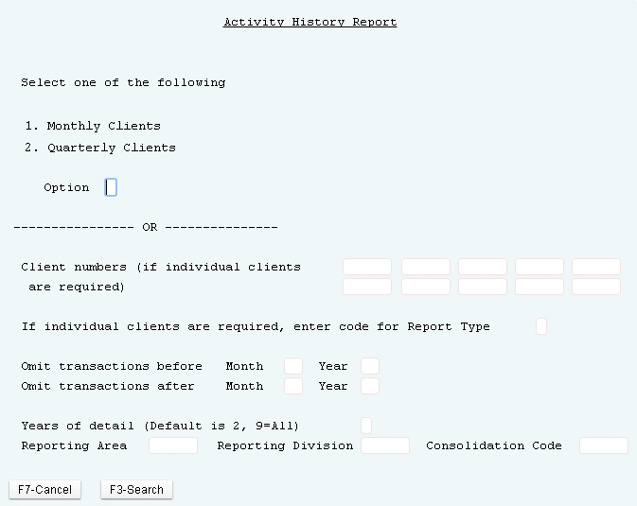
Activity History Report
Periodic Reports > Activity history > Report by client
Analyze recoveries by period of placement

Slide 22
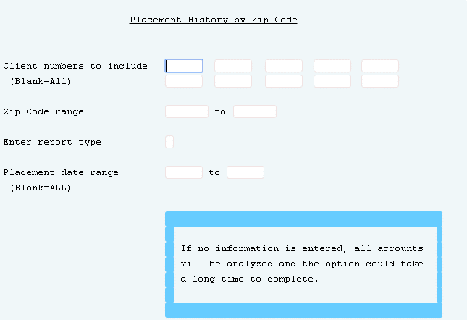
Analyzing Recoveries
Periodic Reports > Placement history > Report by zip code
Reviewing placement history options can be reported by: zip code, amount placed, service dates, etc.

Slide 23
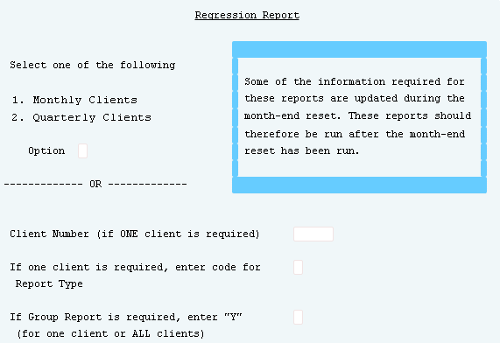
Analyzing Recoveries – How Quickly Are You Recovering For A Client
Periodic Reports > Regression report
Notes:
This is a very important report and can be used to set up rules within Smart Codes for closing accounts based on the age of accounts from placement.
Regression Report:
This is a statistical report which analyzes payments based on the month in which the
Payments were received. It indicates the amounts which were collected against the placement, during each month following the placement period.

Slide 24
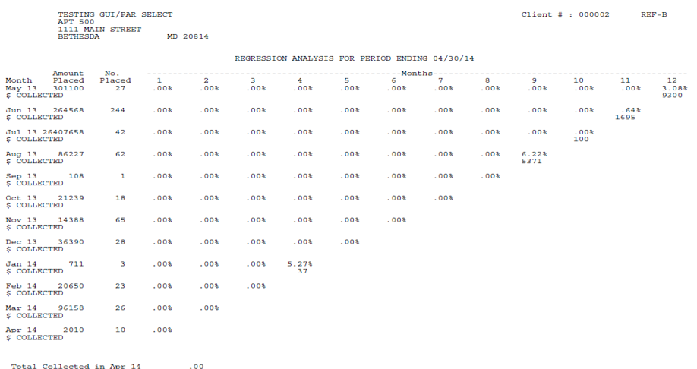
Analyzing Recoveries – How Quickly Are You Recovering For A Client
Periodic Reports > Regression report
Analyzes payments received by month for groups of placements (grouped by month of placement)
Only contains reportable balances
Placements do not include withdrawn accounts
Notes:
This is a statistical report that presents information about how quickly you are recovering money on batches of placements (by month of placement). It shows the amounts which were collected against the placement, during each month following the placement period. It allows you to evaluate when it may be time to “stop working” accounts because the amounts collected per month have dropped to a very small percentage. If all the accounts have been worked, you will probably collect most of what can be recovered within a few months. Long-term payment arrangements would accounts for some collections, but it is usually not profitable to apply resources to non-paying accounts after a certain period of time.

Slide 25
Exercises – Generating Reports For Your Clients
In your system, use COMPANY 98
Where are the key client reports?
Status Report - Run and review a Status Report. How would you use a status report?
Close-out Report – Run this report. Why would an account NOT appear on this report even though that account was closed?
Run a Placement History report.
What is the differences between a withdrawn account and a closed account?
How is the recovery percentage calculated?
Run a Regression Report - How can this report be used to determine how much effort to put into a client’s accounts?
Run an Acknowledgement report and a New Business report, some info is the same some is different. Without just listing the fields, what is the overall differences for these reports?

Slide 26
RMEx Management Training: Generating Reports For Your Clients
Thank you!

