Slide 1
RMEx Management Training: Handling Disputes and Objections

Slide 2
Agenda
Understanding how to flag accounts in RMEx for various types of disputes or objections
Warning users that an account is being disputed or has an objection when the account is displayed
Closing accounts automatically based on its status
Moving an account from an agent to a supervisor
Notifying and providing account information to your client when an account is being disputed or has objections
Adding an attorney on the account, how mail is handled when there is an attorney

Slide 3
Flagging Accounts In RMEx For Various Types Of Disputes Or Objections
What does the collector need to know as an account is presented to them?
Description Codes
User-defined
Shows collectors that certain event has happened on an account
Store special account info/characteristic

Slide 4
Description Codes - Examples
Bankruptcy
Legal Dispute
Dispute Resolved
No Credit Reporting
Billed Insurance
Returned To Client
Sent Final Demand Letter
Garnishment Filed
Do Not Send to Dialer
OK To Speak To Spouse
Your RMEx solution. . . . .

Slide 5
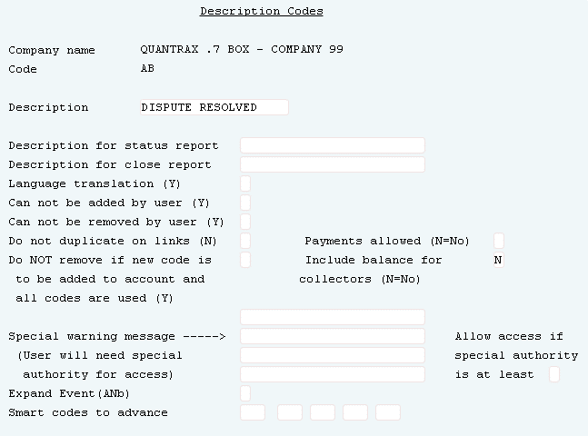
Creating Description Codes
System Control menu 1 > Description codes > Description code
Can be added to an account manually or only with a Smart code
Can choose to have code duplicate on linked accounts

Slide 6
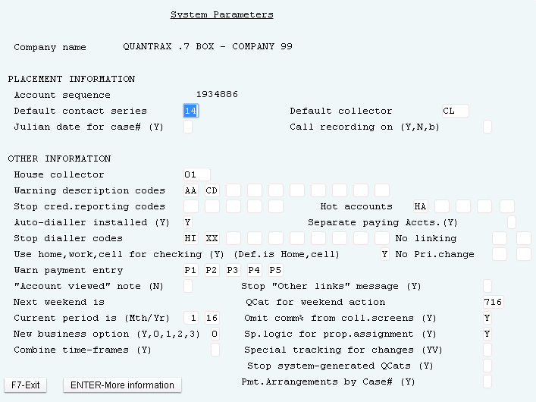
Adding Warning Message With Description Codes
System Control 1 > System Parameters
If one of the10 Description Codes exist on an account ( or within a linked group), the consumer's name displays in red on Account detail screen

Slide 7
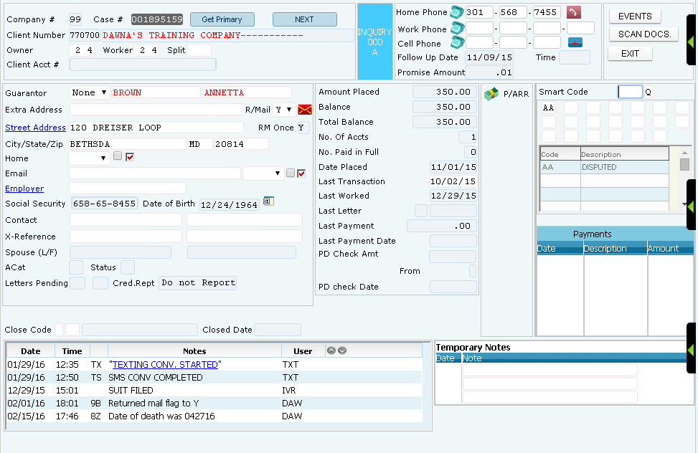
Description Codes – Warning Message
System Control 1 > System Parameters

Slide 8
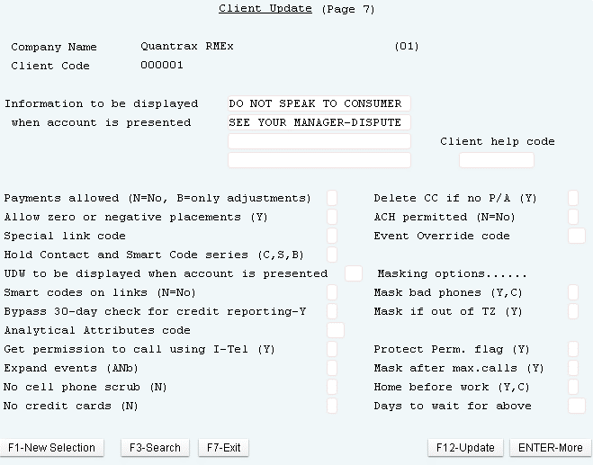
Warning Users That An Account Is Being Disputed Or Has An Objection When The Account Is Displayed
Management Menu > Client Update > Page 7- Information to Be Displayed When Account is Presented
Useful tool for any kind of messages (warning, general info)
Updates “on-the-fly”

Slide 9
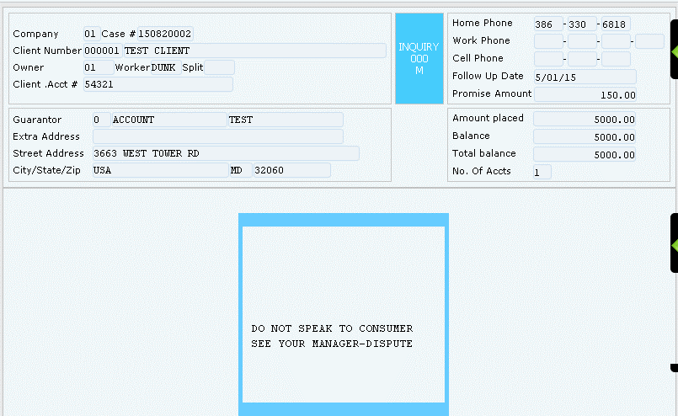
Warning Users That An Account Is Being Disputed Or
Has An Objection When The Account Is Displayed
Management Menu > Client Update > Page 7- Information to Be Displayed When Account is Presented
Example: Warning messaged displays when account is presented to agents

Slide 10
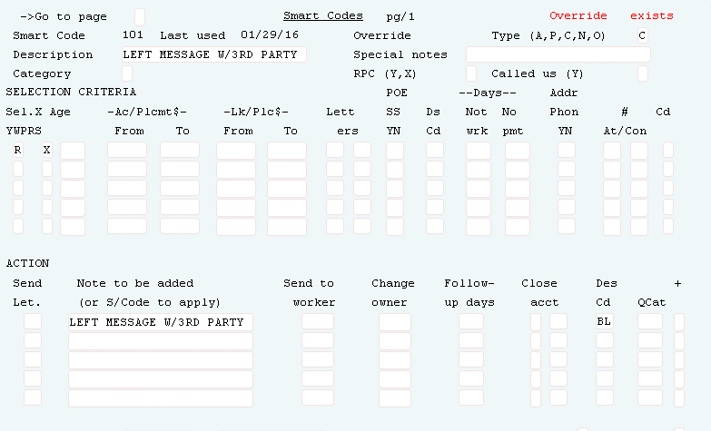
Automating Description Codes
System Control menu 1 > Smart codes
Use to make decisions with Smart codes

Slide 11
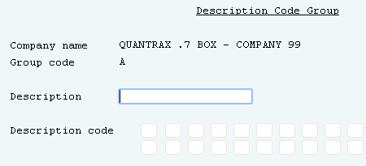
Using Description Code Groups
System Control menu 1 > Description codes > Description code group
Use to remove several description codes at one time

Slide 12
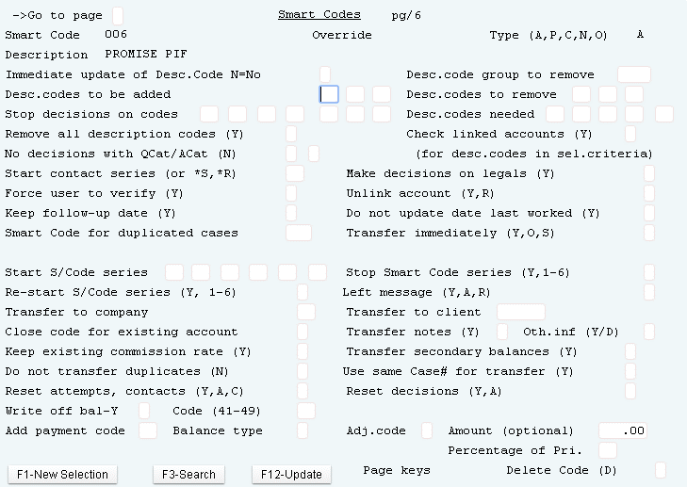
Automating Description Code Groups
System Control menu 1 > Smart codes > Page 6
Use to make decisions with Smart codes

Slide 13
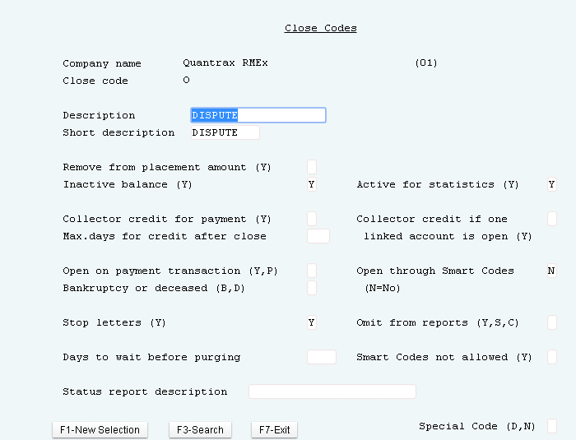
Creating Close Codes
System Control 1 > Close Codes
Two types of Close codes
Active
Inactive

Slide 14
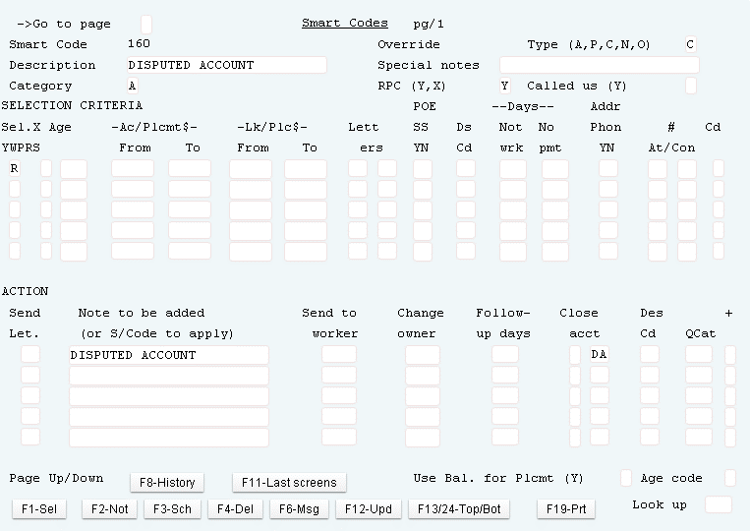
Closing Accounts Automatically Based On Its Status With Smart Codes
System Control 1 >Smart Codes > Page 1

Slide 15
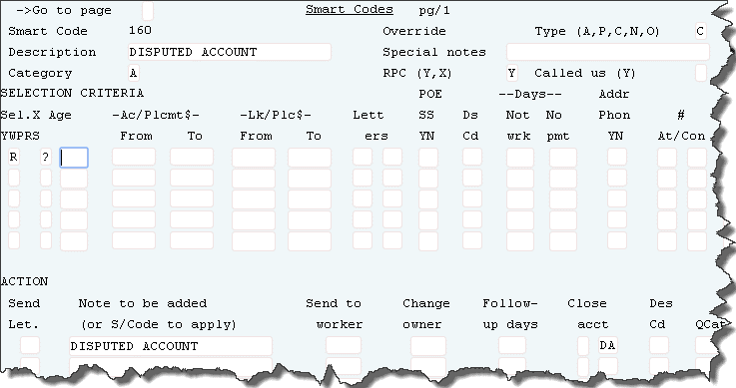
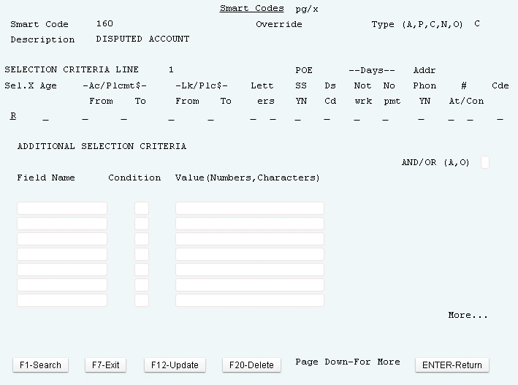
Closing Accounts Automatically Based On Its Status With Smart Codes
System Control 1 >Smart Codes > Page 1 > ? Logic Page 2
Look for if multiple description codes exists – apply Smart code

Slide 16
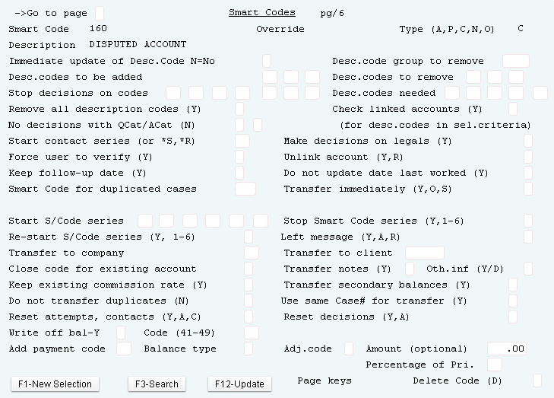
Closing Accounts Automatically Based On Its Status With Smart Codes
System Control 1 >Smart Codes > Page 6 - Close Code for Existing Account

Slide 17
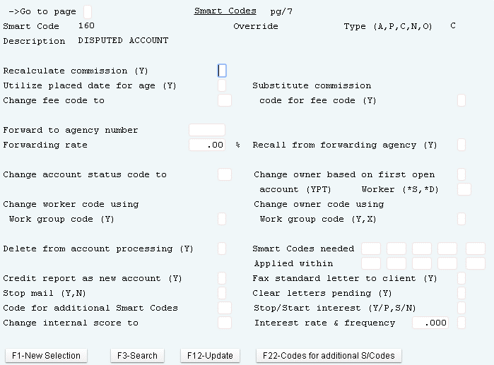
Moving An Account From An Agent To A Supervisor
System Control 1 > Smart Codes > Page 7- Change Worker
System Control 1 > Smart Codes > Page 7- Change Owner

Slide 18
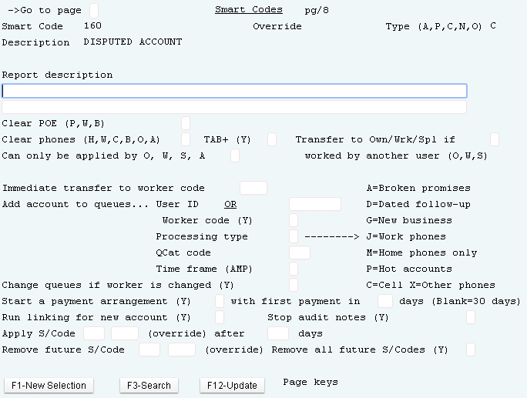
Moving An Account From An Agent To A Supervisor
System Control 1 > Smart Codes > Page 8
On page 8 of the smart code, setup the actions for moving a disputed account to a supervisor

Slide 19
When An Account Is Being Disputed /Has Objections –
Control By QCat
Automate on Accounts
Accounts Presented to Agents
Reports to Clients
Manage Using QCats

Slide 20
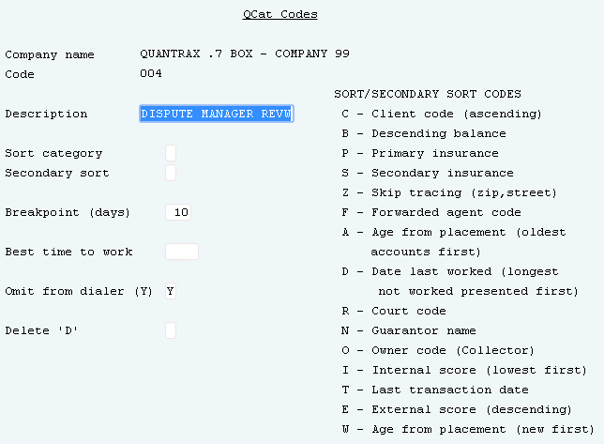
When An Account Is Being Disputed /Has Objections –
Control By QCat
System Control 2 > QCat> By Company
Setup the QCat for disputed accounts to omit from dialer.
For legal disputes, use an R as the secondary sort

Slide 21
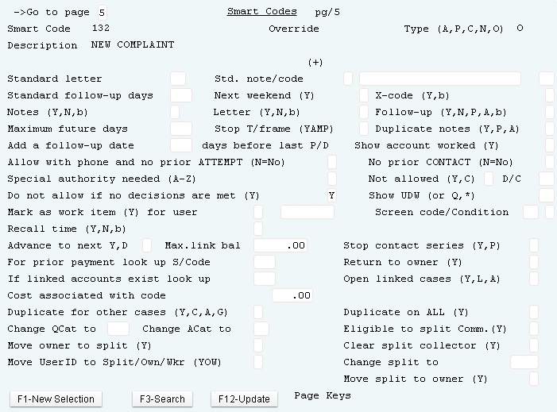
When An Account Is Being Disputed /Has Objections –
Control By QCat via Smart Code
System Control 1 > Smart Codes > Page 5 - Change QCat
Specify the QCat to send the account to

Slide 22
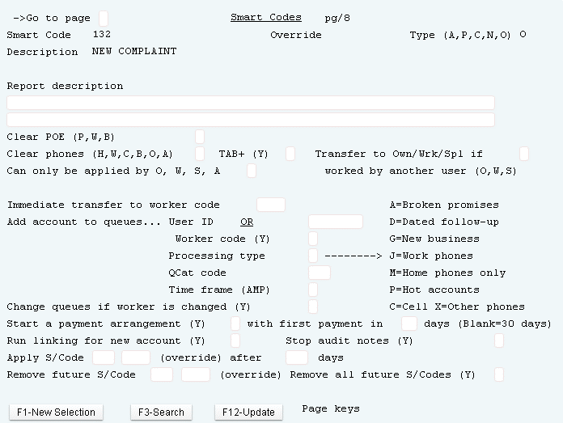
When An Account Is Being Disputed /Has Objections –
Control By QCat via Smart Code
System Control 1 >Smart Codes > Page 8 - QCat Code
Specify the QCat to transfer the disputed account to

Slide 23
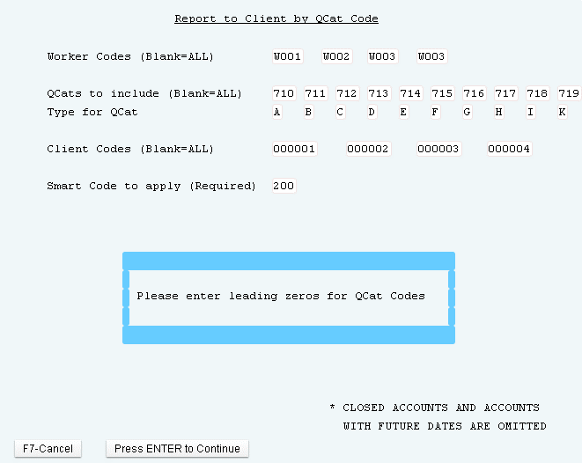
When An Account Is Being Disputed /Has Objections –
Report to Client by QCat
Management menu > Account Processing Reports > Report to Client by QCAT Code
Generate QCat reports by client
Specify a smart code to be applied to the account when this report is run

Slide 24
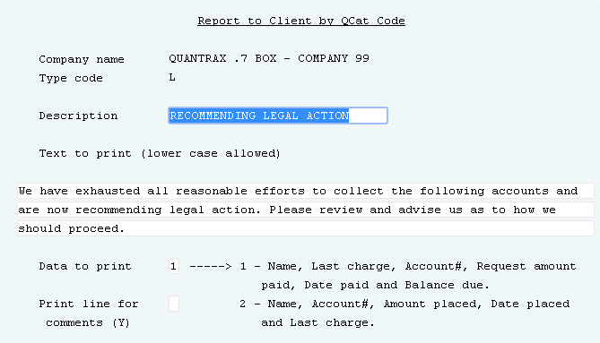
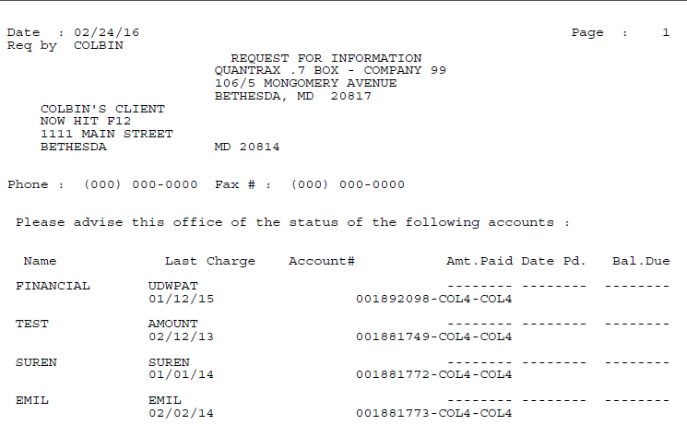
When An Account Is Being Disputed /Has Objections –
Report to Client by QCat – Modify Text In Report
Management menu > Account Processing Reports > Update Text For Report To Client By QCat Code
Default text

Slide 25
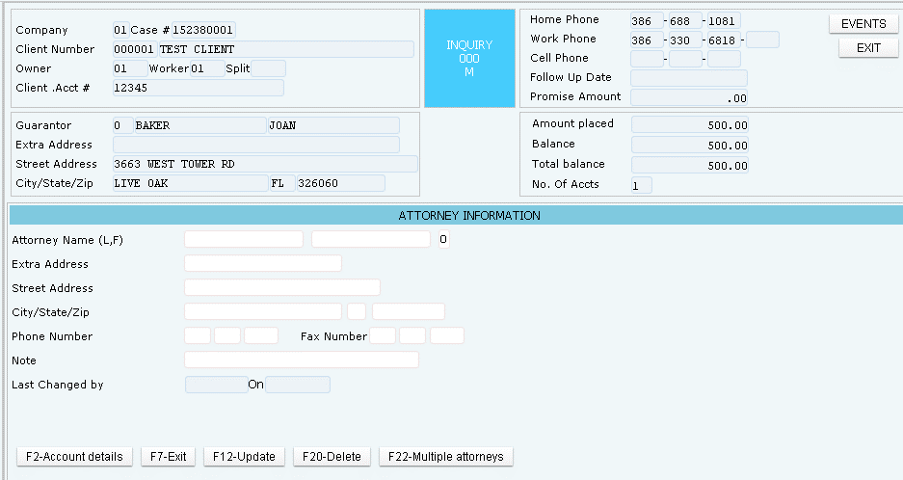
Adding An Attorney On The Account - How Mail Is Handled When There Is An Attorney
Account Details > F2 - Attorney Screen
If a consumer is represented by an Attorney here is where you enter the Attorney’s information.
When there is Attorney info all letters generated for this account will go to the Attorney

Slide 26
Exercises – Handling Disputes And Objections
In your system, use COMPANY 99
Your contract with your client says that any account with a balance under $200 and is being disputed or has objections should be automatically closed as soon as your agency has been told about the dispute/objection.
Create an account with a balance of $150 and flag it as a disputed an account.
Setup your company so you are complying with your contract with your client.
Test that everything is working with the account you created.
What do you need to do if this same consumer has multiple accounts with this client?
Your contract with your client requires that any account that is disputed or has objections with a balance over $1000 must be automatically witched from the agent to their supervisor as soon as your agency has been told about the dispute/objection.
Create an account with a balance of $2000 and flag it as a disputed account.
Setup your company so you are complying with your contract with your client.
Test that everything is working with the account you created.
What do you need to do if this same consumer has multiple accounts with this client?

Slide 27
Exercises – Handling Disputes And Objections (continued)
In your system, use COMPANY 99
One of your agents had just told you that an account is being disputed by a consumer. You want to automatically communicate this disputed account information to your client via RMEx. This is part of your contract with your client when you are alerted about a dispute, objection or any legal matter.
Setup your company so you are complying with your contract with your client.
How can you view this information before you send it to your client?
What do you need to do if this same consumer has multiple accounts with this client?
Herman Munster was just added as the attorney to one of your accounts you added into the system.
We want mail to go directly to the attorney and not the consumer.
Mr. Munster’s address is 1313 Mockingbird Lane, Salem MA 01971.
What will happen if the consumer has multiple accounts with this client?

Slide 28
Exercises – Handling Disputes And Objections (continued)
In your system, use COMPANY 99
Accounts that are marked as disputed or have objections, must display a message before the account details are displayed to agents.
The following special message should be displayed when the account is presented, “Please do not speak to this consumer; this account is being disputed by the consumer”.
The account name should also be displayed in red.
You want to mask all consumer phone numbers to agents, when an attorney is involved. How do you do that?

Slide 29
RMEx Management Training: Handling Disputes and Objections
Thank you!

