Slide 1
RMEx Management Training: Processing Payments

Slide 2
Agenda
Processing different types of payment transactions, checking for accuracy, and posting payments
Reviewing different Balance Types
Applying payments consumers accounts
Tracking different types of payments (checks, money orders or credit cards)
Taking a file from your client and applying it to the consumers accounts
Handling different types of payments (Paid agency and paid client, balance adjustments)
Making decisions based on an NSF, over payment to Agency, over payment to client, etc.
Handling transactions between your agency and your client
Distributing payments across accounts for the same consumer
Understanding commission rates on an account
Setting and authenticating credit cards in real time
Setting up direct checks from a consumer
Processing credit card payments, and direct checks in a batch
Balancing on a daily basis for accurate account processing
Understanding the Payment Reports
Notes:
Payment processing is a very important function which affects clients, consumers and the agency and requires organization, accuracy and an eye for detail

Slide 3
Balance Types
Payment Transactions
Primary Balance
Interest
Other Costs
Your RMEx solution. . . . .
Notes:
A consumer may have a “Primary” balance, but what if there are other costs such as a court cost, and the court cost needs to be separated, and paid separately from the “Primary” balance. We What review these different “Balance types”

Slide 4
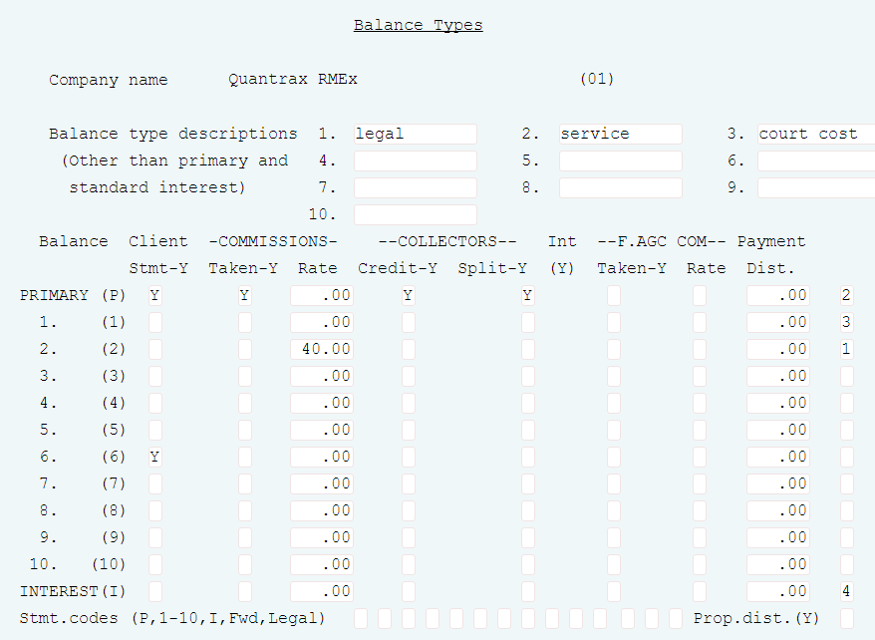
Balance Types
System Control 1 menu > Balance types > Options for the company
Secondary balance types are user defined
Client statements are affected
Notes:
Secondary balances and their properties are defined by the management. Some of these options include the ability to give collectors credit, report on the remittance statement and compute fees based on the amount collected. (Court costs, Services and returned check charges are examples of secondary balances.)

Slide 5
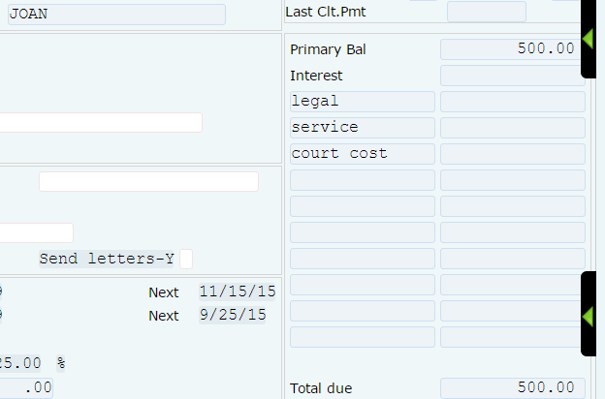
Balance Types
System Control 1 menu > Balance types > Options for the company
The balance type description will also appear on the accounts

Slide 6
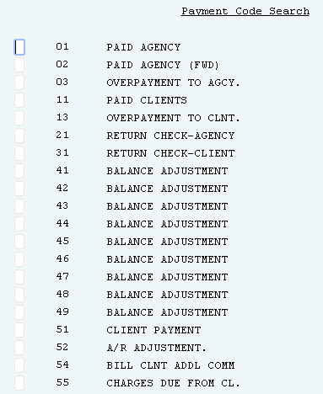
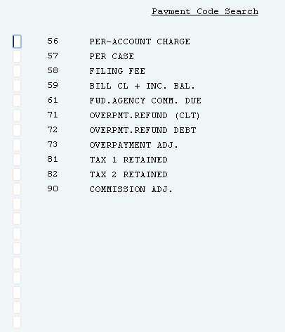
Applying Payments To Consumer Accounts
System Control 2 menu > Payments and Adjustment Codes > Payment Codes
Payment codes define the types of payment
Balance Adjustments 41 thru 49 are user defined
Balance Adjustments to not show up on statements
Notes:
Defining the type of payments a user will be enters.

Slide 7
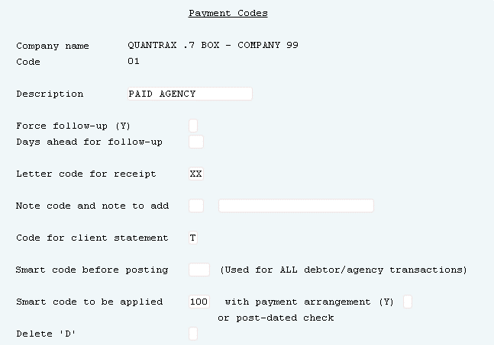
Applying Payments To Consumer Accounts
System Control 2 menu > Payments and Adjustment Codes > Payment Codes
Actions can be taken based on a type of payment
Description on a payment code can be changed, but how that payment code works cannot be changed.

Slide 8
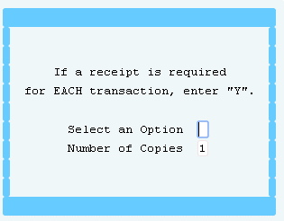
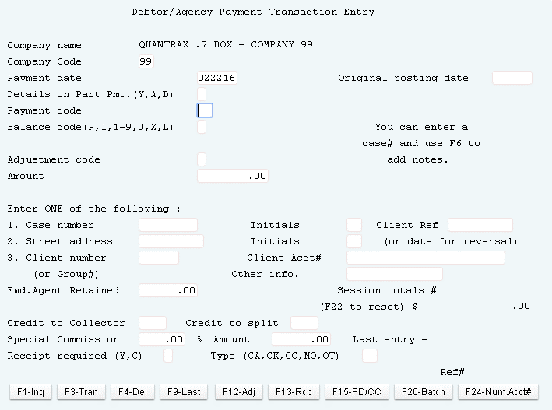
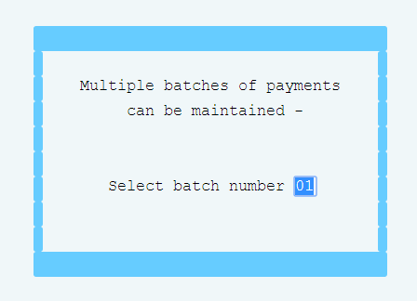
Applying Payments To Consumer Accounts
Payment Transaction menu > consumer/Agency entry
Entered payments are added to a batch
Use option to request a payment receipt when applying the payment
Use Payment Codes at the time of payment and only the correct code should be used
Notes:
The following screens are displayed when this option is selected when you go into consumer Agency entry
The system will automatically assign batch number 01 on this screen. What is a batch? If you have multiple batches open you will need to assign a different number and hit enter.
The following fields can be entered:
PAYMENT DATE - This is automatically filled in with the today’s system date. You should not change this date unless instructed to do so by Management. The system will not allow you to enter a future date however a prior date can be entered. Entering a prior date which falls within a period when a remittance statement was already processed can have serious consequences.
DETAILS ON PART PMT – RMEx will allow you to distribute a payment among different accounts which belong to the same consumer (linked accounts). This option deals with the need to display another screen in the event that you are processing a partial payment, or wish to apply a payment to a specific account in the linked group. The other screen also allows you to change some consumer information and display detailed account information. This field is described later on when we discuss Processing Linked Accounts.
PAYMENT CODE - There are different codes for each type of transaction. It is very important that the correct payment code is used for the transaction, since client remittance statements, cash and statistics are impacted.
ORIGINAL POSTING DATE – If you are entering a payment that was posted by you client, you can enter that date here.

Slide 9
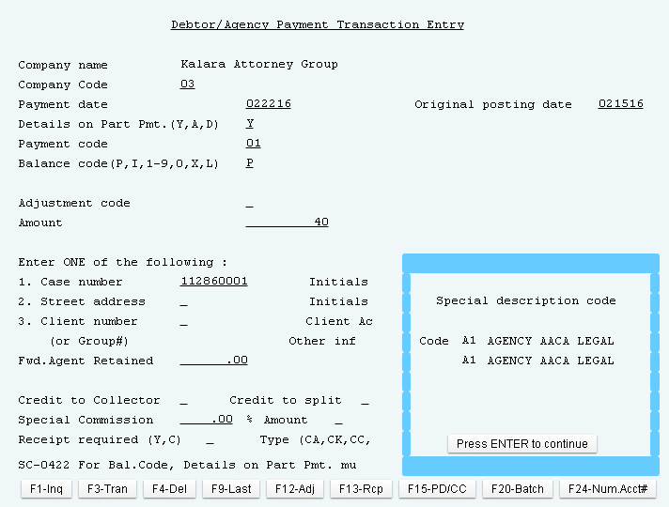
Tracking Different Types of Payments – Paid Agency
Payment Transaction menu > consumer/Agency entry
Notify a user about special conditions when applying payments

Slide 10
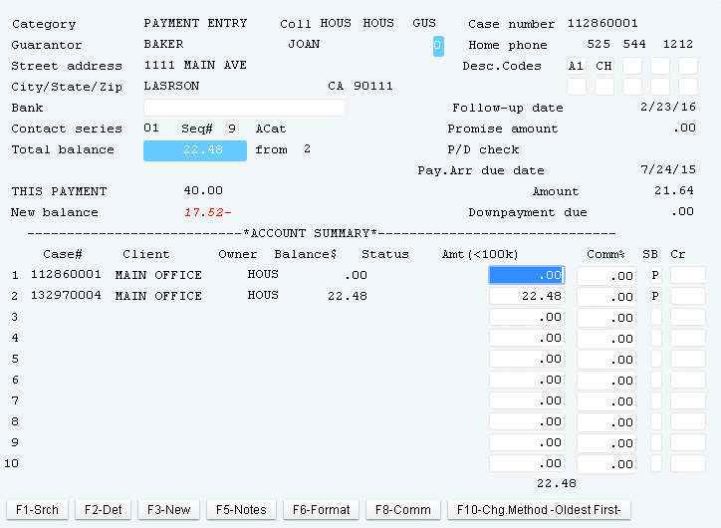
Distributing Payments Across Accounts For The Same Consumer (Linked Accounts)
Payment Transaction menu > consumer/Agency entry
Use to distribute a payment across the linked accounts
Spread the payment across the linked group with F10 - Change Method – Oldest First

Slide 11
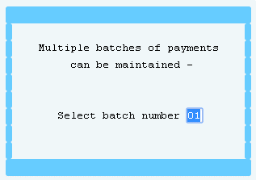
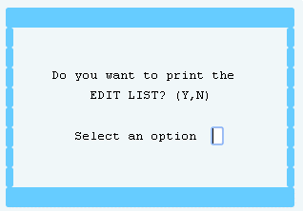
Applying Payments To Consumer Accounts (continued)
Payment Transaction menu > consumer/Agency entry
Batching lets you enter groups of payments in different buckets, and each bucket can be posted at different times
Always request an edit before posting

Slide 12
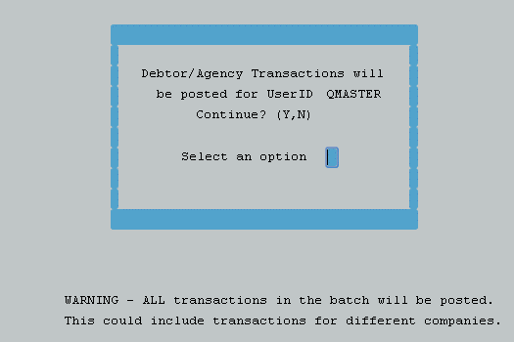
Balancing On A Daily Basis For Accurate Account Processing
After reviewing the edits you can post the accounts
Payment entry and payment posting are based on User IDs

Slide 13
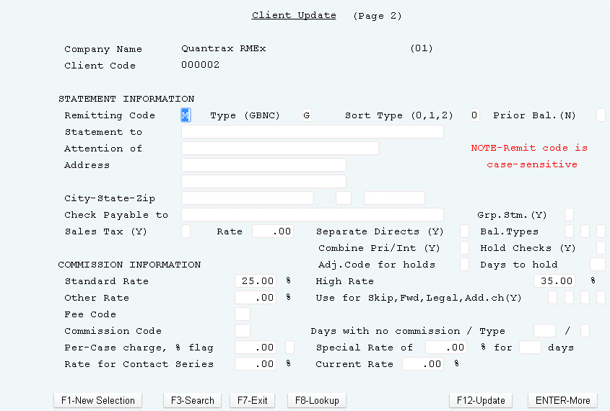
Understanding Commission Rates On An Account
Management menu > Client Update > Page 2
Commissions are at the account level (changing the client does not change the account)
Fee codes can be used to give different commissions based on rules that were setup

Slide 14
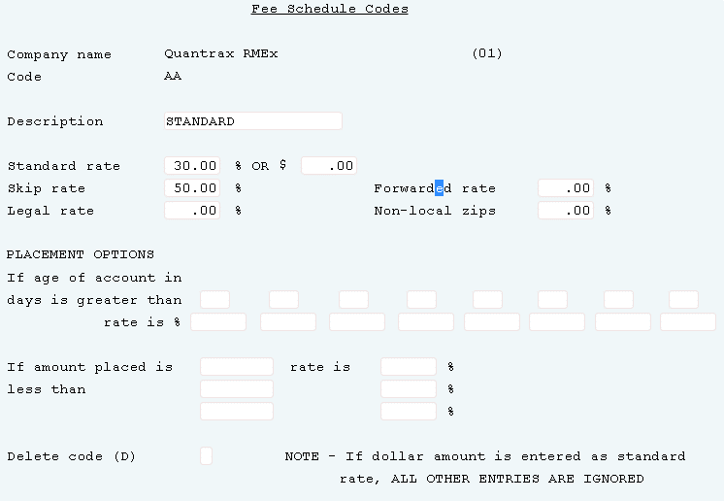
Working With Fee Codes
System Control 1 menu > Fee Codes
Fee Codes automatically adjusts the commission code on an account based on various conditions

Slide 15
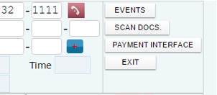
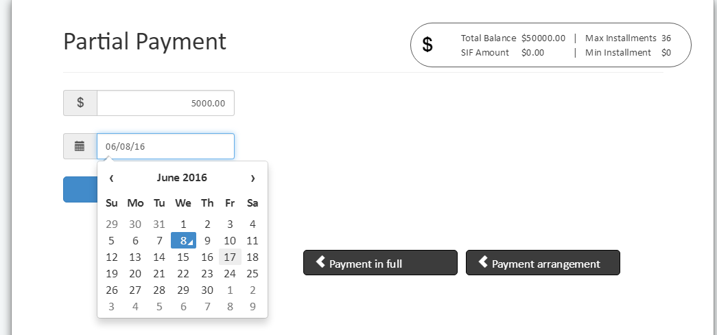
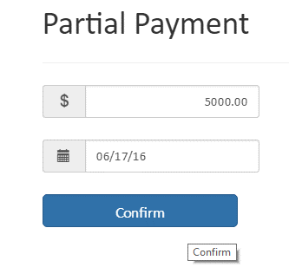
Setting Up Direct Checks From A Consumer
The Payment Interface for setting up direct checks

Slide 16
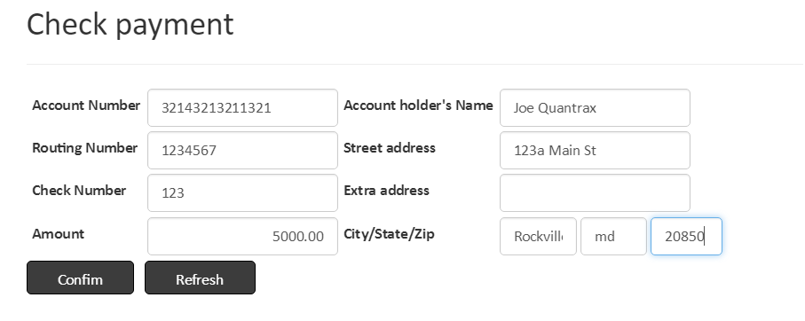
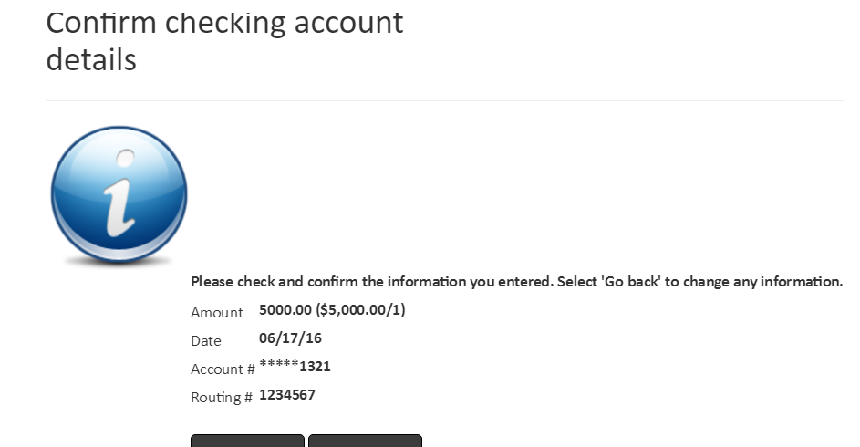
Setting Up Direct Checks From A Consumer
The Payment Interface for setting up direct checks

Slide 17
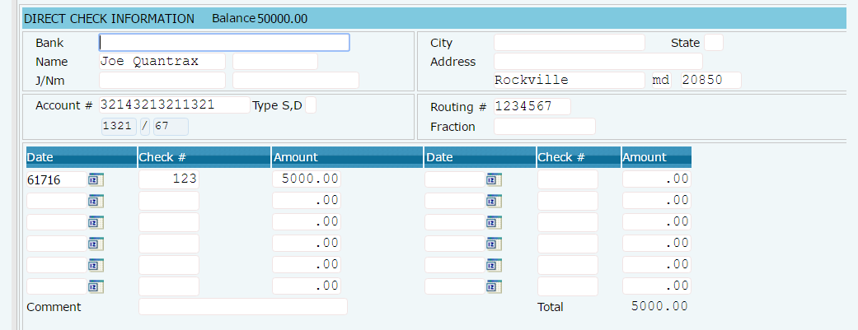
Setting Up Direct Checks From A Consumer
> Account Detail Screen > F9 P/A > F14 Direct Checks

Slide 18
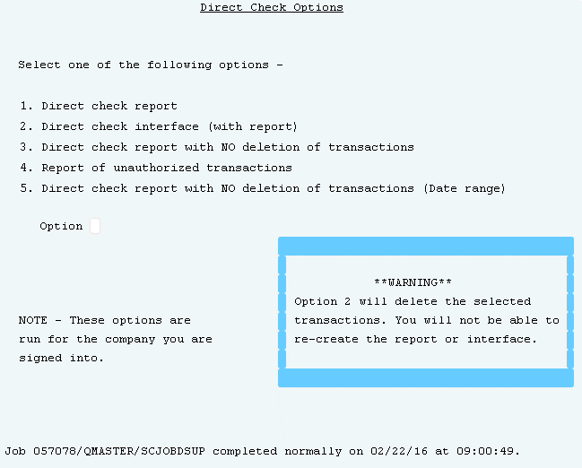
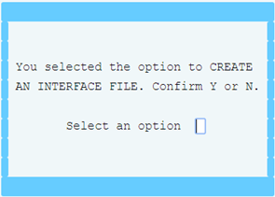
Running Direct Checks Options For Posting
Payment Transaction menu > Direct Check> Direct check interface (with report)
Direct Check option must be run before Post Dated Check Options
Notes:
Remember direct checks should be processed before the postdated check options. This will merge the direct checks due today with the postdated checks due today. This allows you to apply and post the direct checks and the postdated checks together because the actual account application and posting occurs when the postdated check processes are ran.

Slide 19
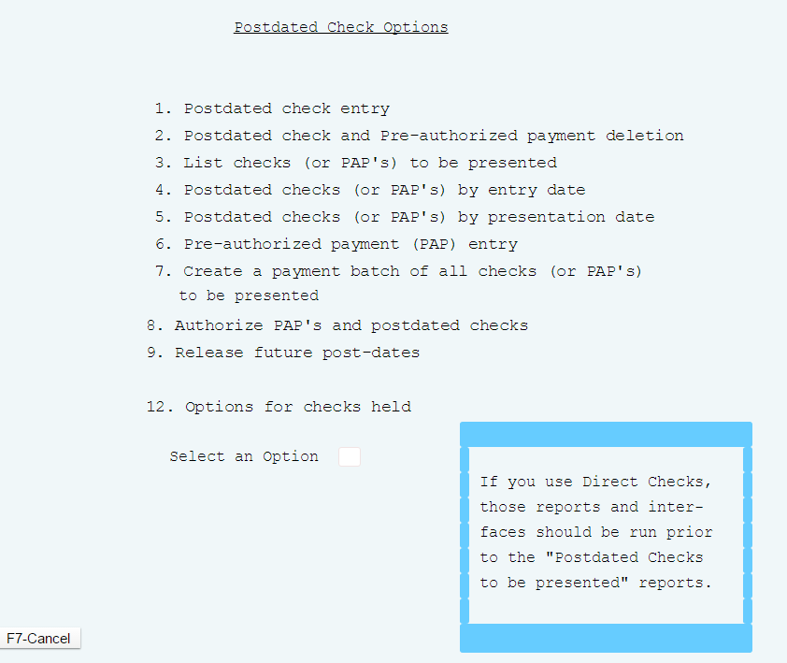
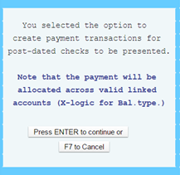
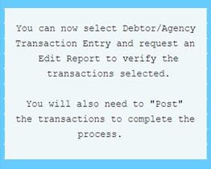
Running Post Pated Options - REQUIRED
Payment Transaction Menu > Post Dated Checks
Post dated check options must be run after Direct Check options
Notes:
Remember direct checks should be processed before the postdated check options. This will merge the direct checks due today with the postdated checks due today. This allows you to apply and post the direct checks and the postdated checks together because the actual account application and posting occurs when the postdated check processes are ran.

Slide 20
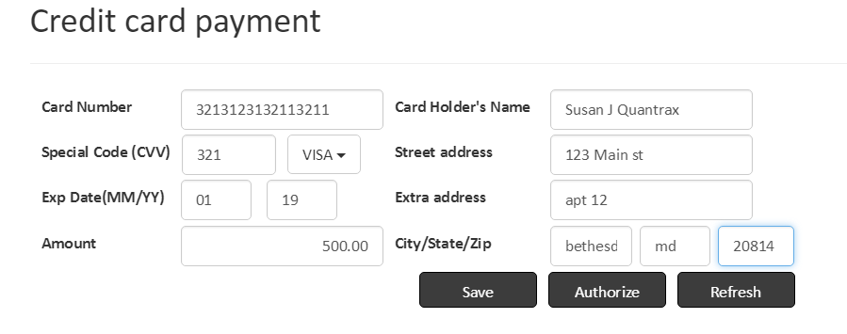
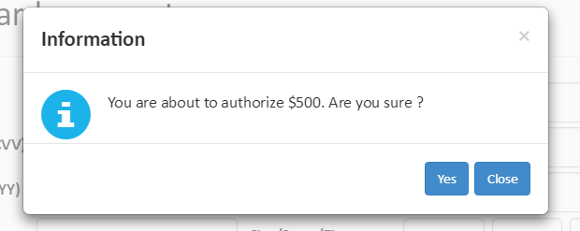
Setting Up And Authenticating Credit Cards In Real Time
Credit Cards from the Payment Interface
Enter credit cards on a consumers accounts
Authorize credit cards in real time, this requires a third party vendor

Slide 21
Setting Up And Authenticating Credit Cards In Real Time
Credit Cards from the Payment Interface
Enter credit cards on a consumers accounts
Authorize credit cards in real time, this requires a third party vendor
Tab Q to Credit Cards

Slide 22
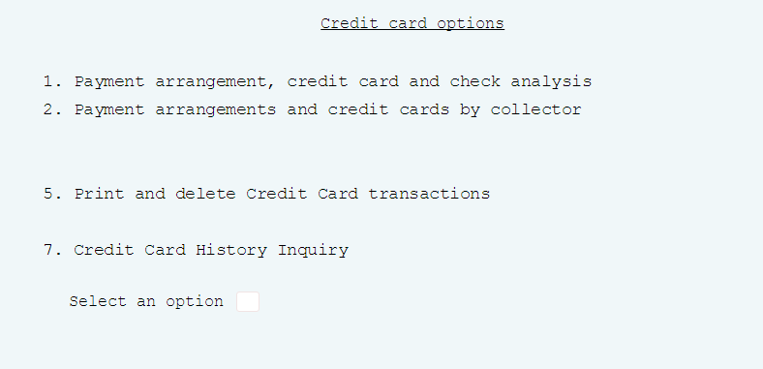
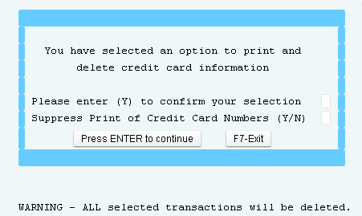
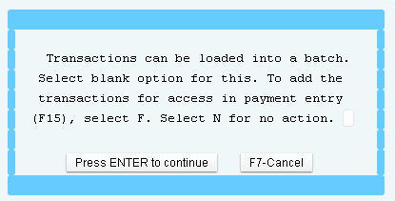
Processing Credit Card Payments, And Direct Checks In A Batch
Payment Transaction menu > Credit card options
Run the option to print and delete credit cards daily
Can also be applied to a batch

Slide 23
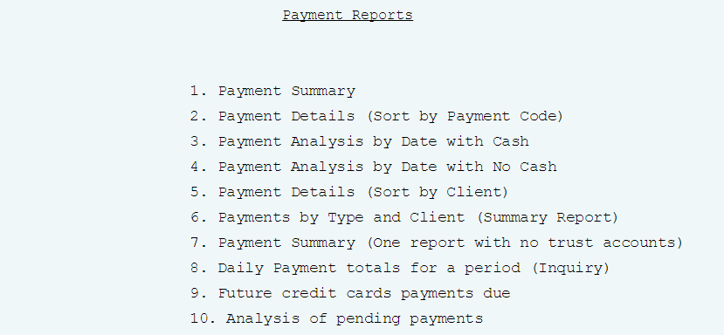
Understanding the Payment Reports
Payment transaction menu > Payment reports for a period
Analysis pf pending payments - shows an estimate of pending payments
Payment detail list - shows account payment detail with payment codes
Daily payment summary - shows money collected by the day of the month, and compares your collections to the same month a year

Slide 24
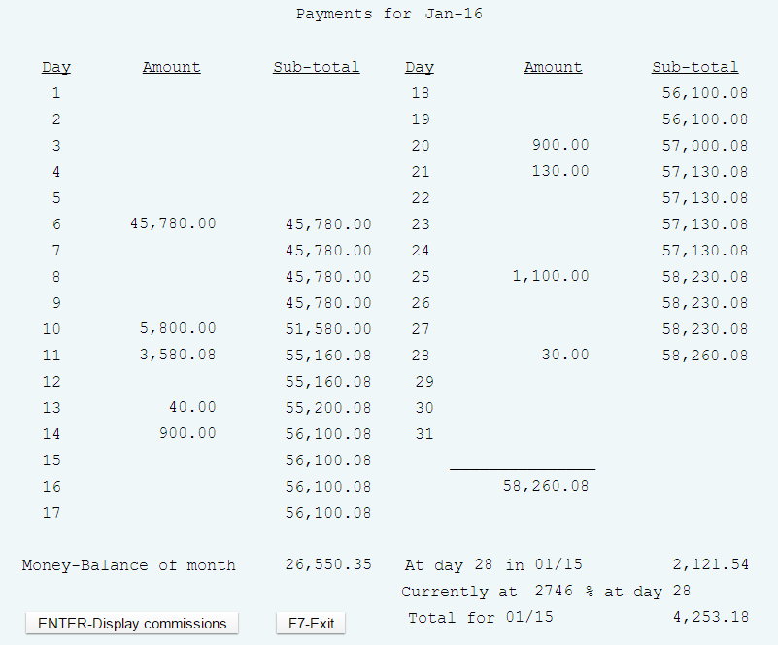
Understanding the Payment Reports
Payment transaction menu > Payment reports for a period
Daily payment summary - shows money collected by the day of the month, and compares your collections to the same month a year
Press ENTER to display the commissions in the Amount field

Slide 25
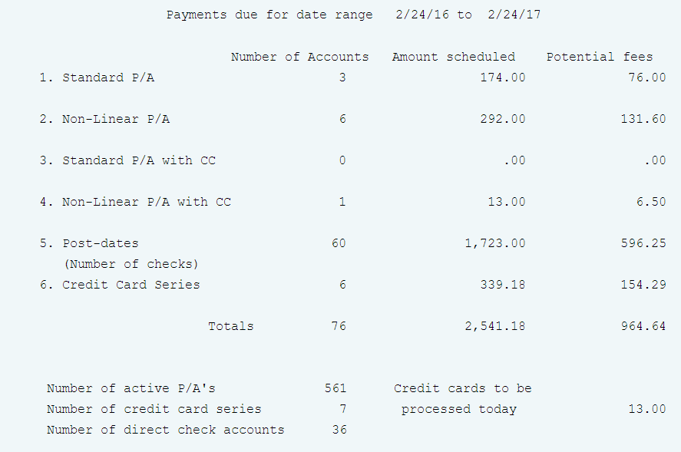
Understanding the Payment Reports
Payment transaction menu > Payment reports for a period
Analysis pf pending payments - shows an estimate of pending payments

Slide 26
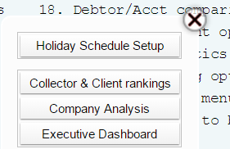
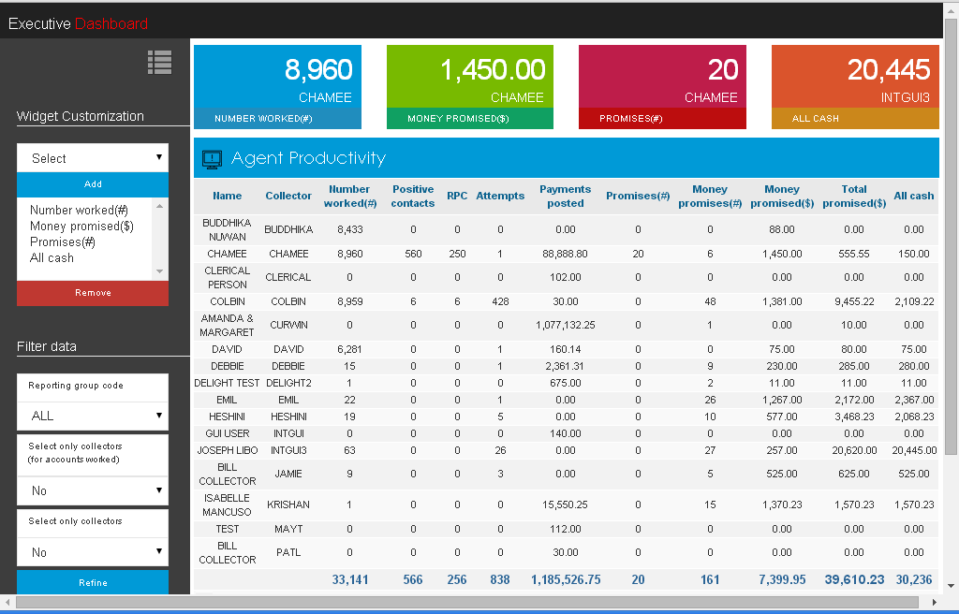
Executive Dashboard

Slide 27
Exercises – Processing Payments
In your system, use COMPANY 99
A consumer has entered your office and given you $100.00. Apply this payment.
Find an account with a linked balance then enter another payment - one that will pay off the primary and linked accounts.
Your client has informed you a different consumer has given them $50.00, apply this payment as a direct payment.
Run and review your edit. There is a mistake, you should not have entered in the $50.00 payment. Delete this payment before you posting the account.
Run your edit again, if the edit looks good, post the payment.
The payment for $100.00 is returned (a bad check). Reverse that payment on that account.
Your clerical person entered a batch of payments, and left for the day. You need to delete their batch. How would you do this?

Slide 28
Exercises – Processing Payments (continued)
In your system, use COMPANY 99
For bad checks (NSF), if you wanted to send an account to legal, or take some kind of action every time a consumer gave you a bad check, how could you take that action automatically in the back ground without a user doing anything?
Look at your balance types by company. Make sure there is more than one balance type other than the Primary Balance. Setup your balance types so that the Primary Balance will be paid first, and any other balance types are paid in the order you would like.
You have agreed with your client that you will take 14% commission on an account when entered and 25% if the consumer’s mail is returned. Set up a fee code to reflect this.
A Fee code lets you base your commission on several conditions. Which one of these statements below in not true?
a. How long an account has been placed and in collections
b. Age of the account at placement
c. Account goes legal
d. Balance

Slide 29
Exercises – Processing Payments (continued)
In your system, use COMPANY 99
Reviewing the Client (0ff the Management Menu)
Find a client that has existing accounts in the system. Now place the fee code( from exercise #10) on the client and save it.
Does this automatically affect accounts that are already in the system?
Review the account and explain what happens when you change a fee code at the client level.
You have agreed that if a payment goes directly to the client within the first 14 days of placement you will not take commission on that account. Set that up for your client.
Payment Reports For A Period
What report could I run to see what accounts adjustment code 42 was applied to?. Run that report to confirm this.
What display shows you the money collected by the day of the month, and compares your collections to the same month a year ago? Did you hit “ENTER” to display the commission?
How can you get an estimate of pending payments for the rest of the month?

Slide 30
RMEx Management Training: Processing Payments
Thank you!

