Slide 1
RMEx Management Training: Contacting Consumers

Slide 2
Agenda
Managing Phone Numbers In RMEx
Understanding How RMEx Creates Queues
Simplifying Account Management
Contacting The Right Consumers At The Right Time
Integrating Your Dialer
Understanding Events
Understanding Smart codes (SC) And Making Them Work For You
Allowing The System To Audit Accounts To Ensure Productivity
Communicating With Consumers In Unconventional Ways

Slide 3
Managing Phone Numbers In RMEx
Account detail screen
Other phone number screen
Phones on linked accounts
Cell scrubbing options
Phone numbers are not in the right place
Working the primary account
Your RMEx solution. . . . .

Slide 4
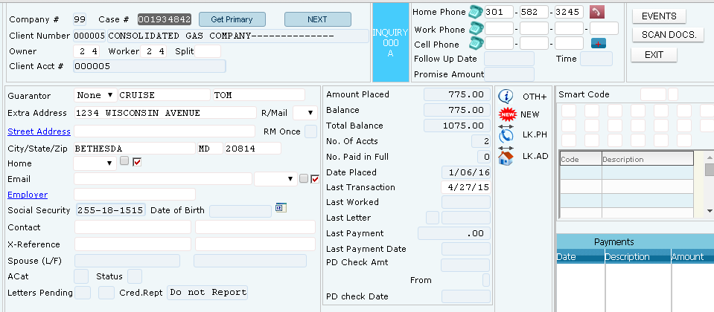
Managing Phone Numbers In RMEx – Account Detail Screen
Inquiry menu > Account inquiry > Account Detail
Agents can view and modify phone numbers
Numbers determined to “not be useful” can be removed from the Account detail screen (home, work or cell with permission)
A home, work or cell number that is changed on the Account detail screen, automatically the information is intelligently duplicated across linked accounts

Slide 5
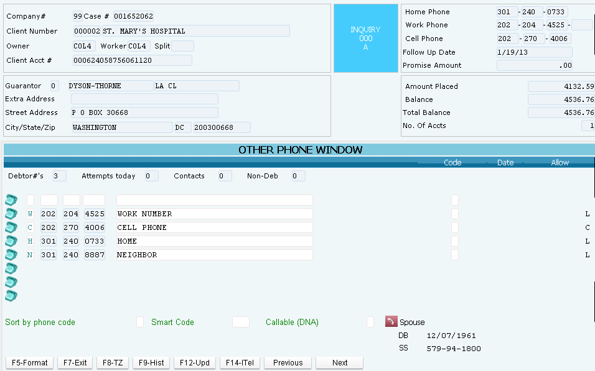
Managing Phone Numbers In RMEx - Other Phone Number Screen
Inquiry menu > Account inquiry > Account detail screen > Tab - +
Additional phone numbers can be loaded into a “Other phones” window, along with a user-defined phone code
The phone code can be changed to a “lower case” code, indicating that the number is bad

Slide 6
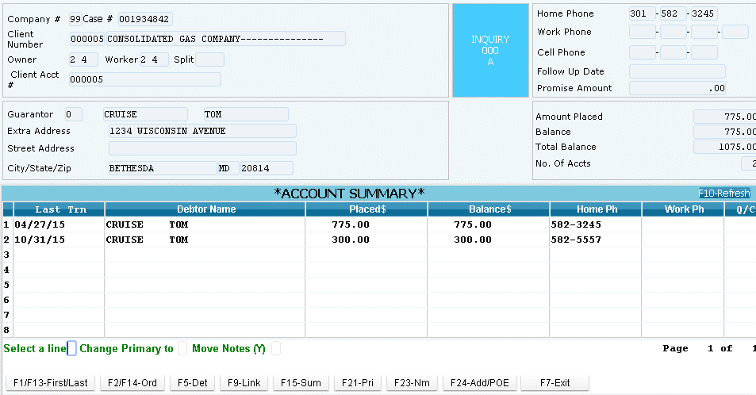
Managing Phone Numbers In RMEx - Phones On Linked Accounts
Inquiry menu > Account inquiry > Account detail screen > F5- Linked Accounts > F24-Alt. Format
Home phone and work phone are automatically duplicated on linked accounts
If a good number exists on any linked account it will populate into the account

Slide 7
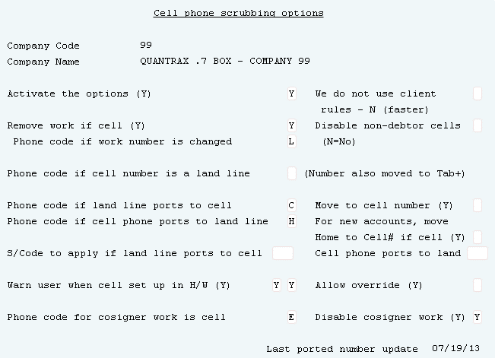
Managing Phone Numbers In RMEx – Cell Phone Scrubbing Options
System Control menu 3 > Cell phone scrubbing option
Cell phone scrubbing identifies cell phones and takes user-defined action in real time. This applies to new accounts loaded into the system and information later changed or added
Real-time information allows an agent to immediately know that a cell phone is being put into the landline field
Permission is obtained immediately and documented as a part of your compliance processes

Slide 8
Managing Phone Numbers In RMEx - Notifying Agents When Phone Numbers Are Not In The Right Place
System Control menu 3 > Cell phone scrubbing option
When a cell phone number is put in a home or work field and cell scrubbing is on; it will notify the agent that the number is a cell phone

Slide 9
Managing Phone Numbers In RMEx - Working The Primary – How Cell Phone Numbers Are Moved
During the nightly process………..
Linking Process
System checks new accounts for bad phone numbers that were previously removed from existing linked accounts
System removes “bad numbers” in new accounts from the Account Detail screen and changes the Tab+ phone code to a lowercase
Notes are added to the new account indicating the numbers were removed

Slide 10
Understanding How RMEx Creates Queues - How Queues Are Built During Nightly Processing
During the nightly process………..
During the account processing phase of the nightly
Review new and existing accounts
Intelligently sorts the accounts
Work maps will be built
Notes:
If this was a Filing Cabinet

Slide 11
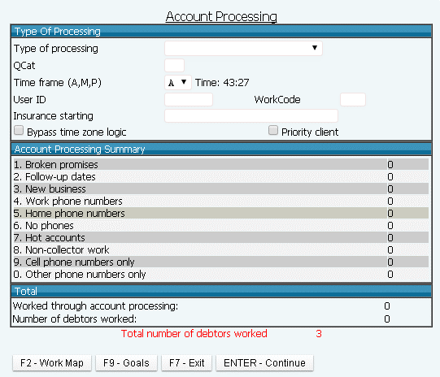
Understanding How RMEx Creates Queues -The Work Map (Account Processing)
Account processing menu > F2- Work Map
Work Maps display the collector’s accounts to be worked
Consists of Processing Types = “buckets” that organize accounts
Notes:
Filing cabinet – The draws

Slide 12
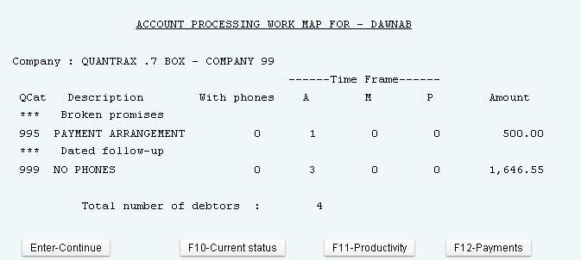
Understanding How RMEx Creates Queues -The Work Map (Account Processing)
Account processing menu > Work Map inquiry
The Processing Type

Slide 13
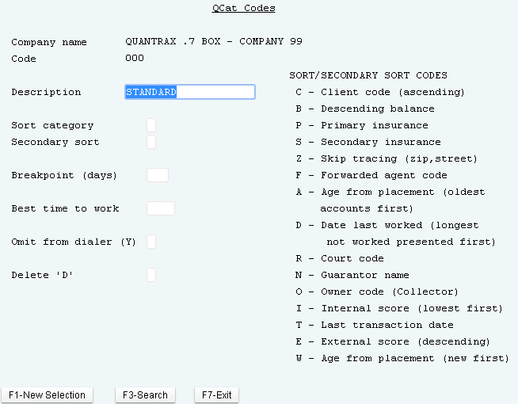
Understanding How RMEx Creates Queues - QCat Codes (By Company)
System Control menu 2 > QCat Codes > By Company
Consists of Processing Types = “buckets” that organize accounts
Processing Types can be broken down to have “sub-buckets” or categories called QCats (Queue Categories)

Slide 14
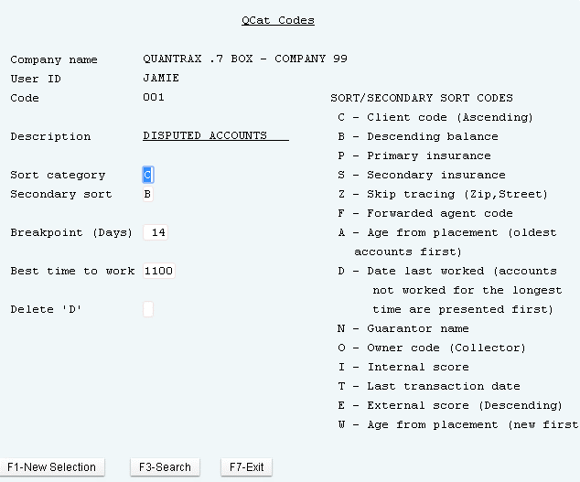
Understanding How RMEx Creates Queues - QCat Codes (By User)
System Control menu 2 > QCat Codes > By User

Slide 15
Understanding How RMEx Creates Queues - The Powerful “Contact Series”
Automated process to schedule when contact is made with consumer
Gets accounts into a dialer campaign
Keeps accounts away from a collector
Manage your accounts

Slide 16
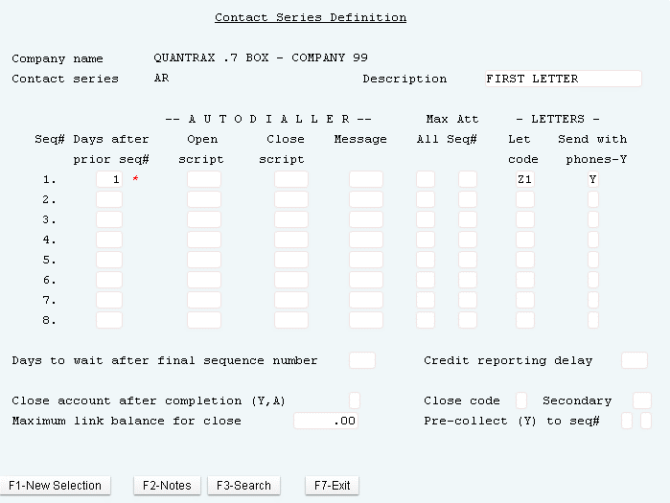
Understanding How RMEx Creates Queues - The Powerful “Contact Series”
System Control Menu 1 > Contact series definition
Notes:
A contact series is a way to automate a series of phone calls and/or letters to be generated a specified number of days apart

Slide 17
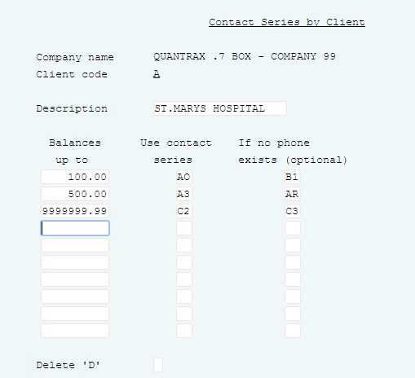
Understanding How RMEx Creates Queues - The Powerful “Contact Series”
System Control Menu 1 > Contact series by client

Slide 18
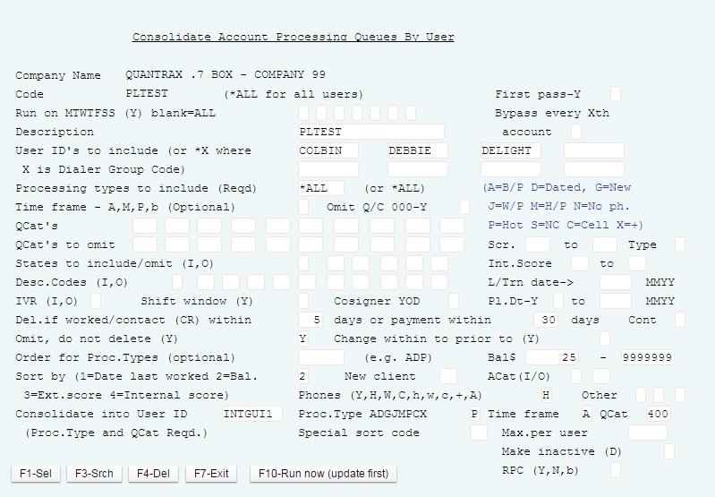
Simplifying Account Management - Queue Consolidation
Management menu > I-Tel menu > Queue consolidation
Takes a group of accounts from the work queues and puts them in a separate bucket to be accessed via work maps or a dialer
“Done on the fly” - this is a manual process
Can also be setup in the nightly (can automate)

Slide 19
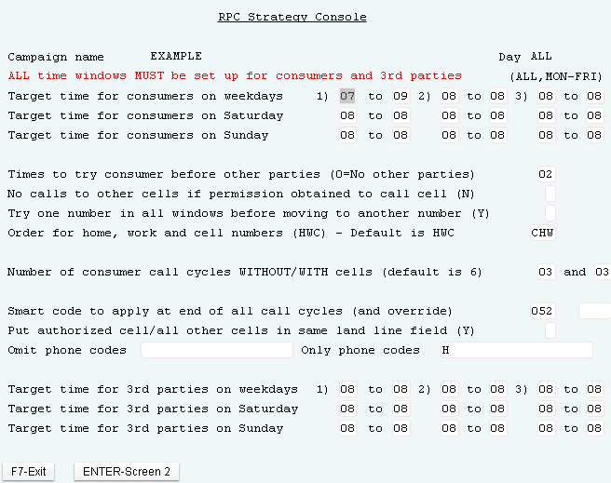
Contacting The Right Consumers At The Right Time - Right Party Console (RPC)
I-Tel Options menu > Right Party Contact Console – Page 1
Manages cell phone strategy
Set up the rules at the campaign level
Makes attempts to different types of numbers (home, work, cell and third parties), making sure that each number receives the same number of attempts and that each attempt is made at a different time in the day

Slide 20
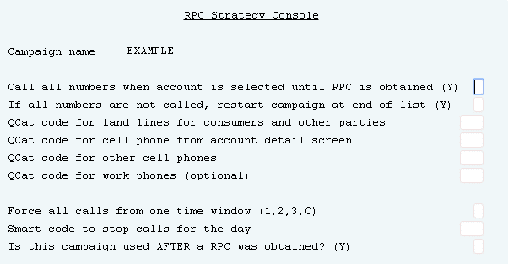
Contacting The Right Consumers At The Right Time - Right Party Console (RPC)
I-Tel Options menu > Right Party Contact Console – Page 2
Target different types of phone numbers in account management

Slide 21
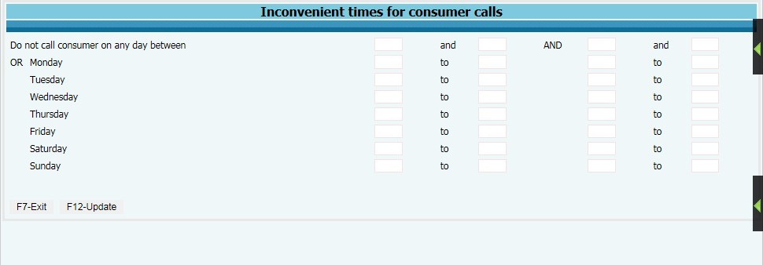
Contacting The Right Consumers At The Right Time - Inconvenient Times
Other phones” screen (Tab+) > F2
Set up times for all days of the week, or up to two times per day of the week
Use option S/Code for inconvenient times, to set up when a smart code is applied and inconvenient times are entered on any of the consumer’s accounts (System Control 1 menu > Company Information>Page 20)
The smart code specified will be applied by the system, and our plan was for you to move the account into a different QCat that does not get called in predictive campaigns

Slide 22
Integrating Your Dialer – Third Party Dialer
RMEx works with the I-Tel fully integrated predictive dialer
Limited integration is available for other dialers, including
Generation of account lists for campaigns
Upload of campaign results

Slide 23
Integrating Your Dialer – Dialer Messaging
RMEx has a fully functional messaging facility
Pre-recorded messages or text-to-speech
Dynamic retrieval of account data (balances, names, creditors, last payment dates, etc.)
Routing of calls to agents or third parties -depending on consumer input or call progression

Slide 24
Integrating Your Dialer – Types of Campaigns
I-Tel supports all type of dialing:
Preview
Power
Progressive
Predictive
Inbound
Message Blasting

Slide 25
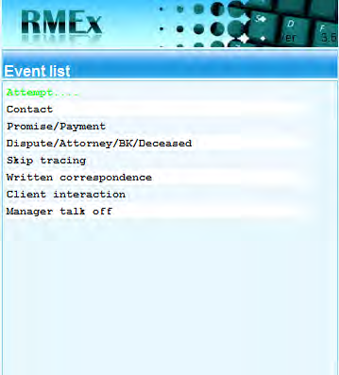
Understanding Events
Events
New “scripting engine” that guides a collector through a series of steps, making sure the correct questions are asked, the right information obtained and the accounts are worked in the best way
Smart codes can be applied, without the collector actually entering a single smart code

Slide 26
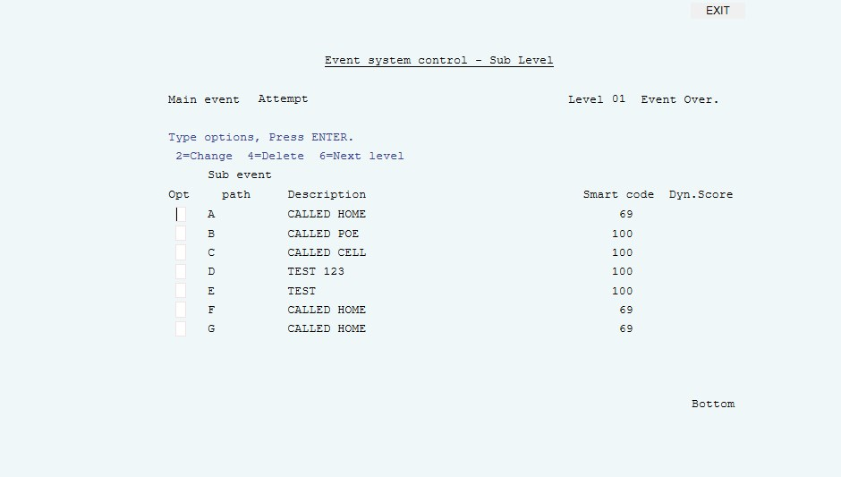
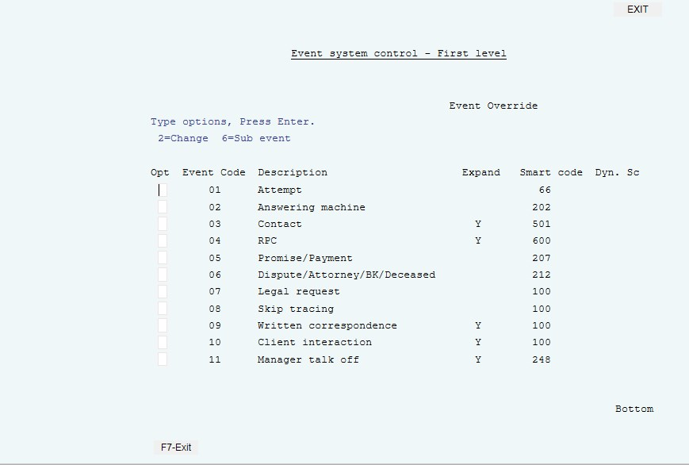
Understanding Events – The Model
Event System Controls
There are two types of Events,
1) Main Events – system defined
2) Sub Events – user defined
By default, events are “expandable”

Slide 27
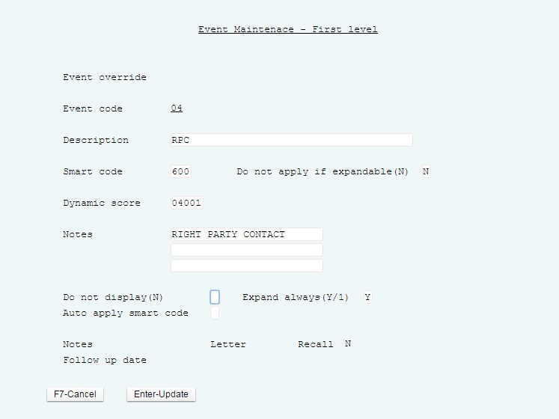
Understanding Events – Creating Events
Event Set up
Add uniforms notes automatically
Apply smart codes

Slide 28
What Is A Smart Code?
It is an Action!
It allows the agents to make the same decision that the manager or owner would make if THEY were working the account
It helps you stop the overworking and under working of accounts
It is user defined
It can behave differently based on clients, collectors, ACats (type of accounts), whether they are in a Contact Series or not
It can make decisions today based on what you may find in the future
It is the collector telling the system what just occurred

Slide 29
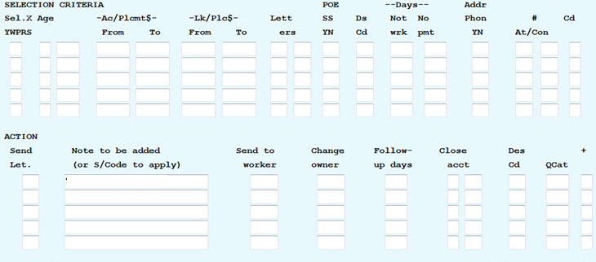
Smart Codes - Write it / Say it in “Plain” English!
System Control menu 1 > Smart codes
SELECTION CRITERIA = If an account meets certain conditions then . . .
AND
OR
OR
ACTION = THEN send a letter, note the account, send to a worker , change owner, follow up days, close account, adds description, or several other actions

Slide 30
Understanding Smart Codes (SC) And Making Them Work For You
Ask yourself the following questions:
What processes can I automate?
How can I avoid human error?
How to insure the correct actions happen at the correct time?
How can I maintain standards and consistency?
How do I enforce compliance?
How do I work accounts intelligently?
How do I keep from over OR under-working accounts?

Slide 31
How Can You Apply a Smart Code
Can be applied to an account manually by a user
Can be applied by the system behind the scenes
A Smart code can apply a smart code

Slide 32
RMEx Translation : “Basic” Smart Codes
Call Residence Phone – No Answer
Selection Criteria = If a call (attempt) was made to the home number AND there is no answer
Action = THEN automatically notate the and move to the next account
Debtor Dispute
Selection Criteria = If the balance is >100 OR If the balance is <100
Action = THEN >100 send to a manager OR <100 close account

Slide 33
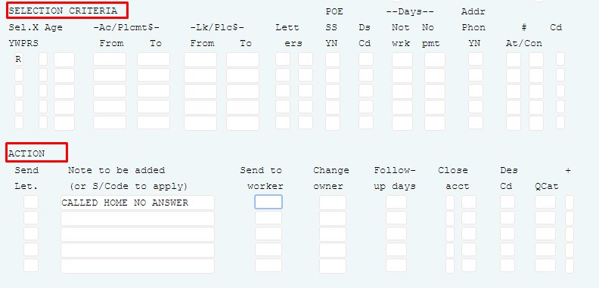
Call Residence Phone – No Answer Smart Code
SELECTION CRITERIA = If an account meets certain conditions then . . .
ACTION = Add a note to the account.

Slide 34
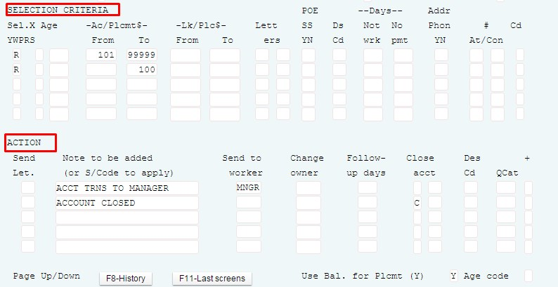
Debtor Dispute Smart Code

Slide 35
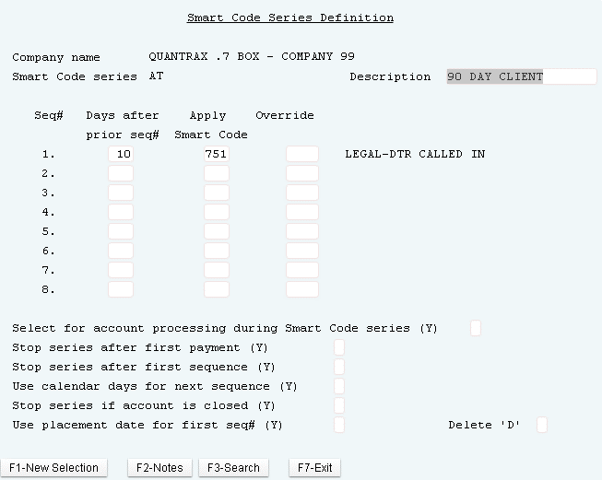
Allowing The System To Audit Accounts To Ensure Productivity – Smart Code Series (SCS)
System Control menu 2 > Smart Code Series Option > Smart Code Series Definition
Automate an account that will be worked in the future
Apply a smart code at a future date based on the conditions of the account at that time

Slide 36
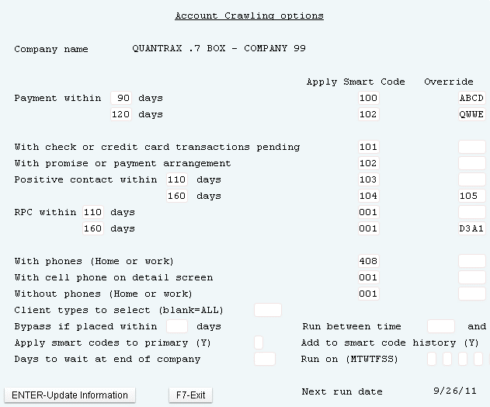
Allowing The System To Audit Accounts To Ensure Productivity – Account Crawler
System Control menu 2 > Smart Code Series Option > Account Crawling Options
The Account Crawler allows you to review your entire inventory of accounts and take actions on the accounts you select
Notes:
ACCOUNT CRAWLER
You can select accounts based on whether they have payments, check or credit card transactions pending, promises or payment arrangements, positive contacts, right party contacts or different types of phone numbers
You can use the Account Crawler for a variety of purposes. For example, you can make sure that all accounts with prior payments or promises are assigned to agents, all accounts with no RPC’s are sent to the dialer, and all accounts with no phone numbers are sent to a data scrubbing vendor.
A report is also furnished showing the start time and end for each company; the first link number and the last linked number processed and the number accounts and debtors analyzed. This will make it easy to review how many accounts were processed

Slide 37
Allowing The System To Audit Accounts To Ensure Productivity – Account list for Audit
Account List for Audit
Be viewed online
Apply a Smart code
Move accounts to be worked
Printed out in a report

Slide 38
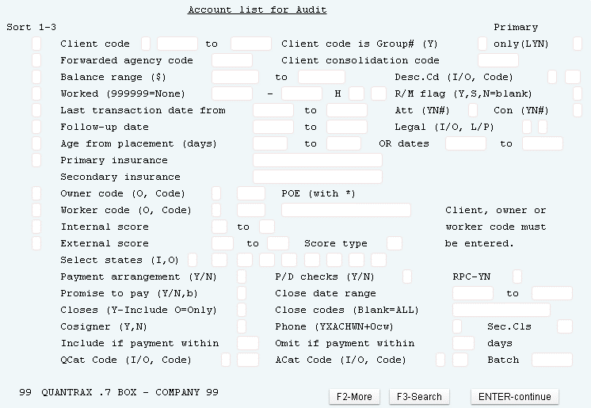
Allowing The System To Audit Accounts To Ensure Productivity – Account Audit
Management menu > Smart code/User audit options > Display Accounts For Audit > Run Account List For Audit

Slide 39
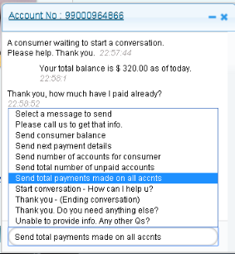
Communicating With Consumers In Unconventional Ways – Text Messaging
RMEx has created a texting platform for agent to communicate with the consumer using text messaging.
We authenticate consumers using last four digits of the SSN, first three letters of the last name and any Phone number or DOB

Slide 40
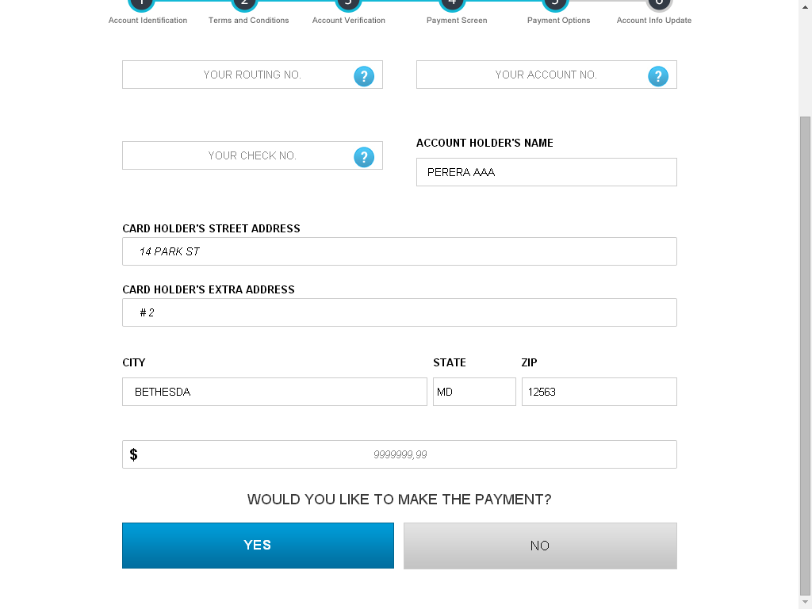
Communicating With Consumers In Unconventional Ways – Mobil Payment Portal
RMEx Mobile Payment Portal allows your consumers to make payments through RMEx using their I-Pad, Smartphone or PC

Slide 41
Communicating With Consumers In Unconventional Ways - Email
Emails can be sent to consumer with permission
Cut down on letter cost

Slide 42
Exercises – Contacting Consumers
In your system, use COMPANY 99
Add a phone number to the Account detail screen, cell phone field. Check the Other phone number screen, how is the number appearing?
Now remove the same number from the Account detail screen. Check the Other phone number screen, what has changed?
Try to add the same number to the Account detail screen? Is the resulting behavior what you would expect?
In the Other phone number screen, change a “good” number to a “bad” number.
Set up 3 QCats to be used with Queue consolidations:
910 - dialer campaign 1
911 - dialer campaign 2
912 - dialer campaign 3

Slide 43
Exercises – Contacting Consumers (continued)
In your system, use COMPANY 99
Set up a multiple user consolidation rules (Nightly processing) to create a queue for the UserID HOUS. This consolidation will be used to create a campaign for the following:
Dialer campaign 1
Hot accounts
AM time frame
Wednesday and Friday
Select the accounts from UserID DEFT, Home phone only processing type then:
Omit Description codes for bankruptcy chapter 7 and 13
Omit any account that has a phone number other than a home number
Set up the RPC campaign system controls.
Set up the RPC campaign.
Run the RPC simulation.

Slide 44
Exercises – Contacting Consumers (continued)
In your system, use COMPANY 99
Set up separate Smart codes for each of the following criteria (use 700-705):
700-Close an account bankrupt
701-Put an account in QCat 910
702-A RPC positive contact SC, check that the linked balance is over $500.00 and change the collector to the house collector
703-An attempt SC that checks to see if the account has been worked within the last 30 days and if not, send the 02 letter
704-A contact SC with the consumer’s attorney, who is no longer representing the consumer, and you want the collector to call the consumer tomorrow.
705-A other SC to be used with Events to return an account to the collector
Set up an Event and use SC 705 that a Manager can use to return an account to a collector that they do not want closed.
Set up a Smart code series (SCS) to apply SC 701 in 15 days; setup for the following:
You do not want it to present in account processing
You do want the SCS to stop the series if the account is closed or if a payment is made

Slide 45
Exercises – Contacting Consumers (continued)
In your system, use COMPANY 99
Set up the Account crawler to apply SC 705 to any account that:
Has a payment in the past
Has not had a payment in the last 35 days
Has not been worked within the last 10 days

Slide 46
RMEx Management Training: Contacting Consumers
Thank you!

