Slide 1
RMEx Management Training: Generating Mail And Related Documents

Slide 2
Agenda
Understanding Your Mailing Options
Automating Feedback From The Letter Service
Creating a Letter in RMEx
Configuring types of forms/paper for letter
Defining the letter
The 3 Ways to Send A Letter in RMEx
Sending/Stopping Letter Based On Circumstances
Sending Letters For Post-Dated Checks
Sending Reminder Letters For Payment Arrangements
Handling And Tracking Returned Mail
Understanding the Nightly Process Related To Letters

Slide 3
Understanding Your Mailing Options
In House
Resources Needed
Small volume of letters
Third Party Service
Customized mailing options
Less Resources Needed
Large volume of letters

Slide 4
Understanding Your Mailing Options
Format Your Content (In-house)
Create a “file” for a printing service
Use merge codes to print account information
Automating Feedback From The Letter Service

Slide 5
Automating Feedback From The Letter Service
Automation from Letter Service
Returned mail
NCOA
Smart Codes
Increase rate by client

Slide 6
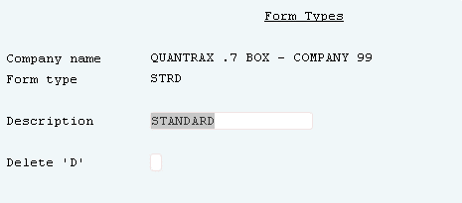
Creating A Letter In RMEx - Form Type
System Control 2 > Form Type
A form type must be setup to print letters
Different form types can be used - one for consumer letters and one for client letters

Slide 7
Creating A Letter In RMEx
Sending letters via email or paper
Concept of “standard letter” or “company” (special) letter
On-demand (selected)
Automated (contact series)
The contact series – a series of letters and / or phone calls
IDL (Initial demand letter) – system can send it after first “contact”
Define the letter in letter codes
Set up the letter in letter format options
Your RMEx solution. . . . .

Slide 8
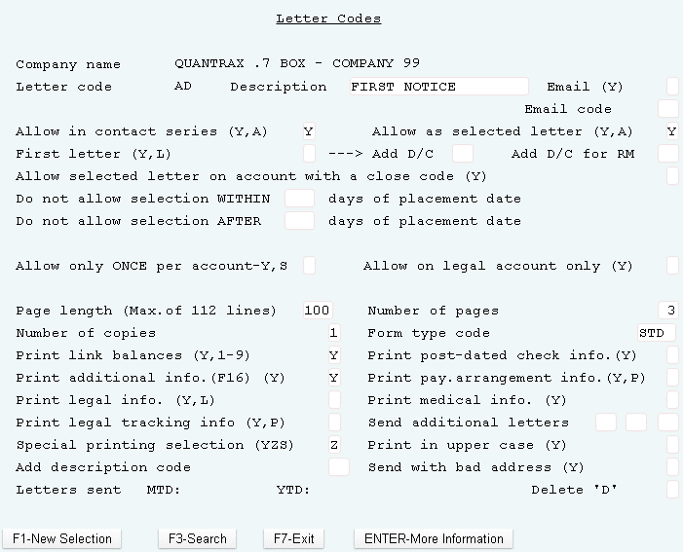
Creating A Letter In RMEx – Defining The Letter
System Control 1 > Letter Codes – Page 1
Add rules for each letter type
Setup Letter code prior to setting up merge code or text in letter format

Slide 9
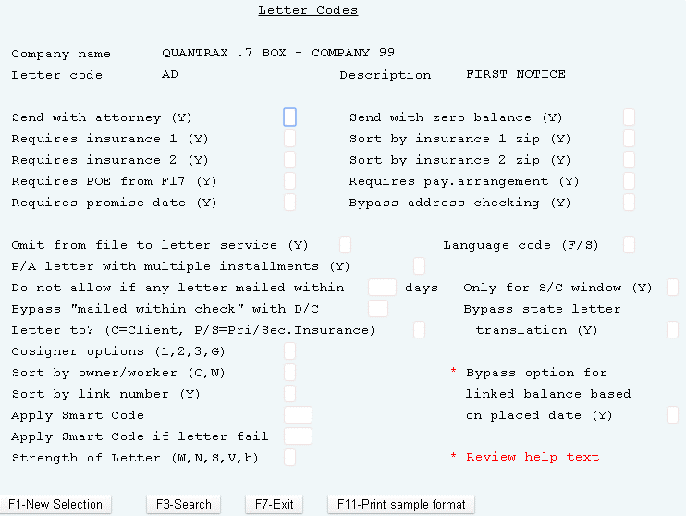
Creating A Letter In RMEx – Defining The Letter (continued)
System Control 1 > Letter Codes – Page 2

Slide 10
The 3 Ways to Send A Letter in RMEx
Send Letters
Contact Series
Agent Request
System Sends Based On rules
Your RMEx solution. . . . .

Slide 11
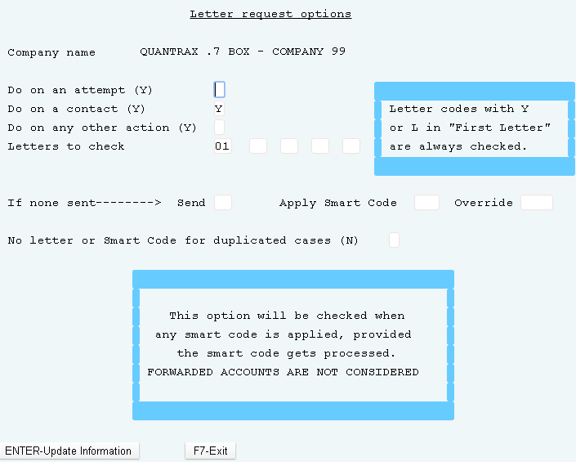
Automatically Send A Letter
System Control 1 > Letter Codes – F7
Request for the system to send a letter if one has not been sent
Select the criteria and request the appropriate letter

Slide 12
Sending / Stopping Letter Based On Circumstances
Select by….
State
Client Group Number
Collector Code
Circumstances
Letter in different language
Different text based on client needs
State compliance requirements
Description Code
Location Code
Your RMEx solution. . . . .

Slide 13
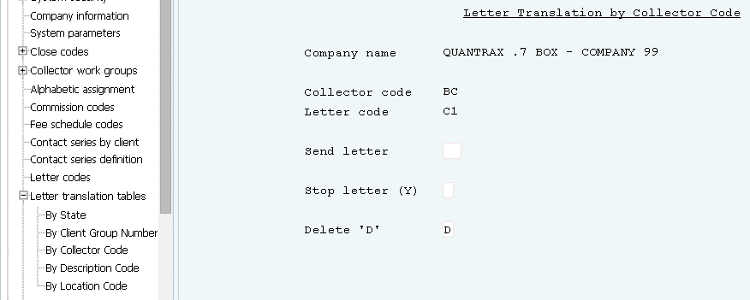
Sending / Stopping Letter Based On Circumstances
System Control 1> Letter Translation Tables

Slide 14
Sending Letters For Post-Dated Checks
Send a reminder letter?
When to send letter?
What letter to send?

Slide 15
Sending Letters: Remind Consumers Of Their Payment Arrangement
Reminder Letter
Which letter?
When to send letter?
Minimum balance to send letter?
“Days-driven” frequency
Reminder Payment Is Late
Which letter?
Grace period before sending letter?
Minimum delinquent amount to send letter?
“Days-driven” frequency
Your RMEx solution. . . . .

Slide 16
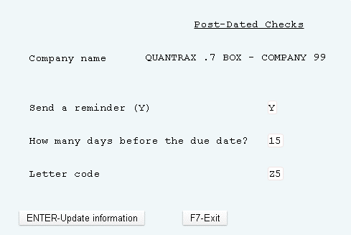
Sending Letters For Post-Dated Checks
System Control 1 > Post-dated Checks

Slide 17
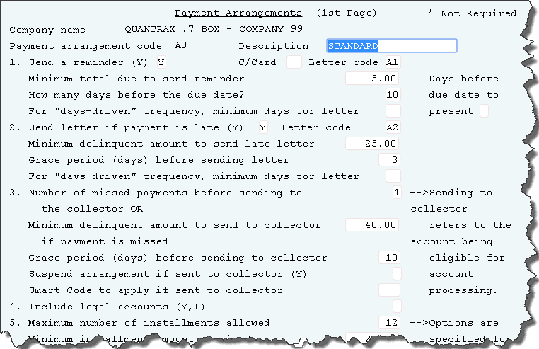
Sending Letters: Remind Consumers Of Their Payment Arrangement
System Control 1 > Payment Arrangements - Page 1

Slide 18
Handling And Tracking Returned Mail
Returned Mail
Setup Mail Return
Setup up letter translation by client
Flag and track account returned mail
Generate letter if settlement
Your RMEx solution. . . . .

Slide 19
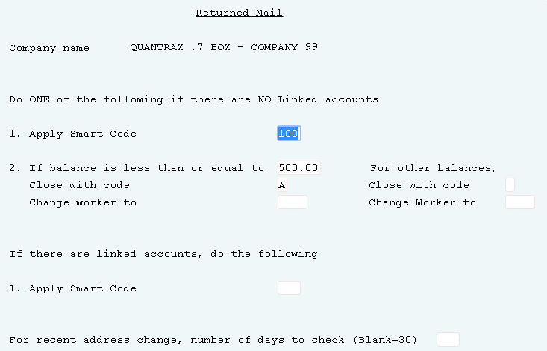
Setup Mail Return
System Control 2 > Returned Mail
By default, the number of days they system checks for an address change is 30 days

Slide 20
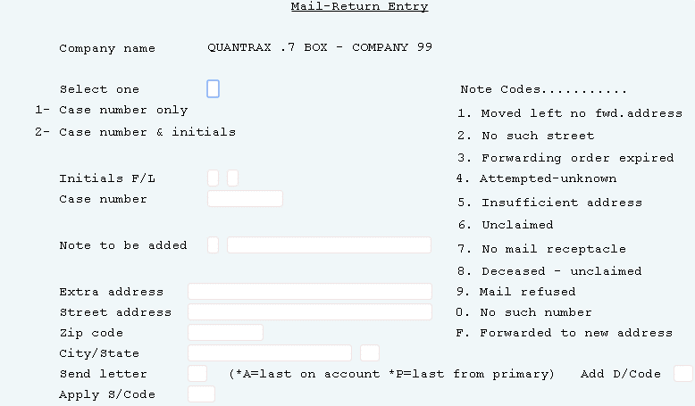
Setup Mail Return
Daily Operations Menu > Mail Return Entry
Automatically resend the last letter sent on the account or the last letter sent using the primary account
The entry clerk can select a specific letter to resend

Slide 21
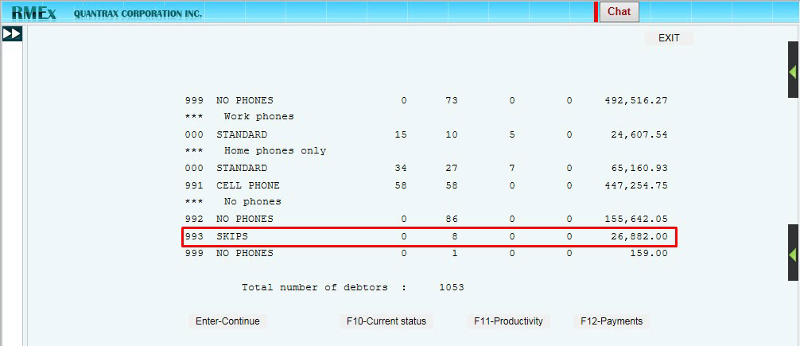
Flag And Track Returned Mail
Account Processing menu > Display Accounts to be worked > F2 – Work Map

Slide 22
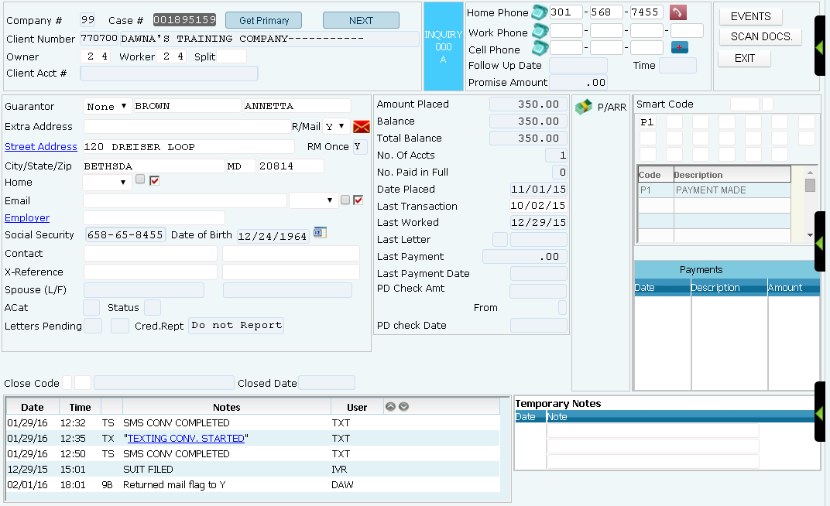
Flag And Track Returned Mail
Inquiry > Account Detail Screen > Return Mail Checkbox

Slide 23
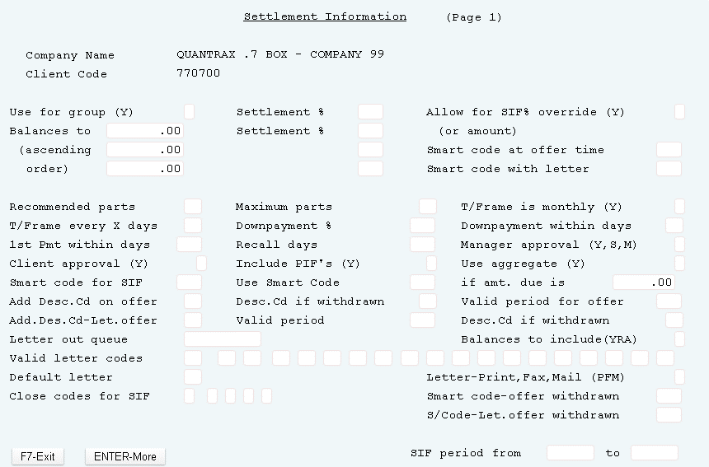
Generate Letter If Settled In Full (SIF)
Management Menu > Client Update > F15 – SIF screen

Slide 24
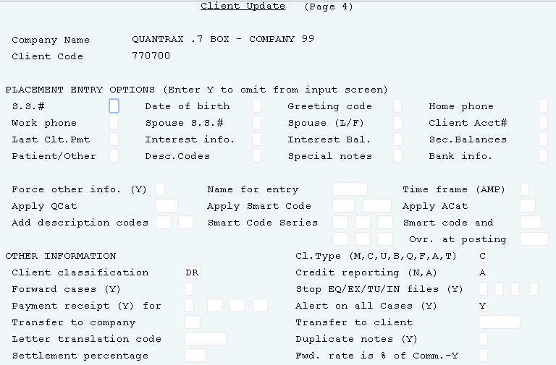
Setup Letter Translation By Client
Management Menu > Client Update (Page 4)

Slide 25
Understanding the Nightly Process Related To Letters
During the Nightly process the system:
Checks contact series, selected letters and promises that require letters/reminders, including post-dates and credit card payments
Checks if we can send a letter based on the business rules (e.g. there is no balance)
Creates a list of letters that can be sent out and those that "fail“ are listed on reports that are generated
Letters that need to be e-mailed are placed on a special file that is processed the next day for compliance reasons (do not want to send at email at 2 AM!)
Letters that can be printed are processed for in-house printing or sent to a mailing service

Slide 26
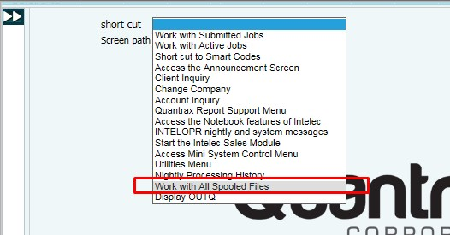
Understanding the Nightly Process Related To Letters – Letter Failed Report
Notes:
Need to figure out what should be used on slides

Slide 27
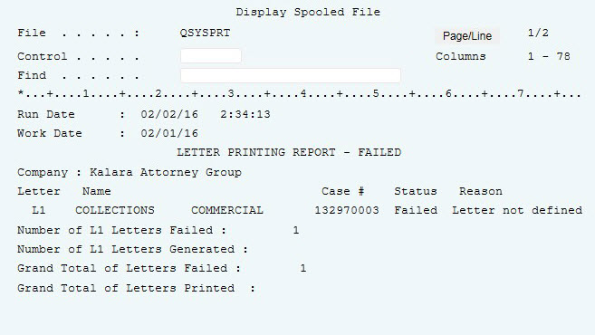
Understanding the Nightly Process Related To Letters – Letter Failed Report
Notes:
Need to figure out what should be used on slides

Slide 28
Exercises – Generating Mail And Related Documents
In your system, use COMPANY 99
Set up letter code T1 as a standard letter. Set up the system controls and the format of the letter as if it was to print in-house.
Set up Contact Series 01 – send 2 letters, 35 days apart. Stop the series if there is a payment or a contact.
Go into an account and request letter T1 using a smart code. How can you tell the letter was requested?
From the letter options, run the option to print selected letters. Did you get the letter to print? Did you see the account on the letters printed report?
Set up a letter T2, similar to, but different from T1.
Check the client code on the test account.
Teach the system to send a T2 whenever you request a T1 for that client.
Try requesting a T1 and then print the letter.
What happened? Check the accounts.
Can you see the history of letters sent?

Slide 29
Exercises – Generating Mail And Related Documents(continued)
Set up a smart code to request a T1, and add a note to the account.
Apply the smart code.
It takes a few minutes for the smart code to process. Did the letter go into letters pending?
Print the letter.
Set up a P/D check reminder, PD. Set up the merge codes. You can test this after you are able to run nightly processing.
Request a T1 on an account. After the letter is in letters pending, close the account. Print the letters. What happened? Is that what you would have expected?
Set up an account. Add an attorney to the account. Request a T1. Print the letter. What happened? What is the difference between this and the other T1’s?
Think about how you would send a Spanish letter when a T1 was requested for a Spanish-speaking consumer.
You want to send an IDL and then make 2 phone calls within the first 60 days, and send one more letter only if there are no phone numbers. How would you do that?
A consumer says “Don’t send me mail” What do you do to stop mail from going out?

Slide 30
Exercises – Generating Mail And Related Documents(continued)
You have worked an account and want to give up… but want to send 2 letters before you close the account.
Set up a contact series to send 2 letters, 27 days apart.
Set up a smart code to start that contact series.
Apply the smart code. What happened?
Check the second account detail screen?
You should have a smart code “Consumer called us”. Make that smart code stop any contact series.
Apply the smart code and wait a couple of minutes.
Did the contact series stop?
Change the client on test account to increase the rate for returned mail.
Mark the account as “returned mail”.
What happened to the commission rate?

Slide 31
RMEx Management Training: Generating Mail And Related Documents
Thank you!

