Slide 1
RMEx Management Training: Identify and Manage Multiple Accounts For a Consumer

Slide 2
Agenda
Working with an account-based vs. consumer based system design
Identifying consumers with multiple accounts
Initiating the process of linking accounts
Distributing payments across linked accounts
Manage linked accounts using linked account summary
Thinking about mail

Slide 3
Working With An Account-Based vs. Consumer Based System Design
Consumer-Based
Each account is worked individually
Does not logically “link” multiple accounts
Account - Based
Work “primary” account after it is paid or closed
Primary “account” concept
Work multiple accounts for the same consumer
Logically “link” multiple accounts

Slide 4
RMEx Is An Account-Based System
Payments can be set up/ distributed on “linked” accounts.
“Linked” accounts can be quickly viewed and analyzed by your agents
Letters can include multiple accounts
Supervisors or agents can link accounts manually
“Link” accounts within client types or client groups
One agent works all the accounts for a consumer who has multiple

Slide 5
What Are The Challenges Of Managing Multiple Accounts For The Same Consumer?
Linked Accounts
Change account info
Take action on accounts
Manage phone calls
Manage balances
Duplicate account info
Handle secondary balances
Distribute payments

Slide 6
Using RMEx To Initially Identify And Link Consumer Accounts
Linking options are setup at the Client Master
Allows accounts to be linked during the nightly process that were loaded that day
Linking Options
No linking
Link to any account in the system
Link to only accounts of the same client type
Link to only accounts in the same client group
Link to only account with the same client number

Slide 7
Strategy For Working Multiple Accounts For Same Consumer
Why is it important to work a consumer with multiple differently?
Have they ever made a payment?
Is there a dispute on file?
Are the represented by and attorney?
Did they file bankruptcy?
A smart code can be applied to all successfully linked accounts
Certain accounts can be deleted from linked letters
Certain accounts can be removed from the account balance at the account detail level
All of these reasons why it is important to work linked accounts differently!

Slide 8
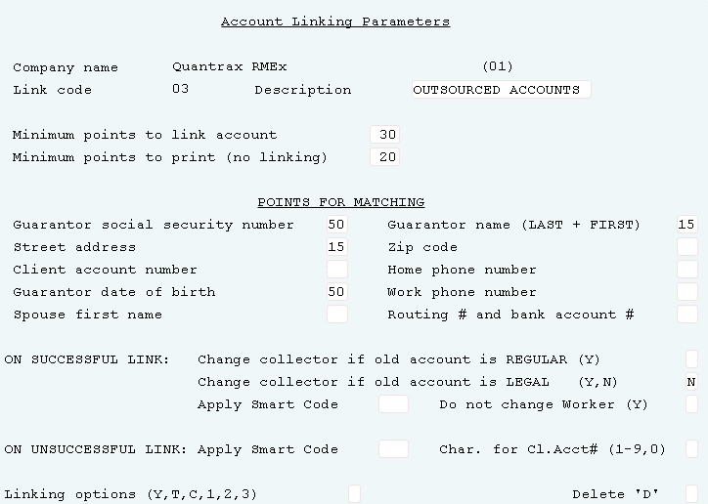
Identifying Consumers With Multiple Accounts
System control 1 > Account linking parameters > Account linking parameters)
Manage how accounts link by a “points” system
Reports are generated - linking report and a possible linking report during the nightly
Notes:
In the Acct of automatic linking, enter "Y" if
the Collector Code on the new account should be
changed to that of the primary account. This
only applies if the Primary Accounts is
classified as Legal.
If the worker code on an account is NOT the same as the owner code on the account you can retain the worker code by entering a "Y" in this field. The system will change the owner code but not the worker code.
This field is ONLY used in conjunction with the field "Client account number" to assign points for linking. By entering a number 1 through 9 in this field, you can now limit the number of characters the system looks for when assigning points : Y : for the Client account number feature. 12345AB - (7)
This field is used to determine : Minimum points to link account : which client's accounts are allowed : Minimum points to print (no linki : to link together

Slide 9
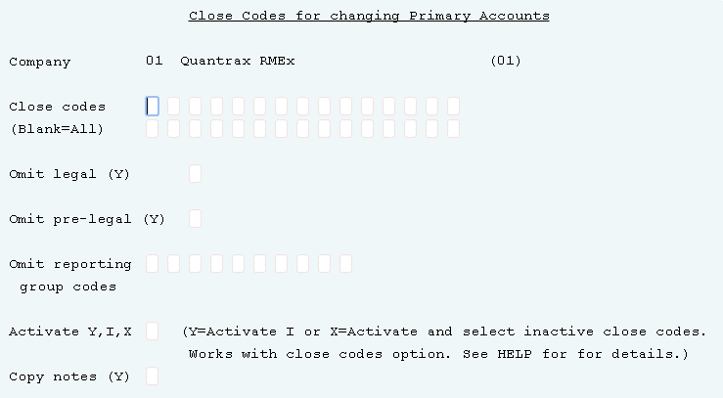
Changing A Primary Account
(System control 1 > Account linking parameters > Close codes for changing primary accounts)
Notes:
Based on the option used in the Activate field (see : Omit pre-legal ( : Activate help before using this feature), you can enter : : specific close codes that are to be considered when : Omit reporting : changing the primary account or leave "blank" to : group codes : include all close codes.
Enter a "Y" (leave close codes field "blank") to : group codes : automatically change the primary account to the newest : : open account (most recent placement date) found, if the : Activate Y,I,X : primary is closed with any close code.
If you want the system to copy the notes from the : : existing primary account to the new primary account, : : enter a "Y".

Slide 10
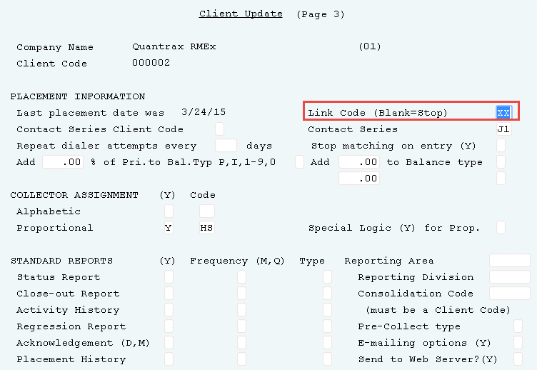
Stopping A Client’s Account From Being Linked
Management Menu > Client Update – Page 3 Link Code)
Indicates the type of linking that should occur for this clients accounts

Slide 11
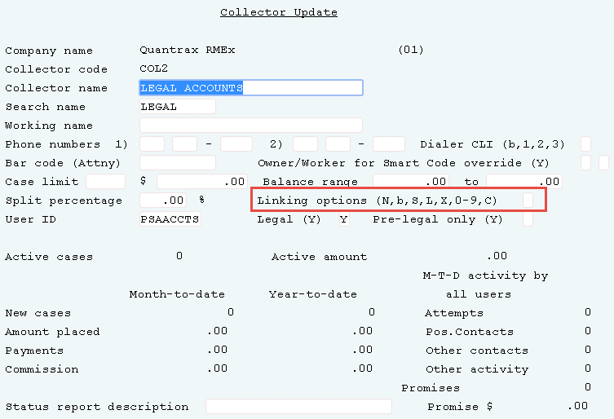
Changing Collector Codes On Linked Accounts
Management Menu > Collector Update
Define rules that control the ownership of accounts when accounts are automatically linked in the nightly processing (In addition to the rules set up in Linking Parameters on the System Control menu 1)
Notes:
This field controls who will wind up : : owning accounts after the linking process puts two (or more) Accts : : together that are owned by different : vity by Mo : collectors. : rs New Accts : : 0 Amount placed : This field allows you to define rules : 0 Payments : that control the ownership of accounts
when accounts are automatically linked : : in the nightly processing. (In addition : Active Accts : to the rules set up in Linking : : Parameters on the System control Menu.) : vity by Mo : : rs New Accts : This field will also allow you to : 0 Amount placed : specify that linking should only take : 0 Payments : place between owner codes which have a

Slide 12
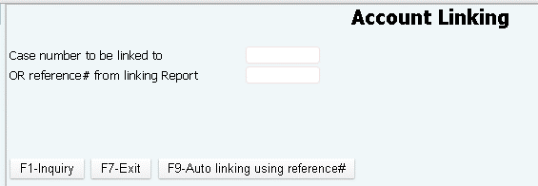
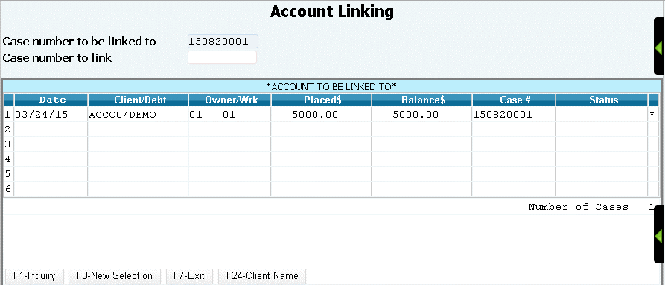
Manually Linking Multiple Accounts For A Consumer
Daily Operations Menu > Account linking
Based on the setup at the collector level – a user can link an account manually, when they fail to meet the point criteria for automated linking

Slide 13
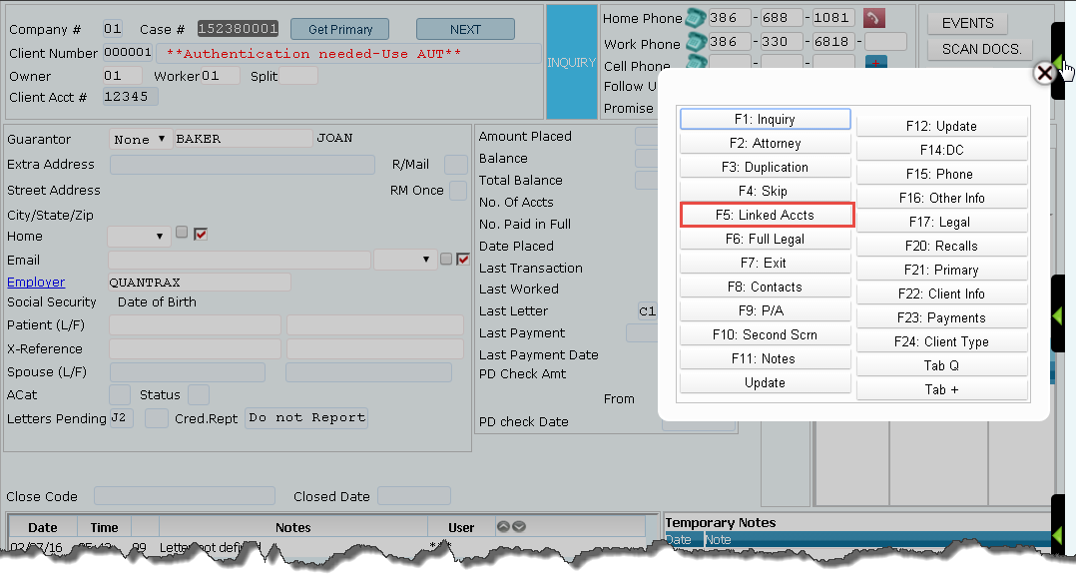
Manually Linking Multiple Accounts For A Consumer
Account inquiry > Account detail screen > F5- Linked Accounts
Allows agents to “link” accounts (if they have permission)

Slide 14
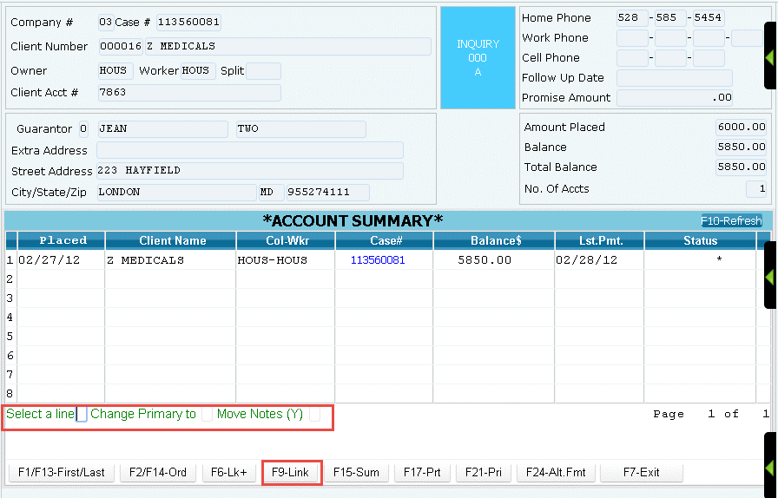
Manually Linking Multiple Accounts For A Consumer
Account inquiry > Account detail screen > F5- Linked Accounts > F9-Linking

Slide 15
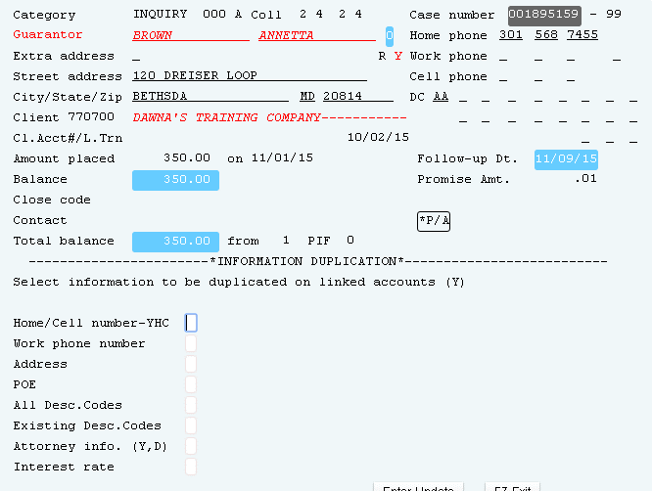
Duplicate Account Info On Linked Accounts
Account detail screen > F3 – Info Duplication
Allows agents to duplicate info on linked accounts (if they have permission)

Slide 16
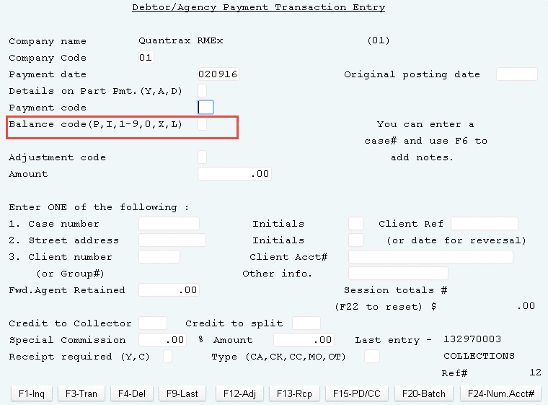
Distributing Payments Across Linked Accounts
Payment Transaction menu > Debtor/Agency Payment Transaction Entry - Balance code(P,I,1-9,0,X,L))
If this option is blank, the system settings under balance types will be used to automatically distribute the payment
Notes:
This field is used to specify which : Enter ONE of the following : : balance type the payment should be : 1. Acct number 2. Street address 3. Client number : applied to.

Slide 17
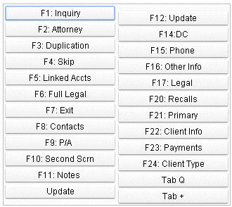
Manage Linked Accounts Using Linked Account Summary (Other Phone Window)
Account detail screen > Tab-+ (plus sign)
Manage phone numbers for linked accounts
Manage addresses for linked accounts
Stop calls from the primary account
Manages information across linked account (e.g. phone number changes)

Slide 18
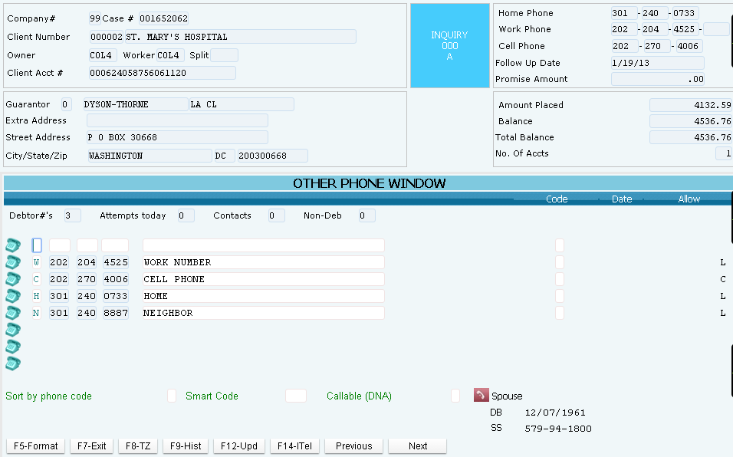
Manage Linked Accounts Using Linked Account Summary
Account detail screen > Tab - + (plus sign)

Slide 19
Thinking About Mail
Think about the following questions for letters for linked accounts…….
Omit from linked balance if within how many days from placement
Omit from linked balance if after how many days from placement
Individual letters (IDL could have one letter for multiple accounts)
How and when do you want to show linked balances and clients owed?
What about new accounts? How do you omit them from linked balances?

Slide 20
Exercises – Identify and Manage Multiple Accounts For a Consumer
In your system, use COMPANY 99
Your motto should be “Work the CONSUMER, not the ACCOUNT”, setup your company to join accounts based on the following :
Create a Basic Client linking option with some of the following criteria:
Guarantor social security number
Guarantor name (LAST + FIRST)
Street address
Zip code
Client account number
Home phone number
Guarantor date of birth
Automatically change the collector based on an existing account
Your company allows all accounts to be linked regardless of any rules. However, you have a client that wants you to work only their accounts; they do not want them combined with other clients. How would you set up the linking parameters?

Slide 21
Exercises – Identify and Manage Multiple Accounts For a Consumer (continued)
In your system, use COMPANY 99
When a new account comes in, it may be assigned to collector BC. However collector PL already has an account for that debtor and you want the system to give the new account to PL. How would you accomplish that?
During the night, two reports are produced, an automatic linking report and a possible linking report. What would you find in those reports?

Slide 22
RMEx Management Training: Identify and Manage Multiple Accounts For a Consumer
Thank you!

