Slide 1
RMEx Management Training: Loading New Business

Slide 2
Agenda
Loading New Business – An Overview
Understanding Standard Account Information
Storing Non-Standard Account Information
Setting Up Your Clients
Contacting Your Consumers (IDL and Automated Calls)
Assigning Accounts to Collectors
Setting Up Client Fees
Creating Business Rules To Link Multiple Accounts For A Consumer
Adding To Descriptive Information To Accounts When They Are Loaded
Organizing The Accounts To Be Worked
Using different methods of loading accounts

Slide 3
Loading New Business – An Overview
Manual Account Entry
I-Load
Custom Code

Slide 4
Understanding Standard Account Information
Consumer Account
Use screen options to access different information
Additional Contacts
Medical data
Balance Types
Phone Numbers
Cosigners
Notes
RMEx Account Detail Screen

Slide 5
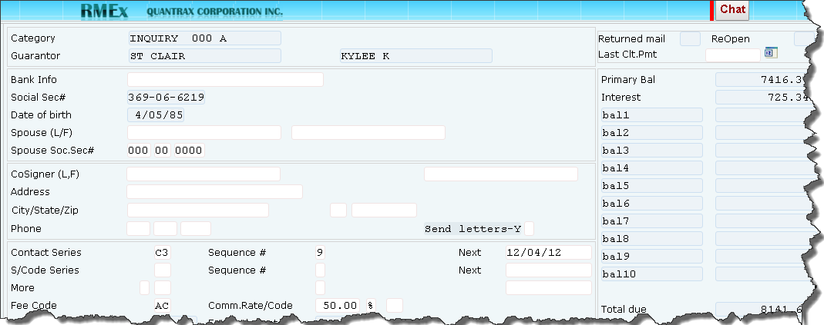
Standard Account Information – Balance Types
Inquiry Screen> Account Detail Screen > F10-Second Account Detail Screen Information
Define up to 10 secondary balances
Define the behavior for each secondary balance

Slide 6
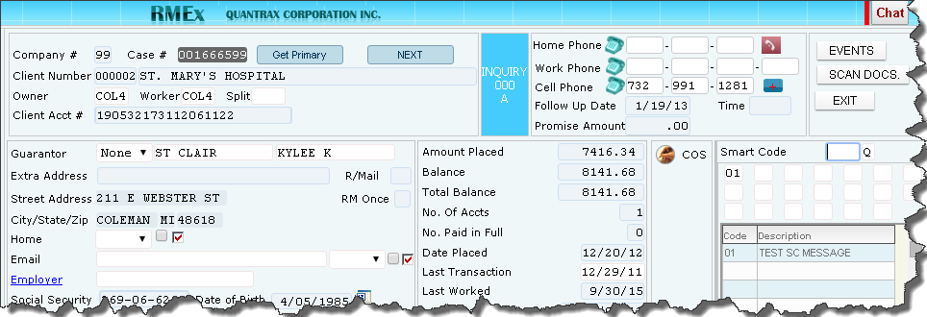
Standard Account Information – Phone Numbers
Inquiry menu > Account Detail Screen
"Best" numbers are on detail screen
Permission is assumed for cell phone
Unlimited number of phone numbers can be stored on “Other phones” screen

Slide 7
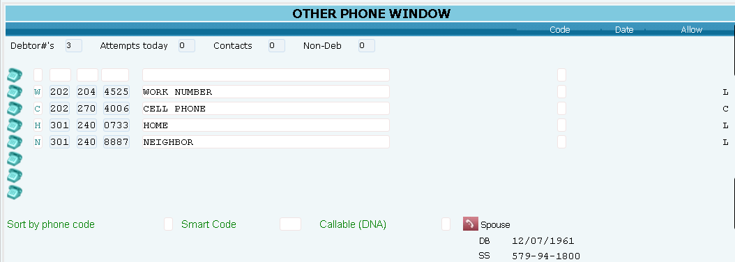
Standard Account Information – Other Phones Screen
Inquiry menu > Account inquiry> Account detail screen > Tab +
Phone codes are needed
Disabled numbers are easily identified
Details and permission are stored at phone number level

Slide 8
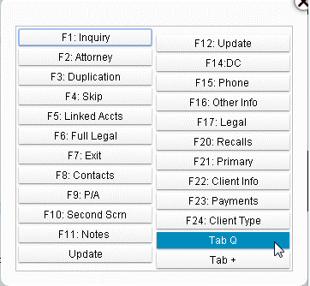
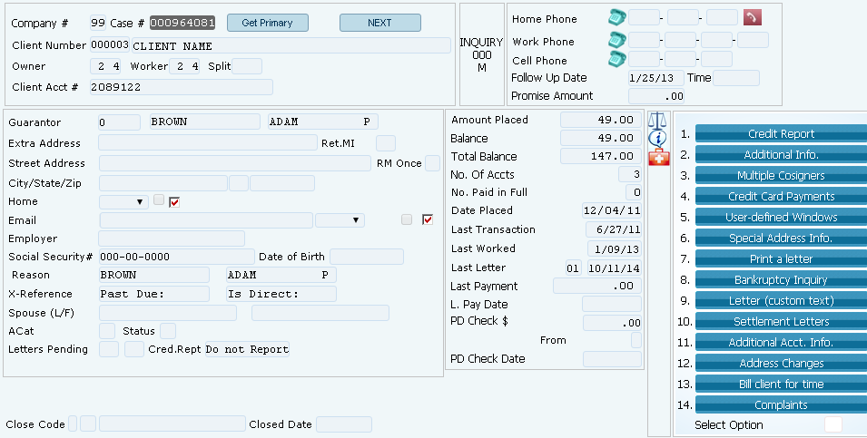
Standard Account Information – Tab Q
Inquiry menu > Account inquiry> Account detail screen > Tab Q
Gives access to other Account Detail screen menu options

Slide 9
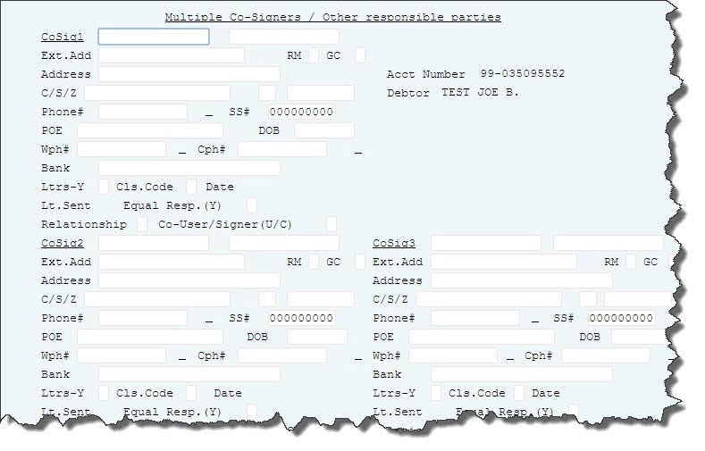
Standard Account Information – Cosigners
Inquiry menu > Account inquiry> Account detail screen > Tab Q > 3-Multiple Cosigners
Up to 3 cosigners per account
It is complex, but they can be separately dunned and worked

Slide 10
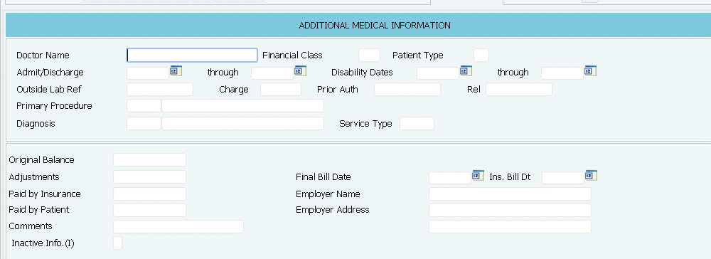
Standard Account Information – Medical Information
Inquiry menu > Account inquiry> Account detail screen > F16 – Other Info
Includes a Account Summary screen (F5)
Up to 4 insurance companies
Ability to bill a 1500 or UB04
NOTE: F16-Other Info will display information based on Client Type

Slide 11
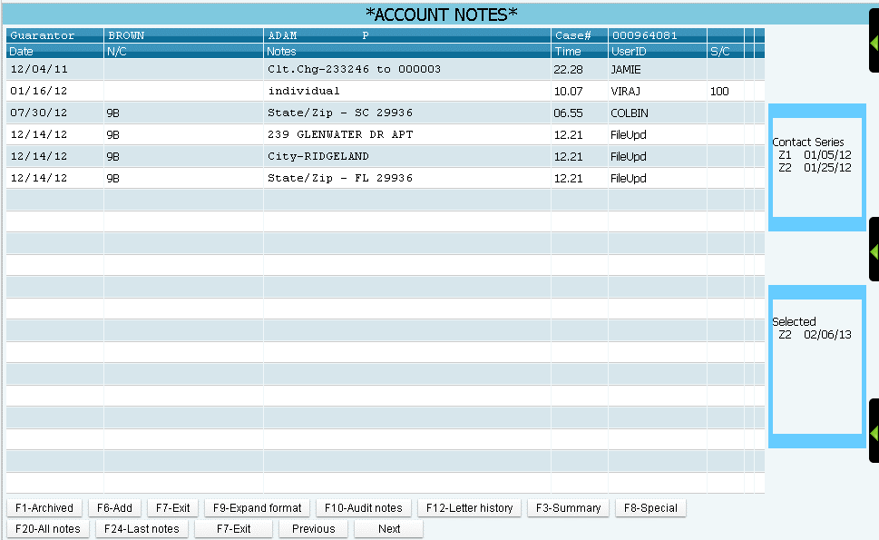
Standard Account Information – Notes
Inquiry menu > Account inquiry> Account detail screen > F11- Notes
Access to multiple Note screens
Ability to use color options to highlight notes

Slide 12
Storing Non-Standard Account Information – User Defined Windows (UDW)
Stores account or process specific info unique to the client type
Creates up to 99 additional screens to store any additional data you may need
Present a window based on the client on the account or the application of a Smart code
Load info into the windows electronically or entered by users
Setup free form windows or templates with some fixed text
Create windows that can not be updated by users
Print information from a window

Slide 13
Storing Non-Standard Account Information – User Defined Windows (UDW)
Inquiry menu > Account inquiry> Account detail screen > 5 - User-defined Windows

Slide 14
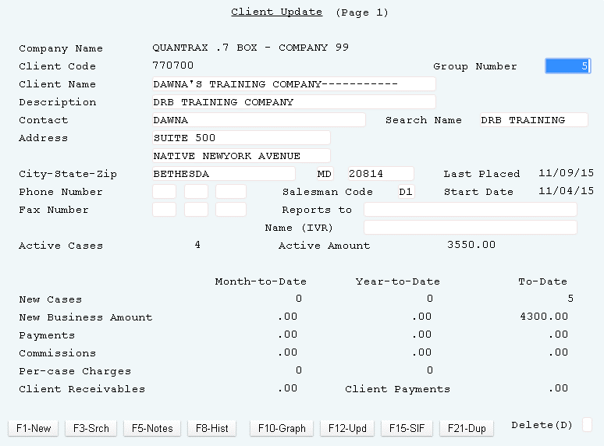
Setting Up Your Clients
Management Menu > Client update (Page 1)
“Group" individual client numbers together by entering a group number
The group number MUST be the same as one of the existing client numbers within the group

Slide 15
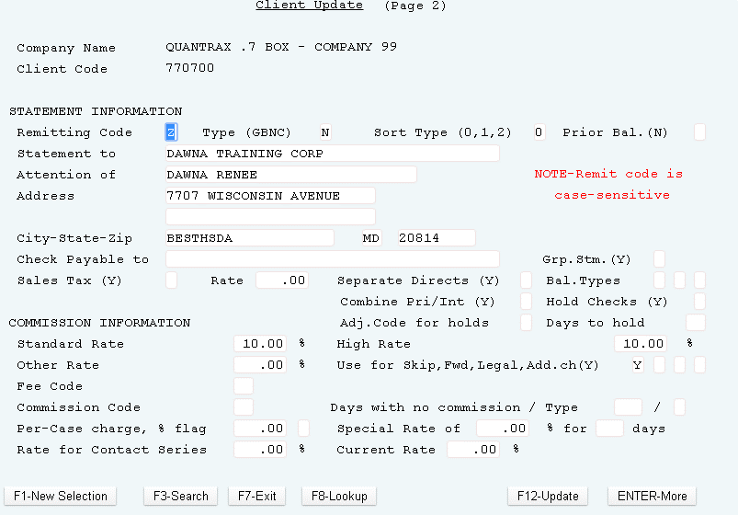
Setting Up Your Clients
Management Menu > Client update (Page 2)

Slide 16
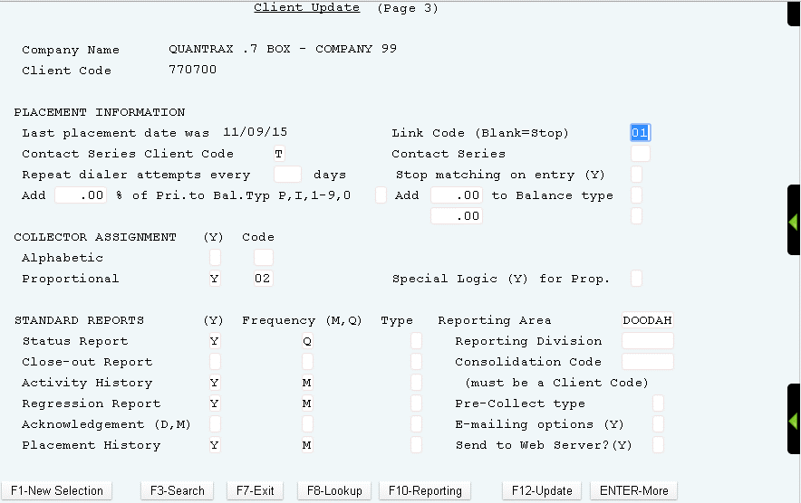
Setting Up Your Clients
Management Menu > Client update (Page 3)

Slide 17
Contacting Your Consumers – Contact Series
Sending
notices
Sending first notice
Making phone calls
Using Scoring
Automating the process
When will agent effort start
When will contact stop
Balance-based strategies
Maximum attempts

Slide 18
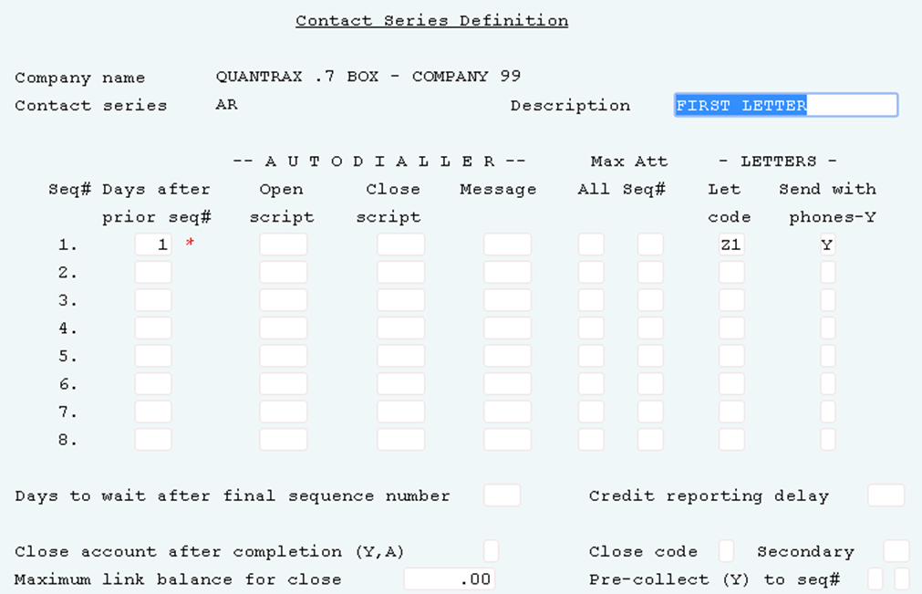
Contacting Your Consumers - Contact Series
System Control 1 > Contact series definition
Create a series of letters or phone calls

Slide 19
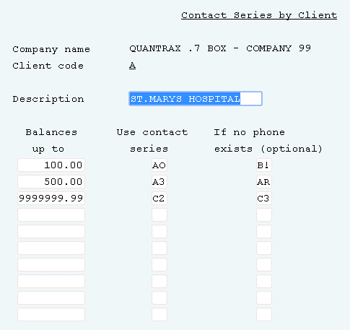
Contacting Your Consumers - Contact Series
System Control 1 > Contact series by client
Tie a contact series to a client

Slide 20
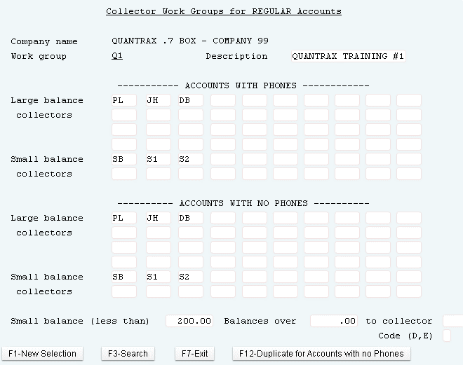
Assigning Accounts to Collectors
System Control 1 > Collector work groups
Linked to a client
Set up for small and large balance collectors
Assign based on existence of a phone number
Set up a single virtual agent for a pool

Slide 21
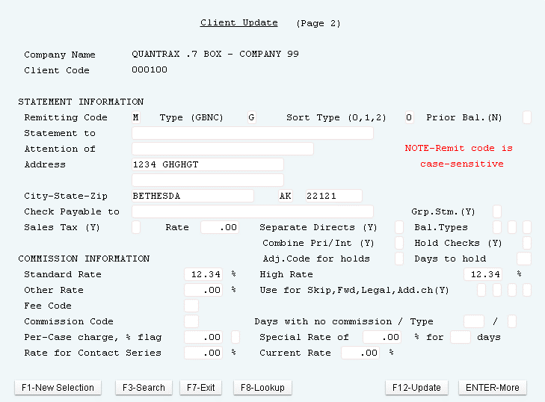
Setting Up Client Fees and Remit Rules (Standard Rates or Fee Schedules)
Management menu Client update > (Page 2)
Simple commission (high and low rate) or fee codes
Rate is kept at account level and can be changed by the system
Separate statements by balance type or type of payment

Slide 22
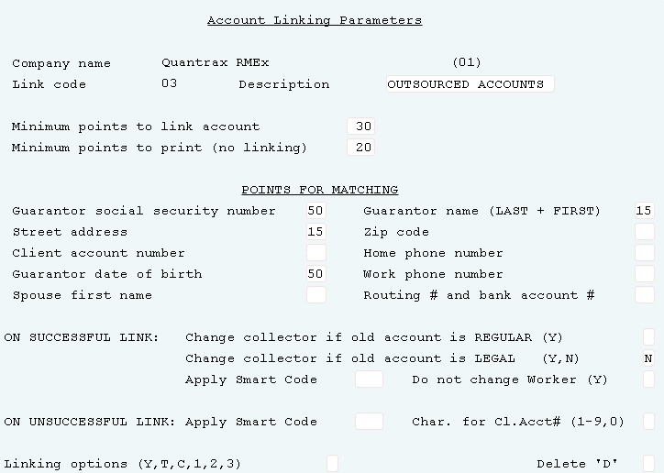
Creating Business Rules To Link Multiple Accounts For A Single Consumer
System Control 1 > Account linking parameters
Limit linking based on client, client type and other rules
Uses a point system to determine if accounts should link
Links during nightly process to existing accounts using the “points structure” set up in the account linking parameters
Apply smart codes to the new account based on successful linking as well as if no linking occurs

Slide 23
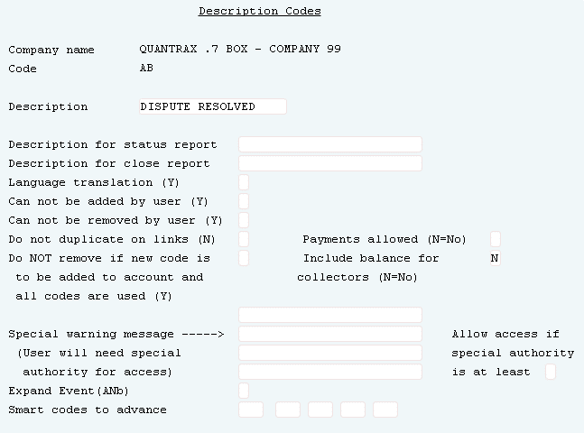
Adding To Descriptive Information To Accounts When They Are Loaded
System Control 1 > Description codes
Create User-defined description codes
Used in decision-making and agent interfaces

Slide 24
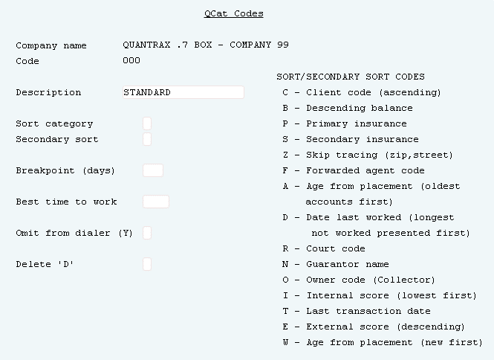
Organizing The Accounts To Be Worked
System Control 2 > QCat codes
Simple and powerful Queue Category (QCat) code
Manage accounts within your queues

Slide 25
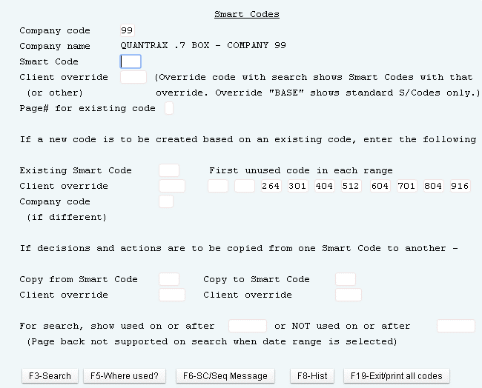
Automating Processes When Accounts Are Being Posted
System Control 1 > Smart codes
Thinking before you even start work!
Apply smart codes
Add description codes
Schedule future action (Smart Code Series)

Slide 26
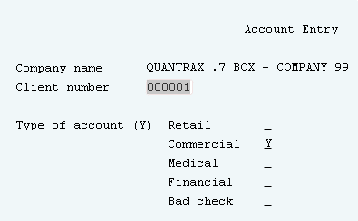
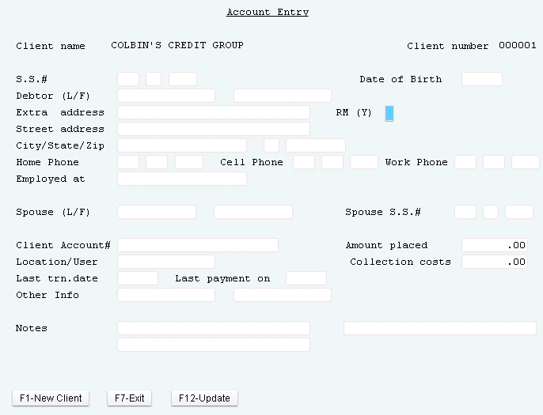
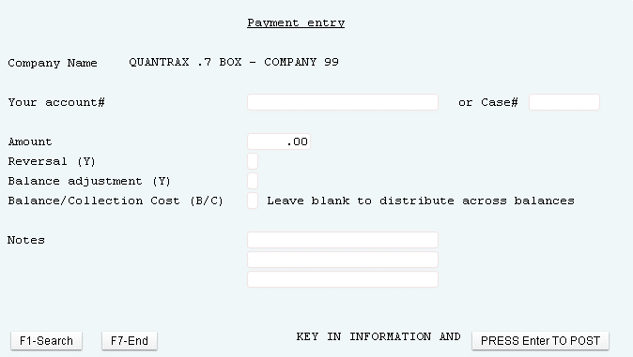
Entering Accounts Manually - Options For Smaller Companies
On-Line Client Menu
Enter, edit and post accounts
Allow clients to enter accounts directly into the system

Slide 27
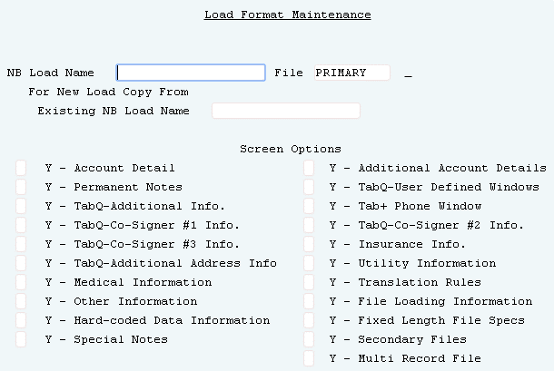
Loading New Business Through I-Load
Special options menu > I-Load Options
Use “I-Load”, an optional ETL (extract, transform, load) module
Allows the user to create, manage and execute new business loads
Train non-technical people to load client data into the system
Load information directly to the User Defined Windows, F16-Insurance screen, Tab + window (Other phones) etc.

Slide 28
Loading New Business With Custom Code
Clients need to send their details to project@quantrax.com in the form of a flat file or a delimited file
Quantrax will write new business loads according to the specification (after clarifying any doubts with the client) and will transmit the code to the client's modification library
Clients that have electronic loads, should convert them for the new system and test prior to the date of final conversion

Slide 29
Exercises – Loading New Business
In your system, use COMPANY 99
Enter an account using your test client code that includes the following information:
First and last name
Address
Social security number
Date of birth
Home and work phone number
Client account number
Amount placed is $500.00
Last transaction date
Description code of CH
Review the account and see what contact series is setup on the account; does it match what is setup on the client master?
What are the owner and worker assigned to the account?
Does it match what is setup in the work group?
Did the CH description code get added to the account?

Slide 30
RMEx Management Training: Loading New Business
Thank you!

