Slide 1
RMEx Management Training: Terminology and Setting Up A Company

Slide 2
Agenda
Reviewing RMEx Terminology
Understanding the Design and Architecture of RMEx
Setting Up a Company
Multi-company concept
Management role
System controls
System parameters
Types of users (owners and workers)
Balance Types
Close Codes

Slide 3
RMExplaining Your Process
verb | RMEx·plain·ing | \ik-ˈsplān\ -ing = to make clear and understandable relative to RMEx
Cosigners
Owner, worker and split collector codes
Home, work and cell phone on the account detail screen
Description codes
ACat codes (Account category codes)
QCat codes (Queue category codes)
Last transaction date
Primary balance
Secondary balances

Slide 4
RMExplaining Your Process (continued)
Interest
Linked balance
Contact series
Smart codes
Smart code series
Close codes (Inactive and active close codes)
Reportable balances
Account status codes
Processing type
Time frame
User ID (for a user)
Campaign

Slide 5
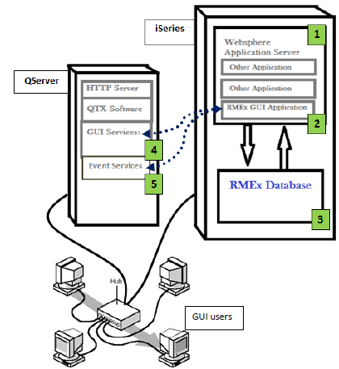
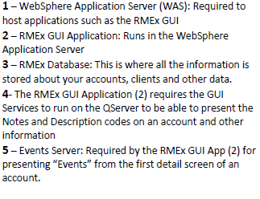
The Components of RMEx Graphical User Interface

Slide 6
Setting Up Your Company – Have A Plan!
“A goal without a plan is just a wish.”
― Antoine de Saint-Exupéry
“If you don't know where you are going, you'll end up someplace else.”
― Yogi Berra
“If you fail to plan, you are planning to fail!”
― Benjamin Franklin
“Efficiency is doing things right; effectiveness is doing the right things.”
― Peter Drucker
“Work your phone numbers, not your accounts!”
― Ranjan Dharmaraja
Ask yourself questions and create a plan…….

Slide 7
What Are Your Company’s Processes - Overview?
Collection Industry
How are you going to operate your company?
How Will I Pay And Collect From My Clients?
How do I monitor and track my business?
When Will You Stop Working An Account?
How are you going to bill and charge your client?
How do I get consumer information in the system ?
How and when to contact the consumers?
What accounts are assigned to which collectors?
How will collectors work their accounts?
How will payments be posted to accounts and commissions be divided?

Slide 8
Working With One vs. Multiple Companies In RMEx
One Company
Control
Easy to manage
Multiple Companies
Staffing controls
Multiple business lines
Different business rules

Slide 9
How Are You Going To Operate Your Company?
Ask yourself many questions:
How many companies and businesses do you have? (early out, third party, debt purchasing)
Should users have access to the system outside of business hours?
Do you have multiple locations?
Should system highlight certain types of accounts?
Do you want to add a warning when collectors are presented with accounts that area associated with special circumstances?
Do you want to stop consumers giving you a check after there was an NSF?
How long do you consider an account as new business?
What client policies/regulations do I need to consider?
Your RMEx solution. . . . .

Slide 10
Setting Up Your Company In RMEx
System Control 1 > Company Information
System Control 1 > System Parameters
Company Name
Address
Phone
System Availability Times for Users To Login
Special Access to Certain Areas In System
Defining system defaults
Creating system warnings for accounts
Customizing your company based on your process
Setting Up Your System Controls

Slide 11
Getting Started - RMEx Menu: Graphical User Interface (GUI)
Collapse Tree Menu
Classic View - menu options similar to green screen

Slide 12
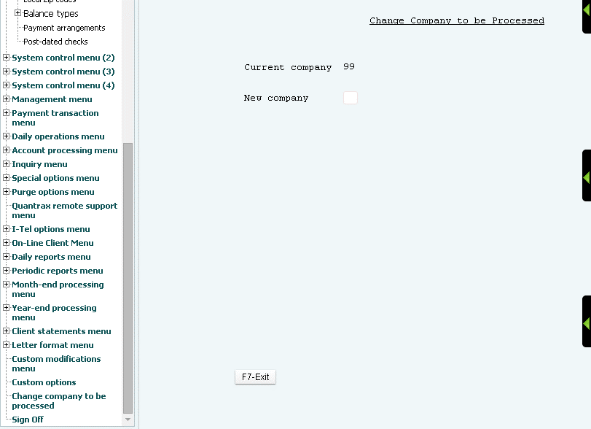
Getting Started - RMEx Menu: GUI– Logging Off and Changing Company

Slide 13
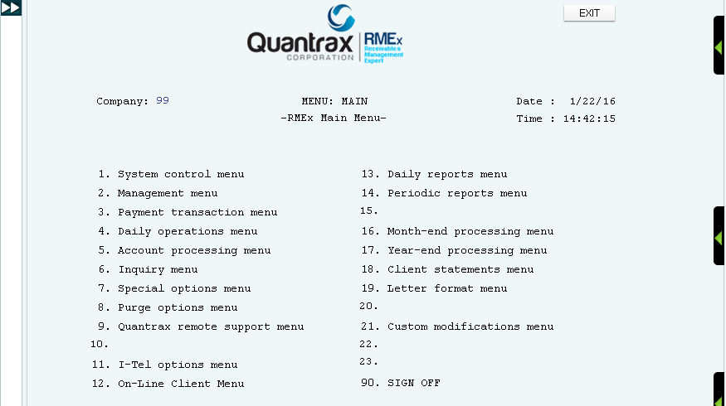
Getting Started - RMEx Menu: GUI – Classic View (similar to green screen)
Expand for Tree Menu
System Control 1 > Change company to be processed

Slide 14
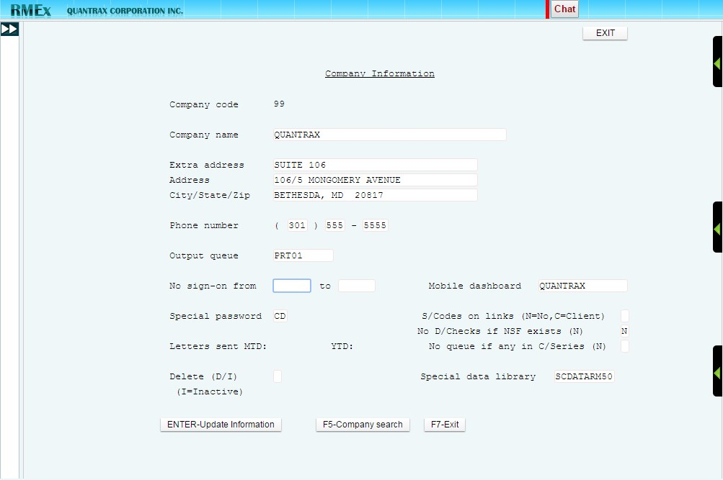
Setting Up Your Company In RMEx – Company Info
System Control 1 > Company Information

Slide 15
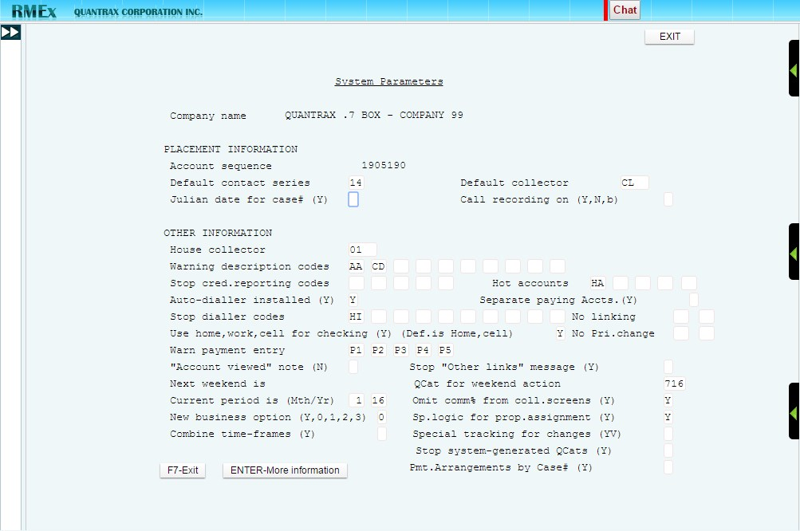
Setting Up Your Company In RMEx – System Parameters
System Control 1 > System Parameters

Slide 16
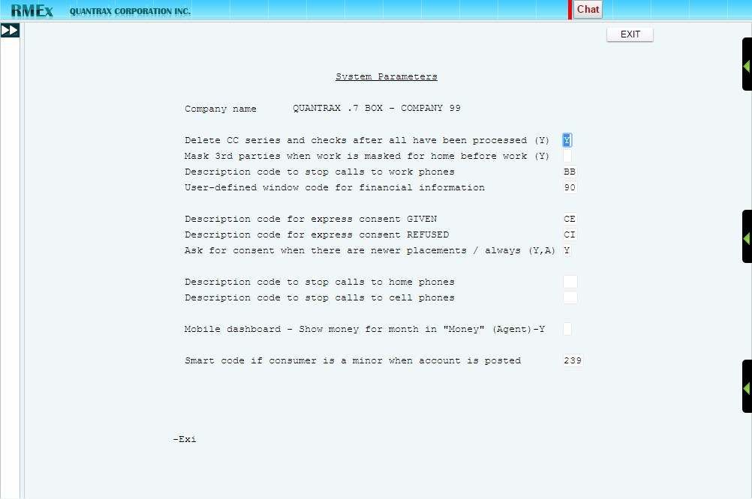
Setting Up Your Company In RMEx
System Control 1 > System Parameters

Slide 17
How Are You Going To Operate Your Company?
Ask yourself the following questions:
Who are my users and what is their role in the process?
What menus do they need access to?
Will you be treating all collectors the same way?
Are certain collectors better at working certain types of accounts?
Owner
Worker
Split Collector
Gets credit for payments
Works the account
Your RMEx solution. . . . .
Shares credit with owner

Slide 18
Setting Up Your Company In RMEx
System Control 1 > System Security
Creating users and giving them access to RMEx Menus
System Control 1 > Collector Workgroups
Setting up credits for payment for one worker
Setting up credits for payments for multiple workers
Setting up a non-pooled environment vs. pooled environment
Establishing how accounts will be worked
Management Menu > Collector Update
Defining Collector Profile

Slide 19
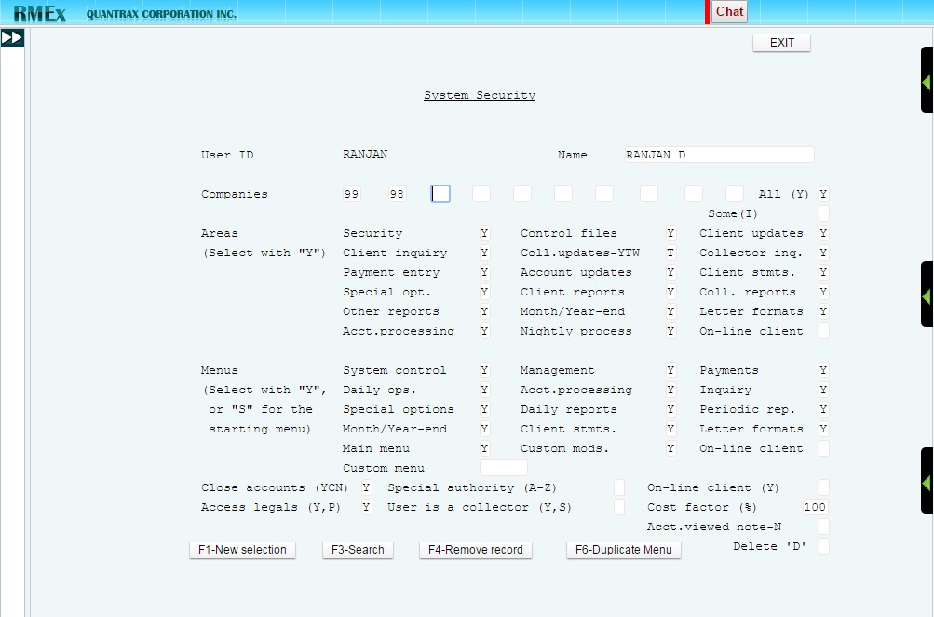
Setting Up Your Company In RMEx – System Security
System Control 1 > System Security

Slide 20
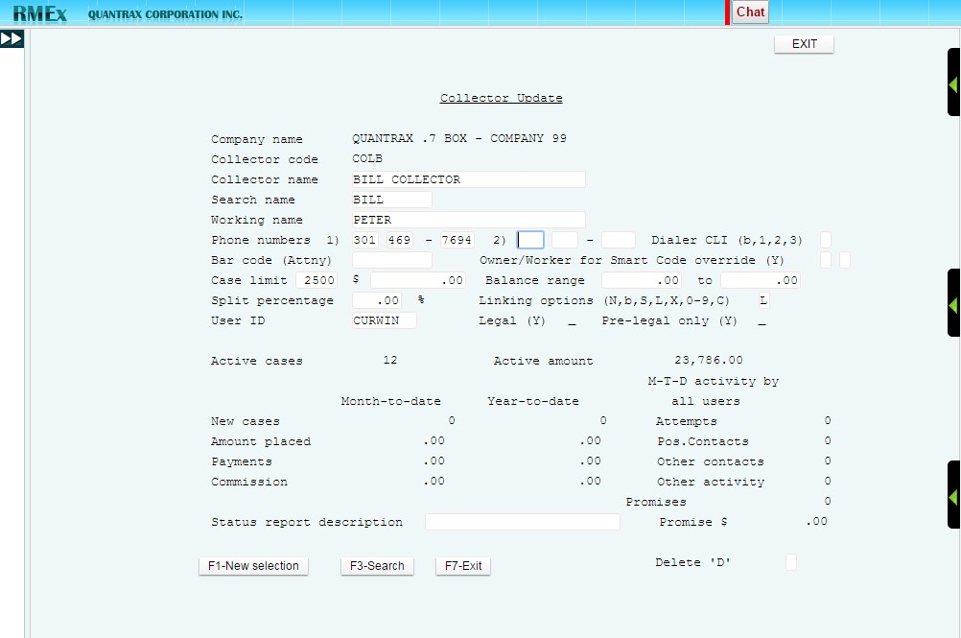
Setting Up Your Company In RMEx
Management Menu> Collector Update

Slide 21
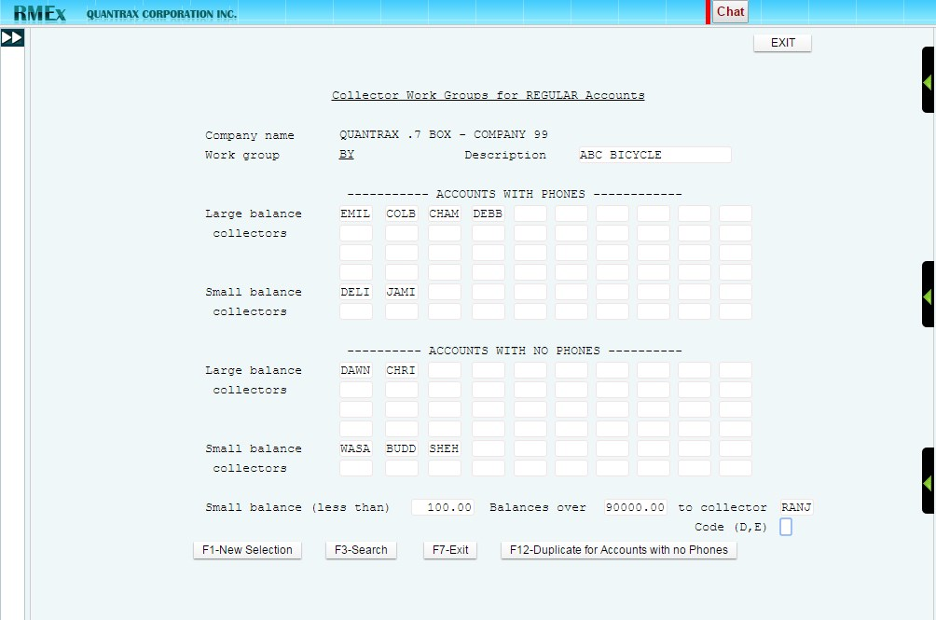
Setting Up Your Company In RMEx – Collector Workgroups
System Control 1 > Collector Workgroups

Slide 22
How Will Monies Be Posted And Divided?
Ask yourself the following questions:
What if a consumer has multiple debts?
Does a collector get commission for all payments?
Are there any payments that I keep a 100% of the monies?
Your RMEx solution. . . . .

Slide 23
System Control Menu 1 > Balance Types
Collector credit
Commissions
Interest
Forwarded agency commission?
Distribution Order
Client Statements
Defining Balance Types
10 User Defined Balance types
Primary
Interest
Payment Distribution

Slide 24
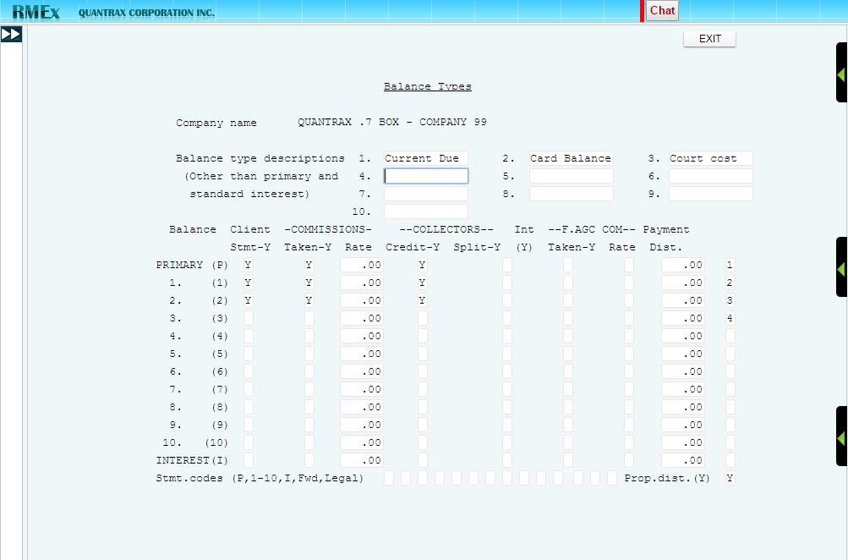
Setting Up Your Company In RMEx – Balance Types
System Control Menu 1 > Balance Types

Slide 25
When Will You Stop Working An Account?
How will you stop the collection process on an account?
When will you stop the collection process on an account?
Does stopping the collection process on an account mean it will not be worked again?
How does stopping the collection process affect your statistics?
Your RMEx solution. . . . .

Slide 26
Closing Accounts
Setting up close codes
Active vs. Inactive closed accounts
Using secondary close codes
System Control 1 > Close Codes > Close Code System Control 1 > Close Codes > Secondary Close Code

Slide 27
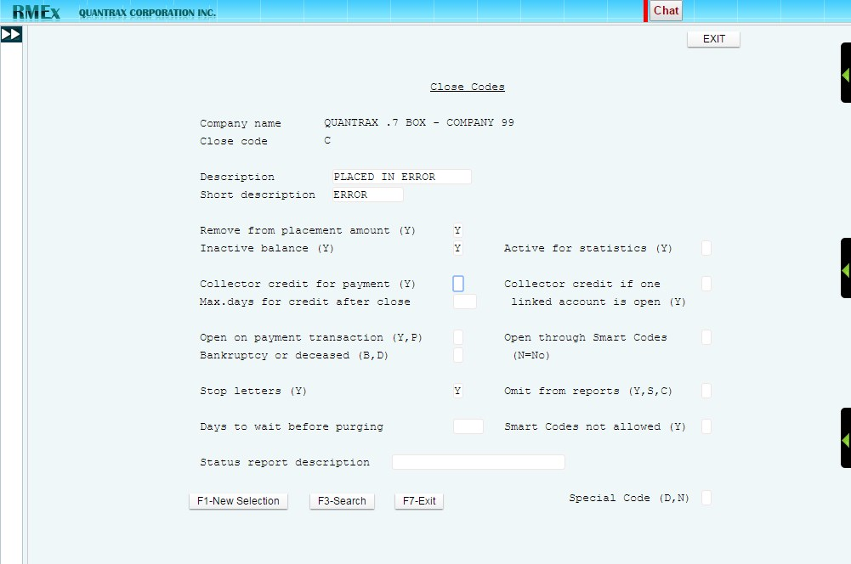
Setting Up Your Company In RMEx – Close Codes
System Control 1 > Close Codes > Close Code

Slide 28
Exercises – Setting Up a Company
In your system, use COMPANY 99
Setup a company with your basic company information (name, address, phone number, etc.). – You should sign on with QMASTER to set up a company.
Make sure users cannot sign on between 9pm and 8am.
Create a special password that ONLY a few people will have when they want to run certain options.
Setup a warning message for accounts that either a garnishment has been filed or there is a lien or malpractice suit.
Setup a warning on the payment entry screen that there are prior NSF’s on file.
Mask all consumers and 3rd part numbers when there is an attorney.

Slide 29
Exercises – Setting Up a Company (continued)
Create a user with the following characteristics (perhaps a sales manager):
The user can only access company 99
The user should be able look at account and clients, but not update clients
The user should be able to access the Payment Options but should not be allowed to enter payments
Create a Legal Collector that can see the full Social Security number.
A consumer is represented by an attorney, how can I make the collector aware of that?
For how long do you want an account considered new business for your queues?
Set up 3 balance types: Court Cost and keep 100% of the monies and the collector does not get any commission. Bad Check fee that the collector does get commission. Interest that you split with your clients and keep 25% of the payment.
Close an account that was “Placed in error”.
The client gives you 6 months to collect an account and after those six months, you must return the account to the client. How would you set up that close code?

Slide 30
RMEx Management Training: Terminology and Setting Up A Company
Thank you!

